Slide 1
Issues and risks of data interpretation
Lucie Pfeiferová, IMG
Michal Kolář, Laboratory of Genomics and Bioinformatics
27.11.2023

Slide 2
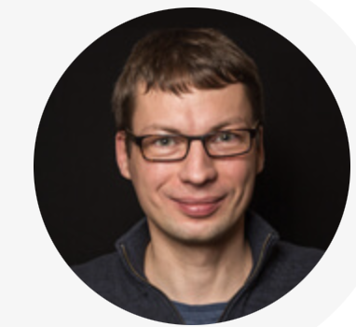
gene expression analysis https://www.img.cas.cz/skupina/michal-kolar/ – RNA-Seq, single-cell RNA-Seq, spatial transcriptomics
Our textbook: https://vydavatelstvi.vscht.cz/katalog/publikace?isid=7592-134-5
(new version in development, extended and in English)

Slide 3
Comparison of sequencing kits
Study of the influence of exosomes on cells
Differences in methods - Single-cell RNA-Seq x Spatial transcriptomics

Slide 4
1 Comparison of sequencing kits
macrophages influenced by exosomes (THP linie)
3 methods – traditional RNA-Seq: KAPA (polyA selection, 5’-3’), 3’ methods: Collibri (Invitrogen, 3’-5’) and QuantSeq (Lexogen, 3’-5’)
3’ methods = Tag-Seq, mRNA-Seq, QuantSeq and other names

Slide 5
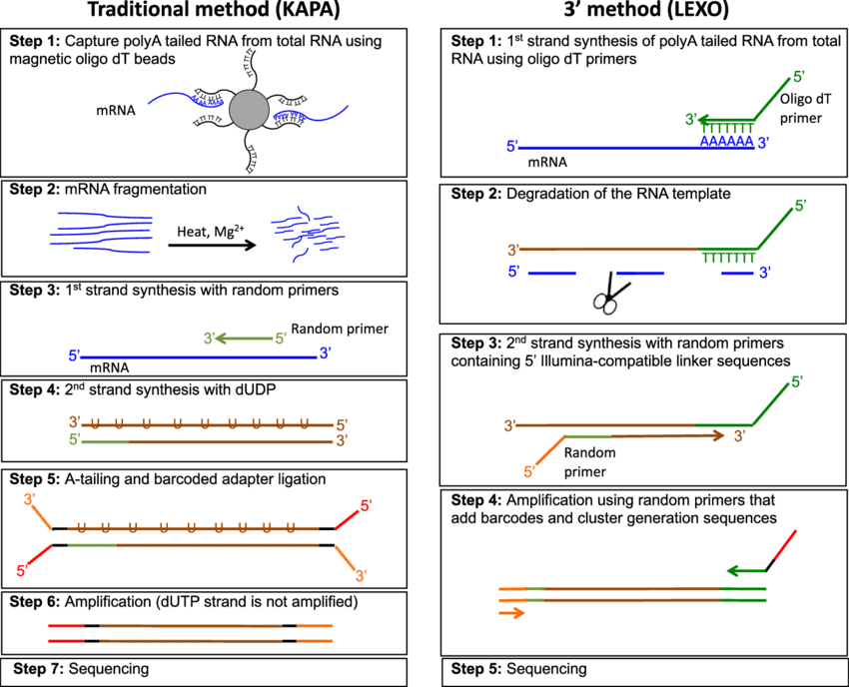

Slide 6
Advantages of 3’Tag-Seq | Disadvantages of 3’Tag-Seq
simpler, cheaper (costs about half or less compared to standard RNA-seq) | Data does not contain any transcript splicing information
less sensitive to RNA sample quality/integrity variations (compared to poly-A enrichment protocols) | Requires (sort of) a reference genome with good annotation (plus known UTRs)
requires significantly lower numbers of sequencing reads | protocol is a (a bit) more sensitive to chemical contaminants (spin column cleaned RNA samples are recommended)
low noise gene expression profiling | Only applicable to Eukaryotic samples (requires polyA*)

Slide 7
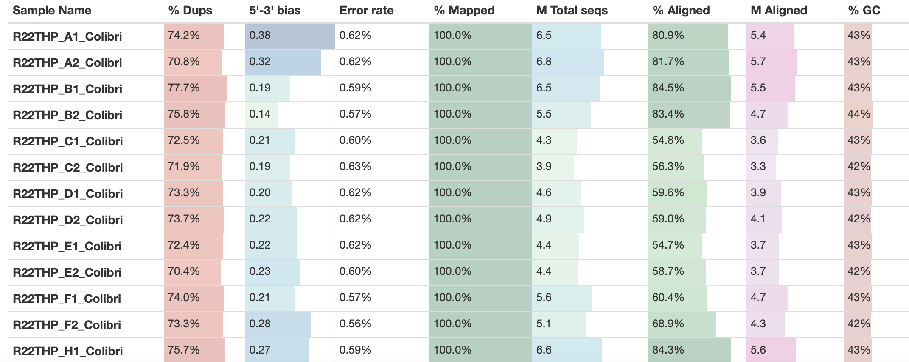
September 2022 – THP macrophages influenced by exosomes
KAPA

Slide 8
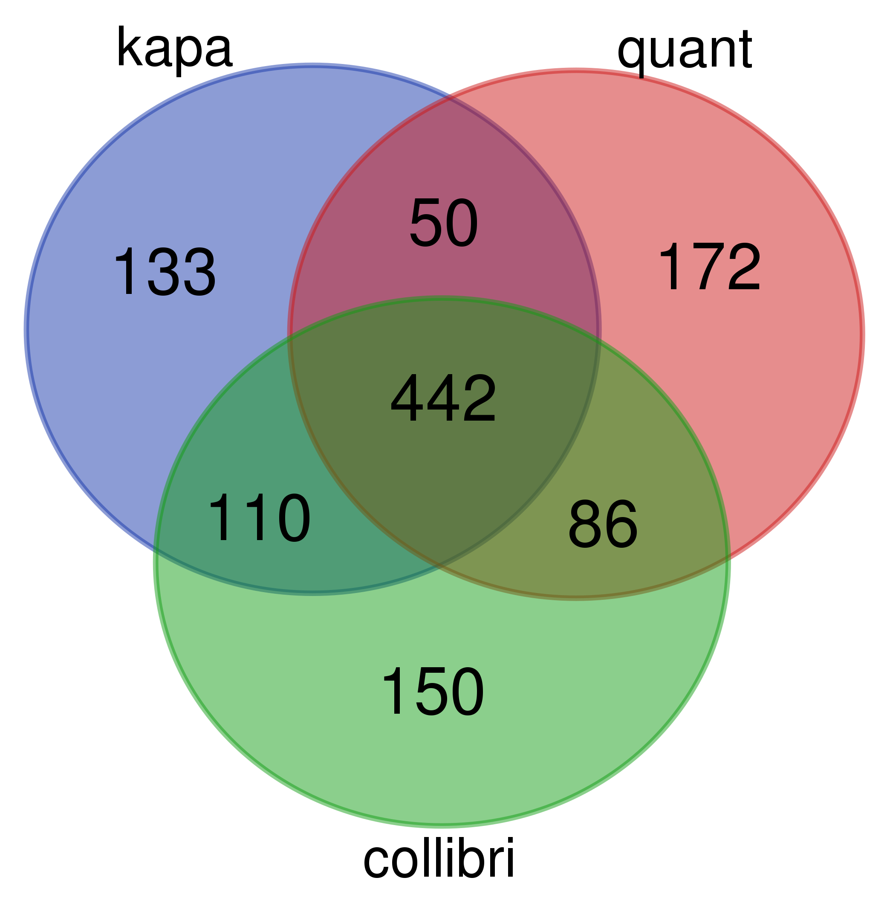
Results 1
down-regulated
up-regulated

Slide 9
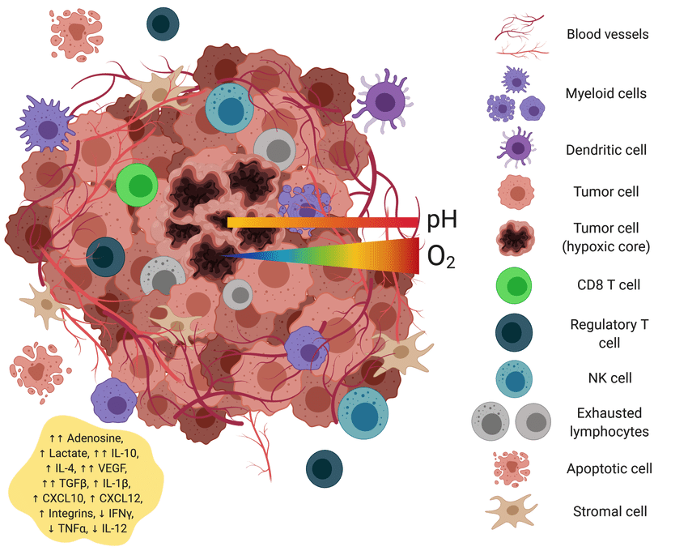
2 Influence of the exosomes
tumor – malignant organ
TME – dynamic composition
communication in TME
model – (head and neck) malignant melanoma
project for my thesis

Slide 10
The initial experiment (sequenced in July 2020)
mCAF EXO FBS
ChD EXO FBS
mCAF EXO G361
ChD EXO G361
mCAF CONTROL
mChD CONTROL
24 h, 72 h
mCAF, ChD
VEM, ZAM, CHDTF6
G361
FBS

Slide 11
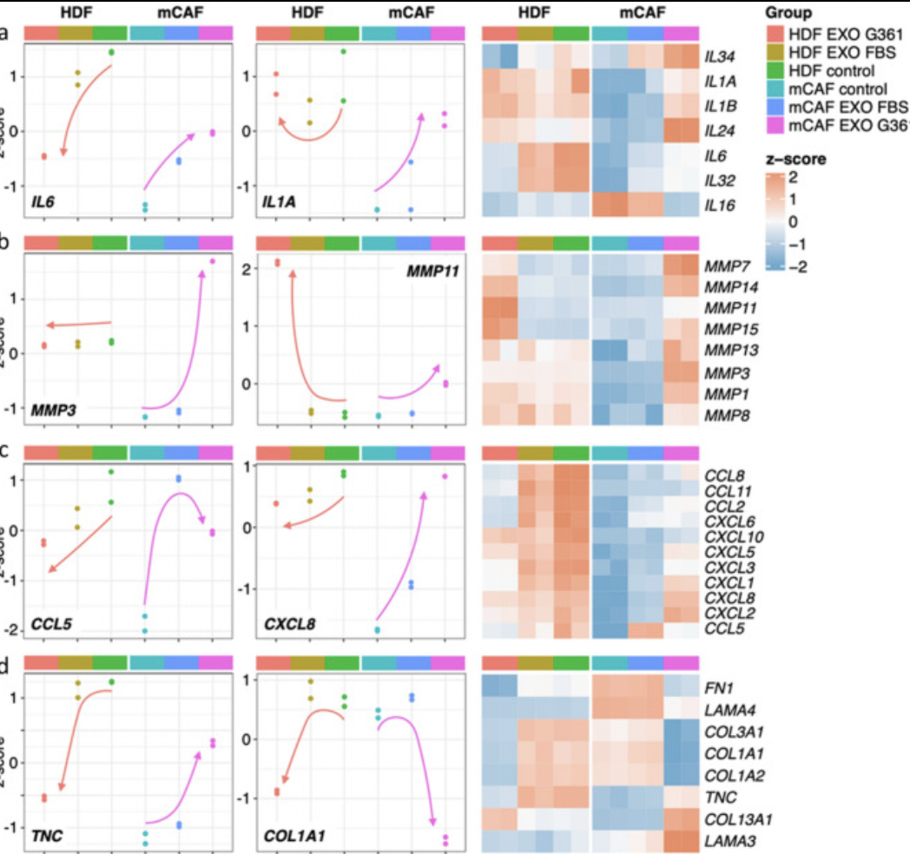
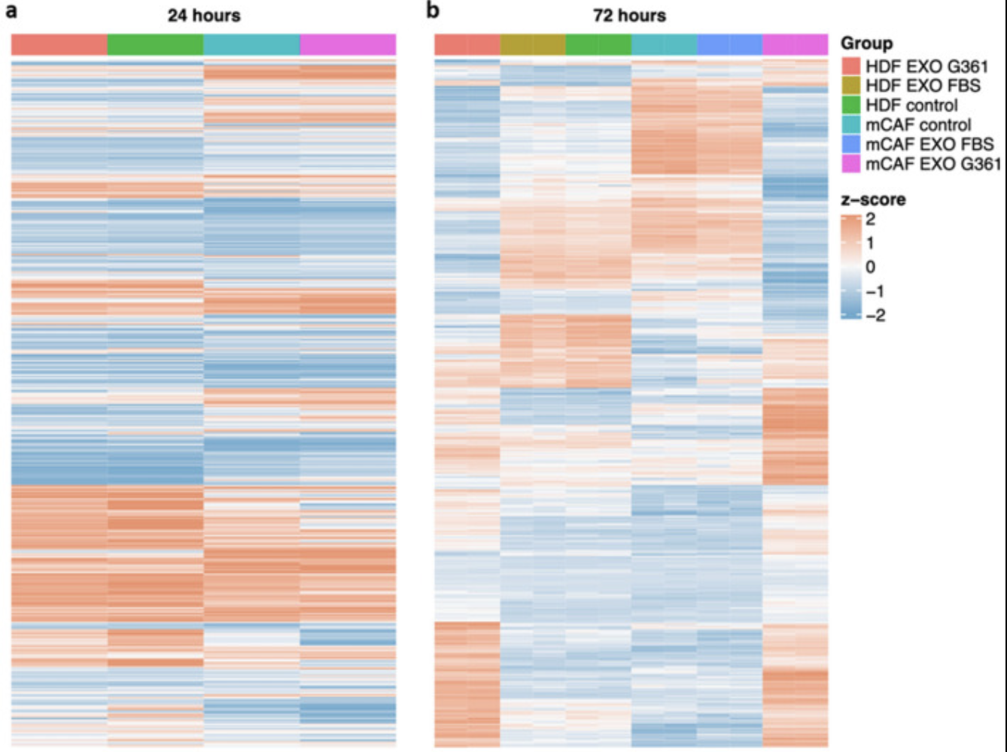
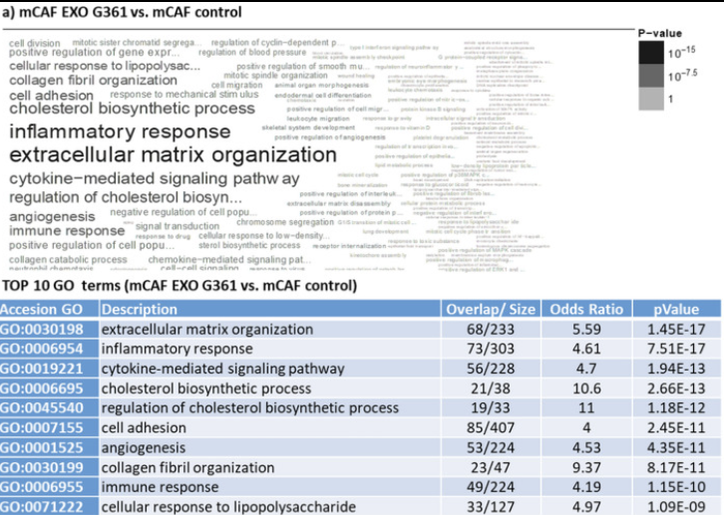
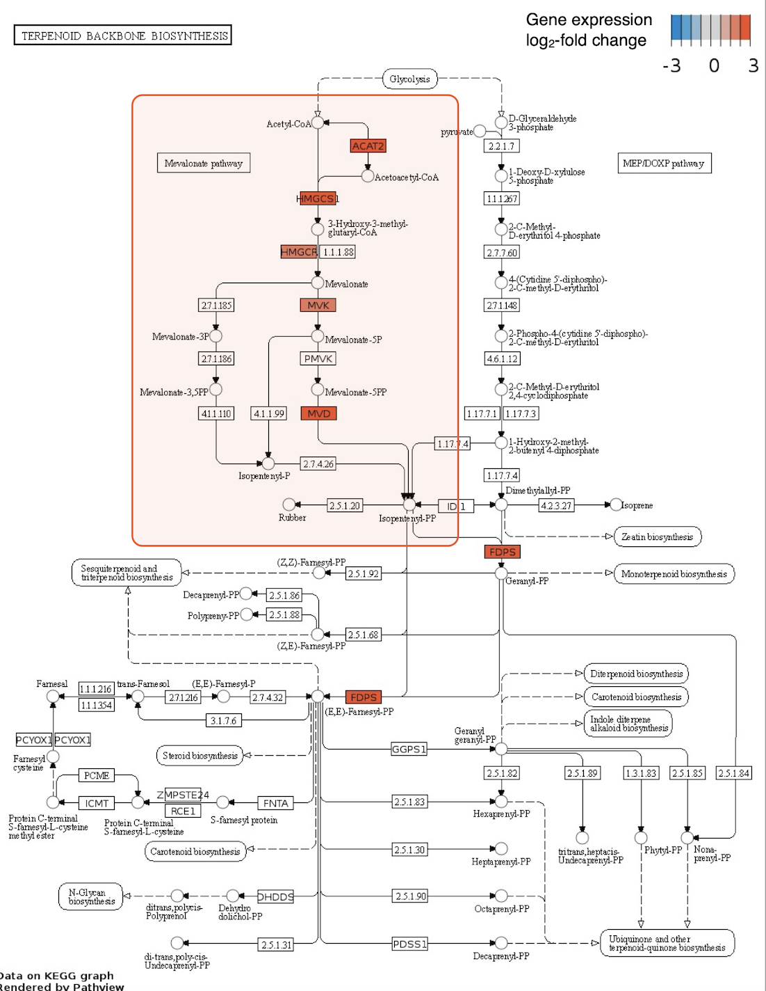
Results of the first (successful) experiment

Slide 12
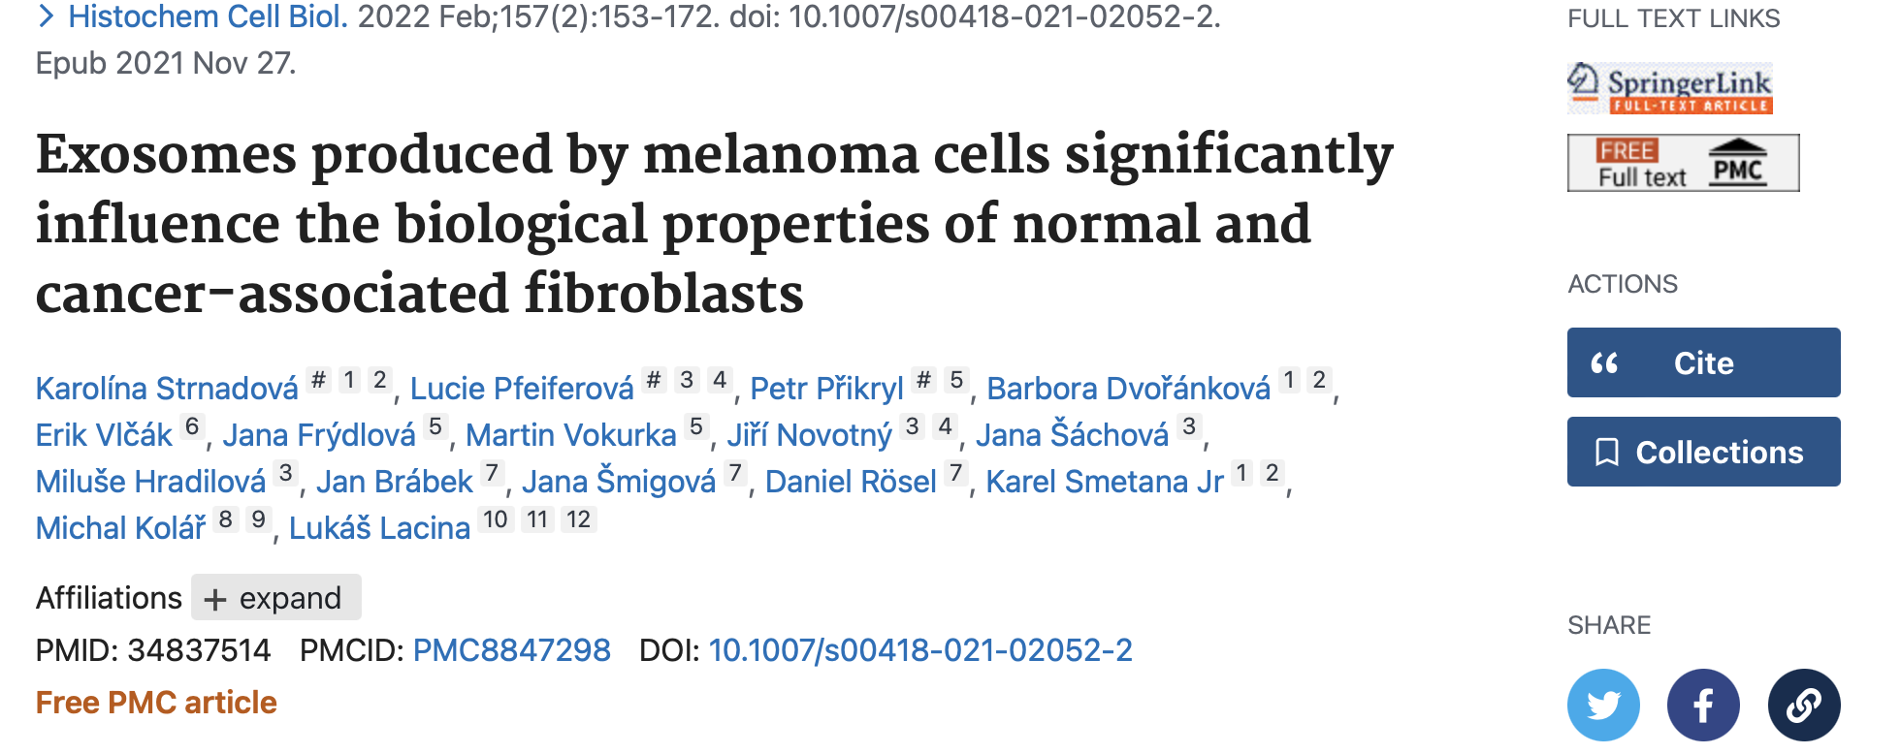

Slide 13
Subsequent analysis (2020-2021)
several RNA-Seq
new single-cell RNA-Seq
proteomics

Slide 14
Sample | Type | Group | Batch | Treatment | Replicate
R21G1 | HFP3 | DF | 1 | 1 | DF_1
R21G2 | HFP3 | DF | 1 | 2 | DF_2
R21H1 | HFP4 | DF | 1 | 1 | DF_1
R21H2 | HFP4 | DF | 1 | 2 | DF_2
R21K1 | HFP3 | DF | 2 | 1 | DF_1
R21K2 | HFP3 | DF | 2 | 2 | DF_2
R21L1 | DFT5 | DF | 2 | 1 | DF_1
R21L2 | DFT5 | DF | 2 | 2 | DF_2
R21O1 | DFT5 | DF | 3 | 1 | DF_1
R21O2 | DFT5 | DF | 3 | 2 | DF_2
R21P1 | HFP4 | DF | 3 | 1 | DF_1
R21P2 | HFP4 | DF | 3 | 2 | DF_2
RNA-Seq May 2021 (sequenced, processed in July)
DF 3 (DFT4, DFT5, HFP3)
MELF 3 (ERM, ZAM, VEM)
BCCF3 (KA14F, BCCF B3, B37CF

Slide 15
Before analysis
Electron microscopy, velocity ✅
Protein content ✅
mRNA content ✅
miRNA content ✅

Slide 16
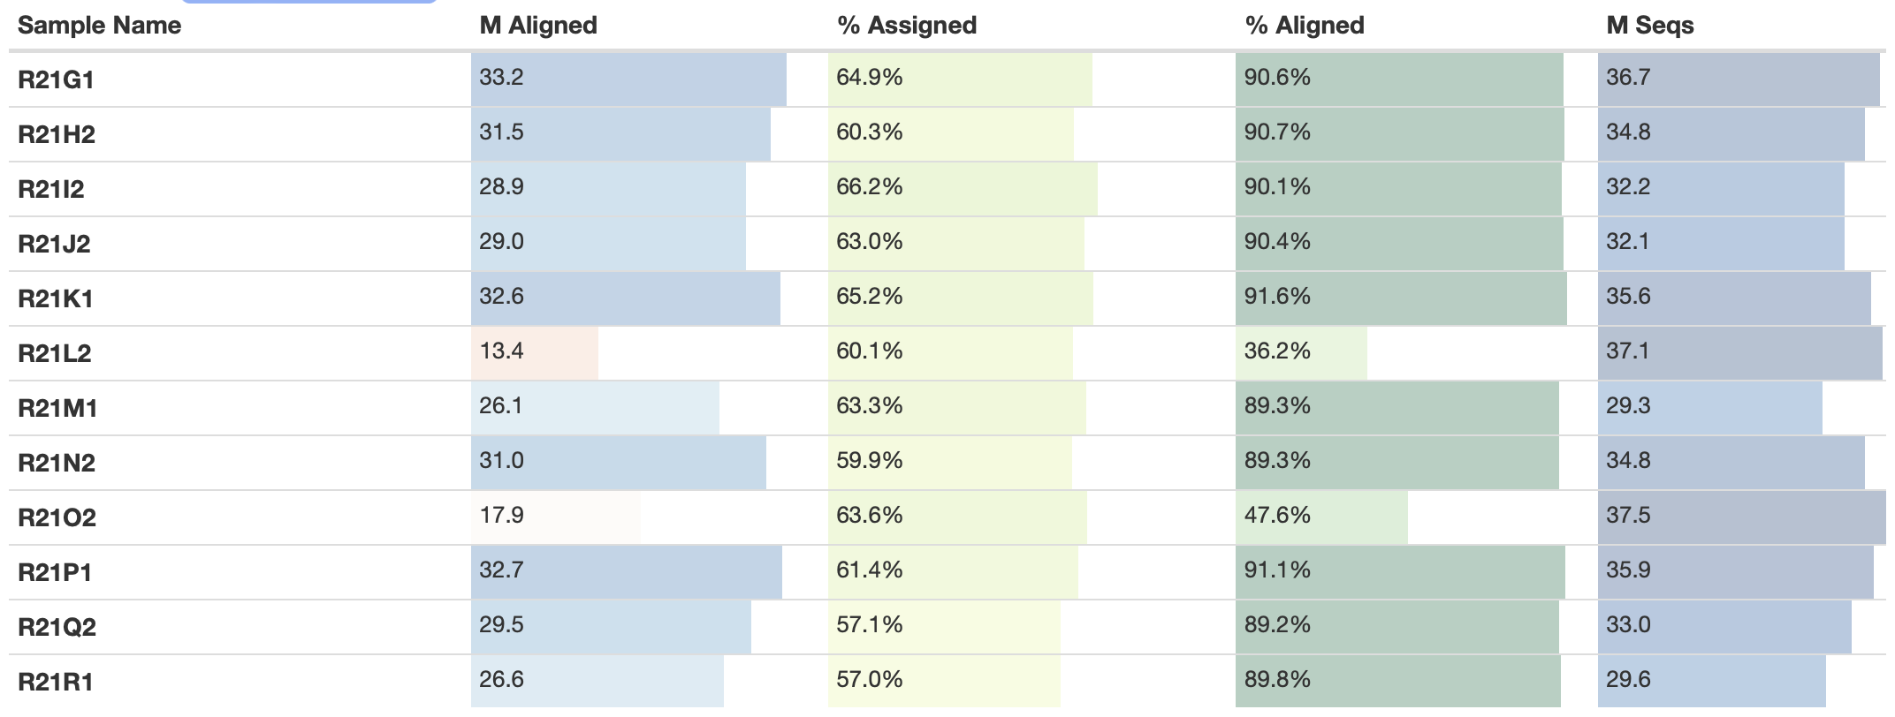
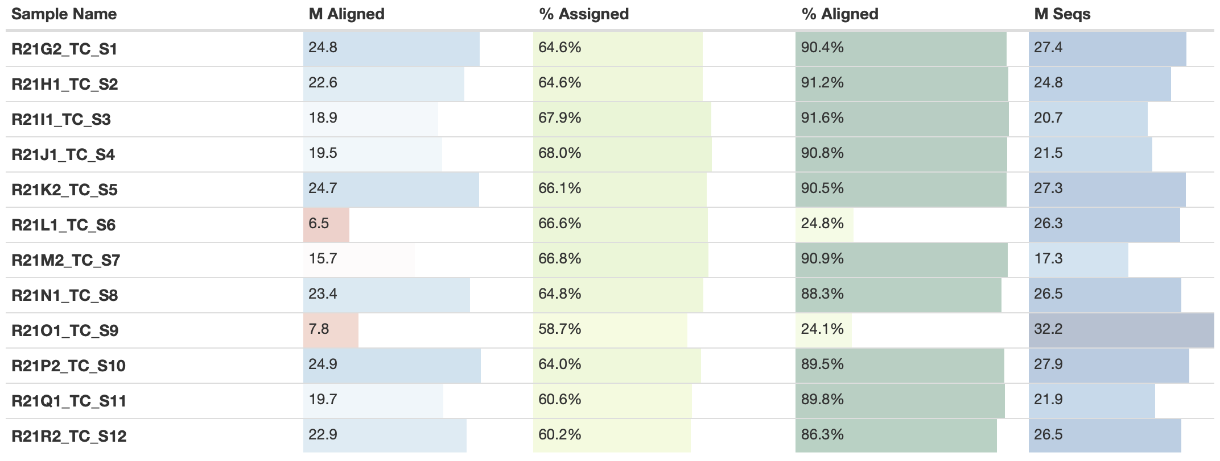
Sequenced March, May, June 2021

Slide 17
What happened? Problem with sample acquisition, preparation, sequencing...?
According to all data everything is fine...sequencing error in 3 runs of the same sample???

Slide 19
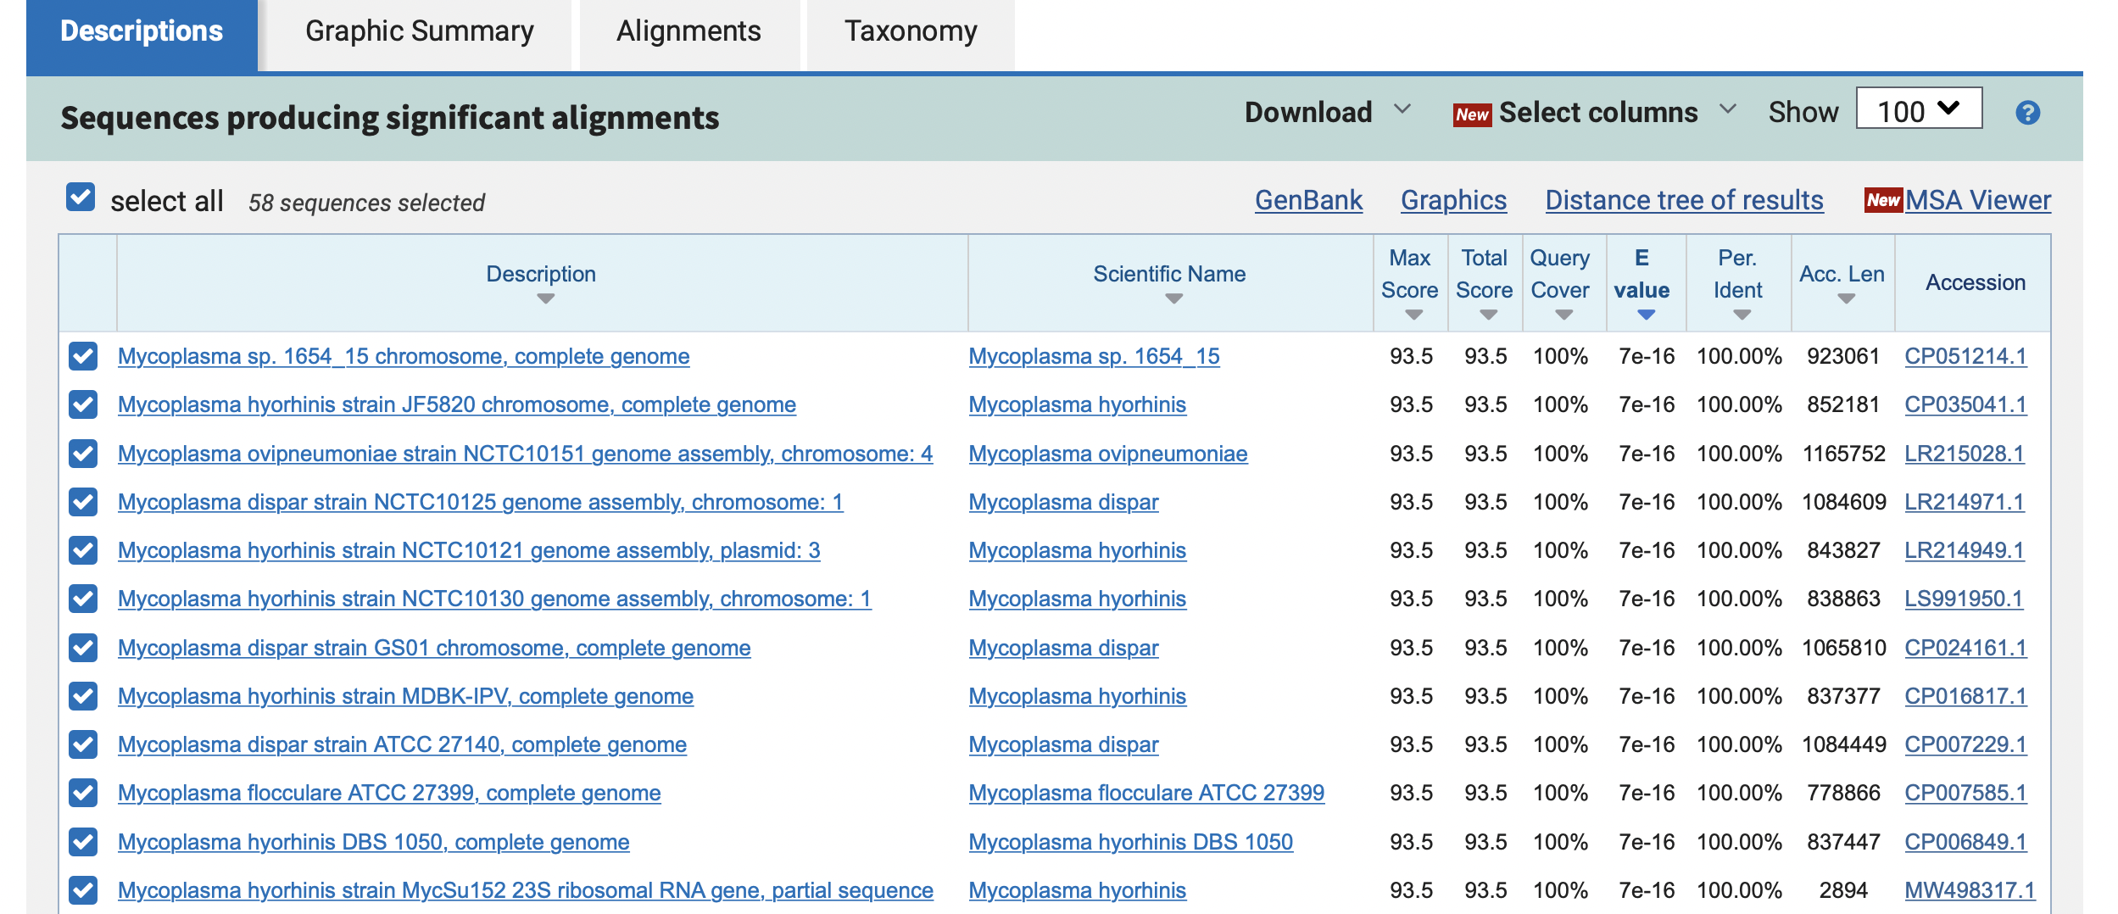

Slide 20
Mapped on mycoplasma

Slide 21
BUT MOST IMPORTANT QUESTION:
Is it just one-time thing? Or its running in samples? If, when did the contamination appear? Is our publication okay?

Slide 23
Remember libraries comparison September 2022? Macrophages THP…influenced…by exosomes
3 methods – traditional RNA-Seq: KAPA(polyA, 5’-3’), 3’ methods: Collibri (Invitrogen, 3’-5’) and QuantSeq (Lexogen, 3’-5’)
3 types of exosomes – 2 commercial, 1 extracted from cells
same protocol as at melanoma study
linie THP

Slide 24
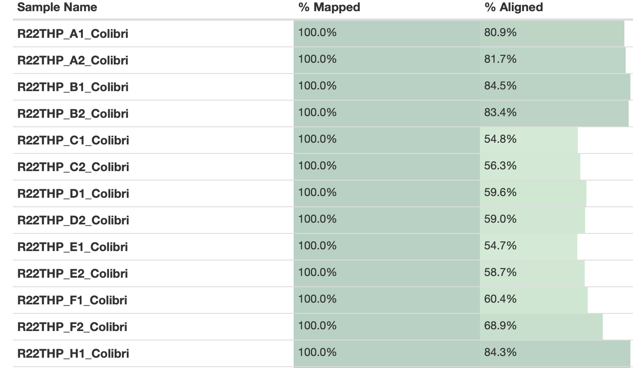
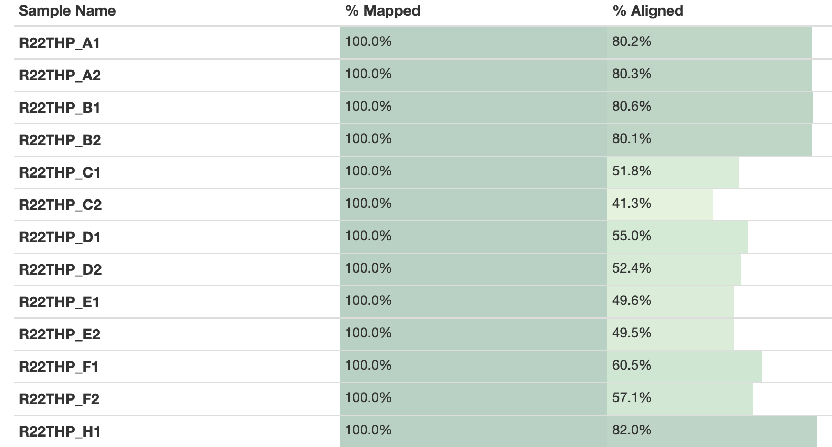
September 2022 – Macrophages…influenced…by exosomes
Collibri
QuantSeq
B,C = control, D-F = exosomes, H-M = medium

Slide 25
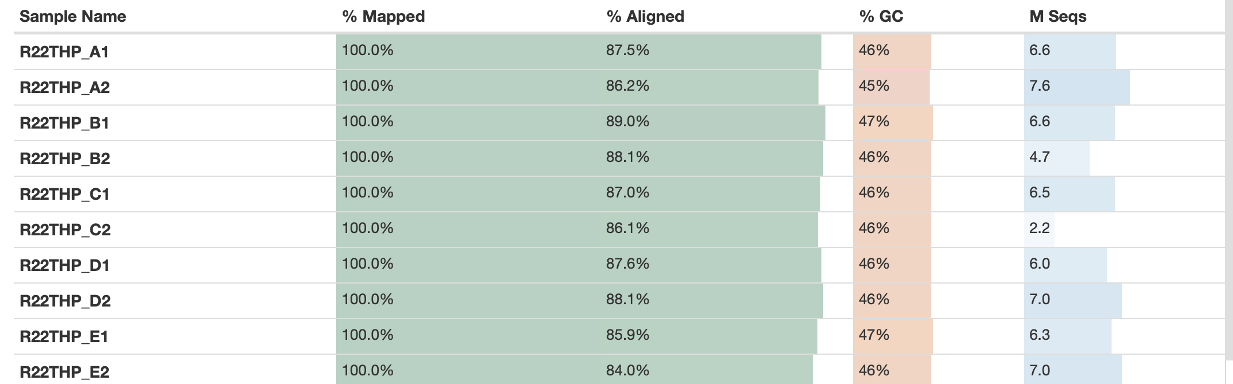
September 2022 – Macrophages…influenced…by exosomes
Collibri
KAPA

Slide 26
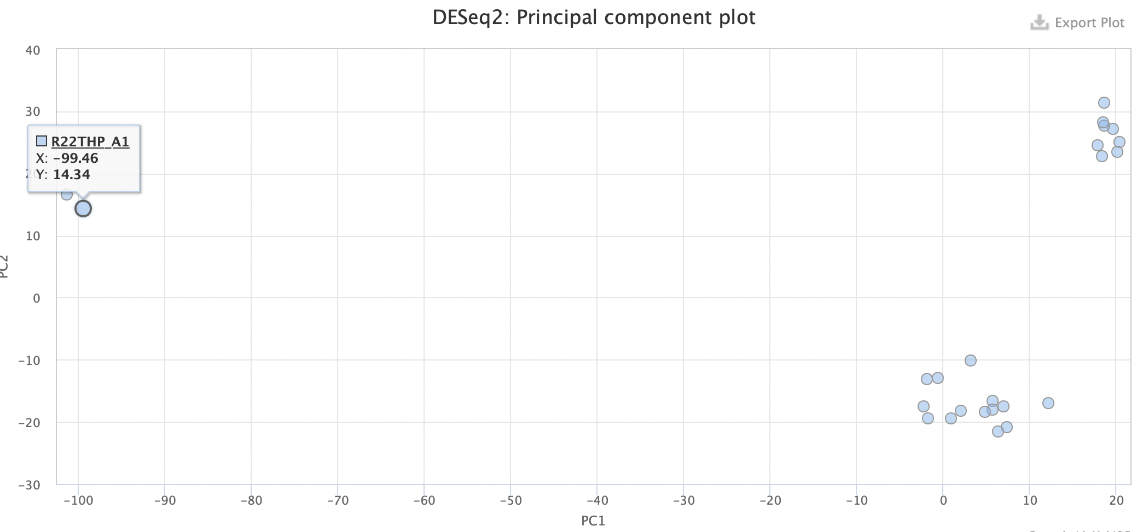

Slide 27
QuantSeq, for out pipeline KAPA had too low number of sequences

Slide 28
SAMPLE | THP KAPA | U937 KAPA
R22THP_B2 | 0.07 | 0.08
R22THP_B1 | 0.08 | 0.06
R22THP_C1 | 0.92 | 0.05
R22THP_C2 | 1.46 | 0.05
R22THP_A1 | 0.06 | 0.31
R22THP_A2 | 0.06 | 0.29
R22THP_D1 | 0.67 | 0.06
R22THP_D2 | 0.64 | 0.06
R22THP_E1 | 1.06 | 0.08
R22THP_E2 | 1.72 | 0.07
R22THP_F1 | 0.96 | 0.07
R22THP_F2 | 1.04 | 0.05
R22THP_H1 | 0.06 | 0.05
R22THP_H2 | 0.06 | 0.04
R22THP_I2 | 0.1 | 0.06
R22THP_K2 | 0.11 | 0.04
R22THP_I1 | 0.11 | 0.06
R22THP_J2 | 0.1 | 0.06
R22THP_L1 | 0.06 | 0.05
R22THP_J1 | 0.04 | 0.06
R22THP_L2 | 0.06 | 0.04
R22THP_K1 | 0.07 | 0.05
R22THP_M2 | 0.06 | 0.07
R22THP_M1 | 0.19 | 0.06

Slide 29
SAMPLE | THP KAPA | U937 KAPA
R22THP_B2 | 0.07 | 0.08
R22THP_B1 | 0.08 | 0.06
R22THP_C1 | 0.92 | 0.05
R22THP_C2 | 1.46 | 0.05
R22THP_A1 | 0.06 | 0.31
R22THP_A2 | 0.06 | 0.29
R22THP_D1 | 0.67 | 0.06
R22THP_D2 | 0.64 | 0.06
R22THP_E1 | 1.06 | 0.08
R22THP_E2 | 1.72 | 0.07
R22THP_F1 | 0.96 | 0.07
R22THP_F2 | 1.04 | 0.05
R22THP_H1 | 0.06 | 0.05
R22THP_H2 | 0.06 | 0.04
R22THP_I2 | 0.1 | 0.06
R22THP_K2 | 0.11 | 0.04
R22THP_I1 | 0.11 | 0.06
R22THP_J2 | 0.1 | 0.06
R22THP_L1 | 0.06 | 0.05
R22THP_J1 | 0.04 | 0.06
R22THP_L2 | 0.06 | 0.04
R22THP_K1 | 0.07 | 0.05
R22THP_M2 | 0.06 | 0.07
R22THP_M1 | 0.19 | 0.06
Collibri and QuantSeq works on different principle, so the ”small” contamination was visible, but using KAPA not…which is funny, because: “The assumption is that this method will primarily target eukaryotic mRNA, as prokaryotic (bacterial) mRNA typically lacks polyadenylated tails.“

Slide 30
Parallel experiment U937 macrophages

Slide 31
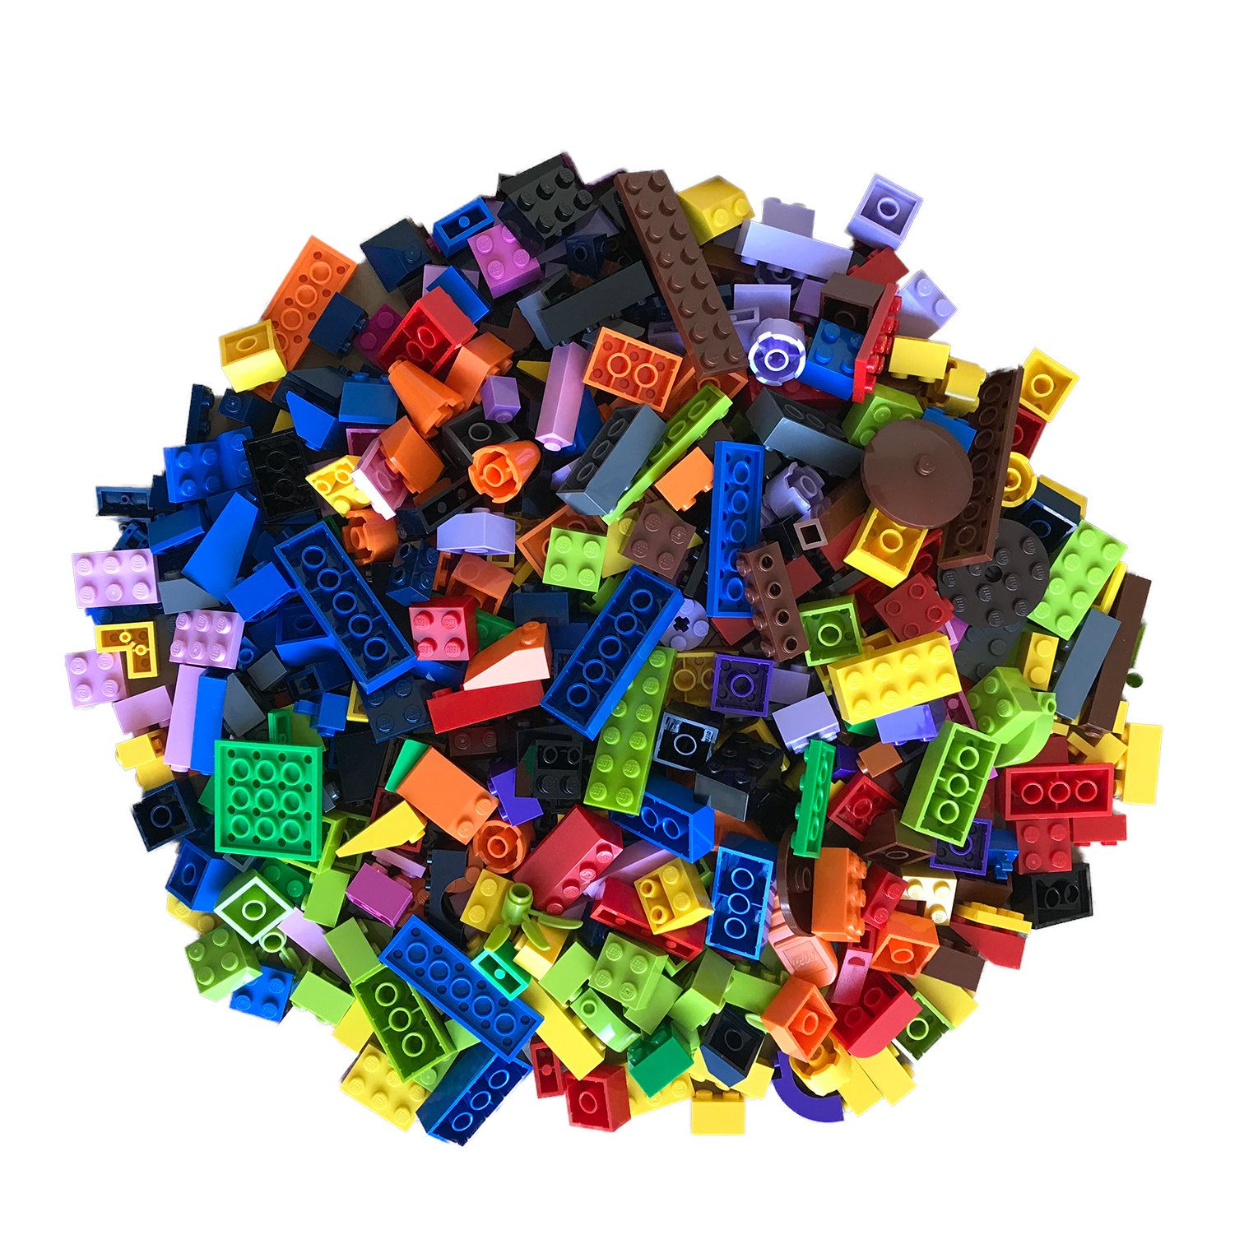
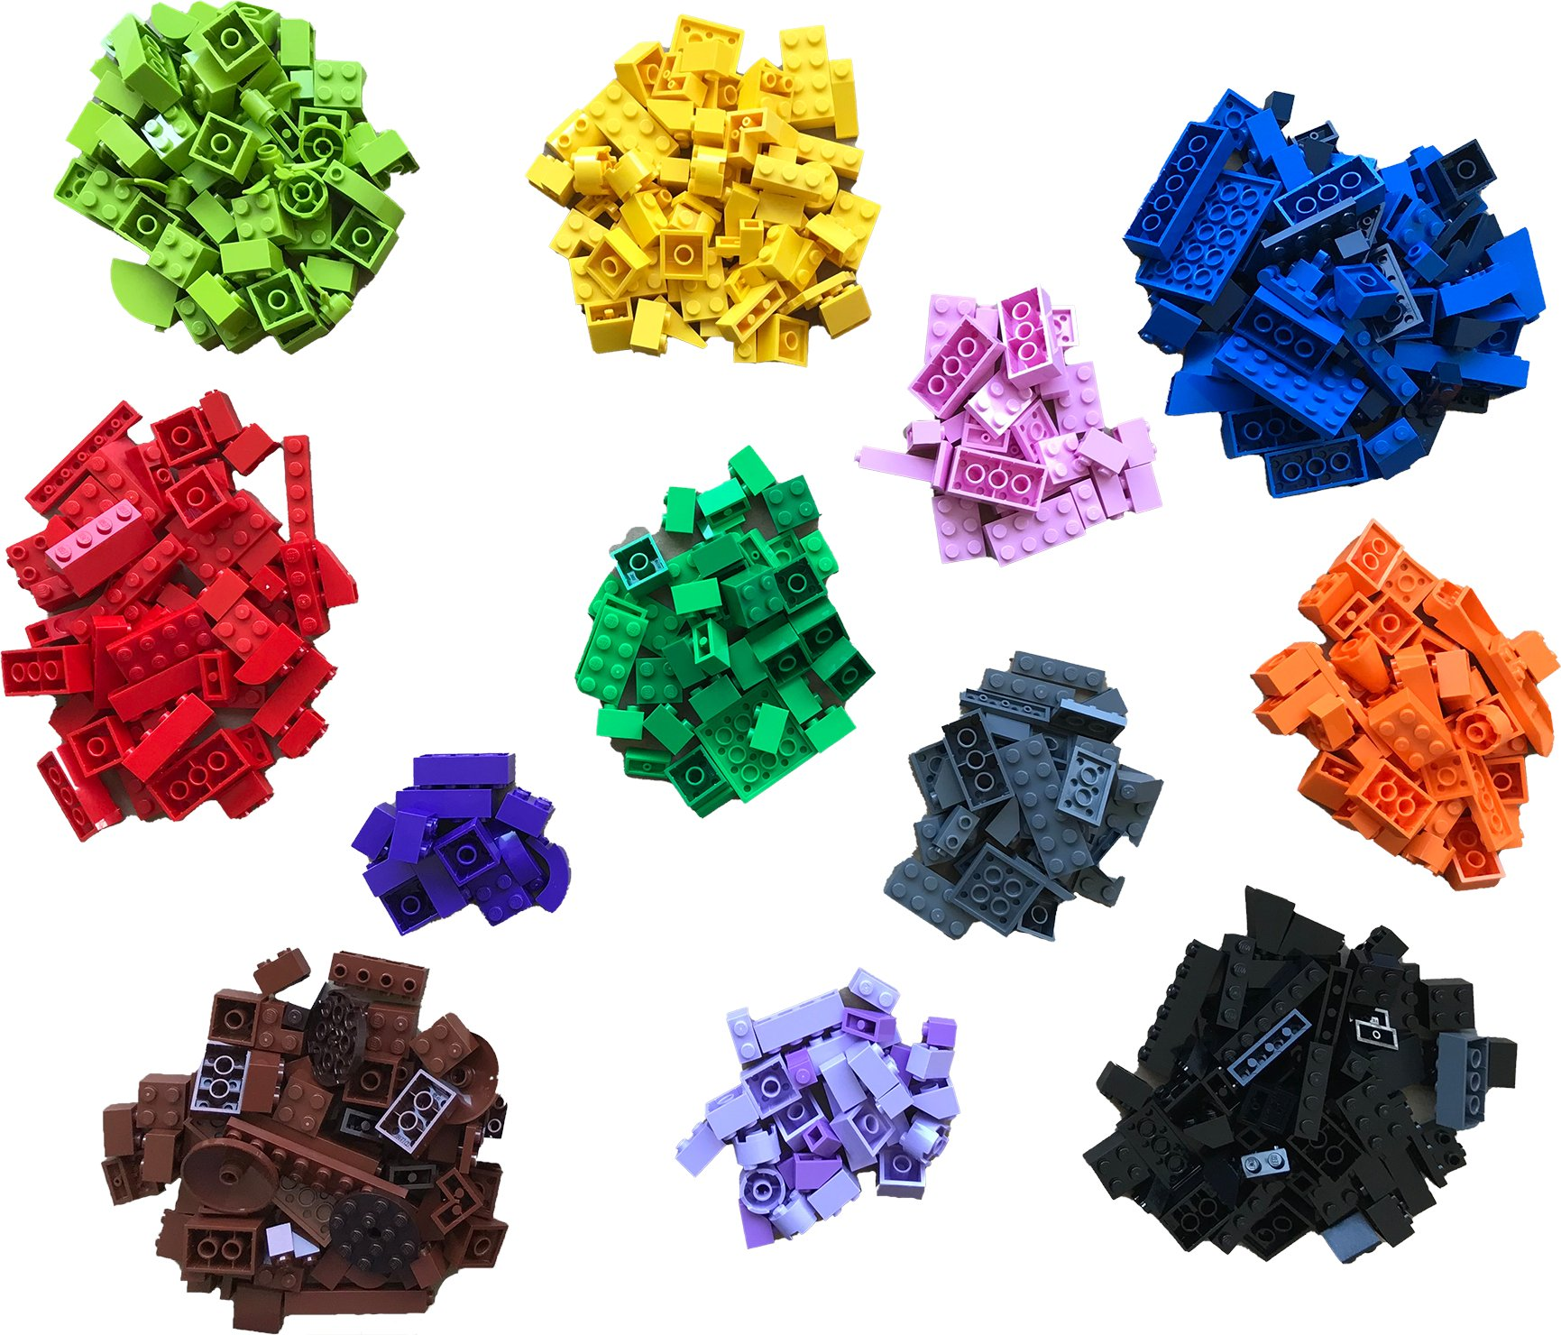
3 Gene expression profiling
Bulk Chunks of tissue, lots of cells | Single cell Populations of individual cells | Spatially resolved Maintains positional information, but several cells
31
https://twitter.com/BoXia7
Notes:
31

Slide 32
Real information

Slide 33
As close as we can, using multi-omics approach
+ Bulk RNA-Seq
+ Single-cell RNA-Seq
<<
+ Spatial transcriptomics
+ Proteomics
+ Metabolomics

Slide 34
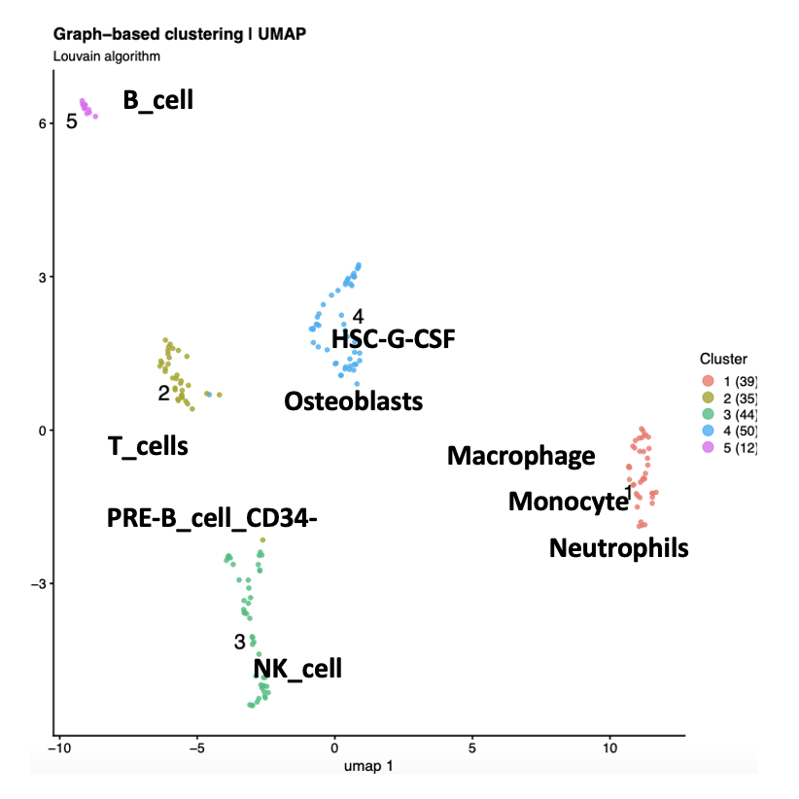
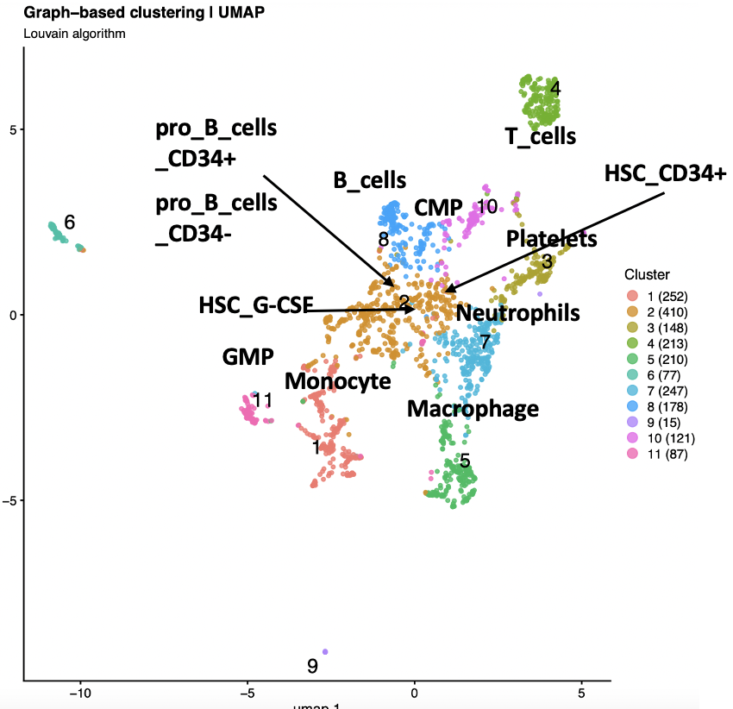
Single-cell RNA-Seq
VS58 | VS59 | Xu et al
AHNAK | AHNAK | SOX2
S100B | CRYAB | PMP2
MBP | S100B | S100B
NCMAP | MBP | NCMAP
NCAM1 | CDKN1 | MAG
JUN1 | JUN1 | DRP2
CDKN1 | MAP1B
PMP2

Slide 35
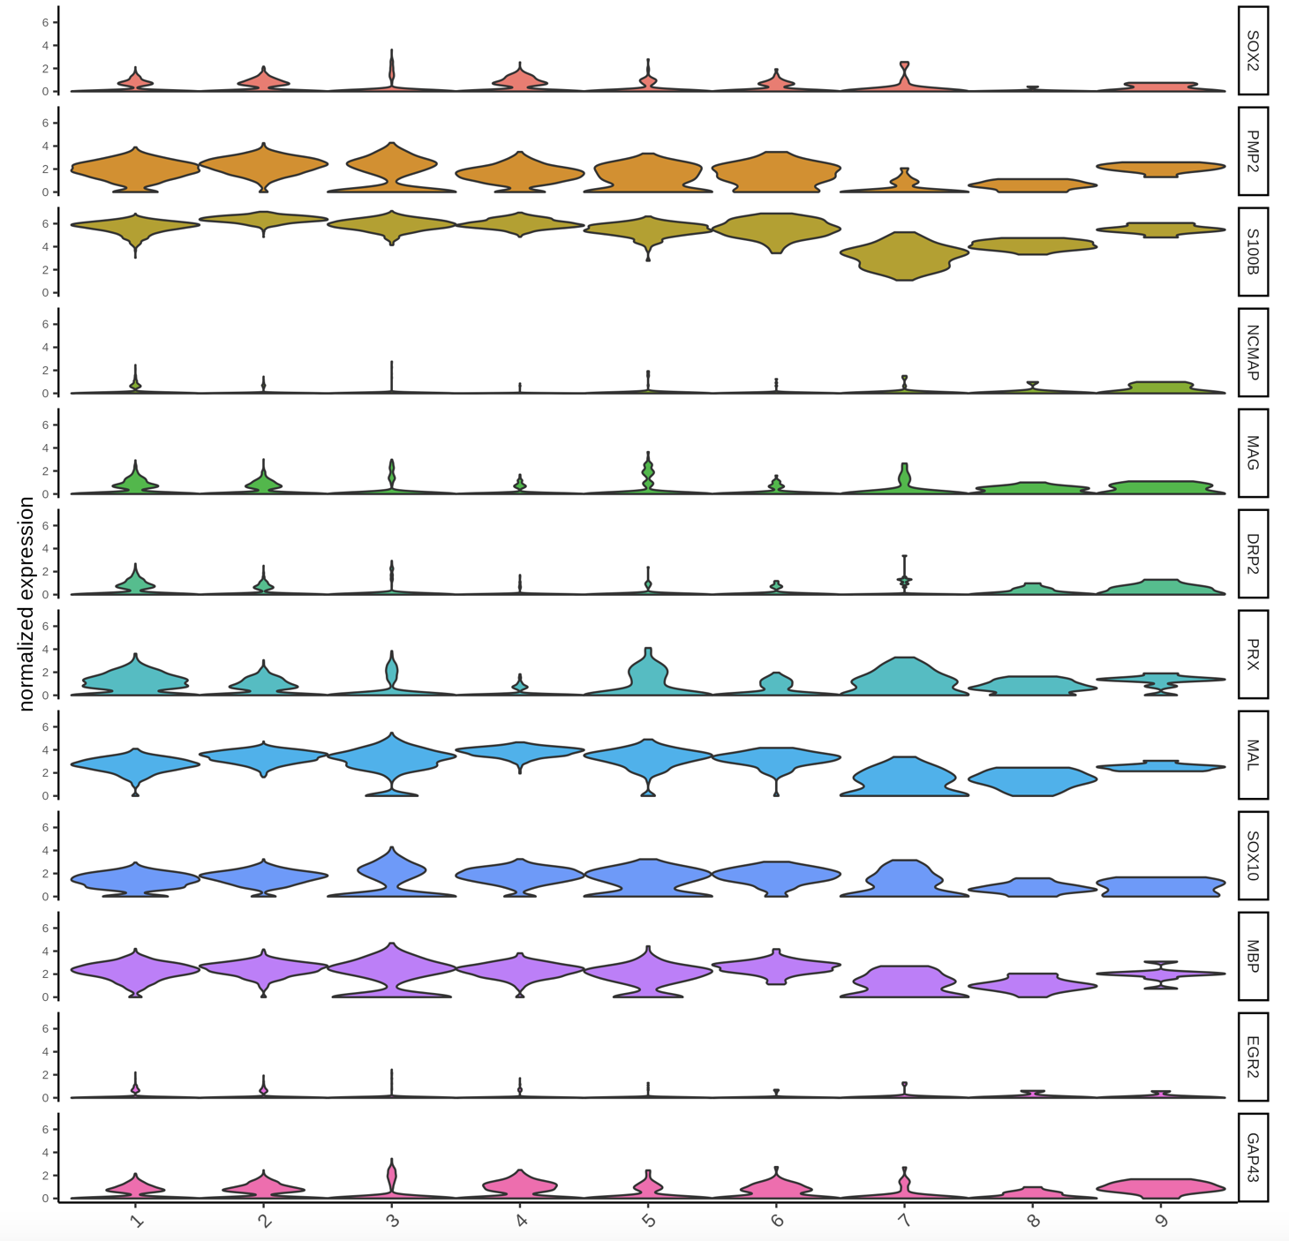
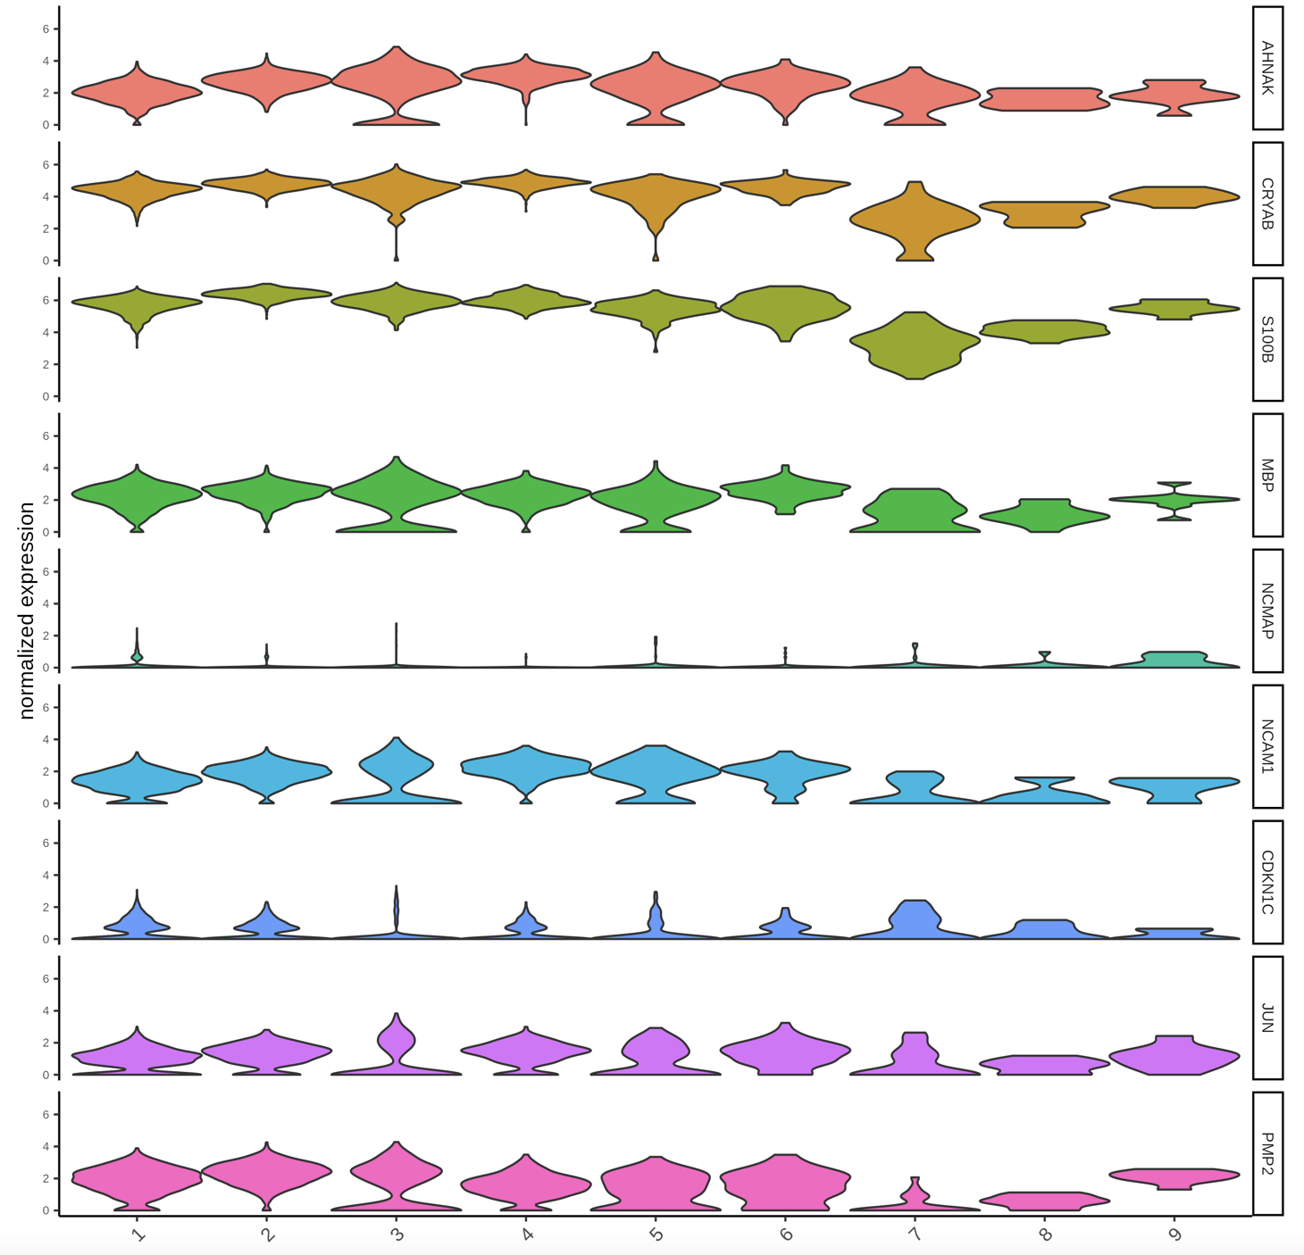
AHNAK S100B CRYAB MBP
NCMAP
NCAM1 CDKN1C JUN PMP2
SOX2
PMP2
S100B
NCMAP
MAG
DRP2
PRX
MAL
SOX10
MBP
EGR2
GAP43

Slide 36
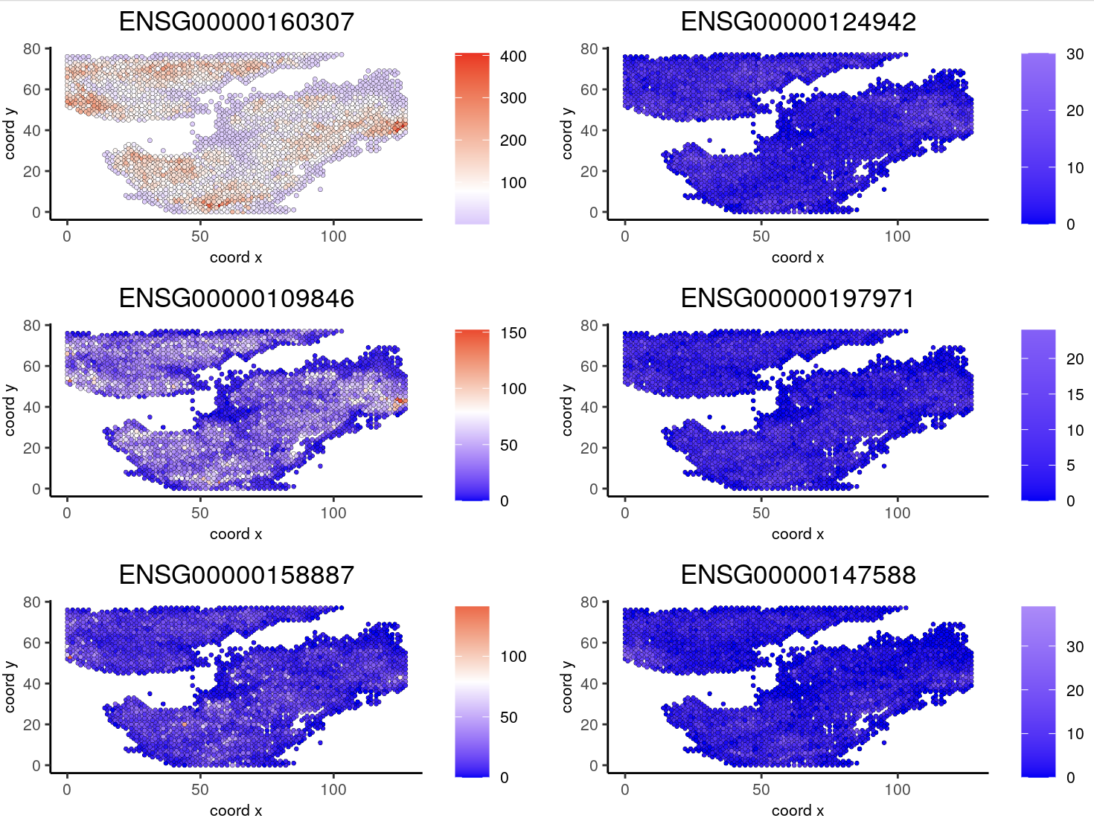
S100B
AHNAK
CRYAB
MBP
MPZ
MBP2

Slide 37
Take-at-home message
the sequencing kit selections depend on
the choice of method matters
no method gives a realistic result
contamination must be monitored at all levels/stages

Slide 38
Even if everyone tries, sometimes it doesn't work out.

