Slide 1
Usecases
Mastigamoeba balamuthi genome project
Jan Pačes hpaces@img.cas.cz

Slide 2
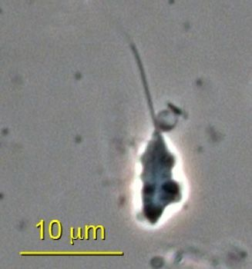
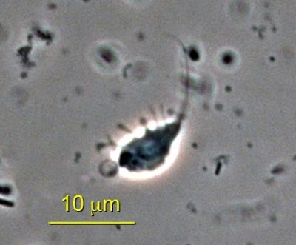
Mastigamoeba balamuthi
Eukaryota; Amoebozoa; Archamoebae; Mastigamoebidae; Mastigamoeba
Mastigamoeba balamuthi is free-living relative of parasitic Entamoeba histolytica.

Slide 3
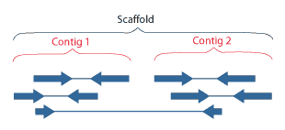
Basic terms
Read
Sequence of a DNA fragment produced by sequencer.
Contig
Series of overlapping DNA sequences used to make a physical map that reconstructs the original DNA sequence.
Scaffold
An ordered and oriented set of contigs. A scaffold will contain gaps, but there is typically some evidence to support the contig order, orientation and gap size estimates.
Assembly
Refers to aligning and merging fragments of a much longer DNA sequence in order to reconstruct the original sequence.
Coverage
Sequencing coverage describes the average number of reads that align to known reference or consensus bases.
Consensus sequence
A sequence pattern derived from the alignment of multiple sequences that represents the nucleotide or amino acid most likely to occur at each position in a sequence.

Slide 4
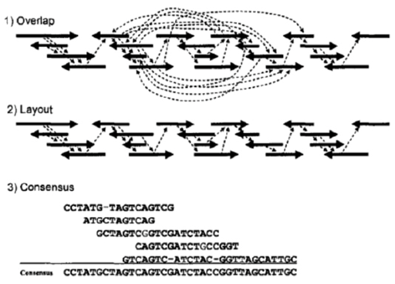
Overlap – Layout – Consensus (OLC)
Find OVERLAPS by aligning the sequences of the reads
LAYOUT the reads based on their alignments
Calculate CONSENSUS based on overlapped sequences
M. Kasahara, Large-scale Genome Sequence, Imperrial Collage Press

Slide 5
Data I - 454
Name type DNA lib reads bases note year
FP0GO9G04 sg 1 1 164505 54189206 2009
FRHL92C01 sg 1 1 618501 233739276 2009
FRHL92C02 sg 1 1 656772 248344600 2009
FR119VM02 sg 1 1 624131 208423654 2009
F2JR2KZ02 pe_3k 1 2 392423 124507954 2009
F3OAQ8101 pe_3k 1 2 365436 105235284 2009
F3OAQ8102 pe_3k 1 2 364688 110565395 2009
F4U1LOO02 pe_8k 1 3 3168 1101377 abort 2009
F7K632R02 pe_8k 2 4 510306 179373522 2009

Slide 6
Preliminary assembly
1 353 996 reads
501 474 699 bases
90% reads aligned
23 638 large contigs
30 631 852 bases
(47 778 all contigs)
(37 685 976 bases)

Slide 7
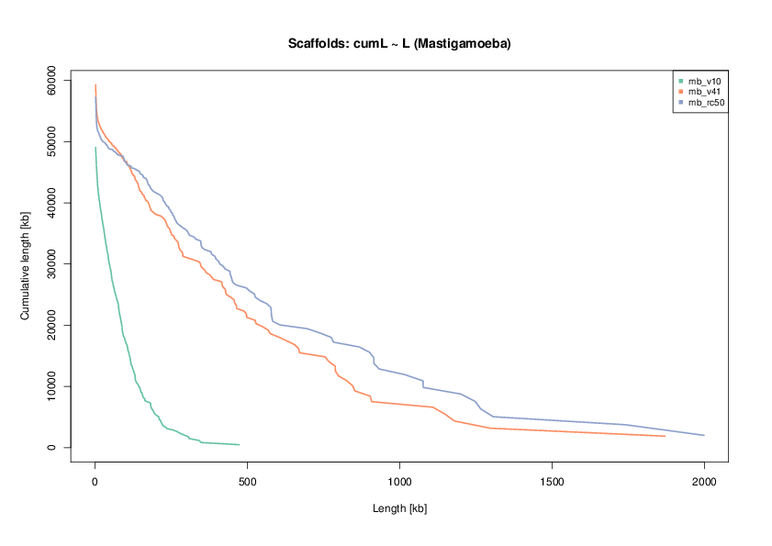
Assembly statistics

Slide 8
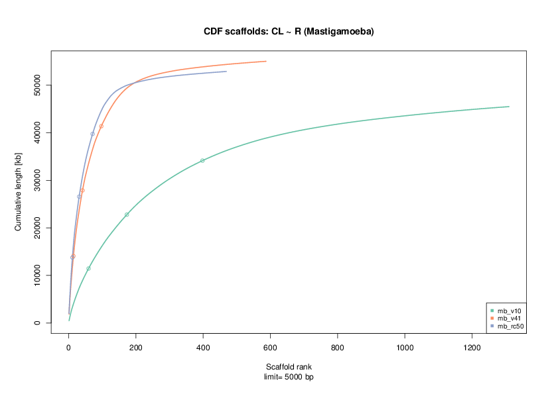
Assembly statistics

Slide 9
How to measure quality of assembly
N50 = 3

Slide 10
Pairs mapping
libraryName = "GPYRH5H07u.sff"
libraryNumPairs = 3058
numInSameScaffold = 644, 21.1%
libraryName = "GPYRH5H04u.sff"
libraryNumPairs = 3049
numInSameScaffold = 605, 19.8%
libraryName = "GPYRH5H08u.sff"
libraryNumPairs = 2853
numInSameScaffold = 573, 20.1%

Slide 11
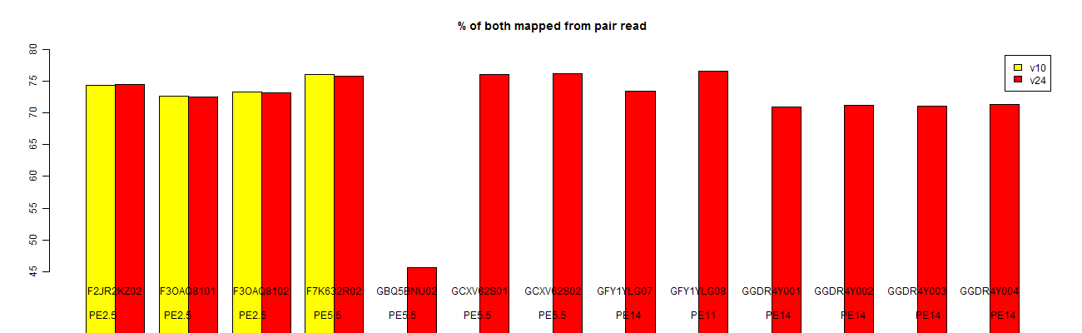
Pair mapping

Slide 12
Pairs mapping - detail
Template | Status | Dist | Left Contig | LP | LO | Right Contig | RP | RO | LD | RD
F2JR2KZ02GXGEI | Link | 842 | contig41792 | 266 | - | contig41791 | 1407 | + | 266 | 576
F2JR2KZ02HWCCR | MultiplyMapped | - | Repeat |  |  | Repeat
F2JR2KZ02IFSVS | Link | 2502 | contig08180 | 1086 | + | contig08182 | 1174 | - | 1328 | 1174
F2JR2KZ02I6OP1 | MultiplyMapped | - | Repeat |  |  | contig45148 | 1039 | +
F2JR2KZ02GV16M | SameContig | 3314 | contig47949 | 6065 | - | contig47949 | 2751 | +
F2JR2KZ02IW3QP | MultiplyMapped | - | contig02188 | 230 | + | Repeat
F2JR2KZ02HEH74 | Link | 450 | contig14856 | 61 | - | contig24260 | 389 | - | 61 | 389
F2JR2KZ02I9DH7 | Link | 1372 | contig43171 | 3463 | + | contig19367 | 304 | - | 1068 | 304
F2JR2KZ02J1DWA | Link | 2117 | contig15275 | 605 | + | contig41840 | 1061 | + | 553 | 1564
F2JR2KZ02I9ZO9 | MultiplyMapped | - | Repeat |  |  | contig43702 | 2749 | +
F2JR2KZ02JVEFR | Link | 2109 | contig02711 | 1154 | + | contig41754 | 1450 | - | 659 | 1450
F2JR2KZ02JXJSI | SameContig | 2164 | contig16479 | 2613 | - | contig16479 | 449 | +
F2JR2KZ02GGH5X | MultiplyMapped | - | contig01208 | 474 | + | Repeat
F2JR2KZ02JSYGZ | Link | 1727 | contig50411 | 187 | + | contig14234 | 996 | - | 731 | 996
F2JR2KZ02GP8D8 | SameContig | 2109 | contig09696 | 2469 | + | contig09696 | 4578 | -
F2JR2KZ02GW8X5 | Link | 2162 | contig46032 | 1482 | - | contig29597 | 680 | - | 1482 | 680
F2JR2KZ02HLCLF | SameContig | 3417 | contig06238 | 6842 | - | contig06238 | 3425 | +

Slide 13
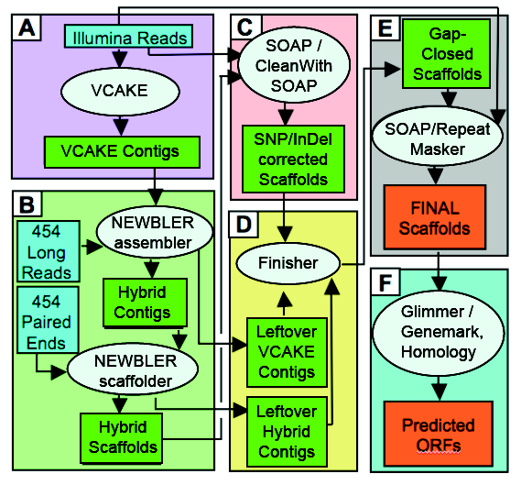
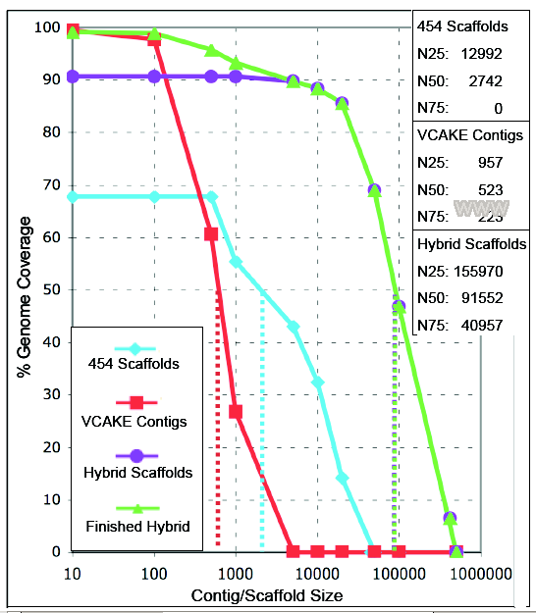
genome - what next?
Notes:
13
13

Slide 14
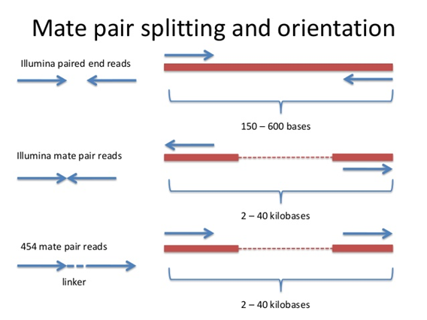
Orientation of pairs

Slide 15
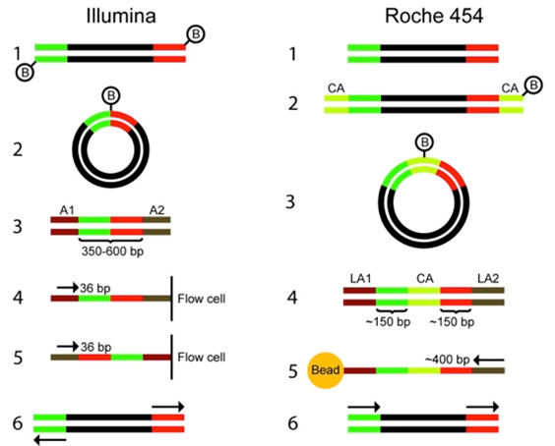
Paired-end library construction

Slide 16
Data II - Solexa
2 x 36 bp mate pairs
  19 168 368 reads;
  690 061 248 bp
2x 36 bp paired-end reads
  31 338 464 reads;
  1 128 184 704 bp
2 x 76 bp paired-end reads
  15 346 572 reads;
  1 166 339 472 bp

Slide 17
Hybrid assembly approaches
Velvet (de Bruin graphs) on Solexa short reads
Add contigs to 454 as another set of reads
Newbler (assembly by overlap)
Newbler on 454
Scaffold using Solexa mate-pairs
Gap filling by Solexa paired-end
Hybrid assemblers (e.g. MaSuRCA)

Slide 18
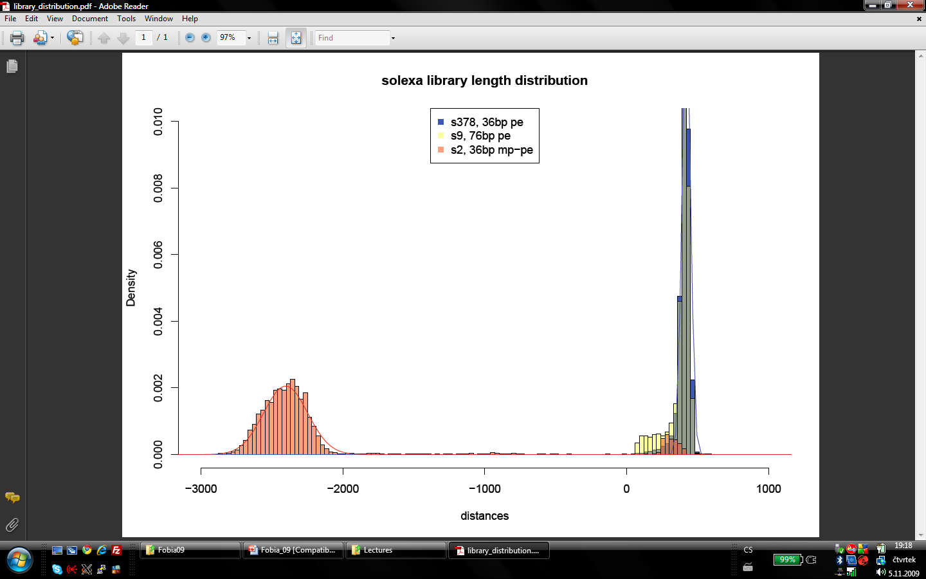
illumina pe and mate-pairs libraries
Notes:
18
18

Slide 19
Data III - 454
name type DNA lib reads bases note year
GBQ5BNU02 pe 20k 2 5 (4) 484776 158464705 2010
GCXV62S01 pe 8k 2 4 709651 257758280 2010
GCXV62S02 pe 8k 2 4 697166 254307731 2010
GFY1YLG07 pe 20k 3 5 89706 33402994 2010
GFY1YLG08 pe 20k 3 6 (5) 114440 43505801 2010
GGDR4Y001 pe 20k 3 5 146212 47361486 2010
GGDR4Y002 pe 20k 3 5 153430 50516840 2010
GGDR4Y003 pe 20k 3 5 152015 50195006 2010
GGDR4Y004 pe 20k 3 5 155637 51862054 2010
GN5IB9S01 pe 12k 3 7 94568 24518736 2010
GN5IB9S02 pe 15k 3 8 104244 26576268 2010
GOA1T9Q04 pe 8k 3 9 106424 25089201 2010
GOA1T9Q05 pe 8k 3 9 108911 25542480 2010
GOA1T9Q06 pe 15k 3 8 66666 18277137 2010
GOA1T9Q07 pe 15k 3 10 93970 21606969 2010
GOA1T9Q08 pe 15k 3 10 126056 31753493 2010
GPYRH5H03 pe 20k 3 11 79105 22351483 2010
GPYRH5H04 pe 20k 3 11 71237 18956594 2010
GPYRH5H05 pe 6k 3 12 100900 33419522 2010
GPYRH5H06 pe 12k 3 13 70037 20871623 2010
GPYRH5H07 pe 20k 3 11 86345 24830049 2010
GPYRH5H08 pe 20k 3 11 63893 17359467 2010
GRD9W6Y04 pe 7k 3 14 60539 434025 abort 2010
GRD9W6Y05 pe 10k 3 15 57185 23428209 2010
GRD9W6Y06 pe 10k 3 15 53831 7814231 2010
GRD9W6Y07 pe 12k 3 7 50478 1464337 2010
GRD9W6Y08 pe 12k 3 13 47124 2789844 2010

Slide 20
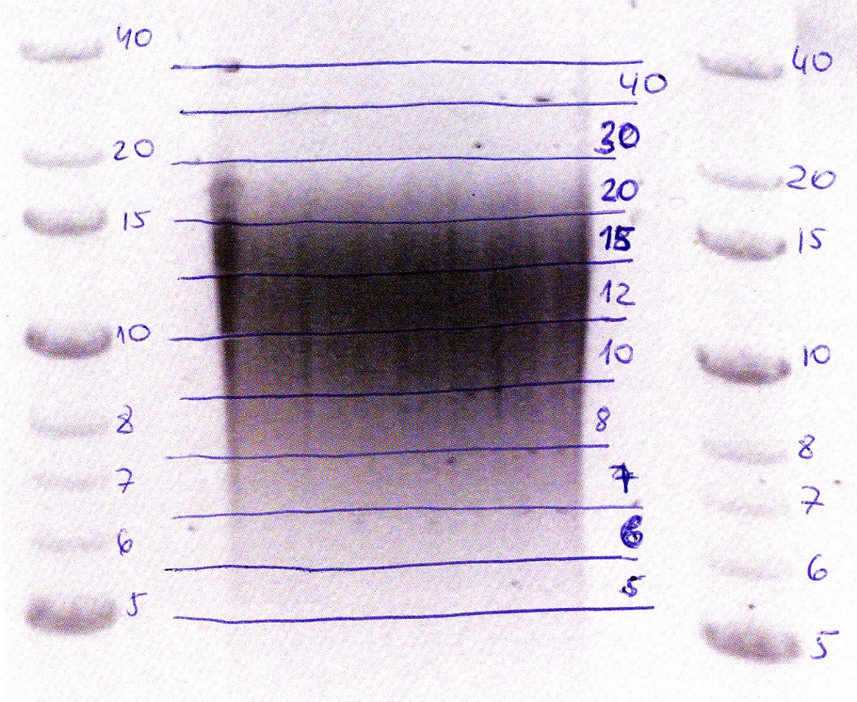
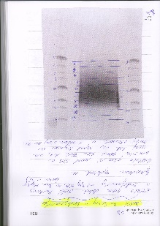
Library sizes

Slide 21
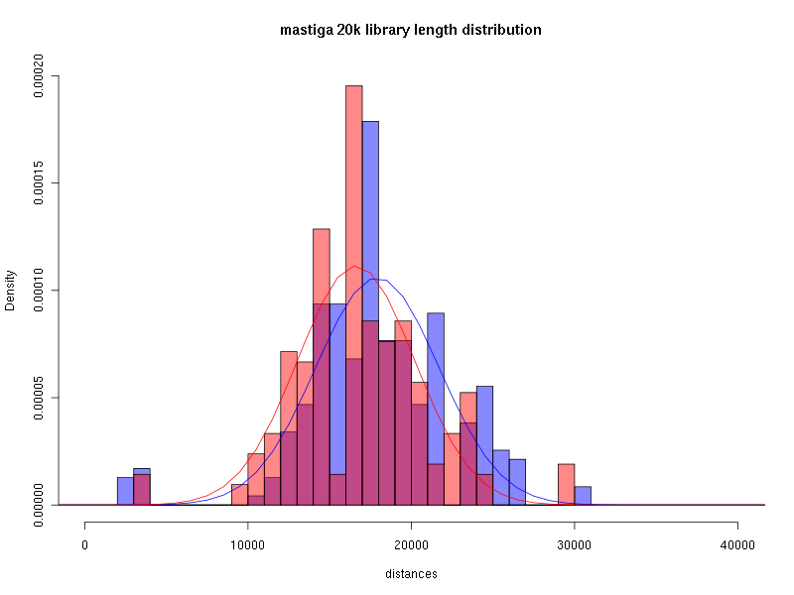
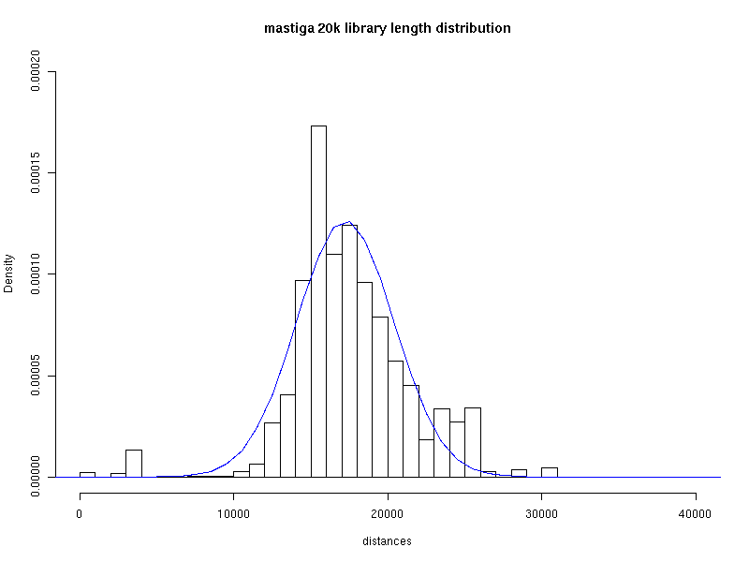
Large libraries length distribution

Slide 22
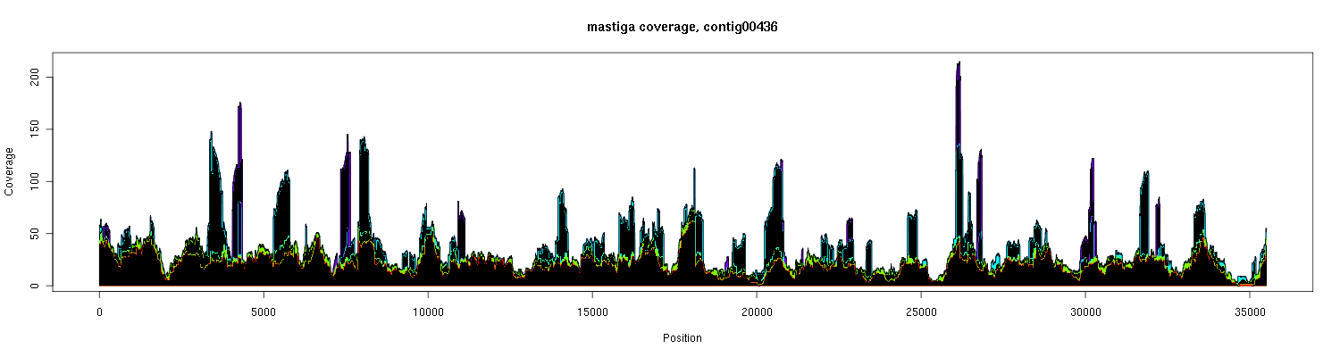
Contig coverage

Slide 23
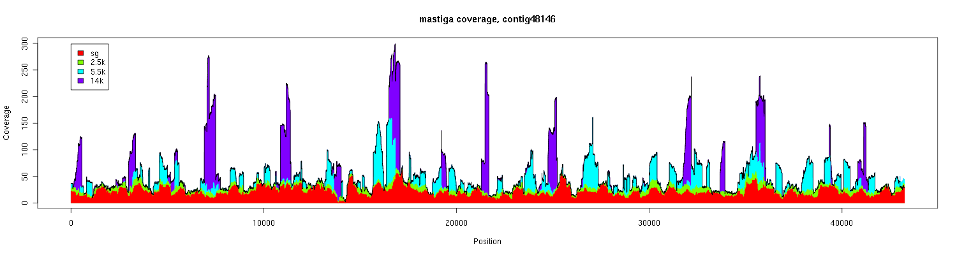
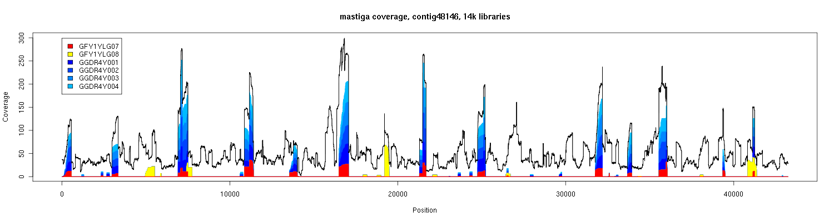
contig coverage
Notes:
23

Slide 24
Data IV - 454
name type DNA lib reads bases note year
GOA1T9Q06 pe 15k 3 8 66666 18277137 2010
GOA1T9Q07 pe 15k 3 10 93970 21606969 2010
GOA1T9Q08 pe 15k 3 10 126056 31753493 2010
GPYRH5H03 pe 20k 3 11 79105 22351483 2010
GPYRH5H04 pe 20k 3 11 71237 18956594 2010
GPYRH5H05 pe 6k 3 12 100900 33419522 2010
GPYRH5H06 pe 12k 3 13 70037 20871623 2010
GPYRH5H07 pe 20k 3 11 86345 24830049 2010
GPYRH5H08 pe 20k 3 11 63893 17359467 2010
GRD9W6Y04 pe 7k 3 14 60539 434025 abort 2010
GRD9W6Y05 pe 10k 3 15 57185 23428209 2010
GRD9W6Y06 pe 10k 3 15 53831 7814231 2010
GRD9W6Y07 pe 12k 3 7 50478 1464337 2010
GRD9W6Y08 pe 12k 3 13 47124 2789844 2010

Slide 25
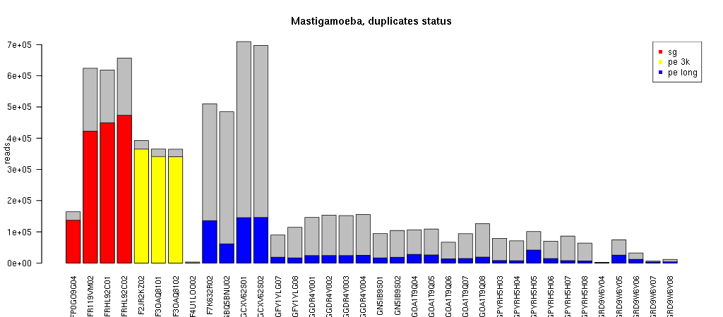
454 duplicates
Notes:
25

Slide 26
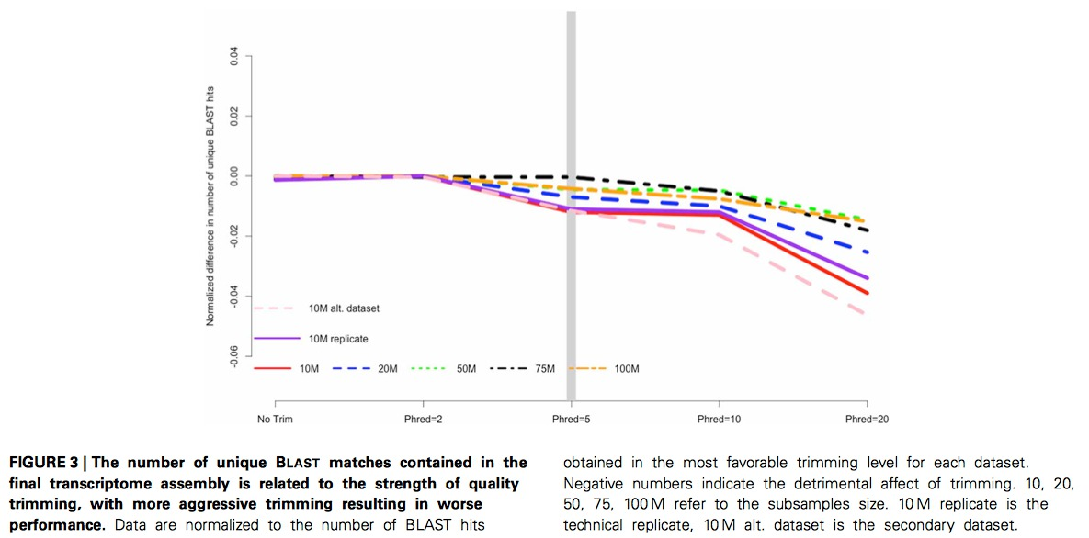
Quality filtering / trimming

Slide 27
Data V - Illumina
2 x 100 bp paired-end reads
  42 976 523 reads
  8 595 304 600 bp

Slide 28
Digital normalization
Distribution of k-mers
Control of
  rare (cleaning)
  abundant (normalization)
Software:
  DSK
  Jellyfish
  Khmer protocols

Slide 29
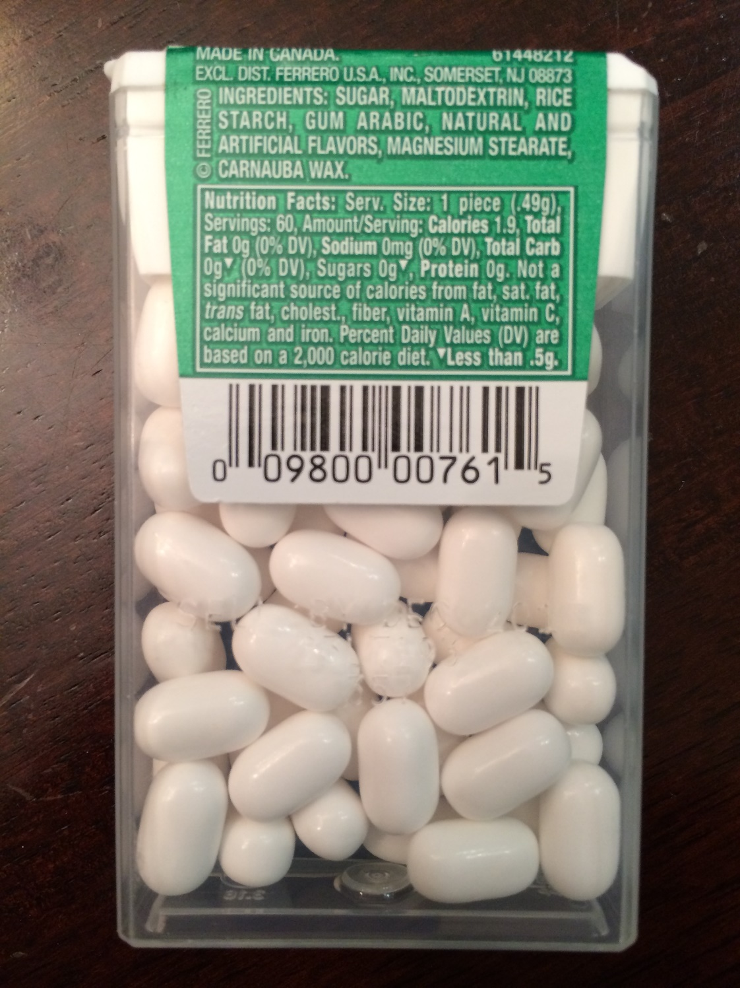
Thresholds
One of the amazing things about Tic Tacs is that they are sugar free.

Slide 30
Thresholds
But:
a food can be labeled with „sugar free“ if: (i) the food contains less than 0.5 g of sugars per reference amount customarily consumed
1.9 (calories per serving) *
3.8 (calories per gram of sugar) *
0.49 (grams per serving)
= 1.862 calories.
98% sugar!

Slide 31
assembly comparison
nb_v29 nb_v30 nb_v32 nb_v33 nb_v34 nb_v36
---------------------------------------------------------------------------------------------------------------------------------------------------
software version 2.6 2.6 2.6 2.6 2.6 2.8
regions 38 41 43 43 + pacbio 43 + illumina 43
filtered yes yes yes yes yes no
aligned reads 4,414,072 5,036,898 5,448,678 5,718,208 12,218,118 10,741,831
% 94.92 95.34 95.03 85.29 93.14 86.72
aligned bases 1,087,539,147 1,270,924,686 1,348,850,087 1,534,176,008 1,956,736,699 2,421,019,090
% 97.2 97.54 97.37 73.71 94.1 87.92
scaffolds 1,706 1,788 2,029 2,373 2,126 2735
bases in scaf 55,591,291 57,640,003 59,271,692 59,716,741 57,076,814 58,636,730
largest scaf 1,904,512 2,152,949 1,869,371 1,440,675 1,199,451 2,024,115
N50 scaf 195,312 254,145 346,700 214,608 266,141 165,838
N50 scaf no 75 64 46 69 59 98
contigs in scaf 12,487 10,873 10,516 11,493 10,736 11,913
N50 con in scaf 5,691 6,172 6,129 5,252 4,951 4,847
contigs > 500 27,488 25,675 25,875 33,329 27,897 23,908
bases in con 53,646,155 56,366,171 56,754,532 61,440,595 54,433,516 55,606,857
largest con 48,625 77,327 73,343 41,793 76,461 78,378
N50 con 2,820 3,394 3,410 2,650 2,832 3,722
contigs > 100 55,998 53,462 54,905 82,351 79,592 41,766
% contigs in scaf 45.43 42.35 40.64 34.48 38.48 49.83
coverage 19.56 22.05 22.76 25.69 34.28 41.29
Notes:
31

Slide 32
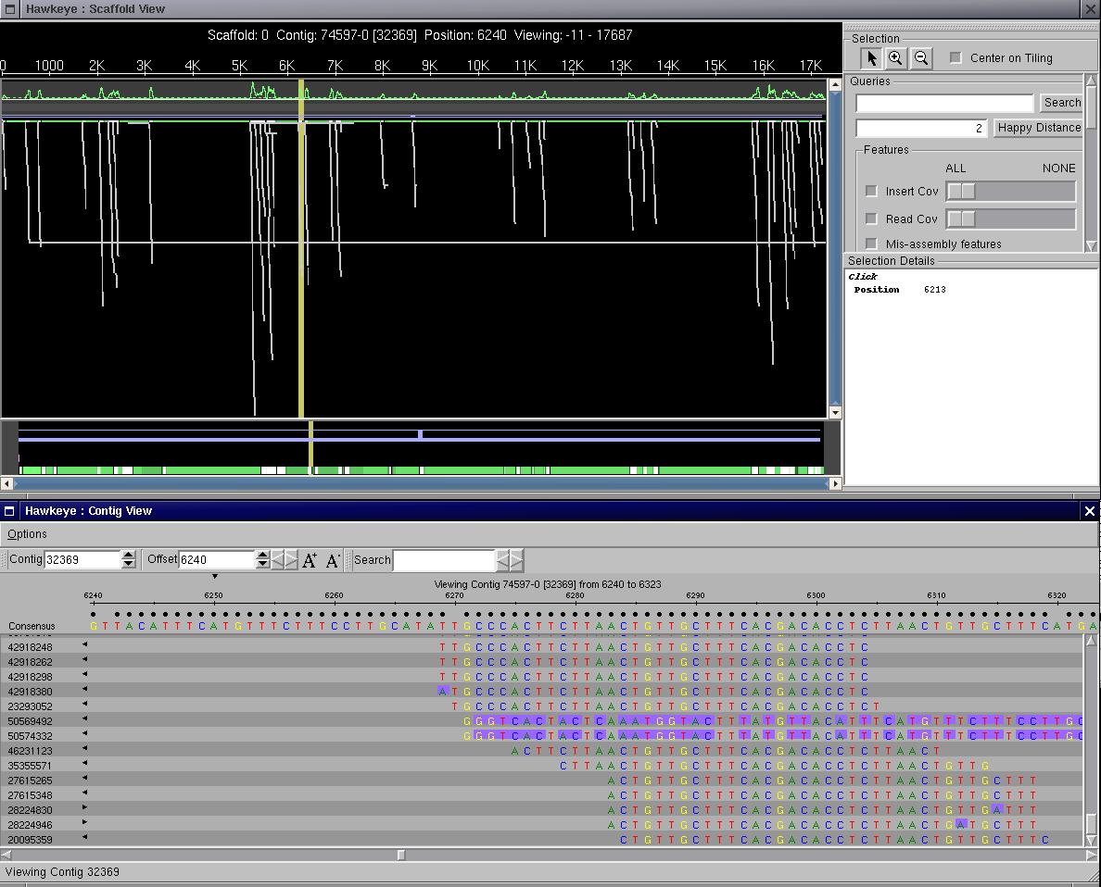

Slide 33
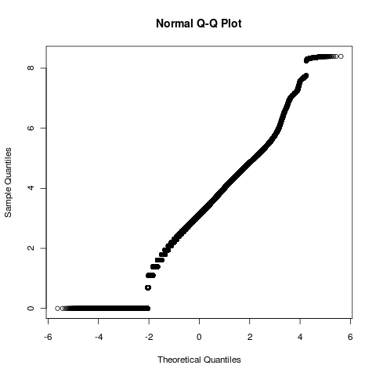
scaffold size distribution
Notes:
33

Slide 34
Variability (SNP and small rearrangements)
Reference | Start | End | Ref | Var | Depth | Freq
>m41_s00001 | 948 | 948 | - | C | 8 | 37%
>m41_s00001 | 961 | 961 | A | G | 10 | 40%
>m41_s00001 | 969 | 969 | A | G | 9 | 44%
>m41_s00001 | 973 | 973 | - | C | 9 | 44%
>m41_s00001 | 992 | 992 | A | G | 7 | 57%
>m41_s00001 | 1003 | 1003 | T | C | 7 | 57%
>m41_s00001 | 1841 | 1841 | A | T | 6 | 50%
>m41_s00001 | 1863 | 1863 | G | T | 5 | 40%
>m41_s00001 | 1868 | 1868 | T | G | 5 | 40%
>m41_s00001 | 1878 | 1878 | A | G | 5 | 40%
>m41_s00001 | 3229 | 3229 | T | C | 13 | 31%
>m41_s00001 | 3236 | 3236 | T | C | 14 | 36%
>m41_s00001 | 3253 | 3253 | G | C | 17 | 35%
>m41_s00001 | 3265 | 3265 | T | A | 14 | 43%
>m41_s00001 | 3271 | 3271 | A | G | 14 | 43%
>m41_s00001 | 3276 | 3276 | A | C | 15 | 40%
>m41_s00001 | 3352 | 3352 | G | T | 7 | 29%
>m41_s00001 | 3363 | 3363 | A | G | 6 | 33%
>m41_s00001 | 3392 | 3392 | T | G | 10 | 60%
>m41_s00001 | 3442 | 3442 | T | C | 15 | 40%
>m41_s00001 | 3508 | 3508 | - | TA | 19 | 68%
>m41_s00001 | 3556 | 3556 | T | C | 18 | 72%
>m41_s00001 | 3593 | 3593 | T | CC | 13 | 62%
>m41_s00001 | 3597 | 3597 | C | - | 11 | 55%
>m41_s00001 | 3610 | 3611 | GG | CT | 12 | 42%
>m41_s00001 | 3612 | 3612 | A | T | 12 | 42%
>m41_s00001 | 3670 | 3670 | G | C | 13 | 46%
>m41_s00001 | 3690 | 3690 | A | G | 14 | 57%

Slide 35
Assembly statistics

Slide 36
Data VI - 454
name type DNA lib reads bases note year
HJ3T9KD07 sg 4 85082 19967991 2012
HJ3T9KD08 sg 4 69350 14384935 2012
HG2CRKC07 sg 4 99805 34923602 2012
HG2CRKC08 sg 4 106855 35375917 2012
HKEKW3O02 sg 4 538957 167104660 2012
HMCYUZJ08 pe 8k ? 16? 130622 46438018 2012
HMKFOBC02 pe 8k ? 16? 569485 171291335 2012
HMY7I9M02 pe 8k ? 16? 519054 155922717 2012

Slide 37
Data VII - pacbio
295,000 long reads
739,397,551 bp
Long reads
CCS (Circular consensus reads)
Stride reads

Slide 38
Dataset VII - mRNA
454
3 medium/small regions of normalized mRNA
4 small regions on 454 FLX
719 556 reads
184 852 854 bp
Illumina
2 x 100 bp paired-end reads
86 605 571 pairs
Transcriptome assembly v3rc1
by Trinity software
61 609 possible transcripts
111 678 528 bp
1812.7 avg transcript size
28 060 best candidate transcripts

Slide 39
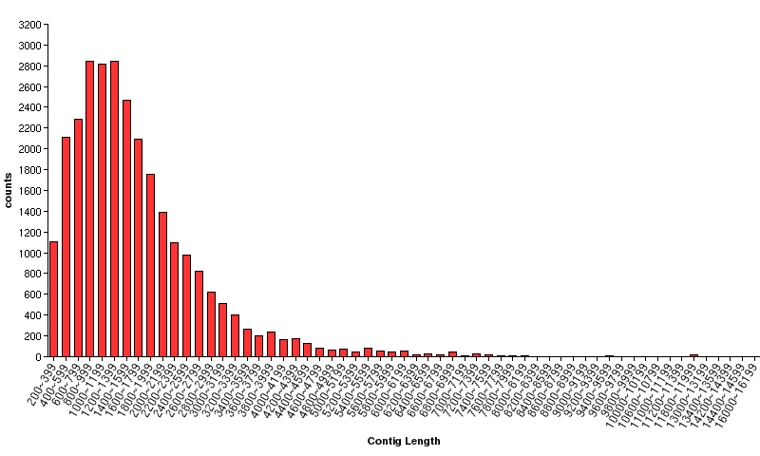
mRNA de-novo assembly
Genes (!) | 28,059
Bases | 46,895,960
Avg Len | 1,671.33
N50 | 2,028
N50 Count | 7,495
N50 Rank % | 26
Notes:
39

Slide 40
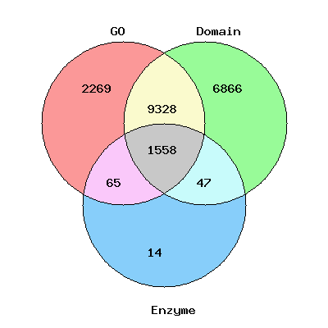
mRNA annotation
GO only | 2269
Domain only | 6866
Enzyme only | 14
GO & Domain | 9328
Domain & Enzyme | 47
GO & Enzyme | 65
GO & Domain & Enzyme | 1558
At least one functional annotation | 20147
Notes:
40

Slide 41
Sequence Name | sequence length | best hit to nr | hit length | E-value | Bit score | GO Biological Process | GO Cellular Component | GO Molecular Function | Enzyme | Domain | annotation type
m.10 | 4053 | gi|328871118|gb|EGG19489.1| DNA recombination/repair protein | 1282 | 3.19e-186 | 640.974185 | GO:0006281 DNA repair | GO:0030870 Mre11 complex | GO:0004518 nuclease activity GO:0005524 ATP binding GO:0017111 nucleoside-triphosphatase activity GO:0008270 zinc ion binding | - | pfam13476 AAA_23 pfam13558 SbcCD_C pfam01576 Myosin_tail_1 pfam05701 DUF827 pfam00769 ERM pfam09311 Rab5-bind pfam07926 TPR_MLP1_2 pfam04423 Rad50_zn_hook pfam07321 YscO | GO & Domain
m.1000 | 1716 | gi|281209856|gb|EFA84024.1| asparagine synthetase | 539 | 2.36e-208 | 714.457857 | GO:0006529 asparagine biosynthetic process GO:0006522 alanine metabolic process GO:0006531 aspartate metabolic process | - | GO:0004066 asparagine synthase (glutamine-hydrolyzing) activity | 6.3.5.4 | pfam00733 Asn_synthase pfam13537 GATase_7 pfam13522 GATase_6 pfam00310 GATase_2 | GO & Enzyme & Domain
m.10007 | 2154 | gi|167516774|ref|XP_001742728.1| hypothetical protein | 573 | 3.4e-93 | 332.078750 | GO:0055085 transmembrane transport GO:0006821 chloride transport | GO:0016021 integral to membrane | GO:0005247 voltage-gated chloride channel activity | - | pfam00654 Voltage_CLC pfam00571 CBS | GO & Domain
m.1001 | 951 | gi|66805621|ref|XP_636532.1| palmitoyl-protein thioesterase 2 | 292 | 4.38e-60 | 228.673583 | - | - | - | - | pfam02089 Palm_thioest pfam05057 DUF676 | Domain only
Sequence Name | sequence length | best hit to nr | hit length | E-value | Bit score | GO Biological Process | GO Cellular Component | GO Molecular Function | Enzyme | Domain | annotation type
m.10 | 4053 | gi|328871118|gb|EGG19489.1| DNA recombination/repair protein | 1282 | 3.19e-186 | 640.974185 | GO:0006281 DNA repair | GO:0030870 Mre11 complex | GO:0004518 nuclease activity GO:0005524 ATP binding GO:0017111 nucleoside-triphosphatase activity GO:0008270 zinc ion binding | - | pfam13476 AAA_23 pfam13558 SbcCD_C pfam01576 Myosin_tail_1 pfam05701 DUF827 pfam00769 ERM pfam09311 Rab5-bind pfam07926 TPR_MLP1_2 pfam04423 Rad50_zn_hook pfam07321 YscO | GO & Domain
m.1000 | 1716 | gi|281209856|gb|EFA84024.1| asparagine synthetase | 539 | 2.36e-208 | 714.457857 | GO:0006529 asparagine biosynthetic process GO:0006522 alanine metabolic process GO:0006531 aspartate metabolic process | - | GO:0004066 asparagine synthase (glutamine-hydrolyzing) activity | 6.3.5.4 | pfam00733 Asn_synthase pfam13537 GATase_7 pfam13522 GATase_6 pfam00310 GATase_2 | GO & Enzyme & Domain
m.10007 | 2154 | gi|167516774|ref|XP_001742728.1| hypothetical protein | 573 | 3.4e-93 | 332.078750 | GO:0055085 transmembrane transport GO:0006821 chloride transport | GO:0016021 integral to membrane | GO:0005247 voltage-gated chloride channel activity | - | pfam00654 Voltage_CLC pfam00571 CBS | GO & Domain
m.1001 | 951 | gi|66805621|ref|XP_636532.1| palmitoyl-protein thioesterase 2 | 292 | 4.38e-60 | 228.673583 | - | - | - | - | pfam02089 Palm_thioest pfam05057 DUF676 | Domain only
m.10011 | 1167 | gi|159466062|ref|XP_001691228.1| serine/threonine protein kinase 15 | 294 | 5.3e-92 | 328.118552 | GO:0002574 thrombocyte differentiation GO:0006974 response to DNA damage stimulus GO:0006355 regulation of transcription, DNA-dependent GO:0051301 cell division GO:0006468 protein phosphorylation GO:0007067 mitosis GO:0034048 negative regulation of protein phosphatase type 2A activity GO:0000086 G2/M transition of mitotic cell cycle GO:0000160 two-component signal transduction system (phosphorelay) GO:0035556 intracellular signal transduction GO:0009069 serine family amino acid metabolic process | GO:0032154 cleavage furrow GO:0005813 centrosome GO:0005634 nucleus | GO:0051721 protein phosphatase 2A binding GO:0035091 phosphatidylinositol binding GO:0000156 two-component response regulator activity GO:0005524 ATP binding GO:0004697 protein kinase C activity | 2.7.11.1 | pfam00069 Pkinase pfam07714 Pkinase_Tyr | GO & Enzyme & Domain
m.10012 | 2286 | gi|159466062|ref|XP_001691228.1| serine/threonine protein kinase 15 | 310 | 1.66e-107 | 379.601125 | GO:0006468 protein phosphorylation GO:0007154 cell communication GO:0009069 serine family amino acid metabolic process | GO:0005952 cAMP-dependent protein kinase complex | GO:0035091 phosphatidylinositol binding GO:0005524 ATP binding GO:0004691 cAMP-dependent protein kinase activity | 2.7.11.1 | pfam00069 Pkinase pfam07714 Pkinase_Tyr | GO & Enzyme & Domain
m.10015 | 1671 | gi|330840642|ref|XP_003292321.1| hypothetical protein DICPUDRAFT_50356 | 176 | 2.59e-59 | 227.353517 | GO:0006468 protein phosphorylation GO:0007165 signal transduction GO:0009069 serine family amino acid metabolic process | GO:0005952 cAMP-dependent protein kinase complex | GO:0035091 phosphatidylinositol binding GO:0004697 protein kinase C activity GO:0005524 ATP binding GO:0000287 magnesium ion binding GO:0004691 cAMP-dependent protein kinase activity | 2.7.11.1 | pfam00069 Pkinase pfam07714 Pkinase_Tyr | GO & Enzyme & Domain
m.10017 | 1671 | gi|330840642|ref|XP_003292321.1| hypothetical protein DICPUDRAFT_50356 | 176 | 2.59e-59 | 227.353517 | GO:0006468 protein phosphorylation GO:0007165 signal transduction GO:0009069 serine family amino acid metabolic process | GO:0005952 cAMP-dependent protein kinase complex | GO:0035091 phosphatidylinositol binding GO:0004697 protein kinase C activity GO:0005524 ATP binding GO:0000287 magnesium ion binding GO:0004691 cAMP-dependent protein kinase activity | 2.7.11.1 | pfam00069 Pkinase pfam07714 Pkinase_Tyr | GO & Enzyme & Domain
m.10018 | 2346 | gi|159466062|ref|XP_001691228.1| serine/threonine protein kinase 15 | 327 | 9e-108 | 380.481169 | GO:0006468 protein phosphorylation GO:0007165 signal transduction GO:0009069 serine family amino acid metabolic process | GO:0005952 cAMP-dependent protein kinase complex | GO:0035091 phosphatidylinositol binding GO:0004697 protein kinase C activity GO:0005524 ATP binding GO:0000287 magnesium ion binding GO:0004691 cAMP-dependent protein kinase activity | 2.7.11.1 | pfam00069 Pkinase pfam07714 Pkinase_Tyr | GO & Enzyme & Domain
m.1002 | 795 | gi|356504462|ref|XP_003521015.1| PREDICTED: probable isoaspartyl peptidase/L-asparaginase 4-like | 133 | 1.67e-09 | 71.145711 | - | - | GO:0016787 hydrolase activity | - | pfam01112 Asparaginase_2 | GO & Domain

Slide 42
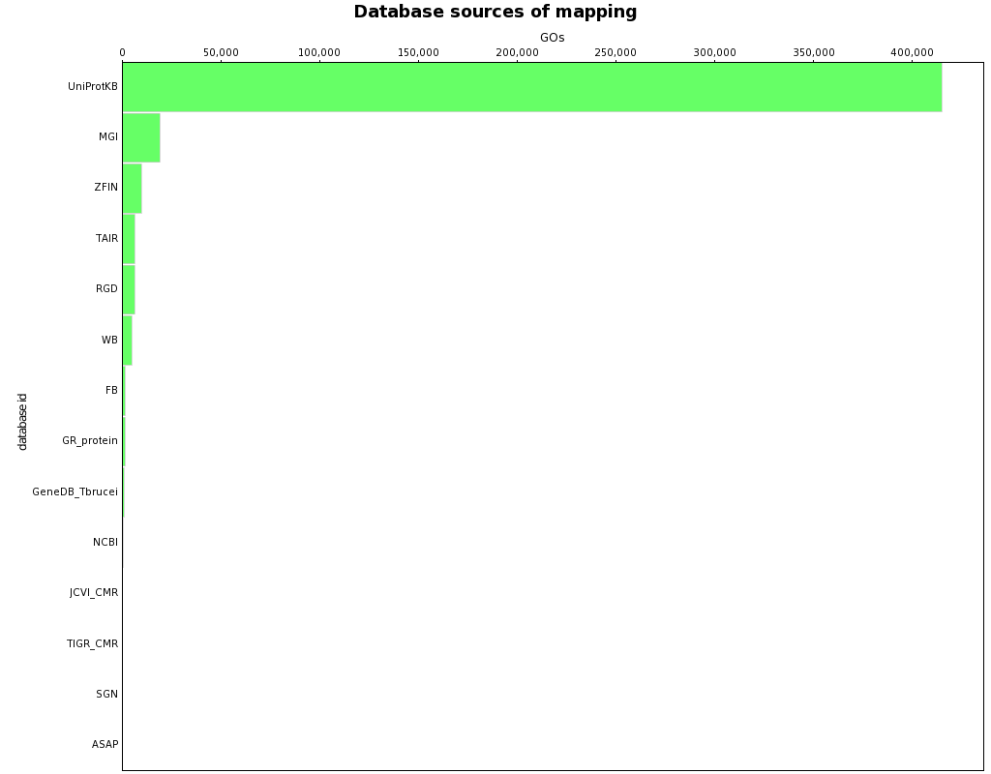
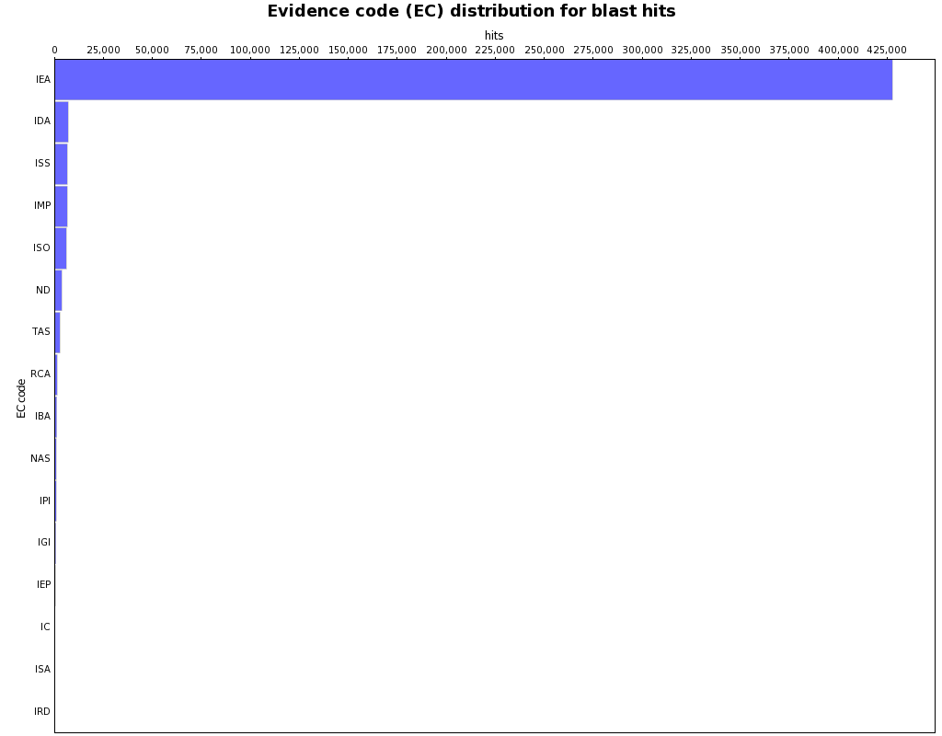
Usefullness of databases
Notes:
42

Slide 43
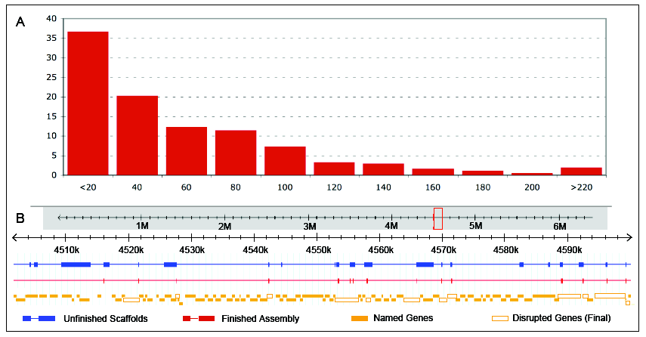
Notes:
43

Slide 44
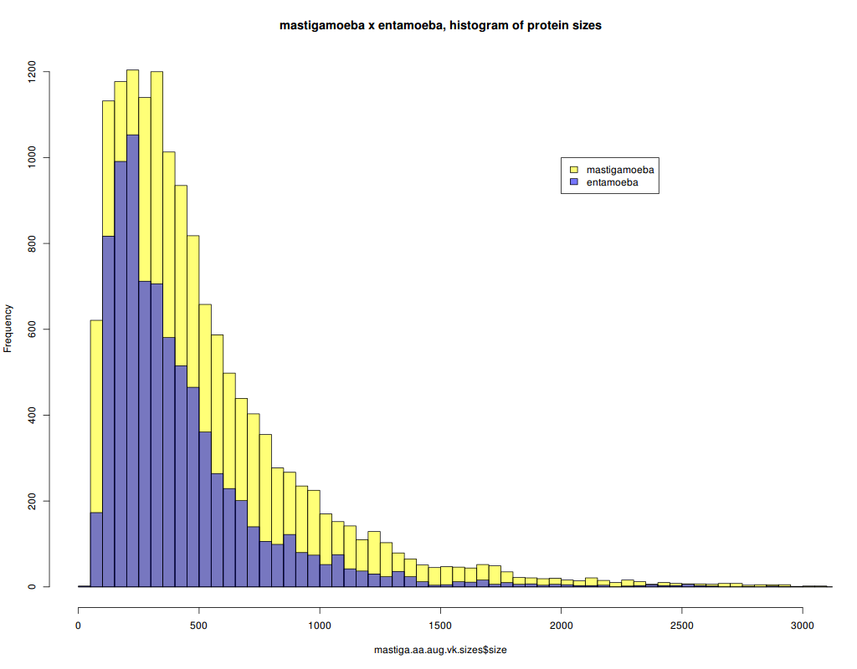

Slide 45
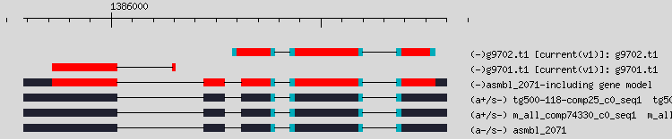
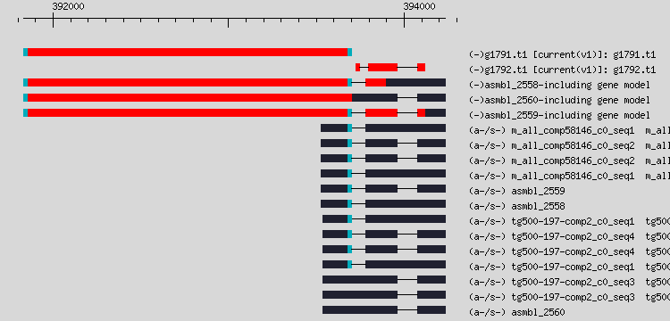
Gene models in PASA

Slide 46
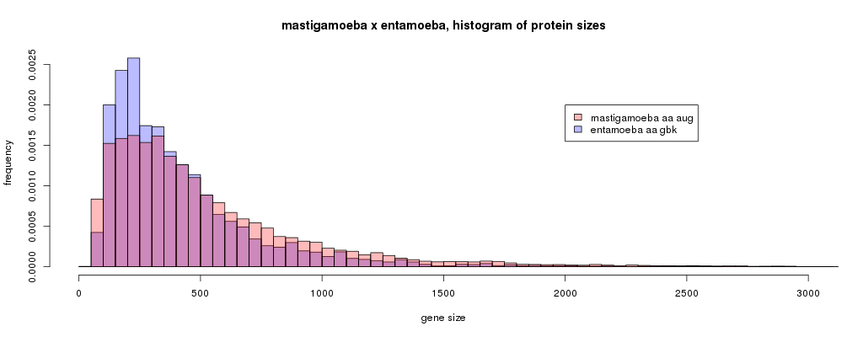
Protein sizes

Slide 47
Results
Project started 2009
Nývltová E, Šuták R, Harant K, Šedinová M, Hrdy I, Paces J, Vlček Č, Tachezy J. NIF-type iron-sulfur cluster assembly system is duplicated and distributed in the mitochondria and cytosol of Mastigamoeba balamuthi. Proc Natl Acad Sci U S A. 2013 Apr 30;110(18):7371-6. doi: 10.1073/pnas.1219590110. Epub 2013 Apr 15. PubMed PMID: 23589868; PubMed Central PMCID: PMC3645556.
Nývltová E, Stairs CW, Hrdý I, Rídl J, Mach J, Pačes J, Roger AJ, Tachezy J. Lateral gene transfer and gene duplication played a key role in the evolution of Mastigamoeba balamuthi hydrogenosomes. Mol Biol Evol. 2015 Apr;32(4):1039-55. doi: 10.1093/molbev/msu408. Epub 2015 Jan 7. PubMed PMID: 25573905; PubMed Central PMCID: PMC4379409.
Žárský V, Klimeš V, Pačes J, Vlček Č, Hradilová M, Beneš V, Nývltová E, Hrdý I, Pyrih J, Mach J, Barlow L, Stairs CW, Eme L, Hall N, Eliáš M, Dacks JB, Roger A, Tachezy J. The Mastigamoeba balamuthi Genome and the Nature of the Free-Living Ancestor of Entamoeba. Mol Biol Evol. 2021 May 19;38(6):2240-2259. doi: 10.1093/molbev/msab020. PubMed PMID: 33528570; PubMed Central PMCID: PMC8136499.

Slide 48
In article
DNA Isolation and Sequencing
DNA from the axenically grown M. balamuthi culture was isolated using phenol–chloroform extraction.
Shotgun (500–800 bp) and paired-end (8–20 kb) fragment genomic libraries were prepared and sequenced on the 454 GS FLX platform with Titanium chemistry following the manufacturer’s protocol (Roche Diagnostic, Rotkreuz, Switzerland) to generate 76.8 million reads. A TruSeq DNA library was analyzed using Illumina HiSeq 2000 (San Diego) at EMBL (Genomics Core Facility, Heidelberg, Germany) to generate 42.9 million paired-end reads. PacBio RS (EA Sequencing & Bioinformatics, Durham, NC) was used to generate 295,000 long reads (details are given in the supplementary Materials and Methods, Supplementary Material online).
RNA Isolation and Sequencing
Total RNA was isolated using TRIzol (Total RNA Isolation Reagent, Gibco BRL) and purified from DNA with the RNeasy Minelute Cleanup Kit (Qiagen). cDNA was prepared using the Transcriptor High Fidelity cDNA Synthesis Kit (Roche). The transcriptome was sequenced with Illumina HiSeq 2000 (San Diego) at EMBL (Genomics Core Facility, Heidelberg, Germany) using the TruSeq RNA library (nonstranded) to generate 86.6 million paired-end reads. Transcriptome assembly was obtained using Trinity with the default parameters (Grabherr et al. 2011).
Genome Assembly and Annotation
The genome sequence was assembled using Newbler (Software Release: 2.6 20110517_1502) (Margulies et al. 2005), with further refinements described in detail in the supplementary Materials and Methods and figure S18, Supplementary Material online. Gene prediction was performed using Augustus 3.0.2 (Stanke and Morgenstern 2005) with a set of 298 manually curated training gene models and hints from the transcriptome mapped onto the genome assembly, which yielded 14,840 protein-coding genes. Manual curation was employed for genes of interest using the interface provided by the Online Resource for Community Annotation of Eukaryotes (ORCAE) webserver (Sterck et al. 2012). Gene annotation was performed using InterProScan (Jones et al. 2014) and Blast2GO (Conesa et al. 2005). Structural RNA genes were predicted and annotated using the Rfam database (Griffiths-Jones et al. 2004) (supplementary table S3, Supplementary Material online). The annotated genome sequence has been deposited in the online resource for community annotation of eukaryotes (ORCAE, https://bioinformatics.psb.ugent.be/orcae/overview/Masba).

Slide 49
that’s it, thank you

Slide 50
Solexa, illumina, pacbio
Solexa
19,168,368 2 x 36 bp mate pairs; 690,061,248 bp
31,338,464 2x 36 bp paired-end reads; 1,128,184,704 bp
15,346,572 2 x 76 bp paired-end reads; 1,166,339,472 bp
Illumina
42,976,523 2 x 100 bp paired-end reads; 8,595,304,600 bp
PacBio
295,000 long reads; 739,397,551 bp

Slide 51
Notes:
51

Slide 52
Notes:
52

Slide 53
name type DNA lib reads bases note year
FP0GO9G04 sg 1 1 164505 54189206 2009
FRHL92C01 sg 1 1 618501 233739276 2009
FRHL92C02 sg 1 1 656772 248344600 2009
FR119VM02 sg 1 1 624131 208423654 2009
F2JR2KZ02 pe 3k 1 2 392423 124507954 2009
F3OAQ8101 pe 3k 1 2 365436 105235284 2009
F3OAQ8102 pe 3k 1 2 364688 110565395 2009
F4U1LOO02 pe 8k 1 3 3168 1101377 abort 2009
F7K632R02 pe 8k 2 4 510306 179373522 2009
GBQ5BNU02 pe 20k 2 5 (4) 484776 158464705 2010
GCXV62S01 pe 8k 2 4 709651 257758280 2010
GCXV62S02 pe 8k 2 4 697166 254307731 2010
GFY1YLG07 pe 20k 3 5 89706 33402994 2010
GFY1YLG08 pe 20k 3 6 (5) 114440 43505801 2010
GGDR4Y001 pe 20k 3 5 146212 47361486 2010
GGDR4Y002 pe 20k 3 5 153430 50516840 2010
GGDR4Y003 pe 20k 3 5 152015 50195006 2010
GGDR4Y004 pe 20k 3 5 155637 51862054 2010
GN5IB9S01 pe 12k 3 7 94568 24518736 2010
GN5IB9S02 pe 15k 3 8 104244 26576268 2010
GOA1T9Q04 pe 8k 3 9 106424 25089201 2010
GOA1T9Q05 pe 8k 3 9 108911 25542480 2010
GOA1T9Q06 pe 15k 3 8 66666 18277137 2010
GOA1T9Q07 pe 15k 3 10 93970 21606969 2010
GOA1T9Q08 pe 15k 3 10 126056 31753493 2010
GPYRH5H03 pe 20k 3 11 79105 22351483 2010
GPYRH5H04 pe 20k 3 11 71237 18956594 2010
GPYRH5H05 pe 6k 3 12 100900 33419522 2010
GPYRH5H06 pe 12k 3 13 70037 20871623 2010
GPYRH5H07 pe 20k 3 11 86345 24830049 2010
GPYRH5H08 pe 20k 3 11 63893 17359467 2010
GRD9W6Y04 pe 7k 3 14 60539 434025 abort 2010
GRD9W6Y05 pe 10k 3 15 57185 23428209 2010
GRD9W6Y06 pe 10k 3 15 53831 7814231 2010
GRD9W6Y07 pe 12k 3 7 50478 1464337 2010
GRD9W6Y08 pe 12k 3 13 47124 2789844 2010
HJ3T9KD07 sg 4 85082 19967991 2012
HJ3T9KD08 sg 4 69350 14384935 2012
HG2CRKC07 sg 4 99805 34923602 2012
HG2CRKC08 sg 4 106855 35375917 2012
HKEKW3O02 sg 4 538957 167104660 2012
HMCYUZJ08 pe 8k ? 16? 130622 46438018 2012
HMKFOBC02 pe 8k ? 16? 569485 171291335 2012
HMY7I9M02 pe 8k ? 16? 519054 155922717 2012
Notes:
53

Slide 54
data 454 I
name type DNA lib reads bases note year
FP0GO9G04 sg 1 1 164505 54189206 2009
FRHL92C01 sg 1 1 618501 233739276 2009
FRHL92C02 sg 1 1 656772 248344600 2009
FR119VM02 sg 1 1 624131 208423654 2009
F2JR2KZ02 pe 3k 1 2 392423 124507954 2009
F3OAQ8101 pe 3k 1 2 365436 105235284 2009
F3OAQ8102 pe 3k 1 2 364688 110565395 2009
F4U1LOO02 pe 8k 1 3 3168 1101377 abort 2009
F7K632R02 pe 8k 2 4 510306 179373522 2009
GBQ5BNU02 pe 20k 2 5 (4) 484776 158464705 2010
GCXV62S01 pe 8k 2 4 709651 257758280 2010
GCXV62S02 pe 8k 2 4 697166 254307731 2010
GFY1YLG07 pe 20k 3 5 89706 33402994 2010
GFY1YLG08 pe 20k 3 6 (5) 114440 43505801 2010
GGDR4Y001 pe 20k 3 5 146212 47361486 2010
GGDR4Y002 pe 20k 3 5 153430 50516840 2010
GGDR4Y003 pe 20k 3 5 152015 50195006 2010
GGDR4Y004 pe 20k 3 5 155637 51862054 2010
GN5IB9S01 pe 12k 3 7 94568 24518736 2010
GN5IB9S02 pe 15k 3 8 104244 26576268 2010
GOA1T9Q04 pe 8k 3 9 106424 25089201 2010
GOA1T9Q05 pe 8k 3 9 108911 25542480 2010
…....
Notes:
54

Slide 55
data 454 II
name type DNA lib reads bases note year
…..
GOA1T9Q06 pe 15k 3 8 66666 18277137 2010
GOA1T9Q07 pe 15k 3 10 93970 21606969 2010
GOA1T9Q08 pe 15k 3 10 126056 31753493 2010
GPYRH5H03 pe 20k 3 11 79105 22351483 2010
GPYRH5H04 pe 20k 3 11 71237 18956594 2010
GPYRH5H05 pe 6k 3 12 100900 33419522 2010
GPYRH5H06 pe 12k 3 13 70037 20871623 2010
GPYRH5H07 pe 20k 3 11 86345 24830049 2010
GPYRH5H08 pe 20k 3 11 63893 17359467 2010
GRD9W6Y04 pe 7k 3 14 60539 434025 abort 2010
GRD9W6Y05 pe 10k 3 15 57185 23428209 2010
GRD9W6Y06 pe 10k 3 15 53831 7814231 2010
GRD9W6Y07 pe 12k 3 7 50478 1464337 2010
GRD9W6Y08 pe 12k 3 13 47124 2789844 2010
HJ3T9KD07 sg 4 85082 19967991 2012
HJ3T9KD08 sg 4 69350 14384935 2012
HG2CRKC07 sg 4 99805 34923602 2012
HG2CRKC08 sg 4 106855 35375917 2012
HKEKW3O02 sg 4 538957 167104660 2012
HMCYUZJ08 pe 8k ? 16? 130622 46438018 2012
HMKFOBC02 pe 8k ? 16? 569485 171291335 2012
HMY7I9M02 pe 8k ? 16? 519054 155922717 2012
Notes:
55

Slide 56
data Illumina, PacBio
Solexa
19,168,368 2 x 36 bp mate pairs 2.4 kbp
690,061,248 bp
31,338,464 2x 36 bp paired-end reads
1,128,184,704 bp
15,346,572 2 x 76 bp paired-end reads
1,166,339,472 bp
Illumina
42,976,523 2 x 100 bp paired-end reads
8,595,304,600 bp
PacBio
295,000 long reads
739,397,551 bp
Notes:
56

Slide 57
mRNA
454
3 medium/small regions of normalized mRNA
4 small regions on 454 FLX
719,556 reads
184,852,854 bp
Illumina
86,605,571 2 x 100 bp paired-end reads
Transcriptome assembly v3rc1
by Trinity software
61609 possible transcripts
111678528 bp
1812.7 avg transcript size
28060 best candidate transcripts
Notes:
57

Slide 58
mRNA
454
3 medium/small regions of normalized mRNA
4 small regions on 454 FLX
719,556 reads
184,852,854 bp
Illumina
86,605,571 2 x 100 bp paired-end reads
Transcriptome assembly v3rc1
by Trinity software
61609 possible transcripts
111678528 bp
1812.7 avg transcript size
28060 best candidate transcripts
Notes:
58

Slide 59
name type DNA lib reads bases note year
FP0GO9G04 sg 1 1 164505 54189206 2009
FRHL92C01 sg 1 1 618501 233739276 2009
FRHL92C02 sg 1 1 656772 248344600 2009
FR119VM02 sg 1 1 624131 208423654 2009
F2JR2KZ02 pe 3k 1 2 392423 124507954 2009
F3OAQ8101 pe 3k 1 2 365436 105235284 2009
F3OAQ8102 pe 3k 1 2 364688 110565395 2009
F4U1LOO02 pe 8k 1 3 3168 1101377 abort 2009
F7K632R02 pe 8k 2 4 510306 179373522 2009
GBQ5BNU02 pe 20k 2 5 (4) 484776 158464705 2010
GCXV62S01 pe 8k 2 4 709651 257758280 2010
GCXV62S02 pe 8k 2 4 697166 254307731 2010
GFY1YLG07 pe 20k 3 5 89706 33402994 2010
GFY1YLG08 pe 20k 3 6 (5) 114440 43505801 2010
GGDR4Y001 pe 20k 3 5 146212 47361486 2010
GGDR4Y002 pe 20k 3 5 153430 50516840 2010
GGDR4Y003 pe 20k 3 5 152015 50195006 2010
GGDR4Y004 pe 20k 3 5 155637 51862054 2010
GN5IB9S01 pe 12k 3 7 94568 24518736 2010
GN5IB9S02 pe 15k 3 8 104244 26576268 2010
GOA1T9Q04 pe 8k 3 9 106424 25089201 2010
GOA1T9Q05 pe 8k 3 9 108911 25542480 2010
GOA1T9Q06 pe 15k 3 8 66666 18277137 2010
GOA1T9Q07 pe 15k 3 10 93970 21606969 2010
GOA1T9Q08 pe 15k 3 10 126056 31753493 2010
GPYRH5H03 pe 20k 3 11 79105 22351483 2010
GPYRH5H04 pe 20k 3 11 71237 18956594 2010
GPYRH5H05 pe 6k 3 12 100900 33419522 2010
GPYRH5H06 pe 12k 3 13 70037 20871623 2010
GPYRH5H07 pe 20k 3 11 86345 24830049 2010
GPYRH5H08 pe 20k 3 11 63893 17359467 2010
GRD9W6Y04 pe 7k 3 14 60539 434025 abort 2010
GRD9W6Y05 pe 10k 3 15 57185 23428209 2010
GRD9W6Y06 pe 10k 3 15 53831 7814231 2010
GRD9W6Y07 pe 12k 3 7 50478 1464337 2010
GRD9W6Y08 pe 12k 3 13 47124 2789844 2010
HJ3T9KD07 sg 4 85082 19967991 2012
HJ3T9KD08 sg 4 69350 14384935 2012
HG2CRKC07 sg 4 99805 34923602 2012
HG2CRKC08 sg 4 106855 35375917 2012
HKEKW3O02 sg 4 538957 167104660 2012
HMCYUZJ08 pe 8k ? 16? 130622 46438018 2012
HMKFOBC02 pe 8k ? 16? 569485 171291335 2012
HMY7I9M02 pe 8k ? 16? 519054 155922717 2012
Notes:
59

Slide 60
Notes:
60

Slide 61
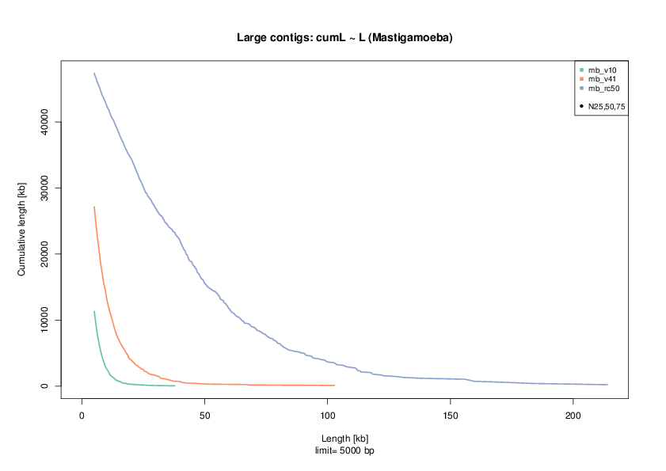
Contigs length evaluation

Slide 62
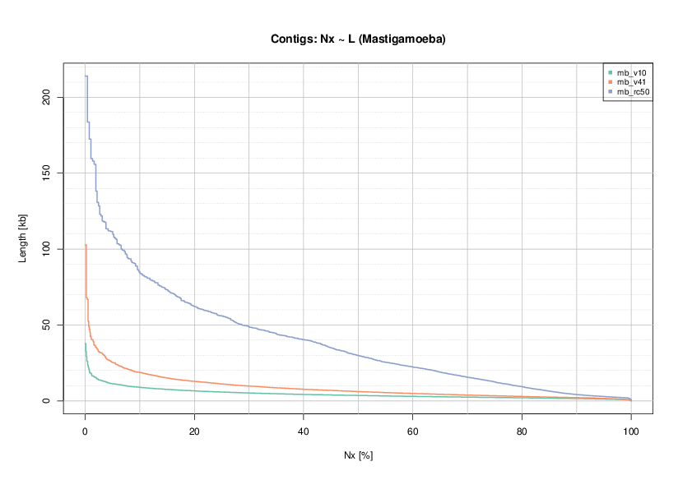
Contigs length evaluation

Slide 63
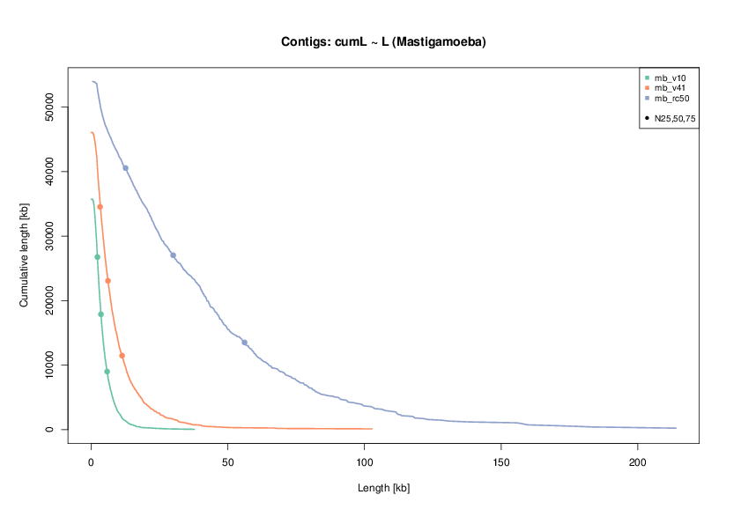
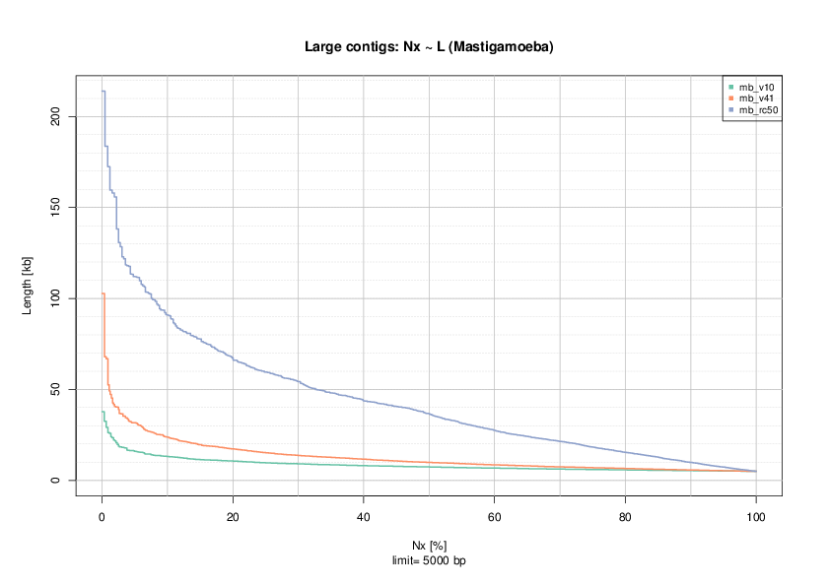

Slide 65
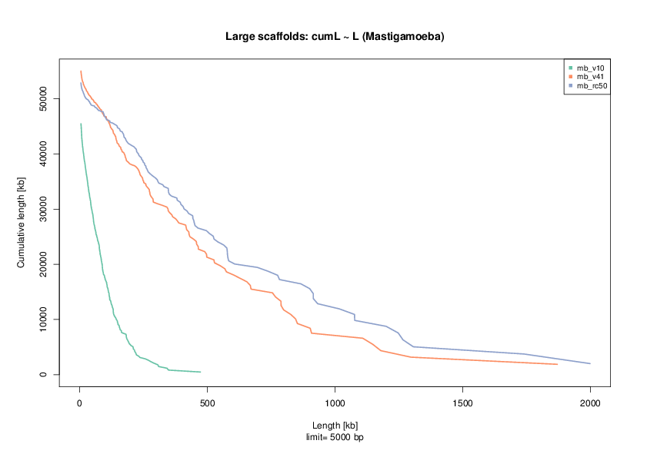
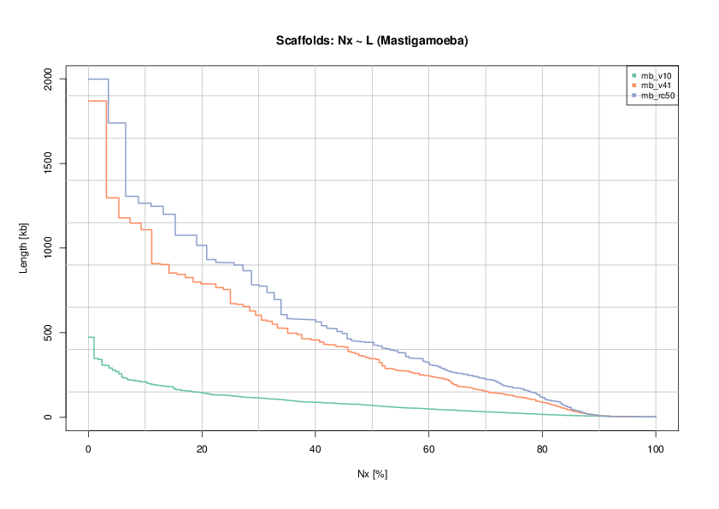
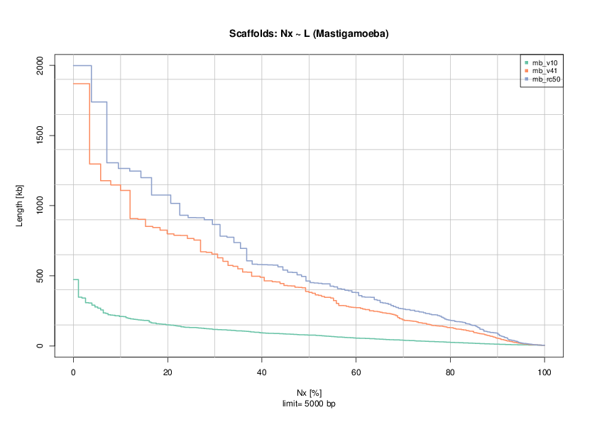

Slide 66
Initial sequencing
Estimated size: 50Mb
Sequencing data:
Abort seq:
Library preps:

