Slide 1
Enzyme inhibitor design
An extended case study

Slide 2
Overview
Introduction: Kynurenine Aminotransferase
The problem at hand
Molecular Design Logic
Structure based validation: Pharmacophores and Docking
Biological validation: a minefield
Wrapping up loose threads
Conclusion

Slide 3
Wim Dehaen
Researcher at UCT Prague
Currently: SBDD in P.Perlikova group (Medicinal chemistry of natural compound inspired scaffolds) + Cheminformatics at D.Svozil group (Department of Informatics and Chemistry)
Formerly: PhD with D.Svozil ("Virtual screening of organic ligands")
Formerly: MSc with B.U.W. Maes ("Synthesis of functionalized pyrido[1,2-e]purines via direct amination")
My interests:
CADD, LBDD, SBDD
Molecular Design
Cheminformatics
Medicinal chemistry
Organic chemistry
Digital signal processing
… and more

Slide 4
Michal Maryška
The main collaborator on this work
Molecular design and synthesis
Main topic of his PhD thesis

Slide 5
Introduction
Kynurenic acid ("KYNA"):
Kynurenine aminotransferase metabolizes conversion of kynurenine to KYNA
Agonist at several ionotropic glutamate receptors:
NMDA antagonist (other antagonists: Ketamine, PCP, high doses of ethanol)
AMPA agonist
Kainate receptor agonist
Elevated [KYNA] in CSF of schizophrenia patients
"Kynurenic acid hypothesis of schizophrenia"
Also: involved in HIV, Tick-Borne Encephalitis, ...

Slide 7
The Kynurenine pathway
Starts from L-tryptophan
Other pathways from Trp: serotonin, melatonin, DMT, THIQs, …
Three terminal products:
KYNA
Quinolinic acid (high conc in Alzheimers and Huntingtons Disease), NAD precursor
Picolinic acid (badly understood, neuroprotective)

Slide 9
Kynurenine aminotransferase
4 isoforms
KAT II is the most expressed in the CNS
Pyridoxal cofactor
KAT II inhibition decreases brain [KYNA] in rats
KAT II inhibitors known (mostly Pfizer series)
Several Xray structures available
Kynurenine bound (next slide)
Inhibitor bound

Slide 11
Known inhibitors
None in the clinic
Covalent vs Non-covalent
Pfizer series
PF-04859989
Covalent
Others:
Weak
Various issues:
CNS penetration
Synthesizability
Potency
ADME liabilities

Slide 12
Irreversible inhibitors
Reversible inhibitors

Slide 13
The problem at hand
Find a series of chemically novel KAT inhibitors with advantageous properties
Must be:
Realistic to synthesize
Covalent (technical reason due to assay)
CNS penetrant
Potent
Novel, structurally distinct chemotypes (IP)

Slide 14
The approach
Scaffold hopping to create novel chemotypes
Manual!
Pharmacophore analysis of known binders and their Xray structures
Manual!
Molecular docking to validate binding
Synthesizability assessment
Manual!
Re-iterate until successful

Slide 15
Molecular design logic
Pfizer PF-004859949 is the most potent compound but hydroxamate is problem
Amine is covalent attachment point to pyridoxal cofactor
Must be nucleophilic/able to form imine
Hydrogen bonding pattern around sidechain of kynurenine is major recognition point

Slide 16
Molecular recognition of PF004859949

Slide 17
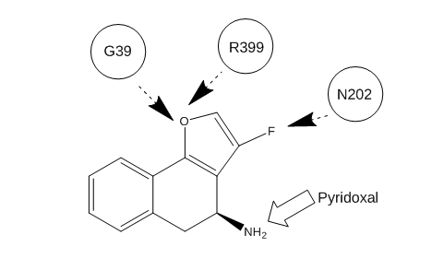
Initial ideas:
Heterocyclic isostere of PF

Slide 18
Initial idea
Flawed for several reasons:
F is very weak HBA
Hybridization of furan removes one lone pair!
Synthetically challenging

Slide 19
The molecule was never reached despite several attempts

Slide 20
New idea: "Bulk" virtual screening
Filter ZINC commercially available compounds using a "pharmacophore" (see previous slide)
Pharmit
3300 molecules remain
RMSD cutoff 662 remain (234 BM scaffolds)
I would not apply this filter today
Scoring by docking (see later)
Compounds were never purchased!

Slide 22
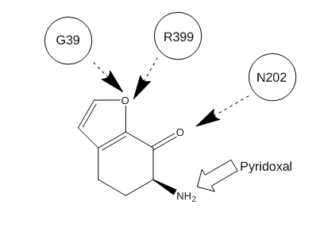
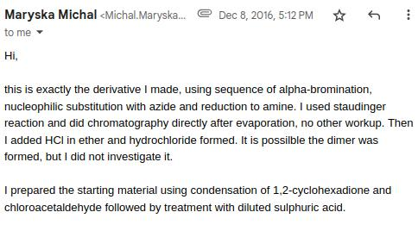
A new design iteration
Compounds need to be much easier to make
MM used Cathinone chemistry!

Slide 23
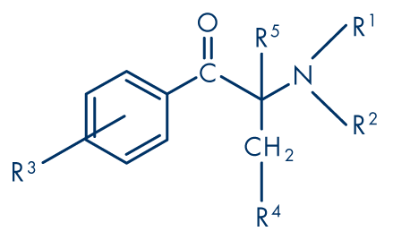
Cathinones?
Drugs of abuse of forensic interest
BAFA group has a lot of knowhow with these molecules because they are sold as MDMA type drugs

Slide 24
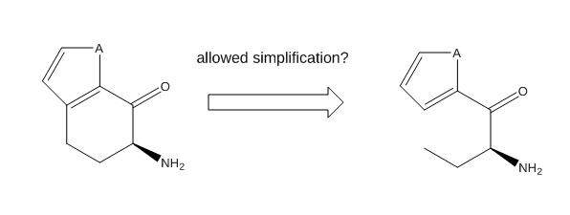
Ring-opened cathinones
Even closer to cathinones would be ring opened derivates
Enthalpic bonus due to better alignment of amine
Entropic penalty because of extra degrees of freedom
Major synthetic simplification allowing large scale synthesis

Slide 25
Building a pharmacophore
At that time, there were 7 pdb structures
Inhibitors in covalent complex with cofactor
This guided the design strictly (compounds MUST pass the ph4)
Built manually based on overlay using Molecular operating environment

Slide 26
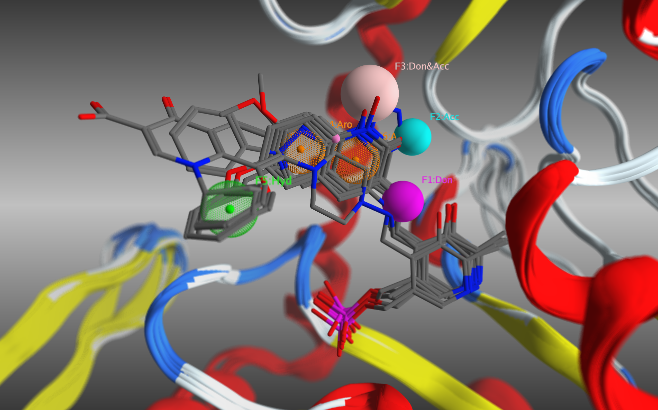

Slide 27
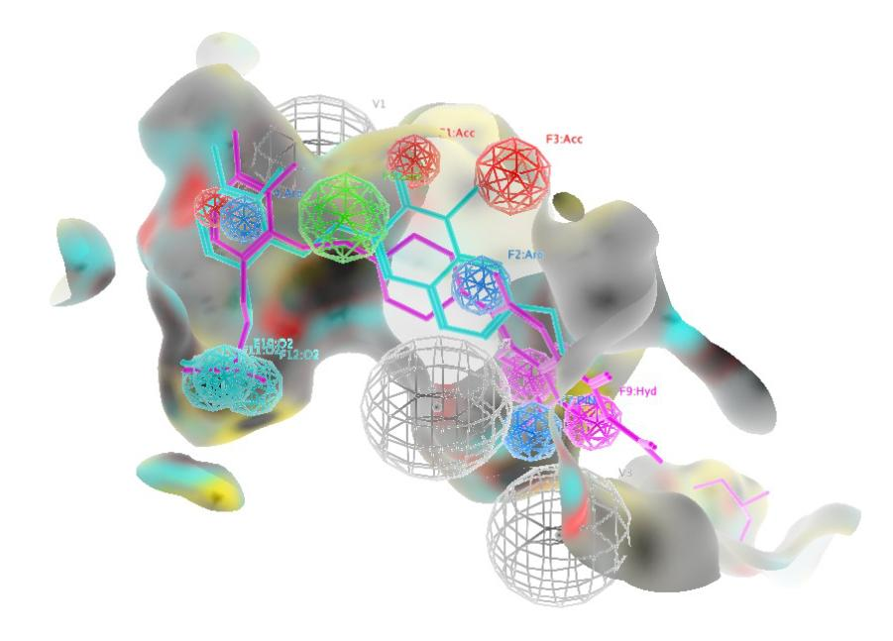
Pharmacophore including cofactor
Cofactor should be included because covalent complex may change geometry
Placement anchor
Required for molecular docking comparison to known complexes!

Slide 28
Molecular docking
Software: Molecular operating environment
Cofactor covalent complex
Created manually!
Standard conditions were used: Induced fit mode, MMFF94x, Triangle matcher placement, London dG initial scoring, GBVI/WSA dG refinement

Slide 29
Molecular docking
Goal is validation of pharmacophore based designs, not ranking
Bulk docking turned out to be useless
Later on, there is a complete ranking failure
Docking confirms these molecules fit the pharmacophore well
Docking is also a way to simply visualize our design hypothesis !

Slide 31
Biological assays
Pfizer developed an assay
Works only for irreversible inhibitors
Based on fluorescence of cofactor !
Collaborators were very slow to set up the assay
Poor organic chemist had to set it up himself

Slide 32
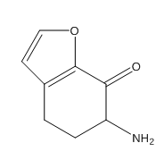
A lucky break
The first compound that was successfully prepared, turned out to be weakly active!
IC50 of about 100 uM
Very weak, but a hit on first try

Slide 33
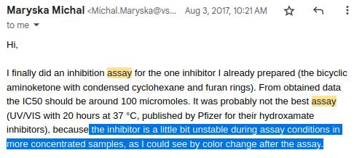
But: a complication

Slide 34
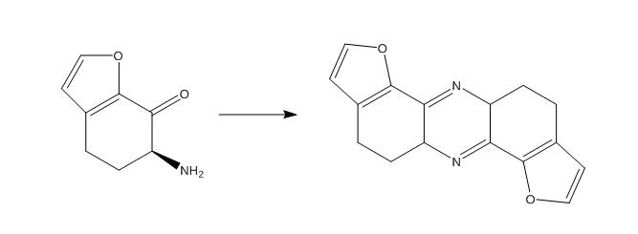
Compounds not stable under assay conditions
Is activity just an artefact?
More potent or more stable compounds needed

Slide 35
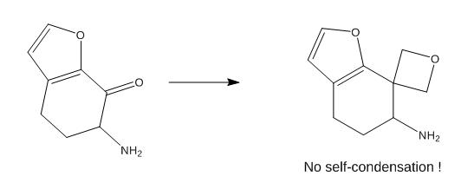
Increase stability
We found a solution for this later
Bioisostere oxetane
We did not include this in the paper
Requires relatively difficult chemistry
Work ongoing

Slide 36
Ring-opening the cathinones
The breakthrough:

Slide 37
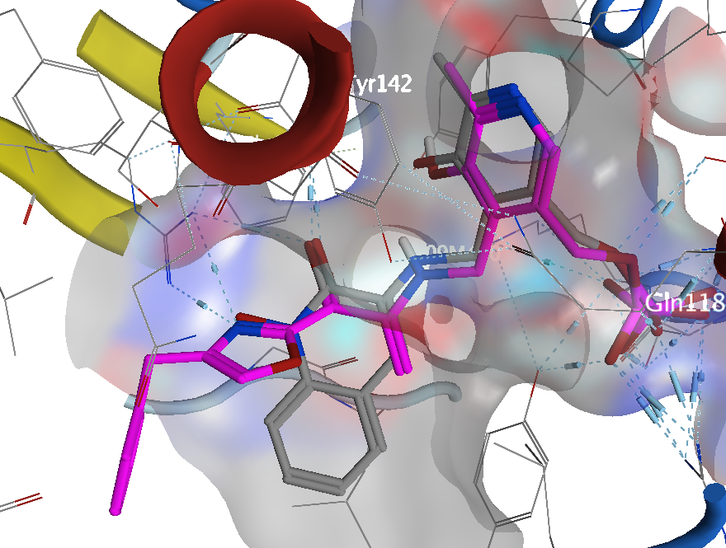
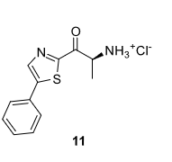
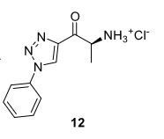
Ring-opening the cathinones
Around this time collaborators at HK set up the fluorimetric assays properly
Initial easy to make compounds:
2-alaninoyl-5-phenylthiazole
4-alaninoyl-1-phenyl-1H-1,2,3-triazole
Compounds were very active:
11: IC50 1.62
12: IC50 3.21

Slide 38
Molecular optimization
Compounds were chosen according to building blocks available for easy cathinone chemistry (~50 compounds)
Synthetic accessibility confirmed in practice!
They would all be made anyway so no priority for modelling
Post hoc docking showed ZERO correlation for ranking
Most were active: pharmacophore hypothesis confirmed

Slide 40
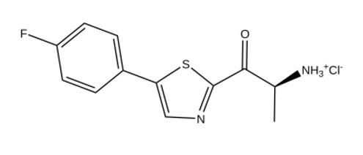
The most active compound
IC50 of 93 nM
One of the most potent known KAT inhibitors!
Very small molecule
Further optimization possible

Slide 41
The end?
Condensing results in a publishable form
Extreme rush
MM needed this complete his PhD
Strange question from reviewers
(next slides)

Slide 42
Tough reviewer:

Slide 43
Answers:
Docking is often a bad guidance for ranking
Pharmacophore modelling and docking actually confirmed the initial hit structure
SAR via commercially available compounds is a benefit, not disadvantage
Inhibitor is one of the most potent known
Scaffold is totally novel

Slide 44
Diplomacy:

Slide 45
Success:
This work was published as "Heterocyclic Cathinones as Inhibitors of Kynurenine Aminotransferase II—Design, Synthesis, and Evaluation " Pharmaceuticals 2021, 14(12), 1291
You can read all the details and all the synthetic chemistry there

Slide 46
The timeline
First conceptualization
September 2016
First compound synthesized
December 2016
First weakly active compound measured
August 2017
Conceptualization of active series
August 2018
Drafting of paper
July 2021
Paper published
December 2021

Slide 47
Take home message(s)
Use knowhow creatively (Cathinone synthesis experience of BAFA)
Know peculiarities of your target
Interdisciplinary collaborations take a long time (project ran 2016-2021)
Bulk virtual screening is senseless if you do not purchase compounds
Smart design is more important then large scale docking
Brute force medchem is a powerful optimization method

