Slide 1
Vývoj bioinformatického software pro diagnostické laboratoře
Ing. Petr Brož
CEO, Co-founder
www.bioxsys.cz
broz@bioxsys.cz
604799725

Slide 2
Presentation - 2022
FUNDING: This work was supported by Ministry of Health of the Czech Republic, grant nr. NU2007-00145. All rights reserved.
www.bioxsys.eu

Slide 3
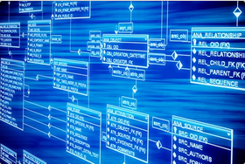
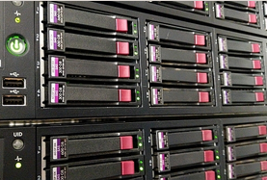
Introduction Bioxsys company
Application
Database
Bioinformatics
infrastructure
www.bioxsys.eu

Slide 4
Introduction Bioxsys company
Bioinformatics
services
Weekly courses
Online courses
www.bioxsys.eu

Slide 5
CZ Customers…
www.bioxsys.eu

Slide 6
Bioinformatická skupina SLG
www.bioxsys.eu

Slide 7
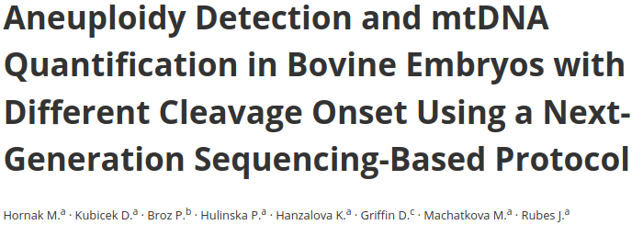
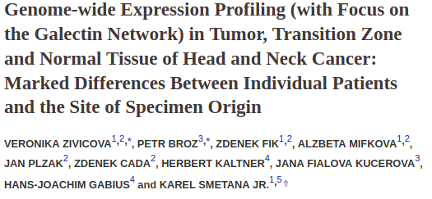
Life Science
www.bioxsys.eu

Slide 8
Software development
GENOVESA - NGS Cloud software
GLEX - LIMS
NEON - LIMS
VARAN - NGS Cloud platform
Genetify - microbiom NGS platform
COVID - NGS Cloud platform
www.bioxsys.eu

Slide 9
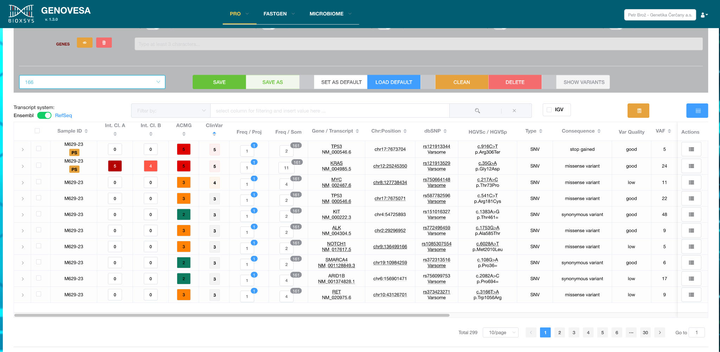
GENOVESA - NGS data analysis
www.bioxsys.eu

Slide 10
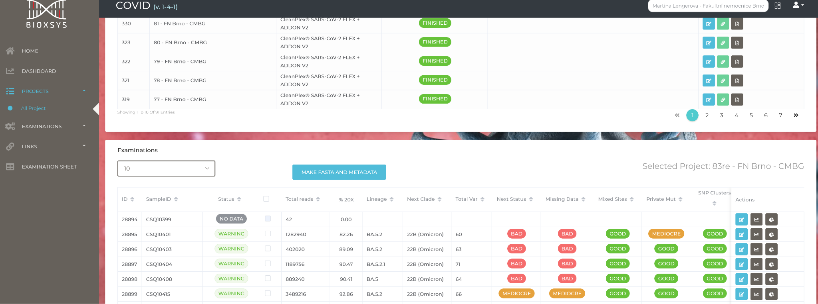
Cloud Aplikace COVID - NGS
www.bioxsys.eu

Slide 11
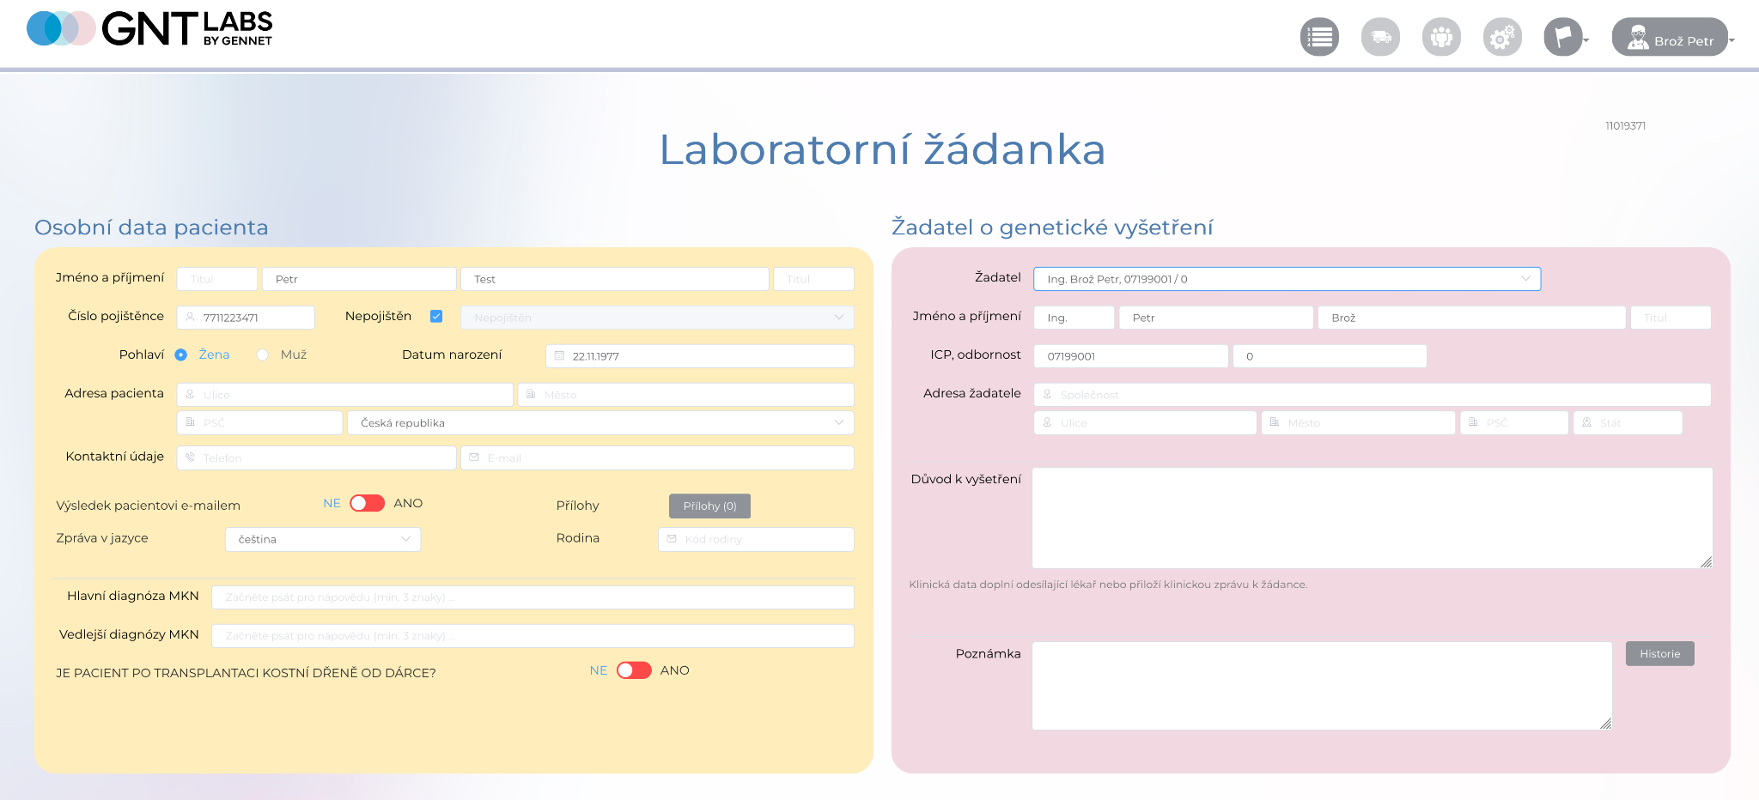
GENNET Laboratorní informační systém
www.bioxsys.eu

Slide 12
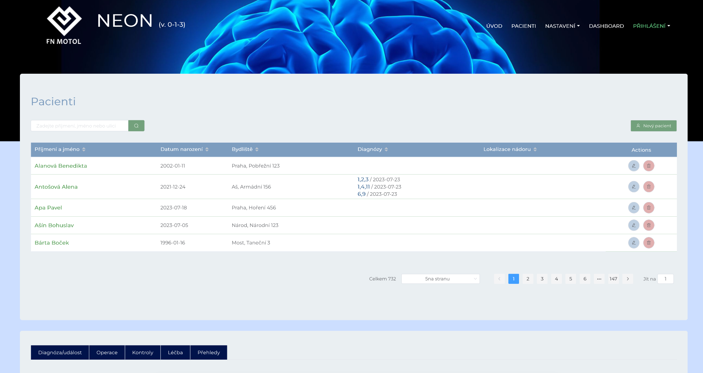
NEON - neurochirurgický laboratorní systém
www.bioxsys.eu

Slide 13
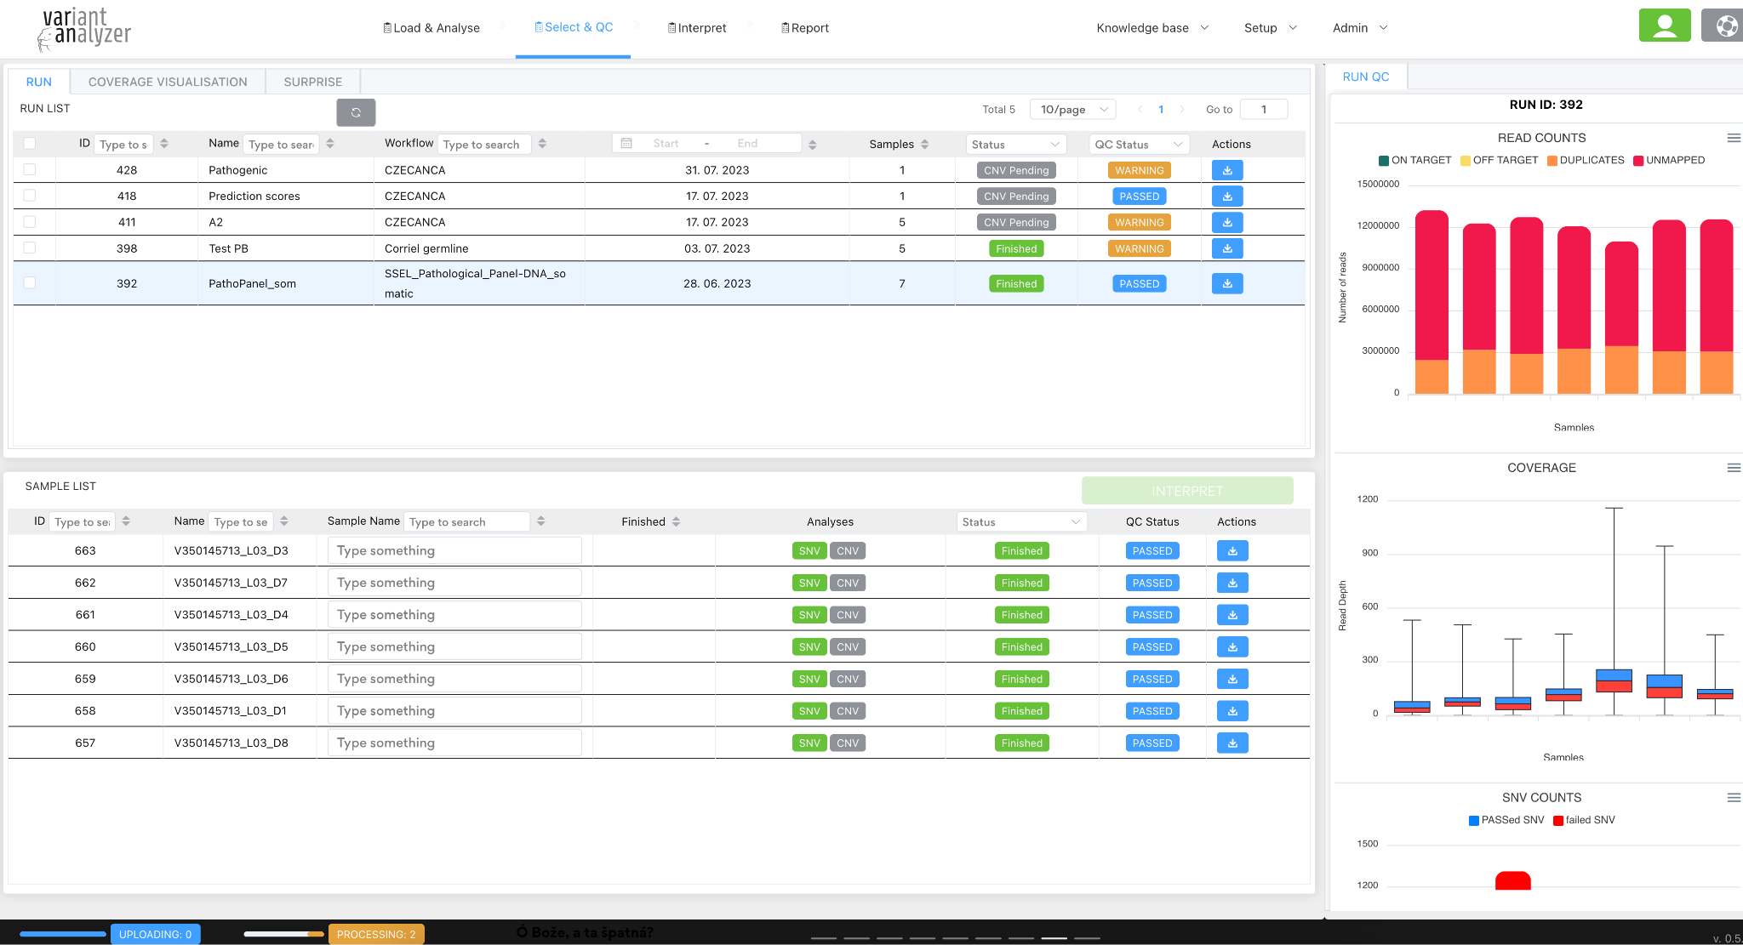
Varan - cloudová aplikace pro hodnocení NGS dat
www.bioxsys.eu

Slide 14
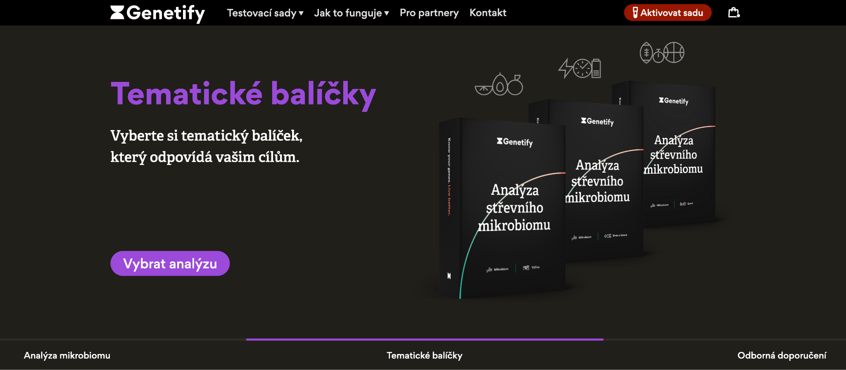
Genetify.me - Analýza mikrobiom
www.bioxsys.eu

Slide 15
What we need to develop commercial software?
The idea
Technology
Computation resources
Capacity resources
Persistence
www.bioxsys.eu

Slide 16
Technology
www.bioxsys.eu

Slide 17
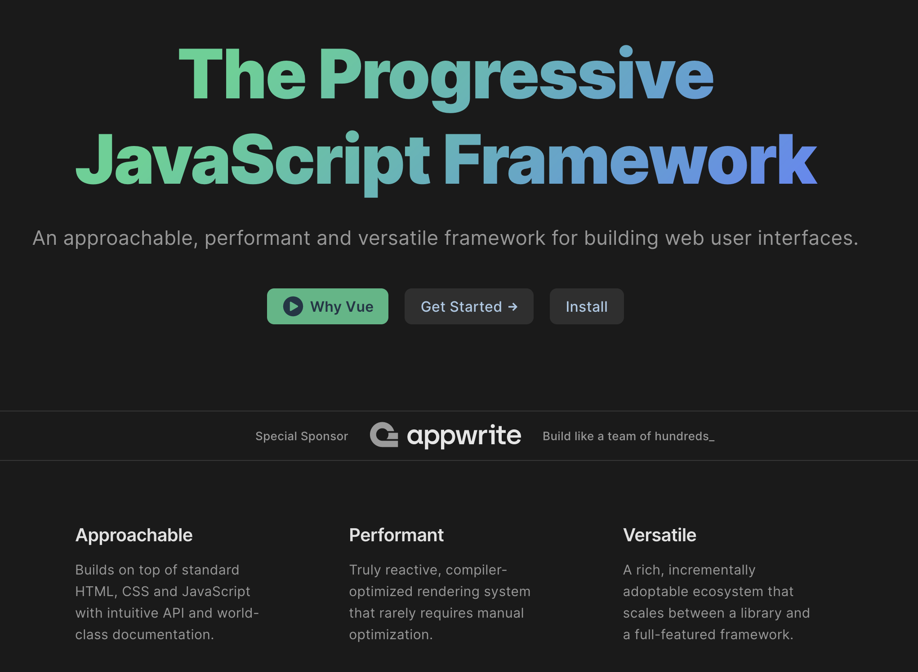
Vue.js
www.bioxsys.eu

Slide 18
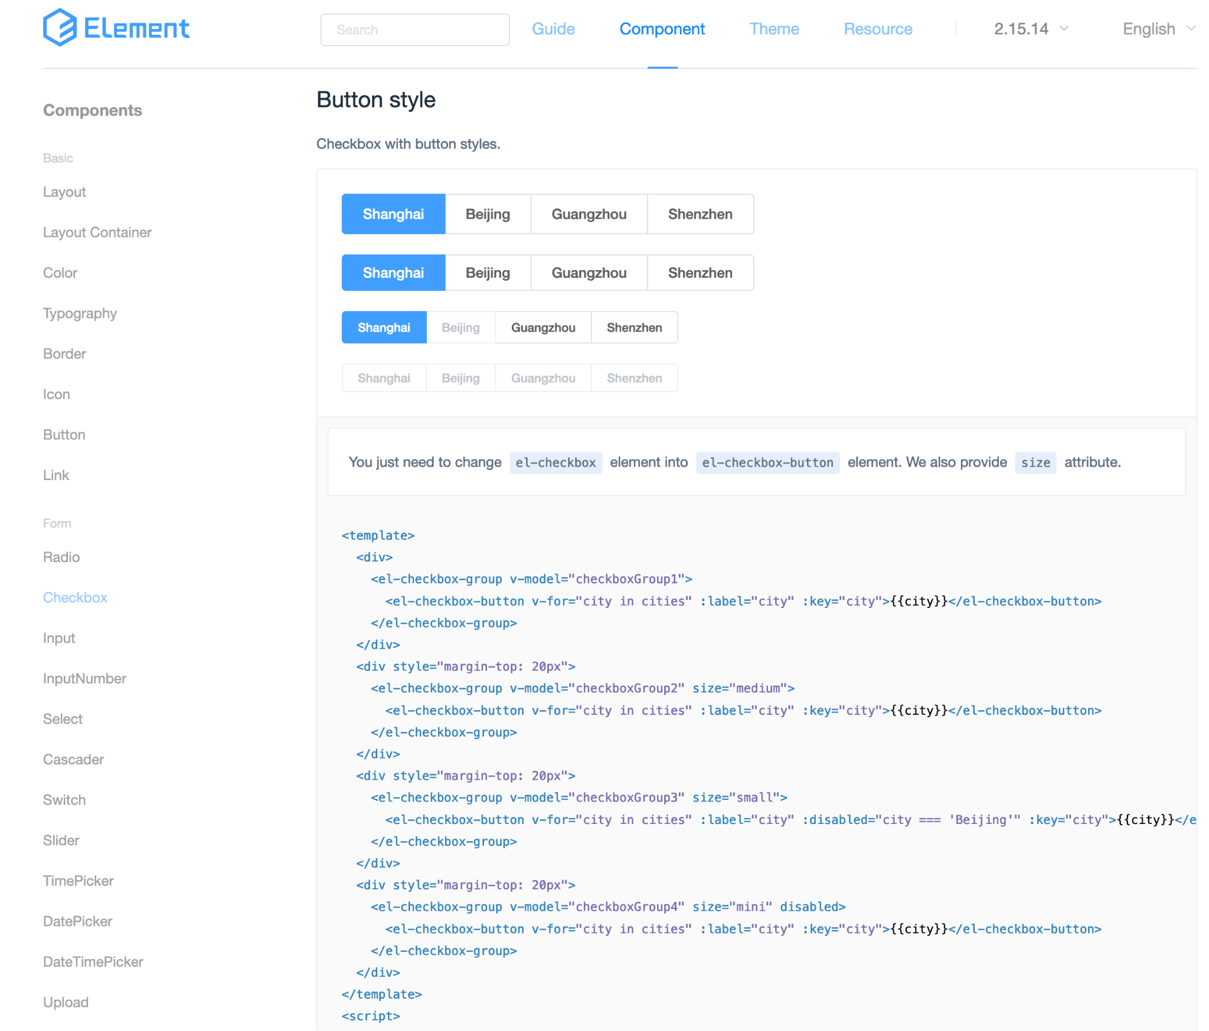
Element - Desktop UI Library
www.bioxsys.eu

Slide 19
Computational resources
Computational servers (> 20 TB RAM, 25 servers, 1U)
WEB servers
Database server
Mongo server (> 1 PB)
Clients servers
Training servers
www.bioxsys.eu

Slide 20
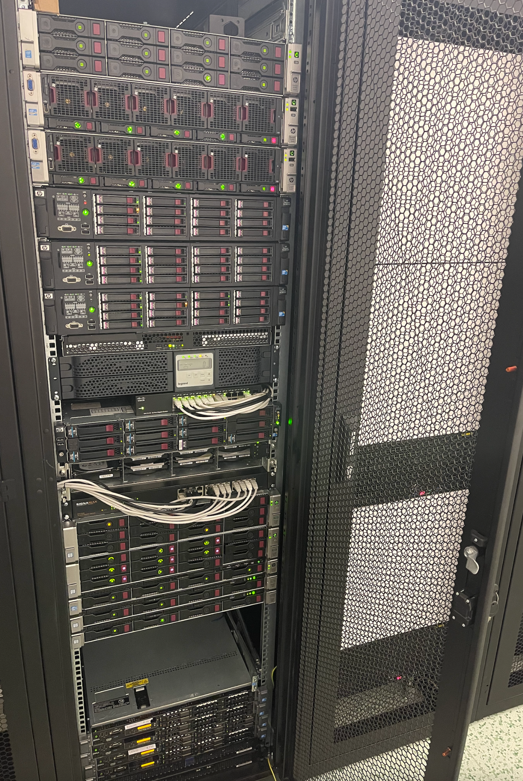
Computational resources
www.bioxsys.eu

Slide 21
Capacity resources
Bioinformatician
Back-end developer
Front-end developer
Database developer
Linux server admin
Network engineer
Application specialist
Sales representative
www.bioxsys.eu

Slide 22
Tools we using
IDE code editor (Sublime, Visual Studio Code)
Database - DataGrip, PgAdmin
GitLab
Redmine
Mongo Object Database - RoboMongo, Studio 3T
Freeform painter (FE developing)
OpenVPN
iTerm, Termius, Terminator
MacOS, Parallel Desktop, ZOOM
www.bioxsys.eu

Slide 23
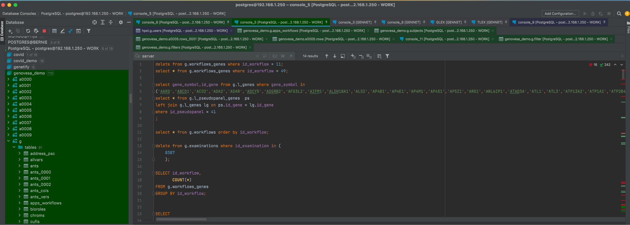
DataGrip
www.bioxsys.eu

Slide 24
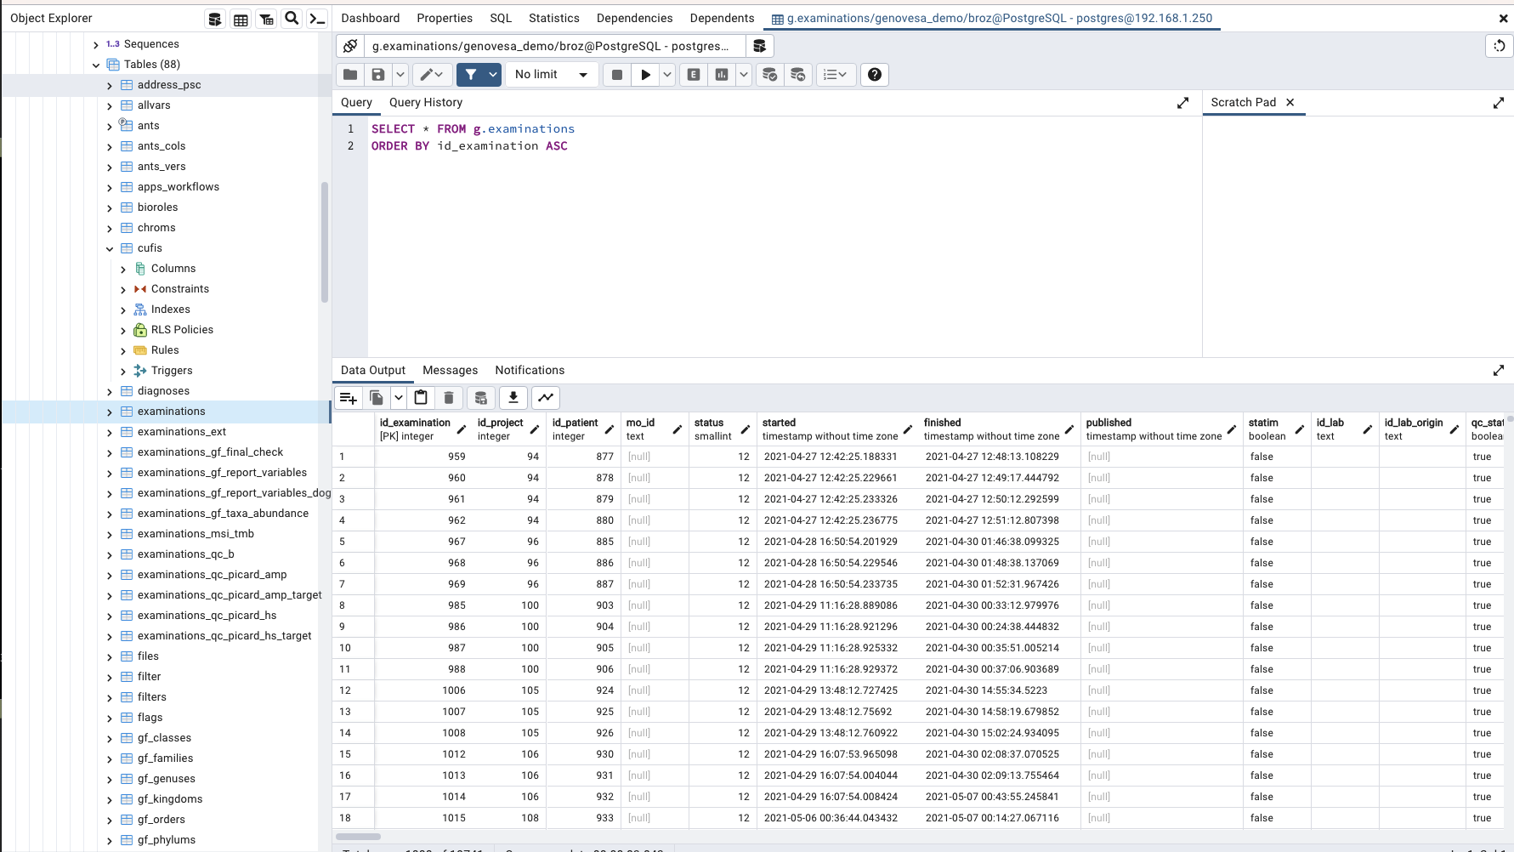
PgAdmin
www.bioxsys.eu

Slide 25
GitLab
Devel and Master Branch
Do commented commits
Never make changes on remote server(s)
www.bioxsys.eu

Slide 26
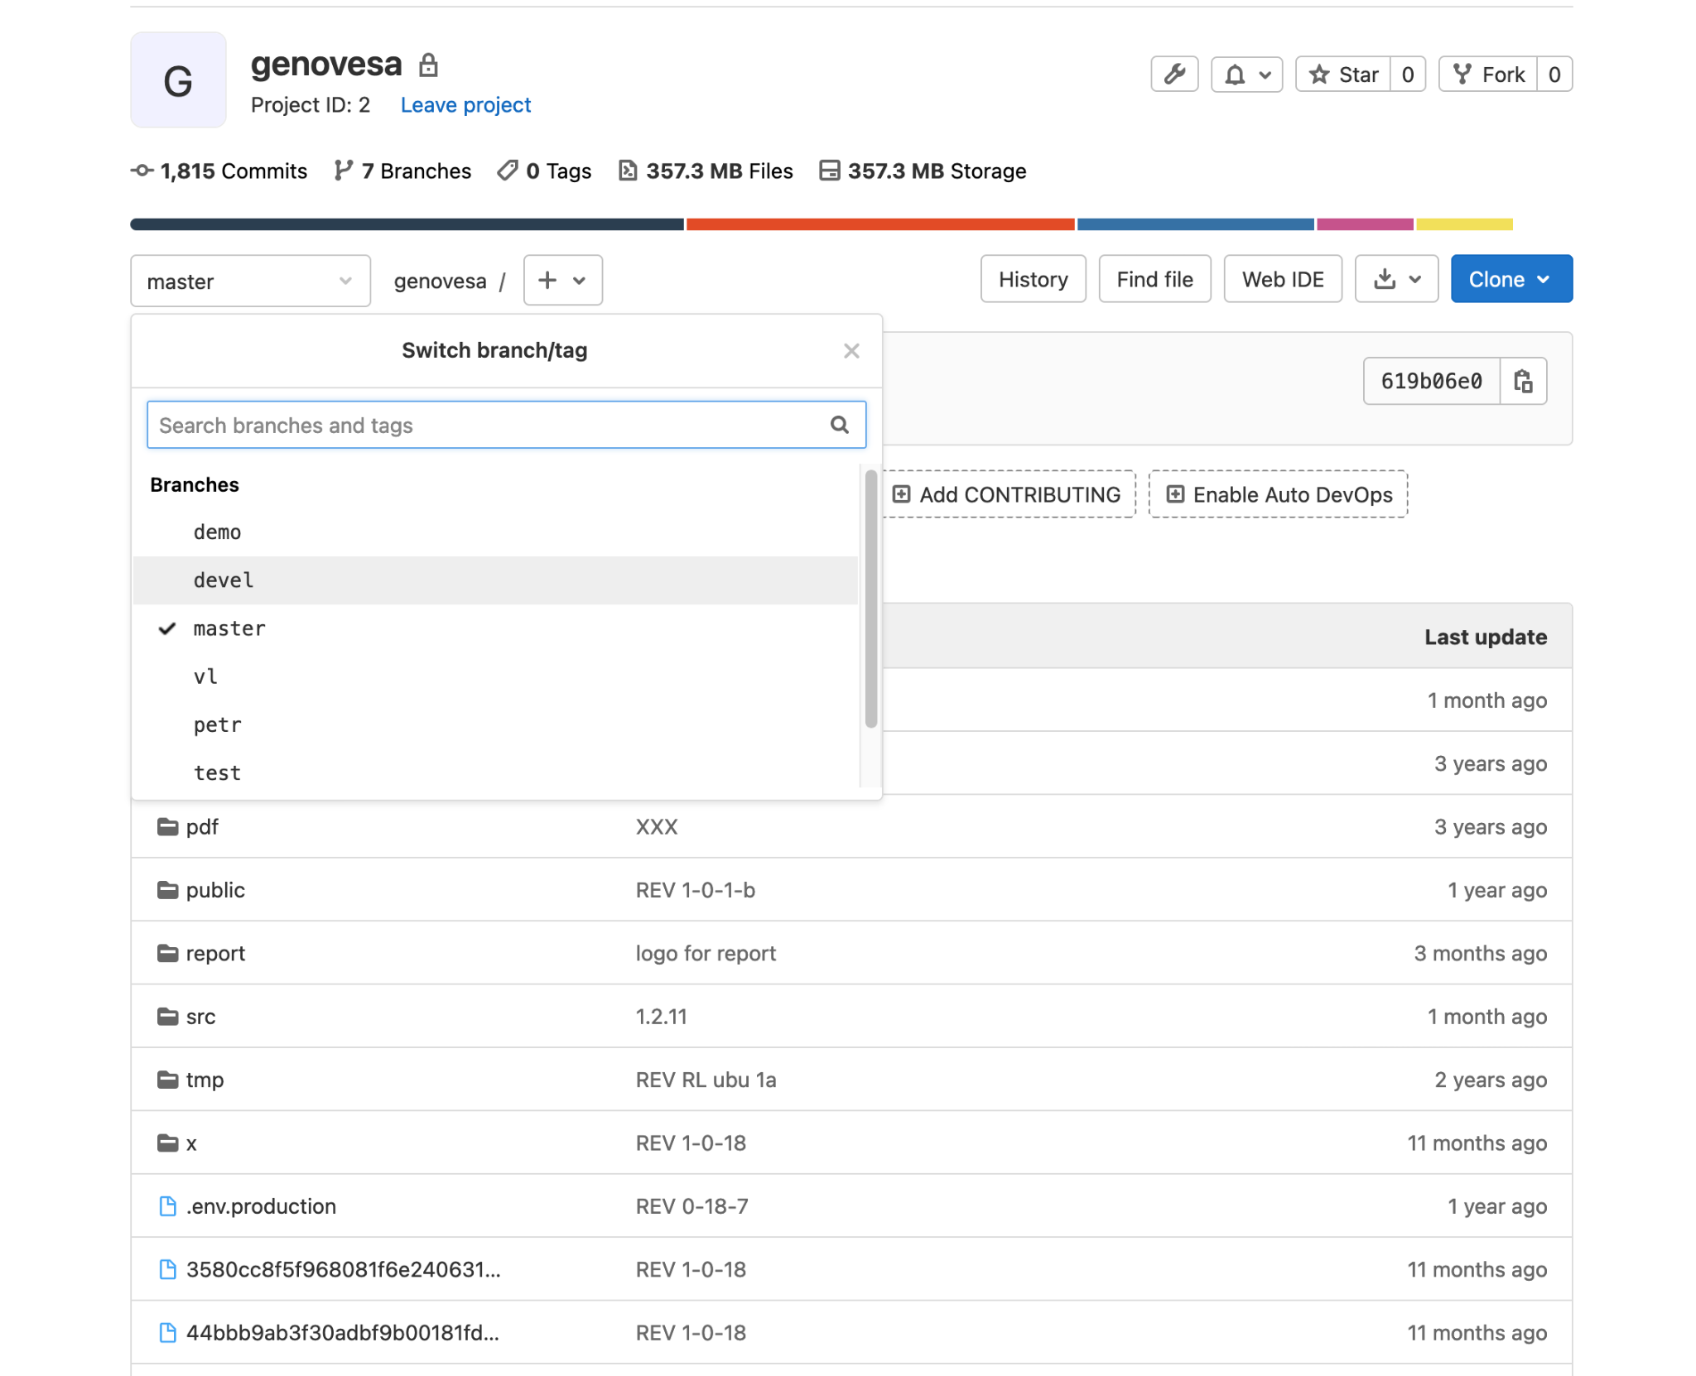
GitLab
www.bioxsys.eu

Slide 27
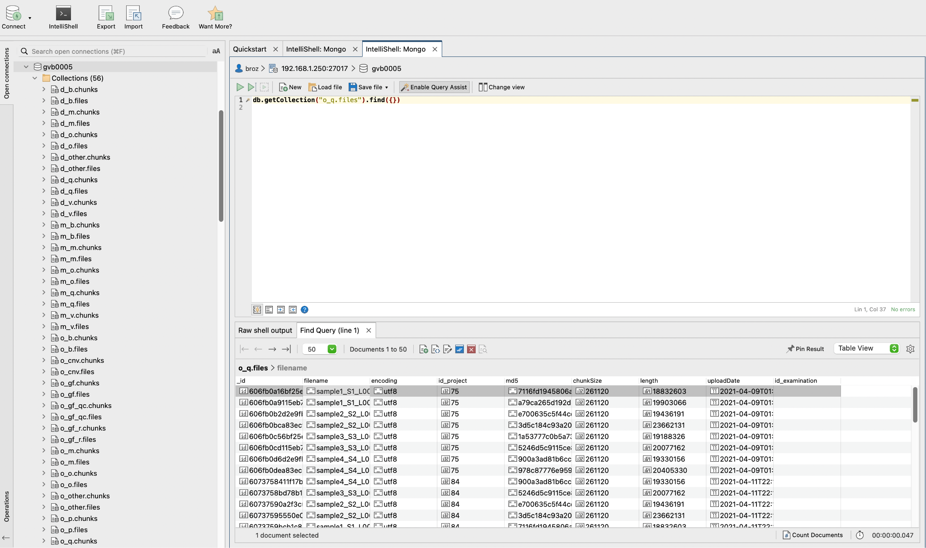
Studio 3T
www.bioxsys.eu

Slide 28
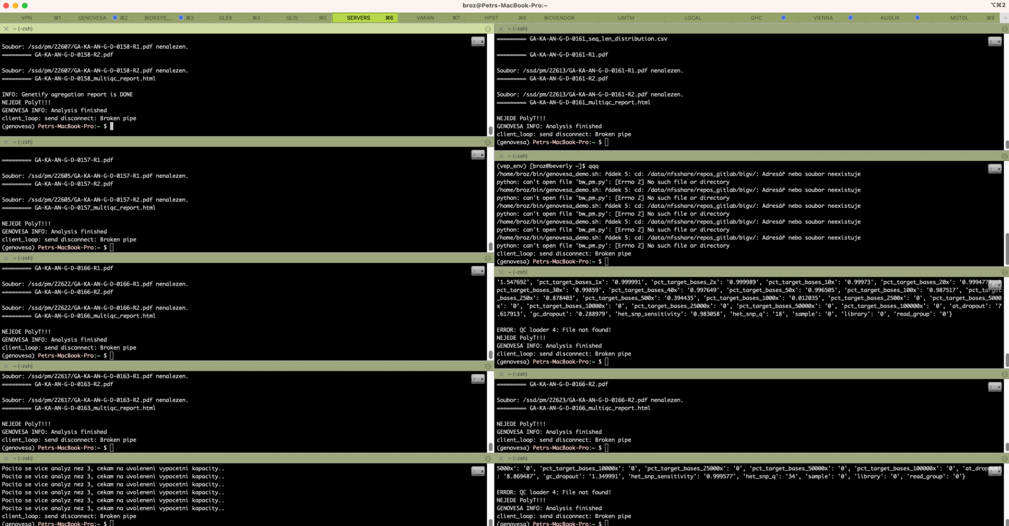
iTerm
www.bioxsys.eu

Slide 29
GENOVESA
SA
TA
DB
FI
RE
SH
Secondary Analysis
Tertiary Analysis
Database
Filtration
Report
Sharing
FASTQ processing and analysis
VCF annotation
Object and Relational Database
Data filtration + add metadata
Reporting variants + sign out samples
Interpretation sharing
www.bioxsys.eu

Slide 30
SA
TA
DB
FI
RE
SH
Secondary
Analysis
Tertiary Analysis
Database
Filtration
Report
Sharing
GENOVESA
No third party cloud computing
Data stored in CZ
ISO 27001 Security
ISO 27018 Cloud services
TISAX Security data transfer
GDPR ready
Cyber security
IVD-R (2024)
Secure layer
www.bioxsys.eu
Notes:
Dulezite kratce predstavit GENOVESU jako Cloudovy bioifnormaticky software, kde vsechna bioinformatikca data jsou ulozena v CR, nepouzivame zadny komercni vypocetni server jako google ci amazon.

Slide 31
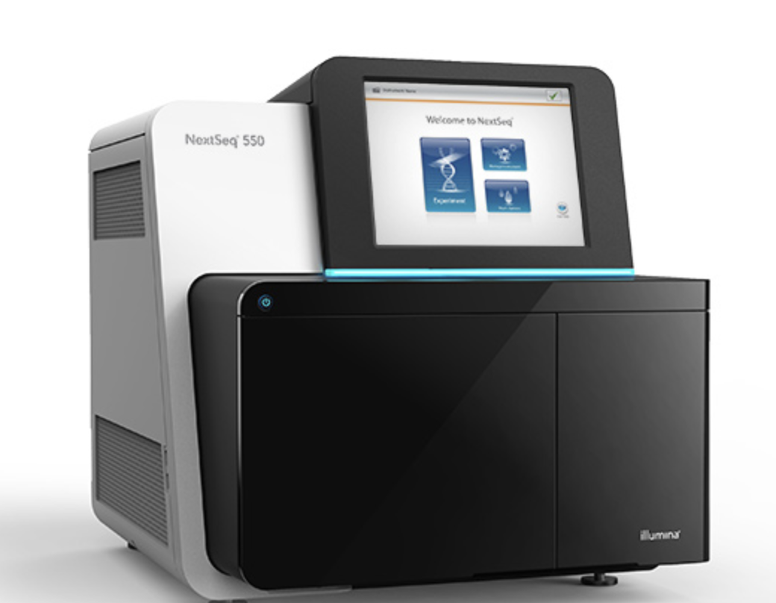
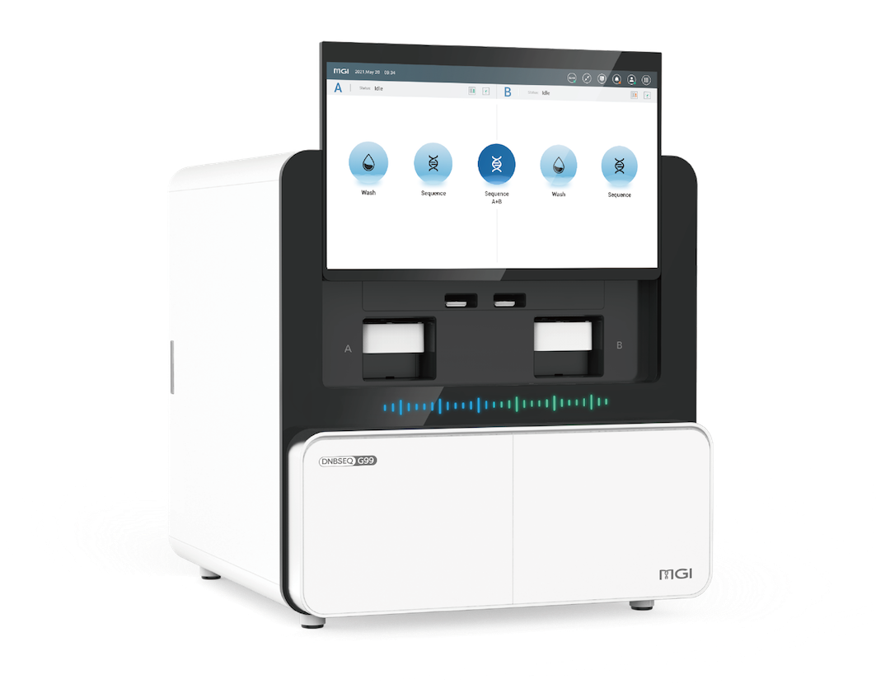
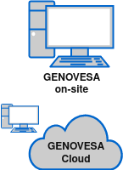
SA
TA
DB
FI
RE
SH
Secondary
Analysis
Tertiary Analysis
Database
Filtration
Report
Sharing
Secondary Analysis
FASTQ
VCF or data migration
Tailored workflow
Your custom workflow
www.bioxsys.eu
Notes:
FASQT predefinovane workflow - germinalni, somaticke, UMI, Sekvenacni technologie (illumina, MGI…), MSI, TMB, CNV, genotypizace, RNA-fuze, PolyT analyza..

Slide 32
SA
TA
DB
FI
RE
SH
Secondary
Analysis
Tertiary Analysis
Database
Filtration
Report
Sharing
Tertiary Analysis
Ensembl, Refseq - MANE Project
SOMATIC - CNV, TMB, MSI, RNA-seq, RNA fusion…
GERMLINE - CNV, Split reads, SNV, Genotyping, PolyT…
Annotation Databases, transcript prioritization
ACMG
www.bioxsys.eu
Notes:
Tri typy dat jako upload: FASTQ,

Slide 33
SA
TA
DB
FI
RE
SH
Secondary
Analysis
Tertiary Analysis
Database
Filtration
Report
Sharing
Database - why we need?
Storing big data - backup
Relational database - normalisation, good performance
Statistics / Filtration
Pseudo-panels
Sharing
Version of annotation databases
…
www.bioxsys.eu
Notes:
Spravne normalizovane a relacne ulozene sekvenacni data muze

Slide 34
SA
TA
DB
FI
RE
SH
Secondary
Analysis
Tertiary Analysis
Database
Filtration
Report
Sharing
Database
Workflow 1
GLOBAL VARIANTS
Diagnostic clinic 1
SOMATIC
workflow N
Diagnostic clinic 2
Diagnostic clinic 3
workflow 1
Diagnostic clinic N
GERMLINE
workflow N
www.bioxsys.eu
Notes:
Popis globalni ciselnik - schema pro subjekty (ma svou vlastni databazi), ktera se da kdykoliv exportovat, popripade importovat z externich software

Slide 35
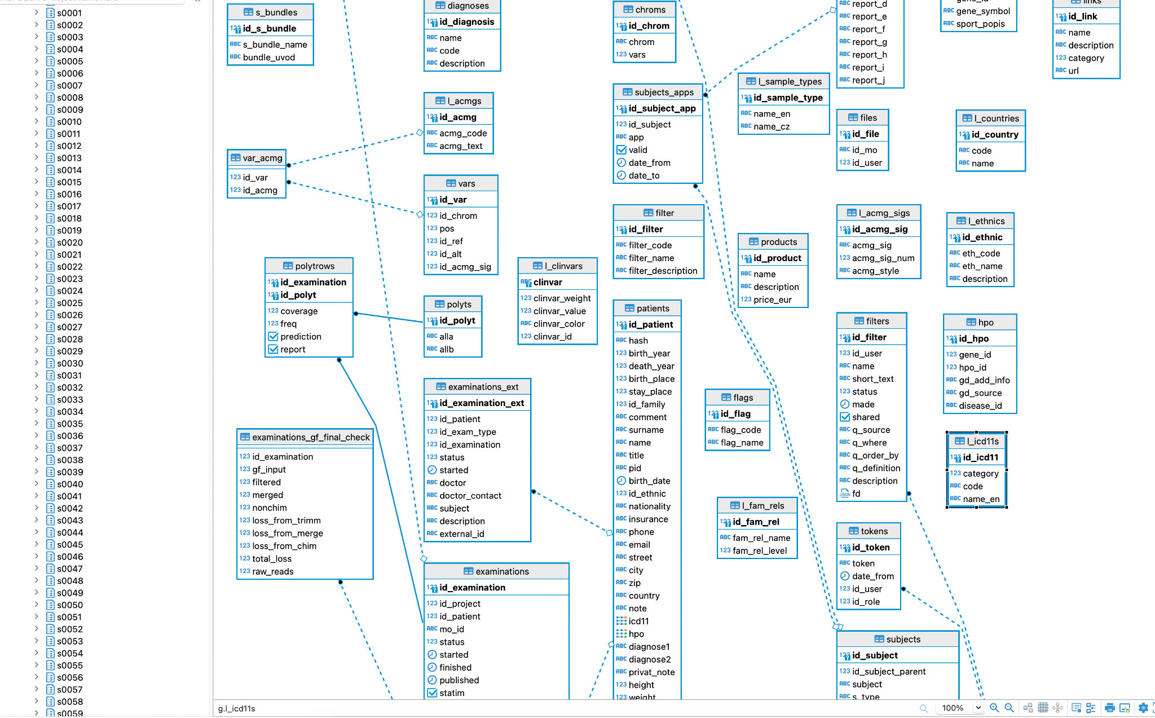
SA
TA
DB
FI
RE
SH
Secondary
Analysis
Tertiary Analysis
Database
Filtration
Report
Sharing
Database
www.bioxsys.eu
Notes:
Popis globalni ciselnik - schema pro subjekty (ma svou vlastni databazi), ktera se da kdykoliv exportovat, popripade importovat z externich software

Slide 36
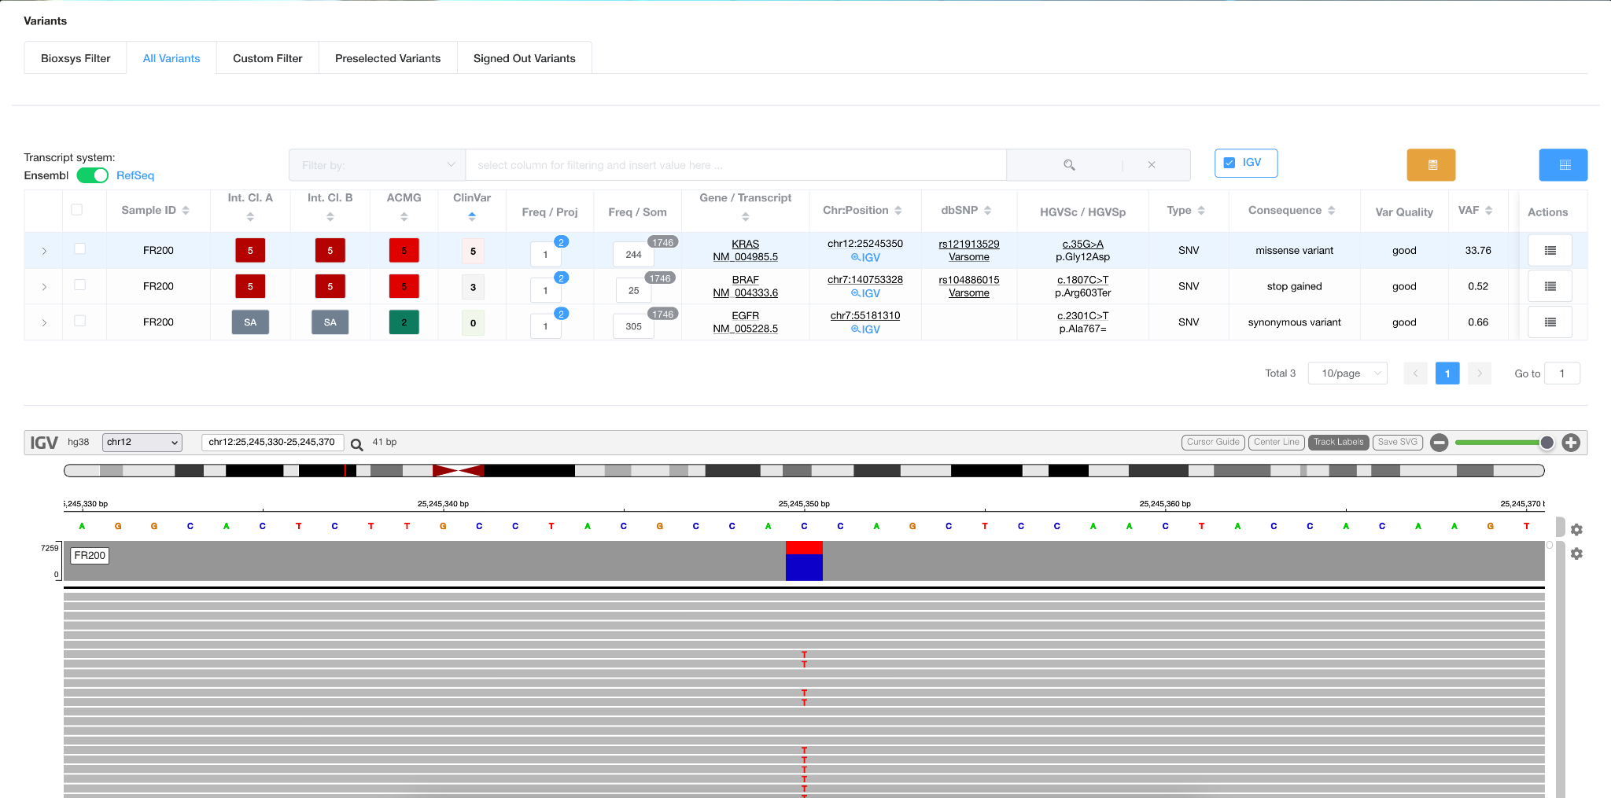
SA
TA
DB
FI
RE
SH
Secondary
Analysis
Tertiary Analysis
Database
Filtration
Report
Sharing
Database
www.bioxsys.eu
Notes:
Popis globalni ciselnik - schema pro subjekty (ma svou vlastni databazi), ktera se da kdykoliv exportovat, popripade importovat z externich software

Slide 37
SA
TA
DB
FI
RE
SH
Secondary
Analysis
Tertiary Analysis
Database
Filtration
Report
Sharing
Database Query
What statistics do you need?
Create Database Query
Create graphical interface (buttons)
Get result
www.bioxsys.eu
Notes:
Tri typy dat jako upload: FASTQ,

Slide 38
SA
TA
DB
FI
RE
SH
Secondary
Analysis
Tertiary Analysis
Database
Filtration
Report
Sharing
Database Query - EXAMPLE 1
Detail statistics about Samples sharing the same variants in:
Current Project
All Projects (based on workflows common variants in Clinic Database)
www.bioxsys.eu
Notes:
Tri typy dat jako upload: FASTQ,

Slide 39
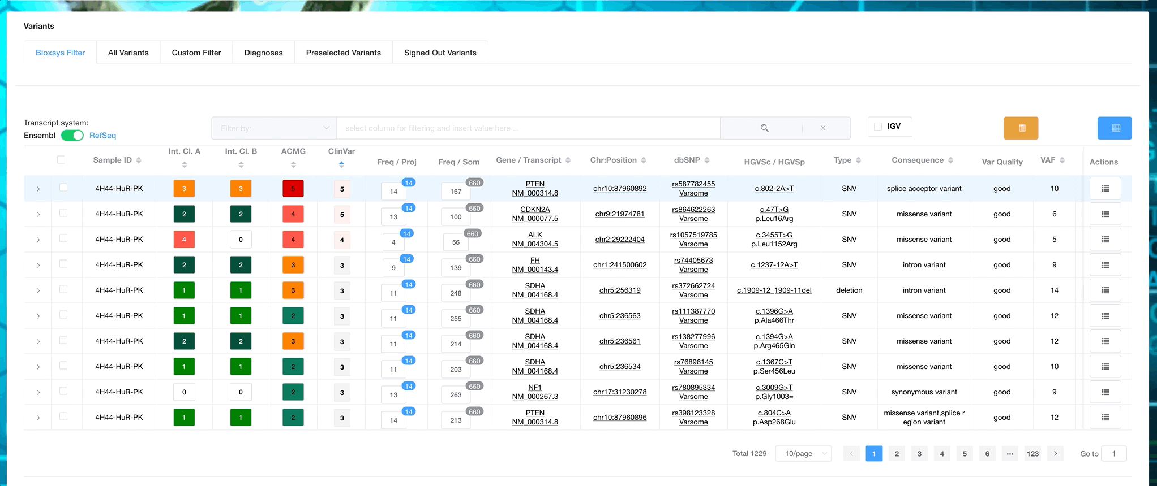
SA
TA
DB
FI
RE
SH
Secondary
Analysis
Tertiary Analysis
Database
Filtration
Report
Sharing
Database Query - EXAMPLE 1
www.bioxsys.eu
Notes:
Tri typy dat jako upload: FASTQ,

Slide 40
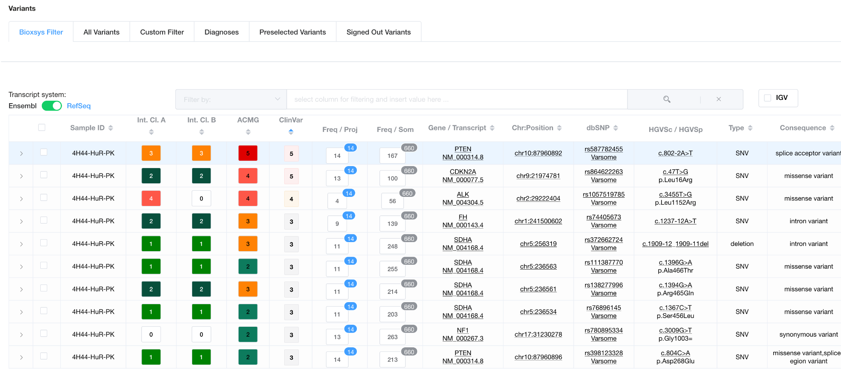
SA
TA
DB
FI
RE
SH
Secondary
Analysis
Tertiary Analysis
Database
Filtration
Report
Sharing
Database Query - EXAMPLE 1
www.bioxsys.eu
Notes:
Tri typy dat jako upload: FASTQ,

Slide 41
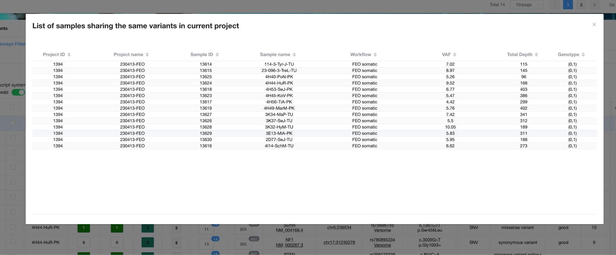
SA
TA
DB
FI
RE
SH
Secondary
Analysis
Tertiary Analysis
Database
Filtration
Report
Sharing
Database Query - EXAMPLE 1
www.bioxsys.eu
Notes:
Tri typy dat jako upload: FASTQ,

Slide 42
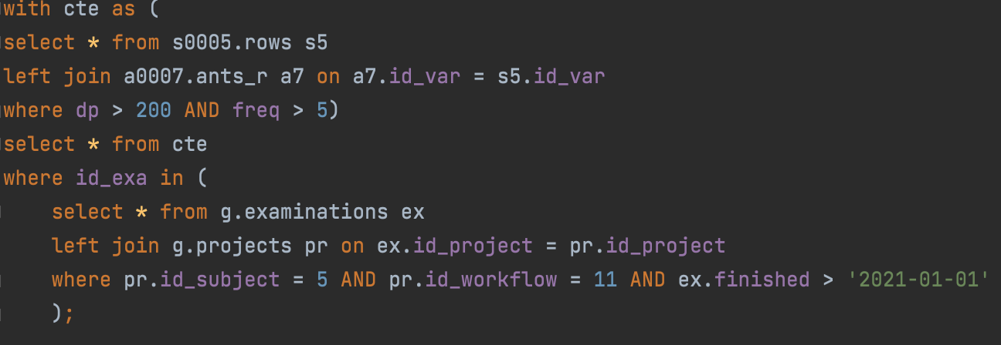
SA
TA
DB
FI
RE
SH
Secondary
Analysis
Tertiary Analysis
Database
Filtration
Report
Sharing
Database Query - EXAMPLE 2
All patients who has:
KRAS mutation c.35G>A (or rs121913529)
Signed out
VAF > 5%
Read of Depth > 200X
Date > 2021-01-01
Internal comment
www.bioxsys.eu
Notes:
Tri typy dat jako upload: FASTQ,

Slide 43
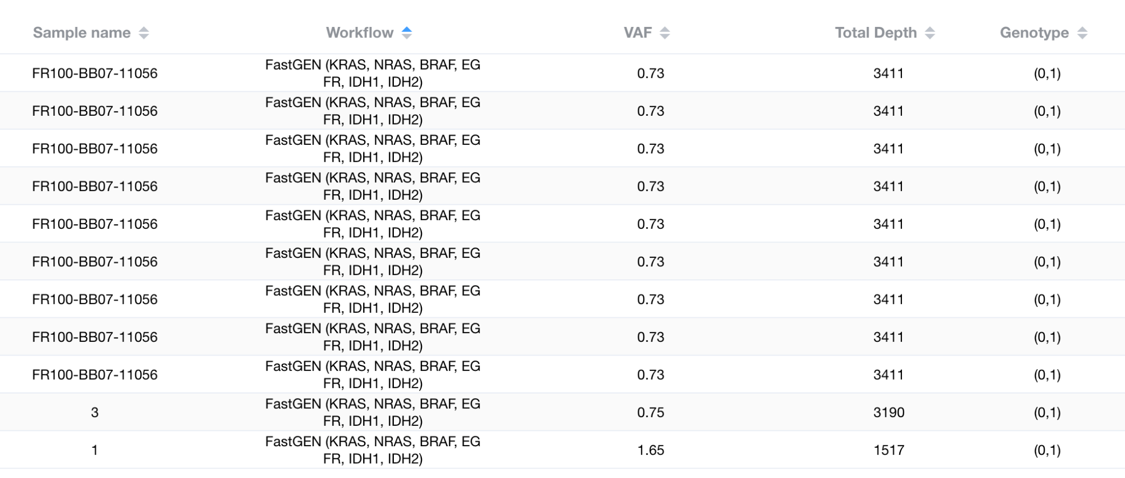
SA
TA
DB
FI
RE
SH
Secondary
Analysis
Tertiary Analysis
Database
Filtration
Report
Sharing
Database Query - EXAMPLE 2
All patients who has:
KRAS mutation c.35G>A (or rs121913529)
Signed out
VAF > 5%
Read of Depth > 200X
Date > 2021-01-01
Internal comment
www.bioxsys.eu
Notes:
Tri typy dat jako upload: FASTQ,

Slide 44
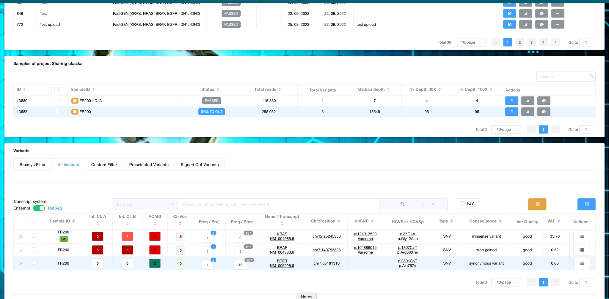
SA
TA
DB
FI
RE
SH
Secondary
Analysis
Tertiary Analysis
Database
Filtration
Report
Sharing
Report
www.bioxsys.eu
Notes:
Tri typy dat jako upload: FASTQ,

Slide 45
SA
TA
DB
FI
RE
SH
Secondary
Analysis
Tertiary Analysis
Database
Filtration
Report
Sharing
Report
www.bioxsys.eu
Notes:
Tri typy dat jako upload: FASTQ,

Slide 46
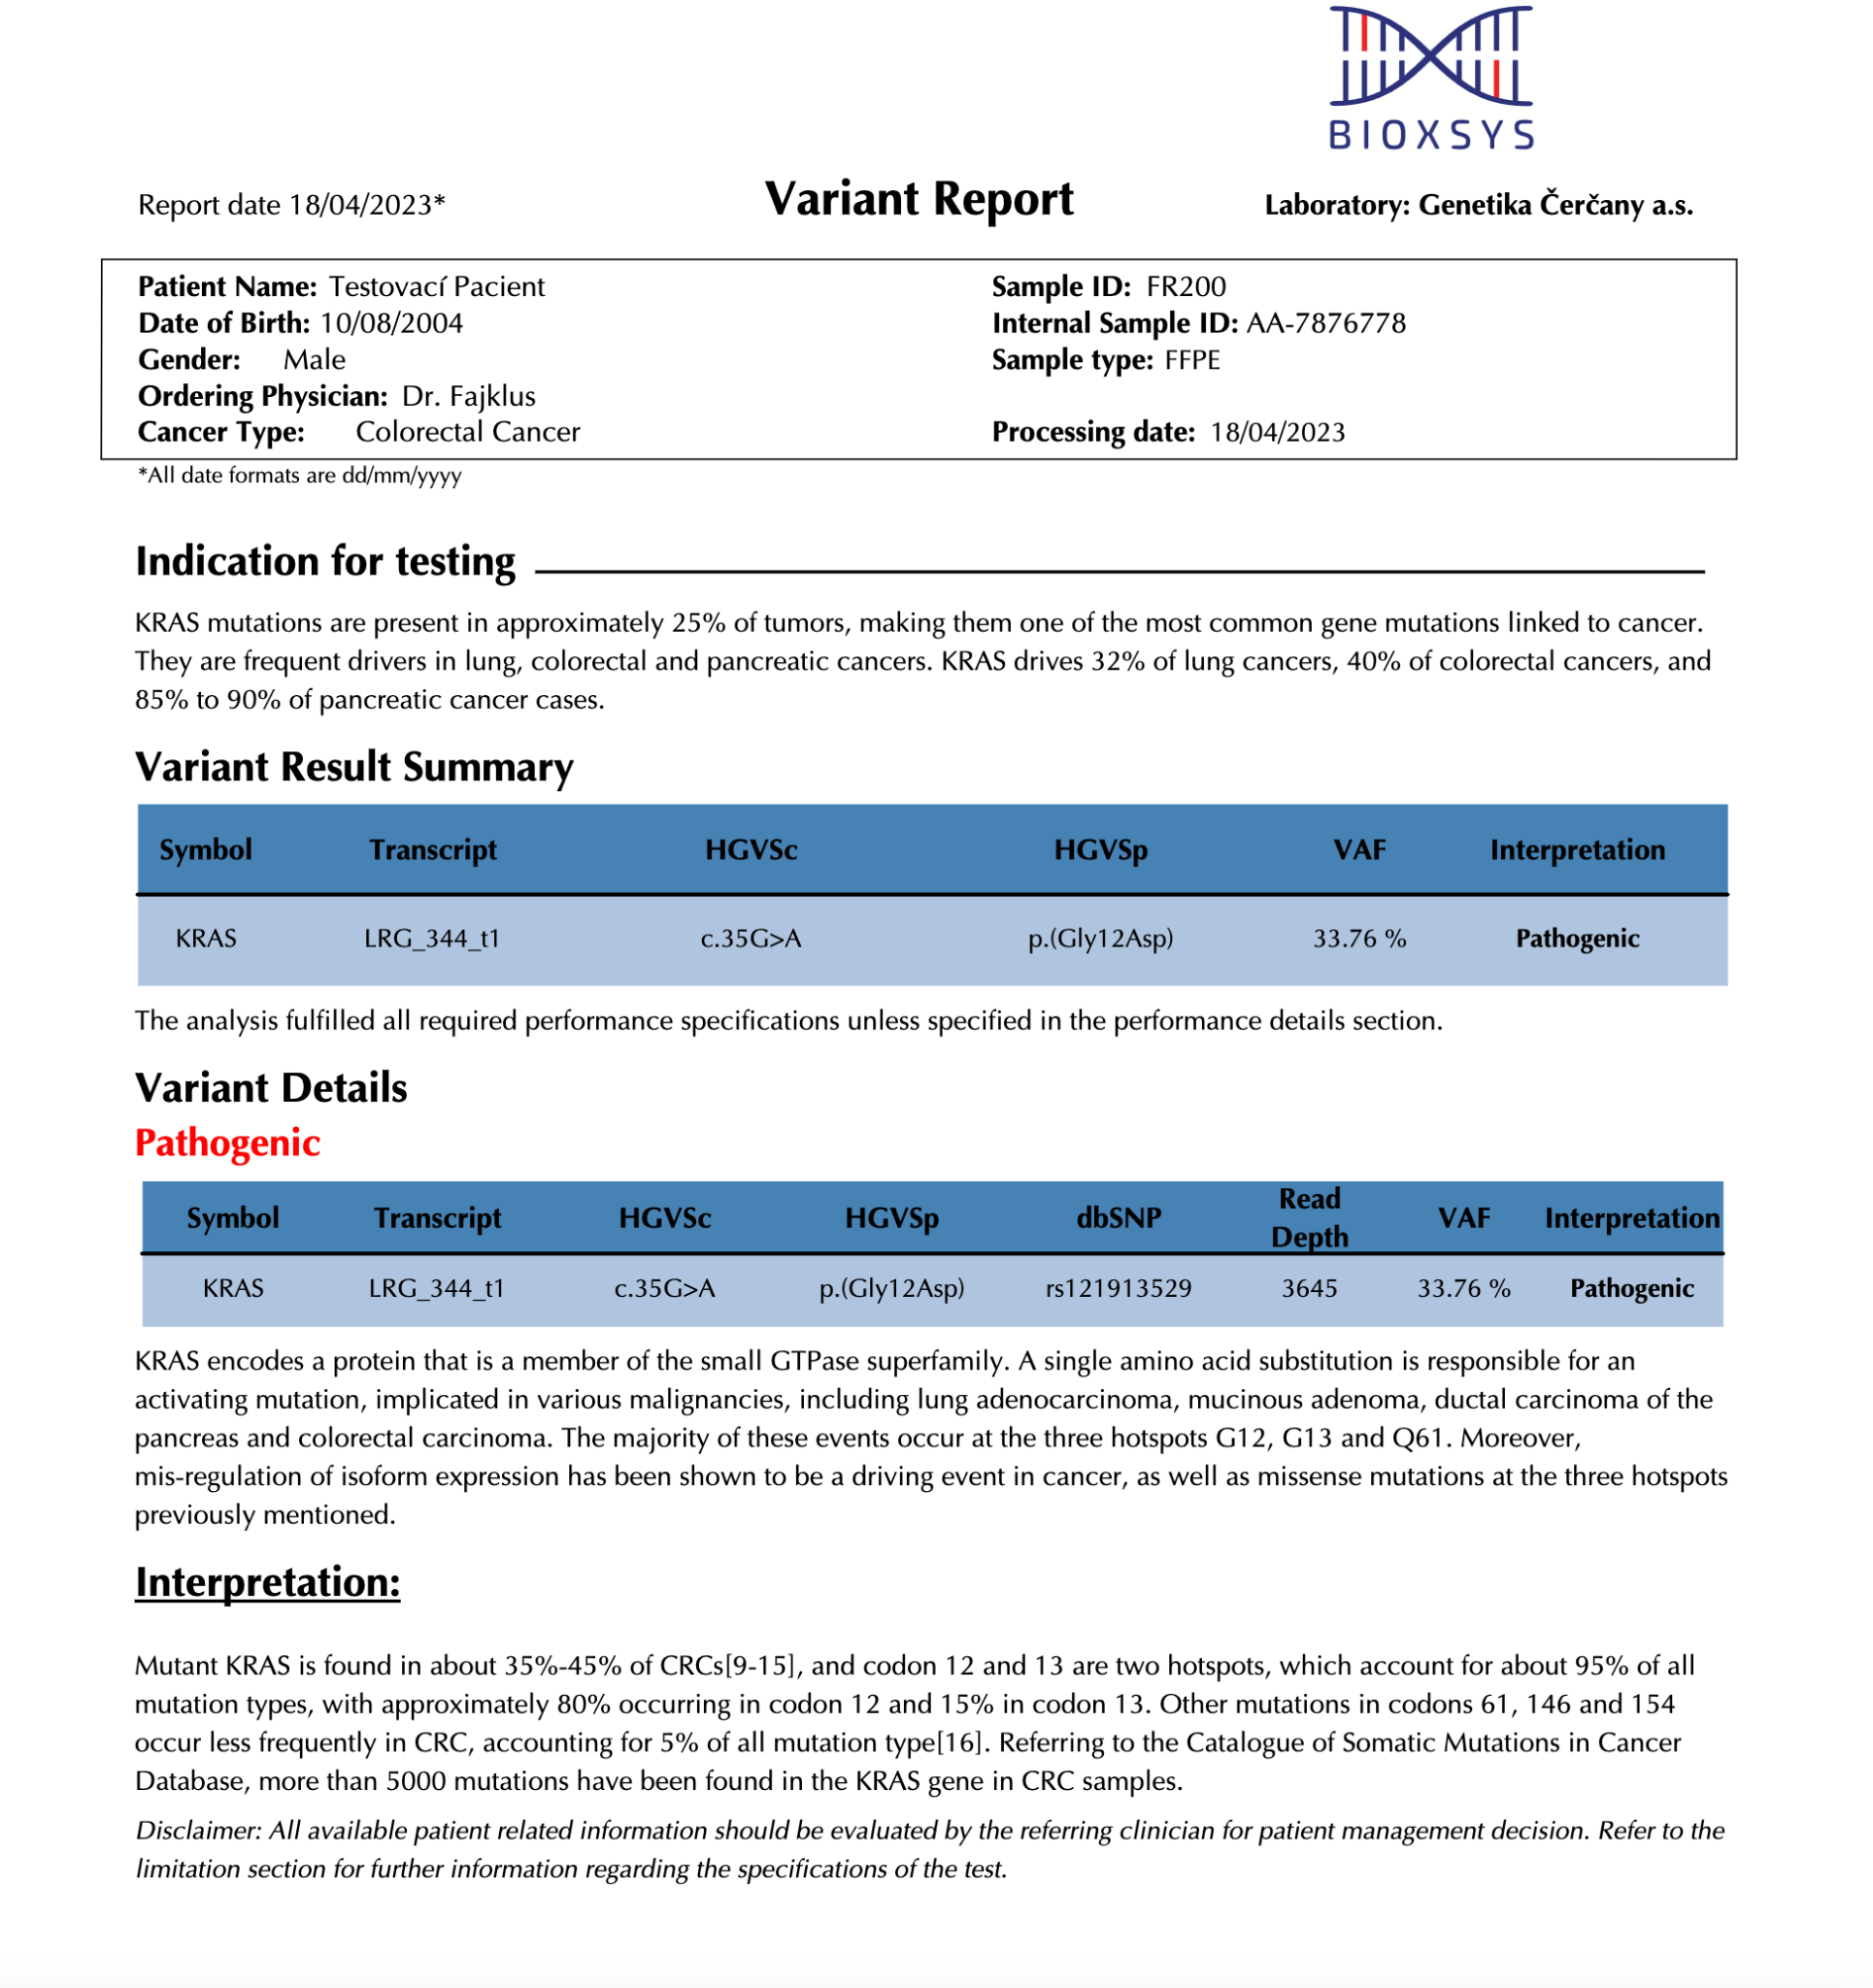
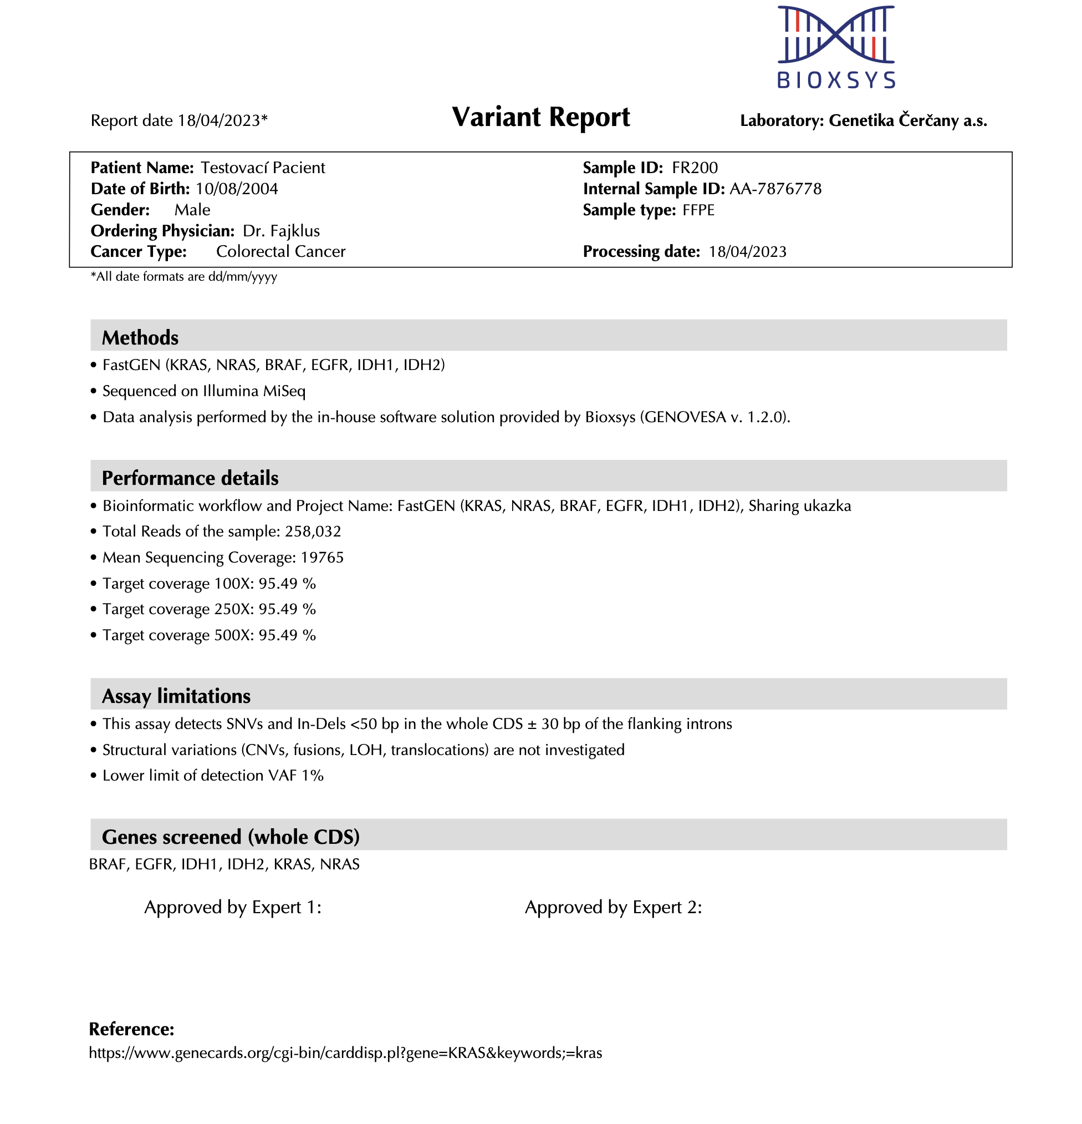
SA
TA
DB
FI
RE
SH
Secondary
Analysis
Tertiary Analysis
Database
Filtration
Report
Sharing
Report
www.bioxsys.eu
Notes:
Tri typy dat jako upload: FASTQ,

Slide 47
SA
TA
DB
FI
RE
SH
Secondary
Analysis
Tertiary Analysis
Database
Filtration
Report
Sharing
Sharing
Diagnostic clinic 1
sharing agreement
Diagnostic clinic 2
Internal Classification A-B
Internal Classification A-B
Variant comments A-B
Variant comments A-B
Variant comments 2 A-B
Variant comments 2 A-B
Date, annotation version
Date, annotation version
www.bioxsys.eu
Notes:
Tri typy dat jako upload: FASTQ,

Slide 48
SA
TA
DB
FI
RE
SH
Secondary
Analysis
Tertiary Analysis
Database
Filtration
Report
Sharing
Sharing
sharing agreement
www.bioxsys.eu
Notes:
Tri typy dat jako upload: FASTQ,

Slide 49
SA
TA
DB
FI
RE
SH
Secondary
Analysis
Tertiary Analysis
Database
Filtration
Report
Sharing
Sharing
sharing agreement
www.bioxsys.eu
Notes:
Tri typy dat jako upload: FASTQ,

Slide 50
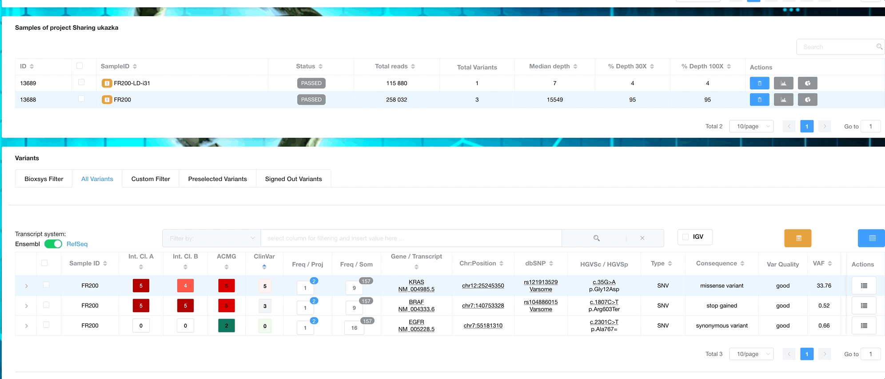
SA
TA
DB
FI
RE
SH
Secondary
Analysis
Tertiary Analysis
Database
Filtration
Report
Sharing
Sharing
www.bioxsys.eu
Notes:
Tri typy dat jako upload: FASTQ,

Slide 51
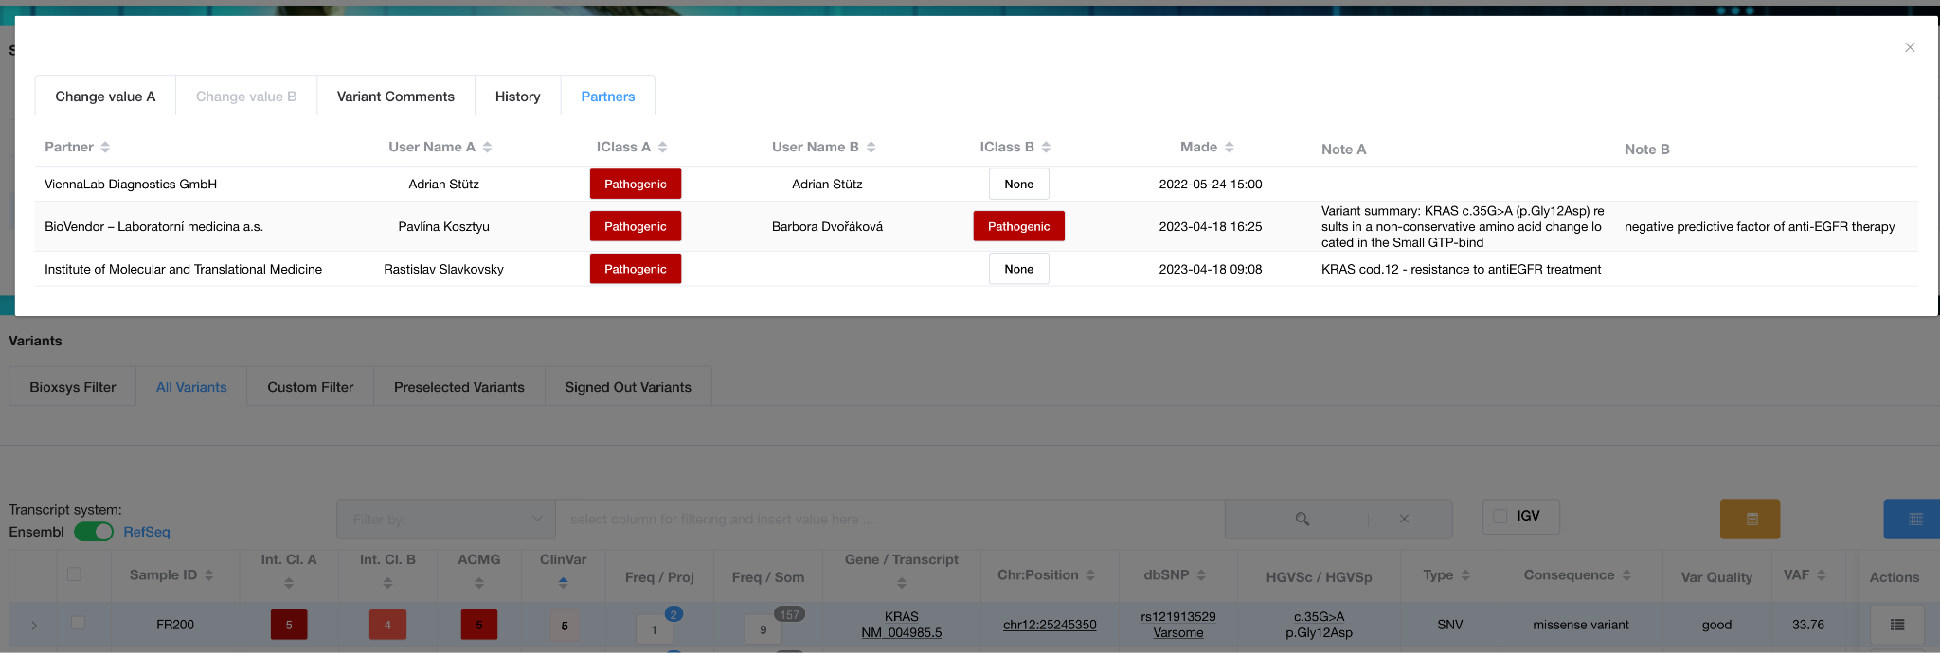
SA
TA
DB
FI
RE
SH
Secondary
Analysis
Tertiary Analysis
Database
Filtration
Report
Sharing
Sharing
www.bioxsys.eu
Notes:
Tri typy dat jako upload: FASTQ,

Slide 52
Ing. Petr Brož
CEO, Co-founder
www.bioxsys.cz
broz@bioxsys.cz
604799725

