Slide 1



SARS-CoV-2, the evolution in action
Jan Pačes
Institute of Molecular Genetics AS CR
University of Chemistry and Technology
ELIXIR

Slide 2
Coronaviruses
Single strand RNA+ viruses
genom around 30 kbp (one of the biggest viroval genomes)
so far 7 human coronaviruses:
  genus: Alphacoronavirus, species HCoV-229E a HCoV-NL63
  genus: Betacoronavirus, species HCoV-OC43 a HCoV-HKU1
    East respiratory syndrome-related coronavirus (MERS-CoV)
    subgenus: Sarbecovirus severe acute respiratory syndrome-related coronavirus
      SARS-CoV
      SARS-CoV-2

Slide 3
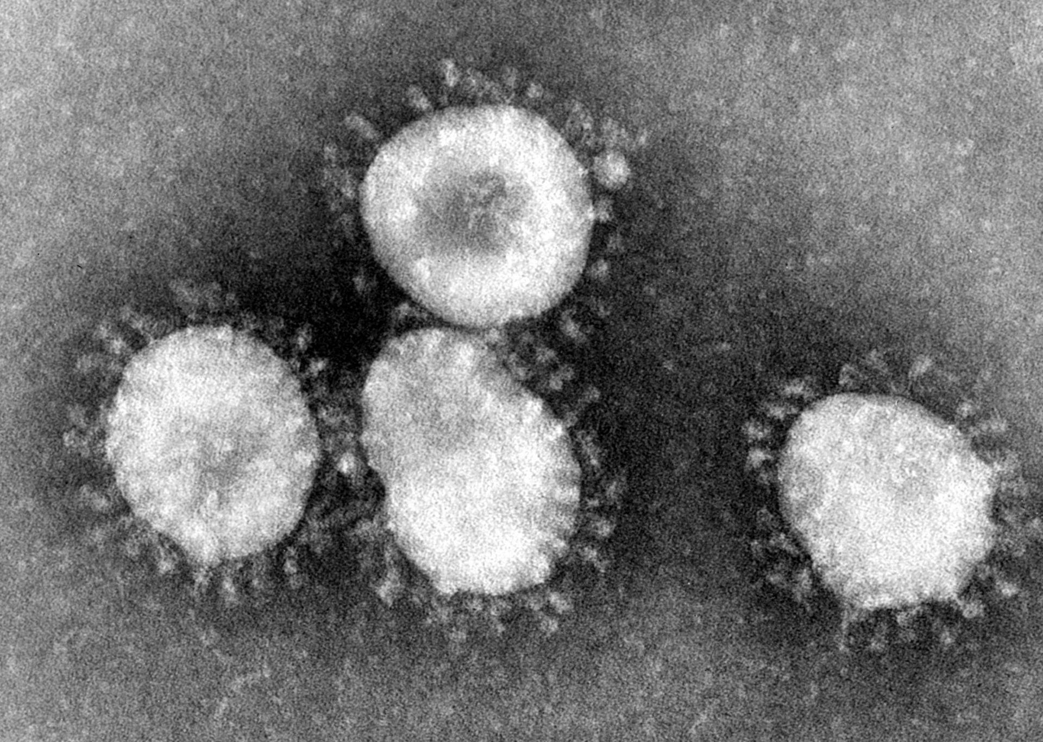
Notes:
Giaimo C (2020-04-01). "The Spiky Blob Seen Around the World". The New York Times.
By National Institute of Allergy and Infectious Diseases (NIAID) - https://www.flickr.com/photos/niaid/49557785797, CC BY 2.0, https://commons.wikimedia.org/w/index.php?curid=87326871

Slide 4
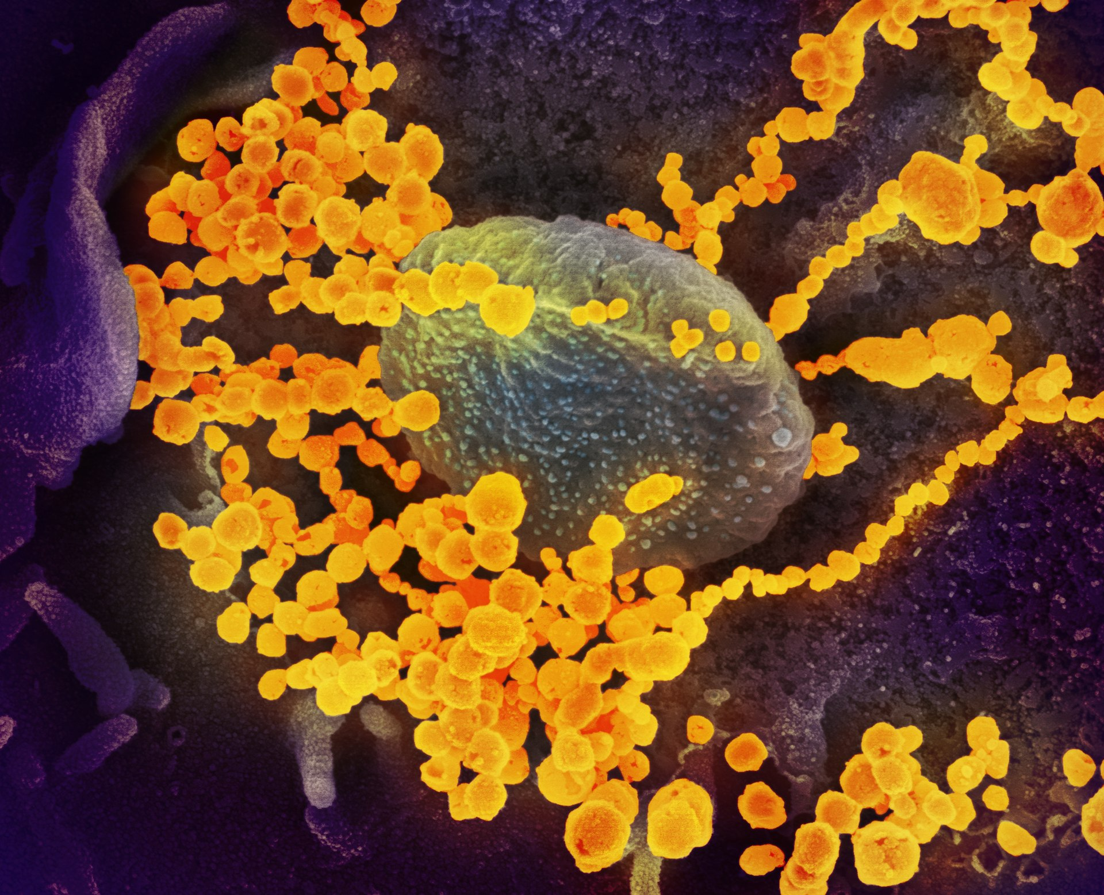
Notes:
Giaimo C (2020-04-01). "The Spiky Blob Seen Around the World". The New York Times.
By National Institute of Allergy and Infectious Diseases (NIAID) - https://www.flickr.com/photos/niaid/49557785797, CC BY 2.0, https://commons.wikimedia.org/w/index.php?curid=87326871

Slide 5
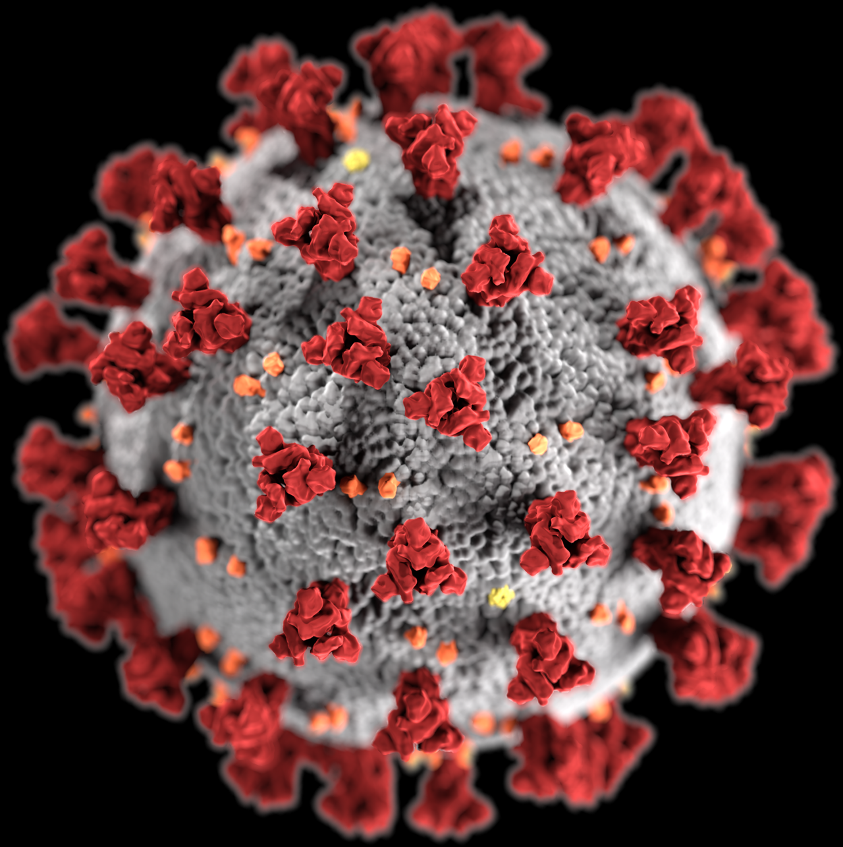
Notes:
Giaimo C (2020-04-01). "The Spiky Blob Seen Around the World". The New York Times.
By National Institute of Allergy and Infectious Diseases (NIAID) - https://www.flickr.com/photos/niaid/49557785797, CC BY 2.0, https://commons.wikimedia.org/w/index.php?curid=87326871

Slide 6
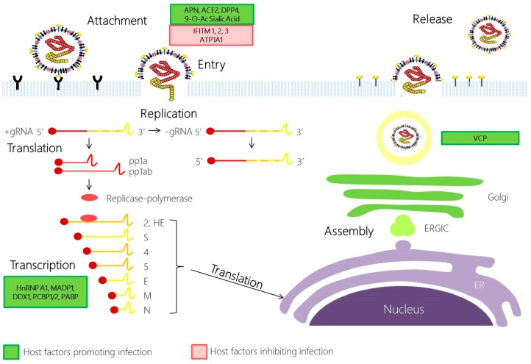
Replication of SARS-CoV-2
receptor binding domain (RBD) of the spike protein binds to the ACE2 receptor (angiotensin converting enzyme 2)
after cleavage of spike protein fusion peptide is exposed
Enters cell in endosome
Notes:
By Yvonne Xinyi Lim, Yan Ling Ng, James P. Tam, and Ding Xiang Liu - https://www.ncbi.nlm.nih.gov/pmc/articles/PMC5456285/, CC BY 4.0, https://commons.wikimedia.org/w/index.php?curid=87764851

Slide 7
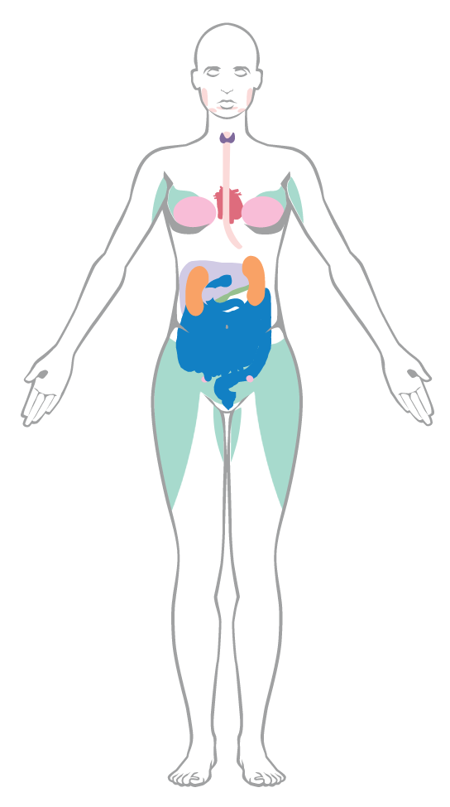

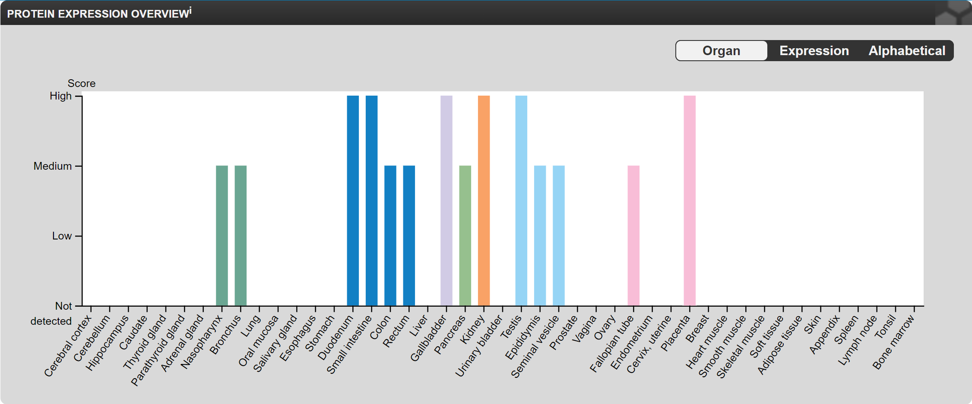
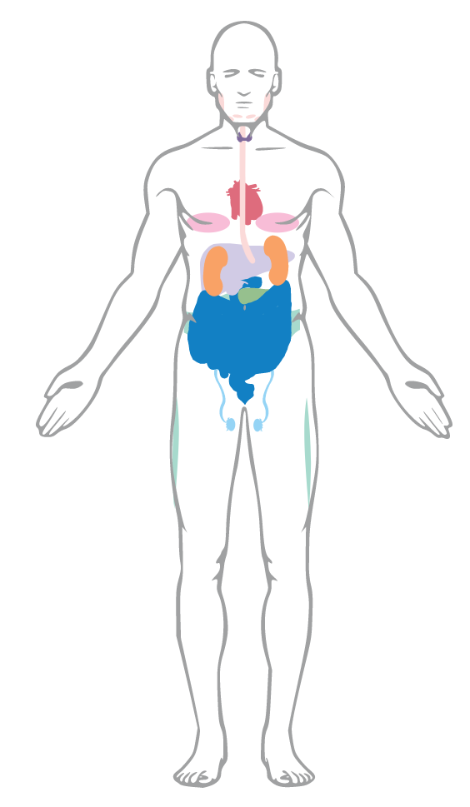
hs-ACE2 expression
Notes:
https://www.proteinatlas.org/ENSG00000130234-ACE2/tissue

Slide 8
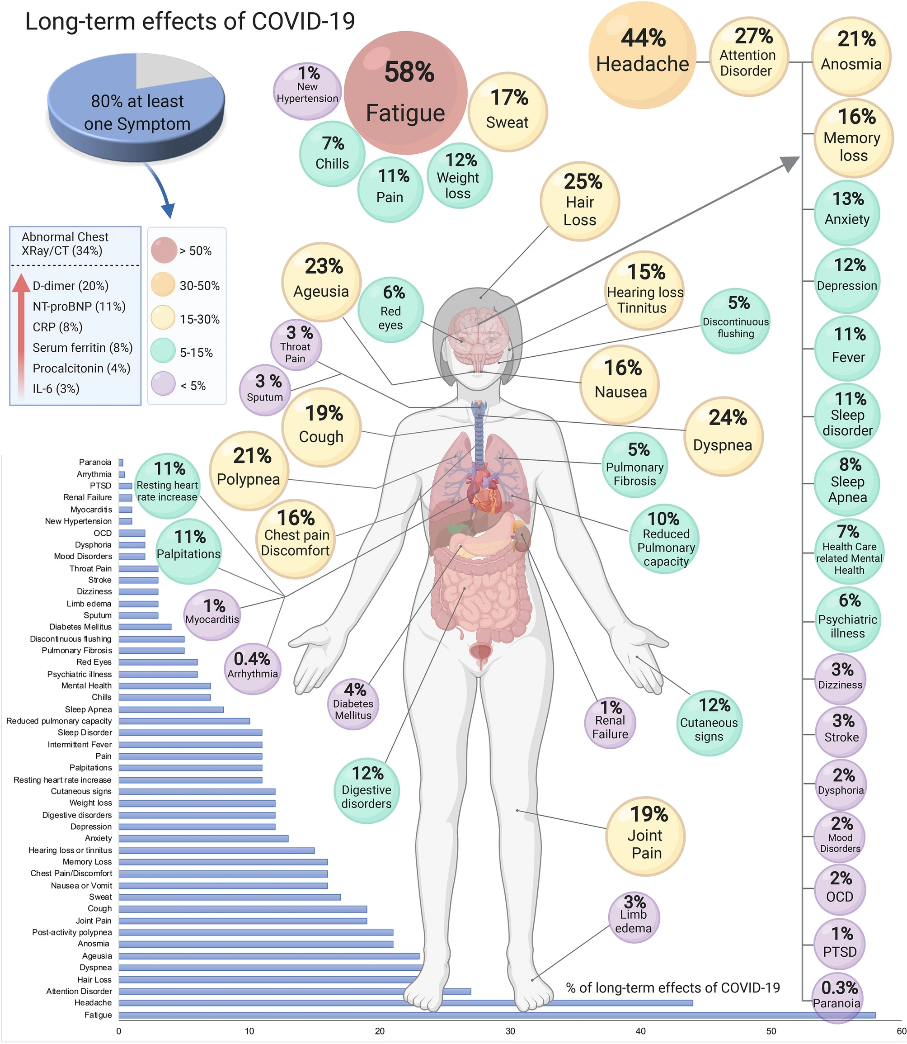

Slide 9
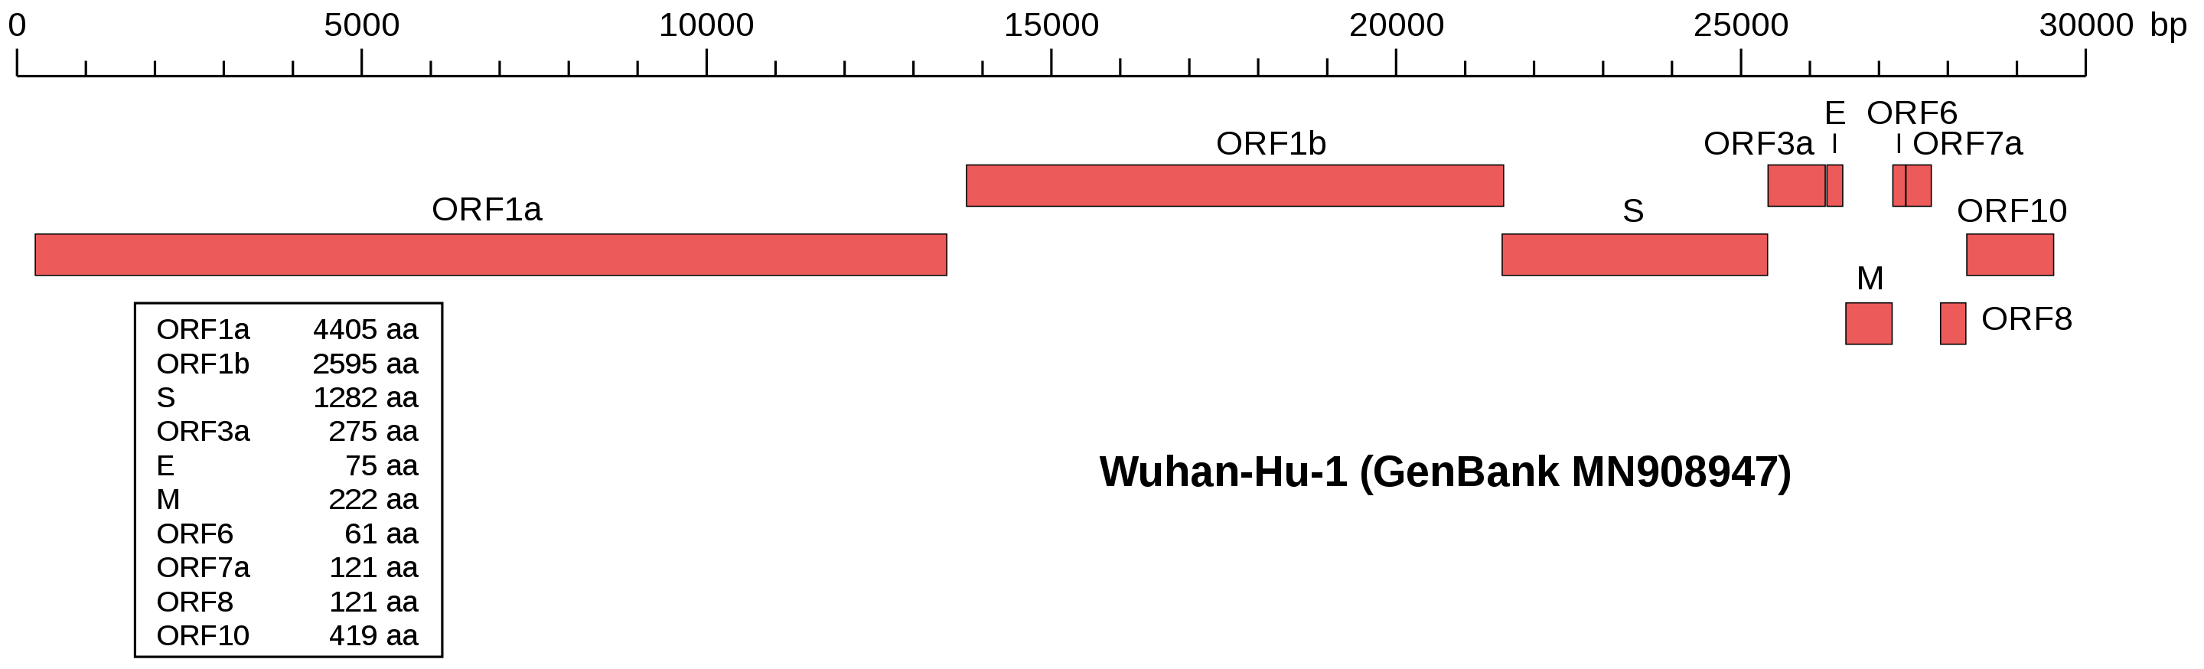
Genomic structure of SARS-CoV-2

Slide 10
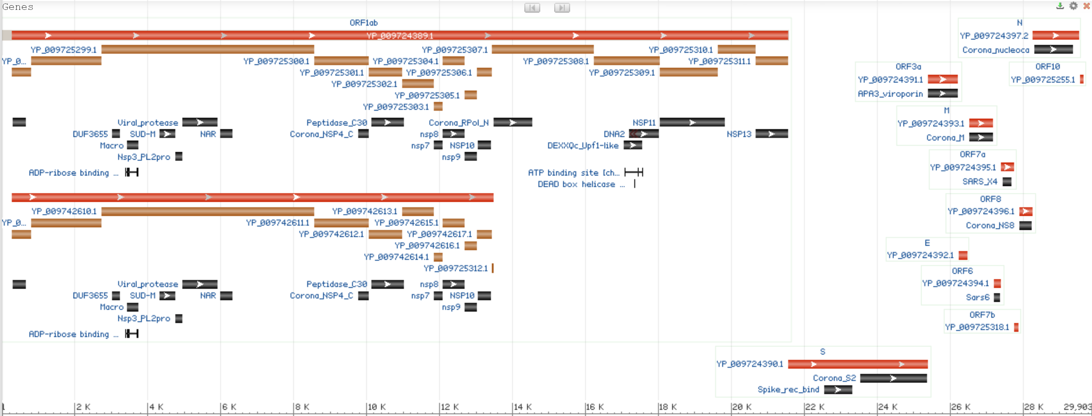
Genomic structure of SARS-CoV-2
Notes:
-1 ribosomal frameshift caused by a slippery sequence (UUUAAAC)

Slide 11
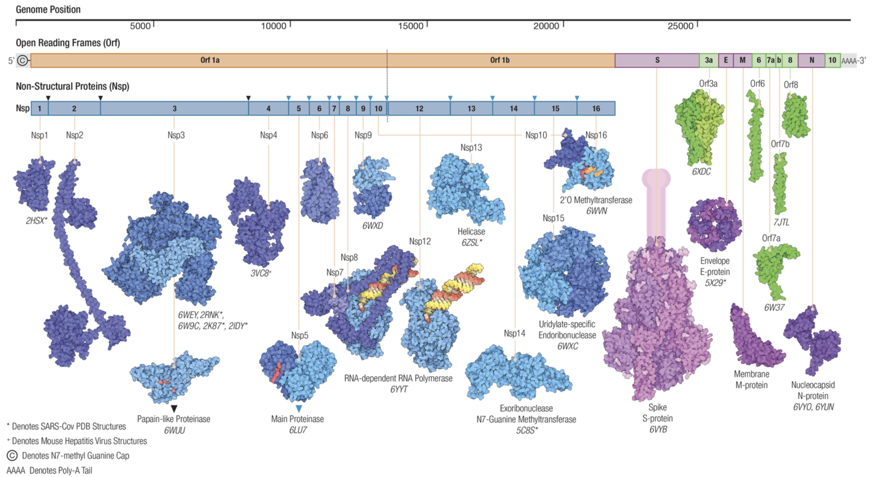
https://doi.org/10.1101/2020.12.01.406637
Notes:
Evolution of the SARS-CoV-2 proteome in three dimensions (3D) during the first six months of the COVID-19 pandemic
Joseph H. Lubin, https://doi.org/10.1101/2020.12.01.406637
Architecture of the SARS-CoV-2 genome and proteome, including non-structural proteins derived from pp1a and pp1ab (nsps, shades of blue), virion structural proteins (pink/purple), and open reading frame proteins (Orfs, shades of green). Polyprotein cleavage sites are indicated by inverted triangles for Papain-like Proteinase (PLPro, black) and the Main Protease (nsp5, blue). The double-stranded RNA substrate-product complex of the RNA-dependent RNA polymerase (shown as the nsp7-nsp82-nsp12 heterotetramer and separately with only nsp12) is color coded (yellow: product strand, red: template strand). Transmembrane portions of the Spike S-protein are shown in cartoon form (pink).

Slide 12
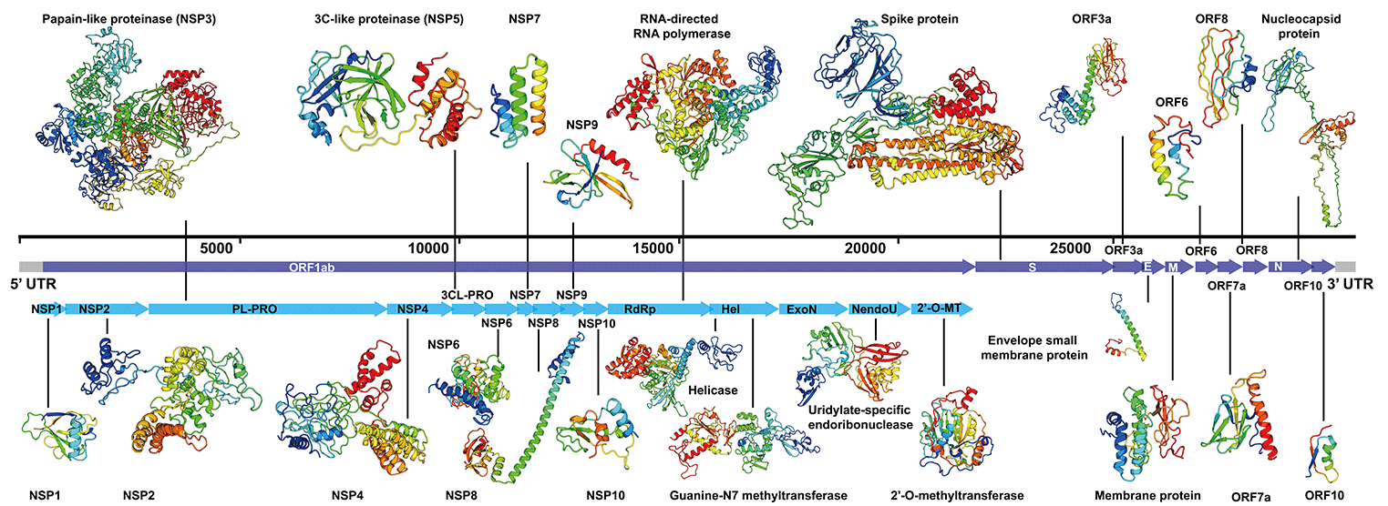
https://zhanggroup.org//COVID-19/
Notes:
Evolution of the SARS-CoV-2 proteome in three dimensions (3D) during the first six months of the COVID-19 pandemic
Joseph H. Lubin, https://doi.org/10.1101/2020.12.01.406637
Architecture of the SARS-CoV-2 genome and proteome, including non-structural proteins derived from pp1a and pp1ab (nsps, shades of blue), virion structural proteins (pink/purple), and open reading frame proteins (Orfs, shades of green). Polyprotein cleavage sites are indicated by inverted triangles for Papain-like Proteinase (PLPro, black) and the Main Protease (nsp5, blue). The double-stranded RNA substrate-product complex of the RNA-dependent RNA polymerase (shown as the nsp7-nsp82-nsp12 heterotetramer and separately with only nsp12) is color coded (yellow: product strand, red: template strand). Transmembrane portions of the Spike S-protein are shown in cartoon form (pink).

Slide 13
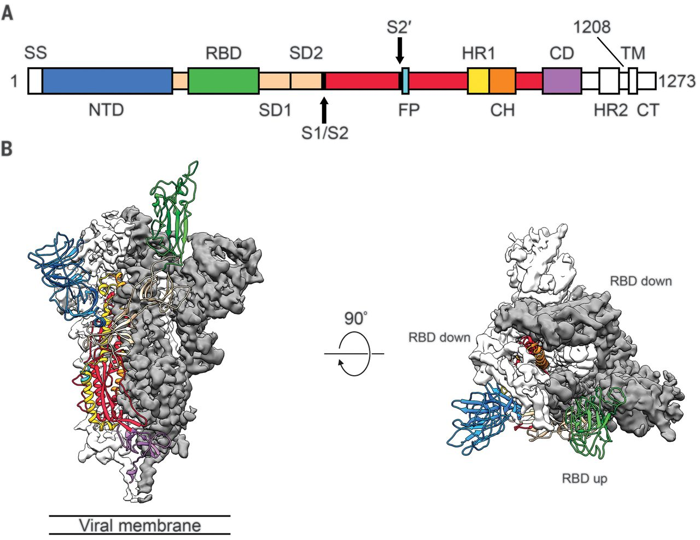
Spike gene and protein
Wrapp D et al, Science 2020
Notes:
Fig. 1 Structure of 2019-nCoV S in the prefusion conformation.(A) Schematic of 2019-nCoV S primary structure colored by domain. Domains that were excluded from the ectodomain expression construct or could not be visualized in the final map are colored white. SS, signal sequence; S2′, S2′ protease cleavage site; FP, fusion peptide; HR1, heptad repeat 1; CH, central helix; CD, connector domain; HR2, heptad repeat 2; TM, transmembrane domain; CT, cytoplasmic tail. Arrows denote protease cleavage sites. (B) Side and top views of the prefusion structure of the 2019-nCoV S protein with a single RBD in the up conformation. The two RBD down protomers are shown as cryo-EM density in either white or gray and the RBD up protomer is shown in ribbons colored corresponding to the schematic in (A).

Slide 14
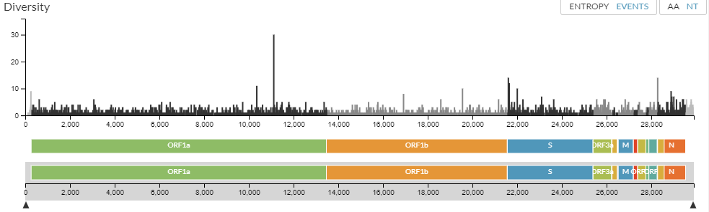
Mutations in SARS-CoV-2

Slide 15
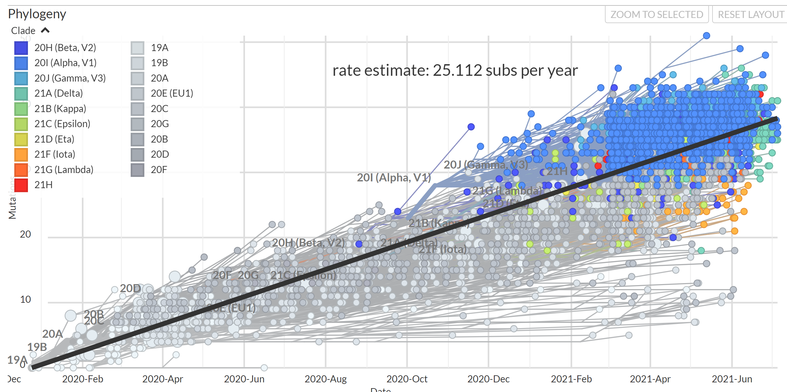
Mutational speed (~ 25/year)

Slide 16
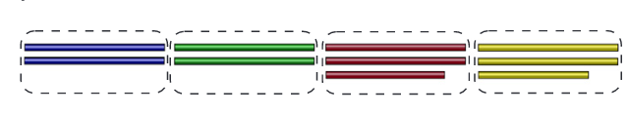

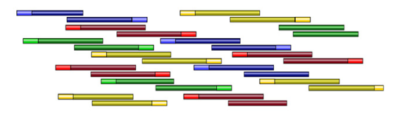


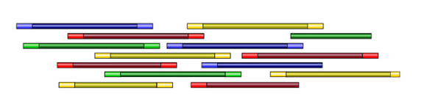
Amplicon sequencing
Clustering
Primer design
Amplicon sequencing
Consensus
Merge
Assembly

Slide 17
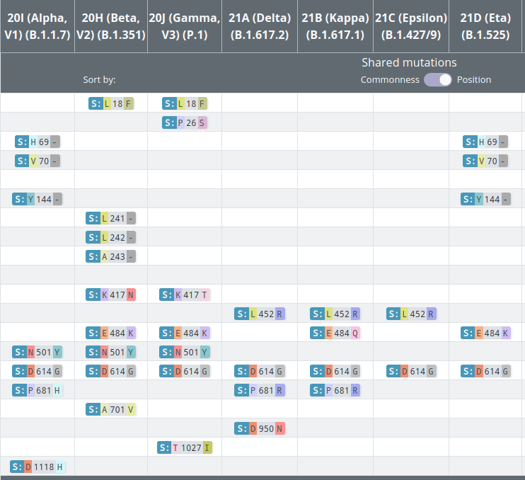
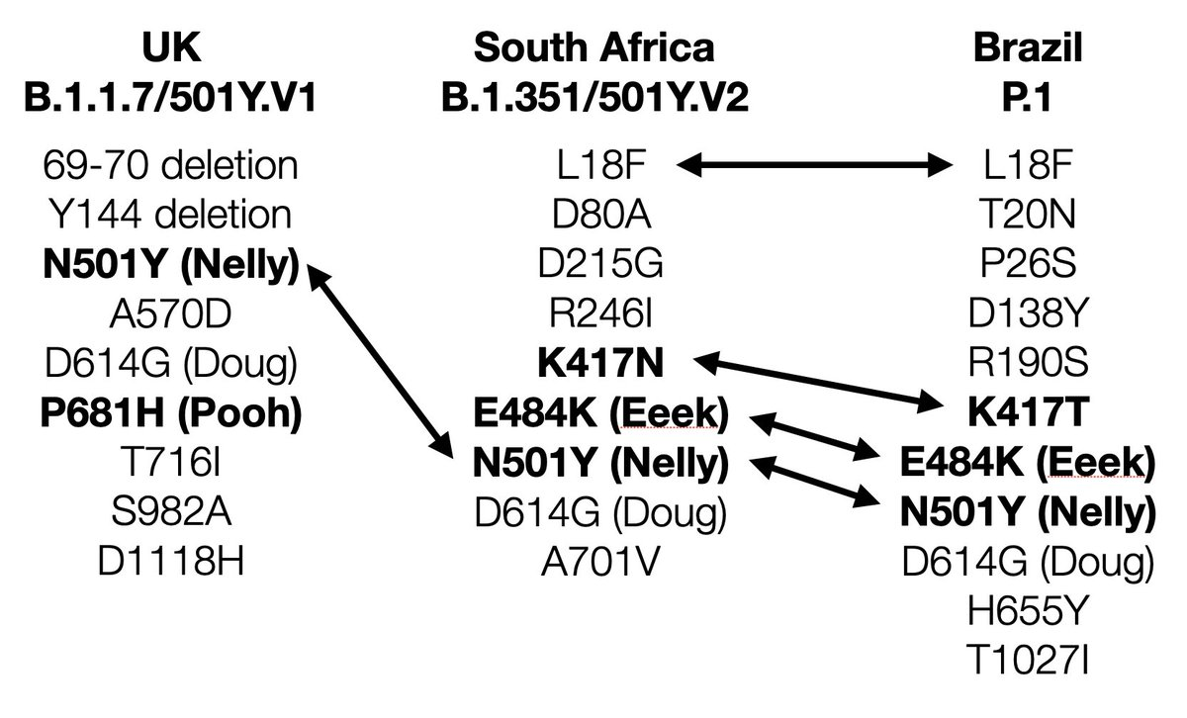
Naming convention of aa mutations
S:N501Y
  protein S
  aminokyselina asparagin
  na pozici 501
  změněna na tyrosin

Slide 18
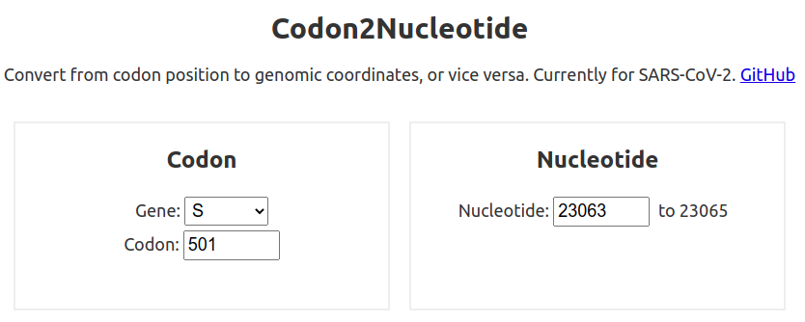
and nucleotide
https://covariants.org/variants/
Mutation Information
S:N501 has appeared multiple times independently: each can be associated with different accompanying mutations
Amino-acid changes are S:N501Y (nucleotide mutation A23063T), S:N501T (nucleotide mutation A23064C), and S:N501S (nucleotide mutation A23064G)
https://codon2nucleotide.theo.io/

Slide 19
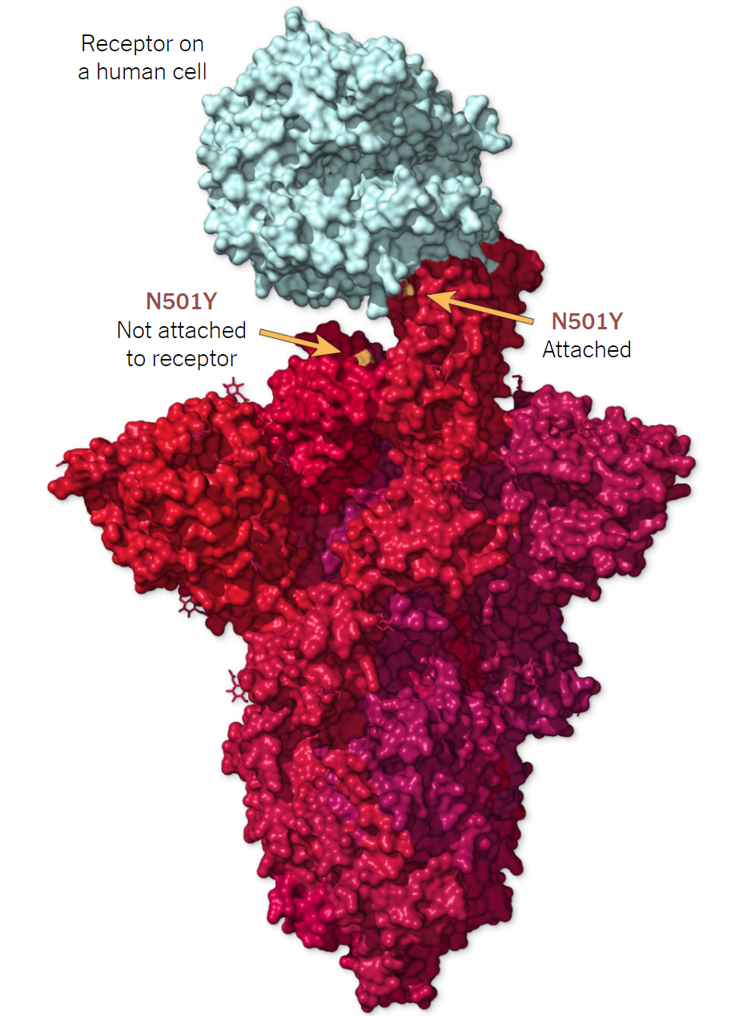
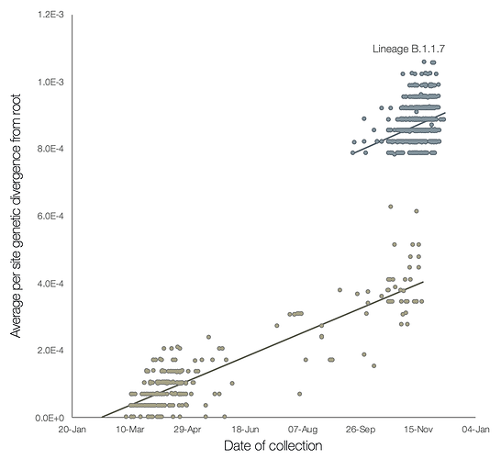
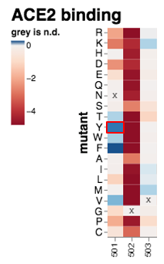
Mutation N501Y

Slide 20
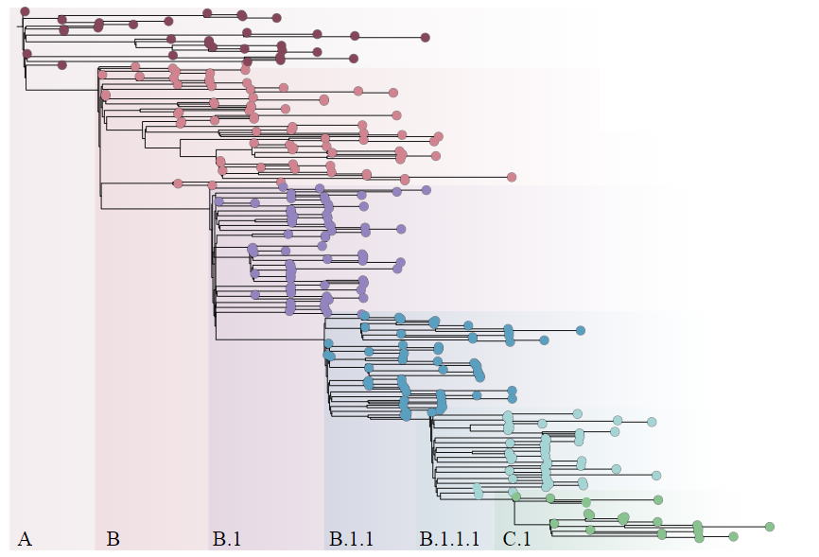
How we name variants (Pango)

Slide 21
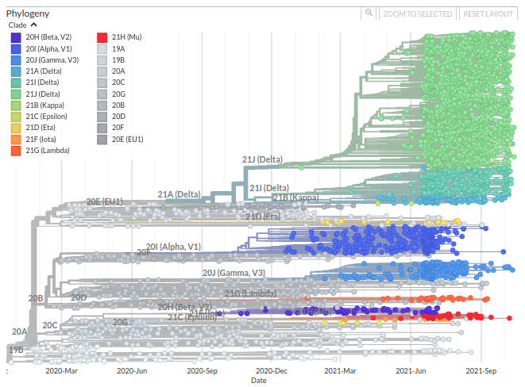
Monofyletic (?)
Notes:
nextstrain

Slide 22
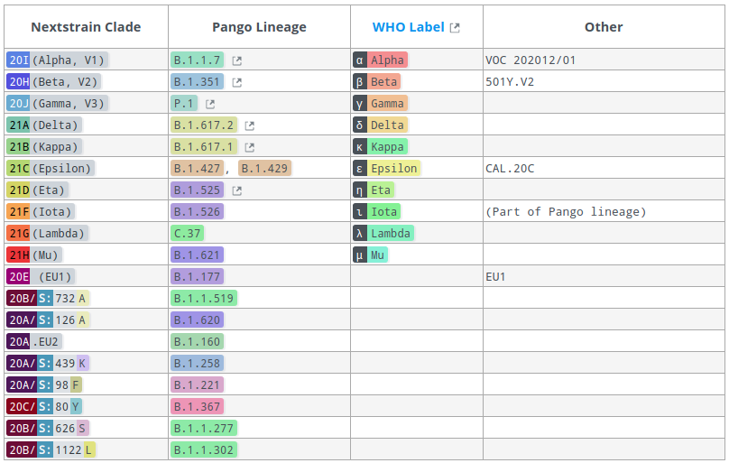
Other naming schemes

Slide 23
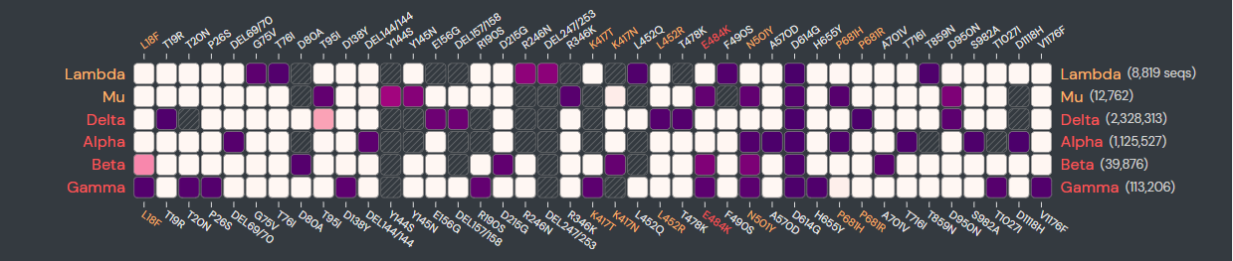
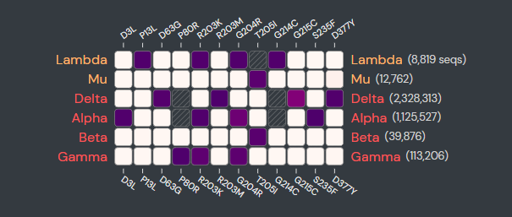
VOC and VOI variant comparison
S
N

Slide 24
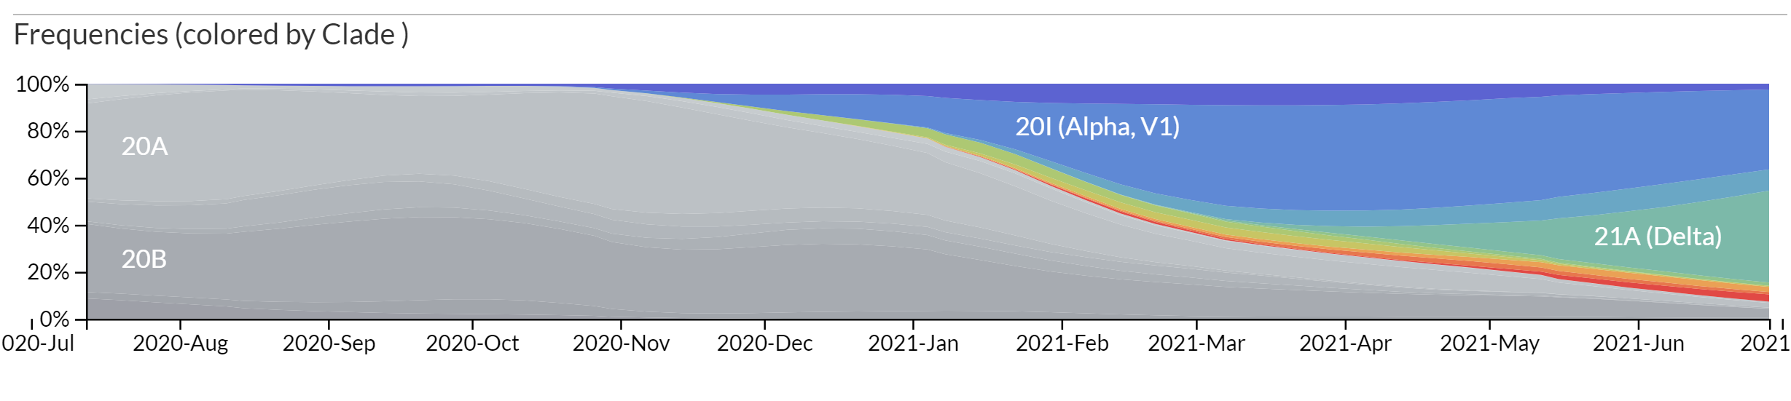
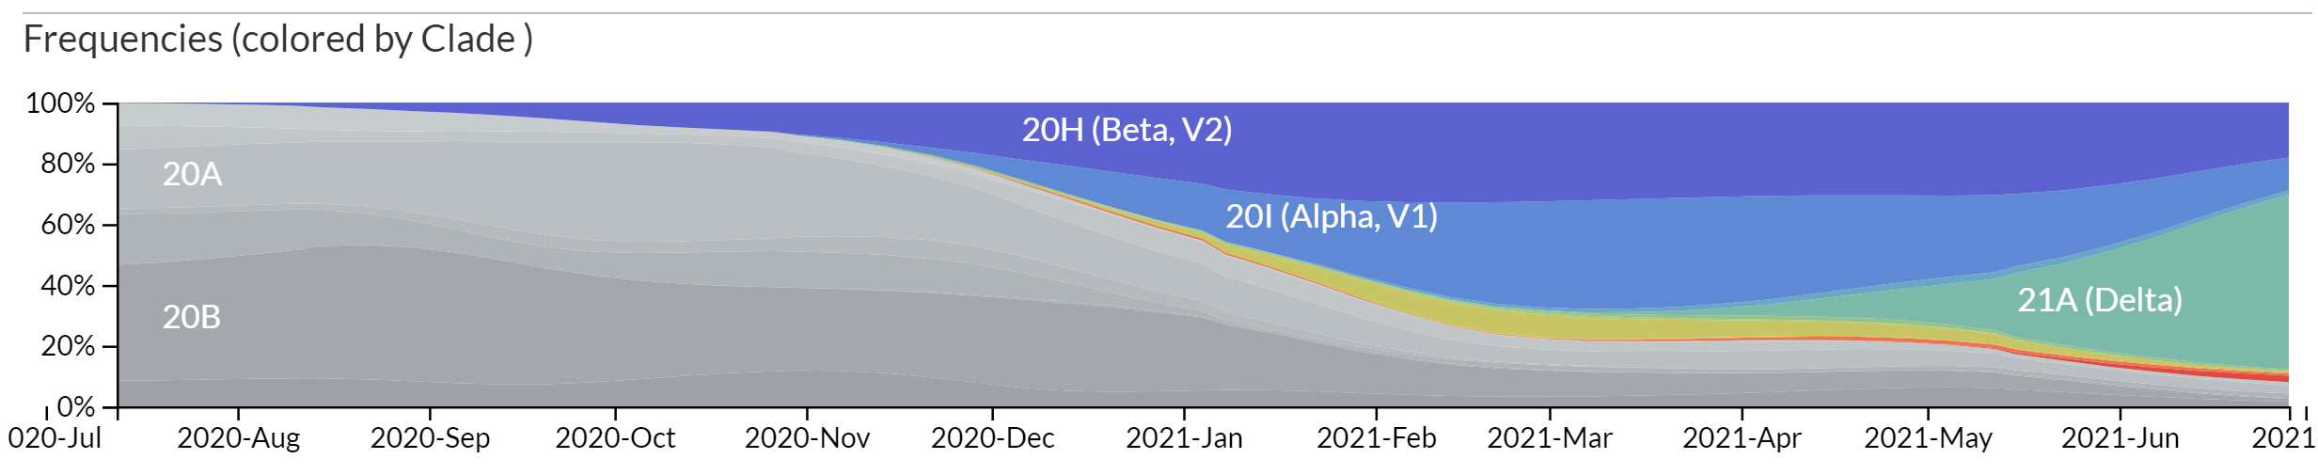
Spread of variants in space and time
Africa

Slide 25
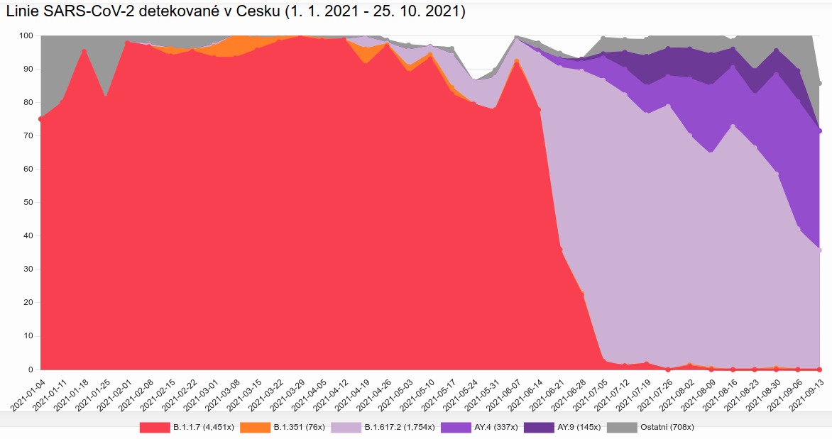
What variants do we have in Czechia?
https://virus.img.cas.cz

Slide 26
COG-CZ
Karel Berka, Michaela Jaroměřská, Artsemi Yuschkevich Katedra fyzikální chemie, Univerzita Palackého v Olomouci
Martin Čech Ústav organické chemie a biochemie, AV ČR
Vladimír Hampl, Zoltán Füssy, Ruth Tachezy, Sebastian Cristian Treitli Přírodovědecká fakulta Univerzity Karlovy, BIOCEV
Michal Kolář, Jan Pačes, Miluše Hradilová, Ondřej Moravčík, Lucie Pfeiferová, Martin Zmuda Ústav molekulární genetiky, AV ČR
Magdalena Jančářová Katedra parazitologie, Přírodovědecká fakulta Univerzity Karlovy
Helena Jiřincová, Alexander Nagy, Timotej Šuri, Jaromíra Večeřová Národní referenční laboratoř pro chřipku a nechřipková respirační virová onemocnění, SZÚ
Martin Kolísko, Serafim Nenarokov, Jeffrey Silberman, Radek Šíma, Monika Wisniewska Parazitologický ústav, Biologické centrum, AV ČR
Jaroslav Nunvář Katedra genetiky a mikrobiologie, Přírodovědecká fakulta Univerzity Karlovy
Miroslav Ruda CESNET
Rastislav Slavkovský Ústav molekulární a translační medicíny, Univerzita Palackého v Olomouci
Monika Čechová Fakulta informatiky, Masarykova Univerzita
Markéta Tomková University of California Davis, UC Davis Genome Center
Hana Medová
Výpočetní a datové kapacity poskytuje Elixir-CZ (www.elixir-czech.cz).

Slide 27
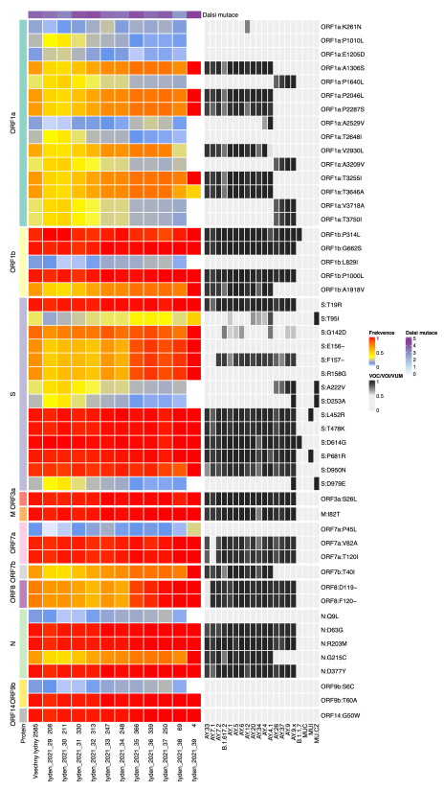
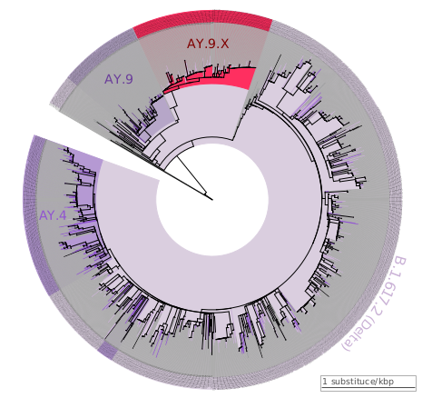
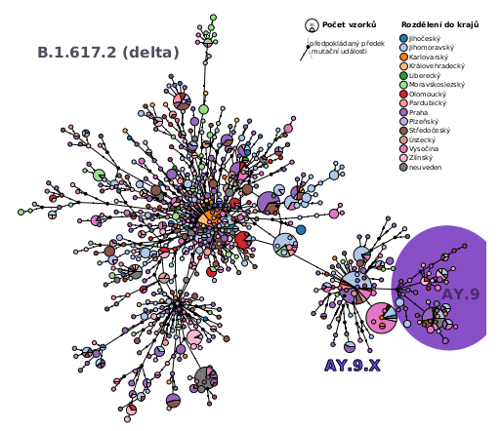
COG-CZ http://virus.img.cas.cz

Slide 28
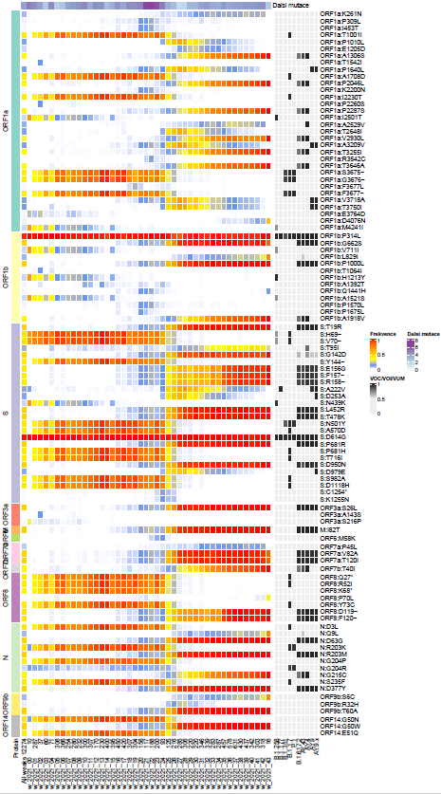
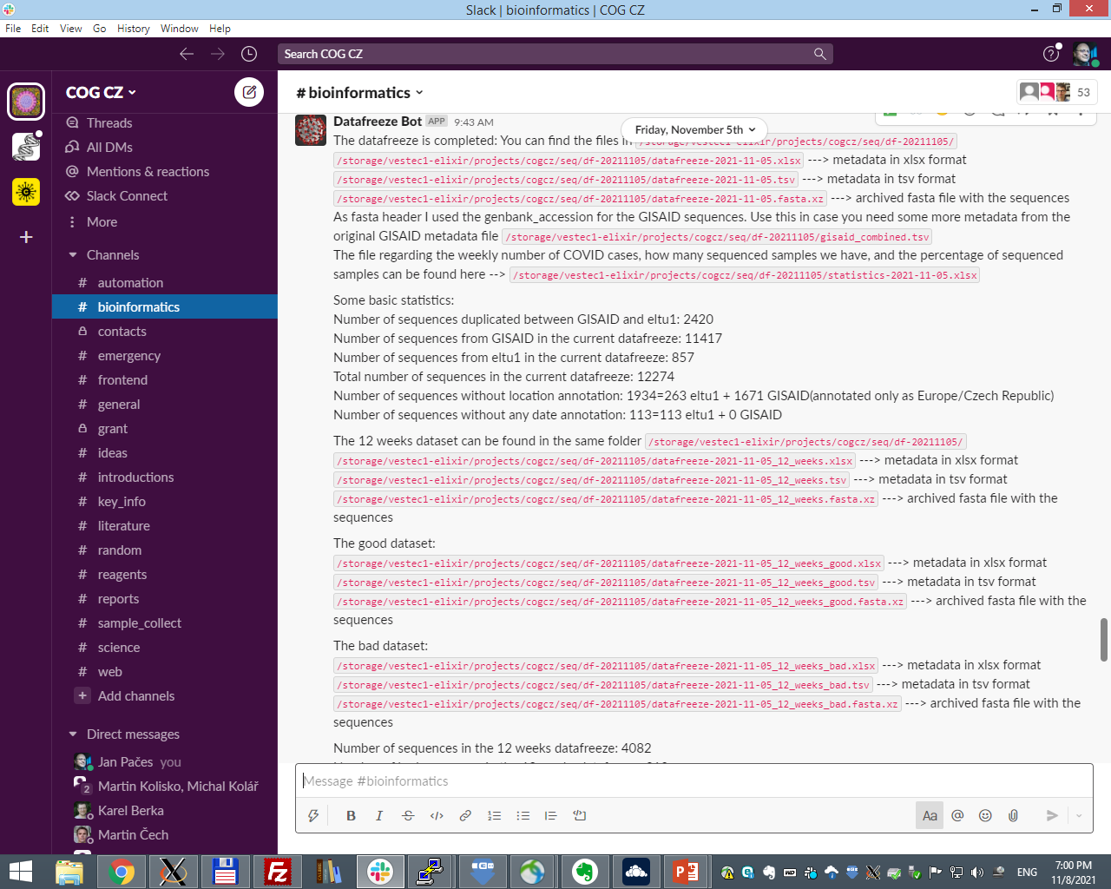
Datafreeze each 2 weeks
1702 B.1.617.2
802 AY.43
702 AY.4
191 AY.9
73 AY.4.4
61 AY.20
55 AY.46.6
52 AY.42
50 AY.5
19 AY.46
16 AY.26
12 AY.7.1
11 AY.44
10 AY.7
10 AY.36
9 AY.7.2
8 AY.46.2
8 AY.41
8 AY.1
7 AY.4.2
7 AY.39
7 AY.34
6 AY.25
6 AY.23
5 AY.4.5
5 AY.4.3
5 AY.33
4 AY.6
4 AY.12
1 None
1 C.37
1 B.1.351.5
1 AY.47
1 AY.4.1
1 AY.38
1 AY.3
1 AY.16
1 A.2.5.3

Slide 29
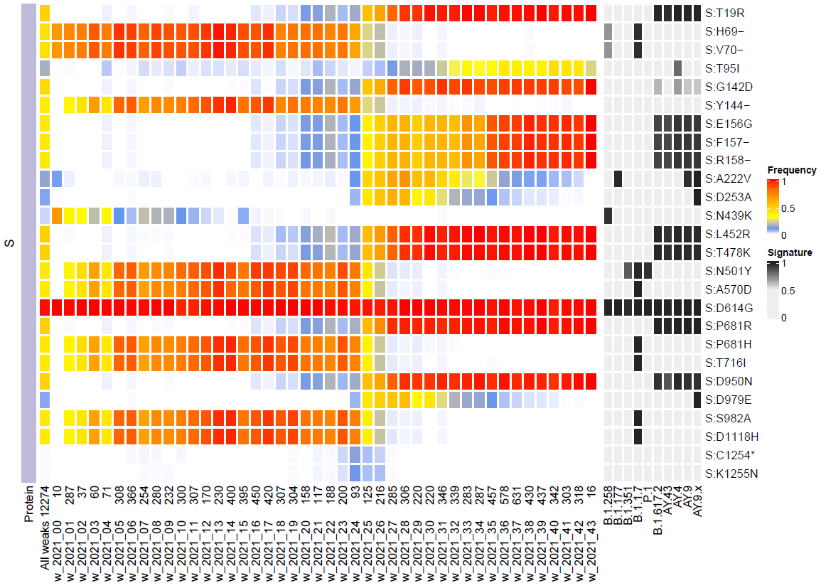
Alpha
Delta

Slide 30
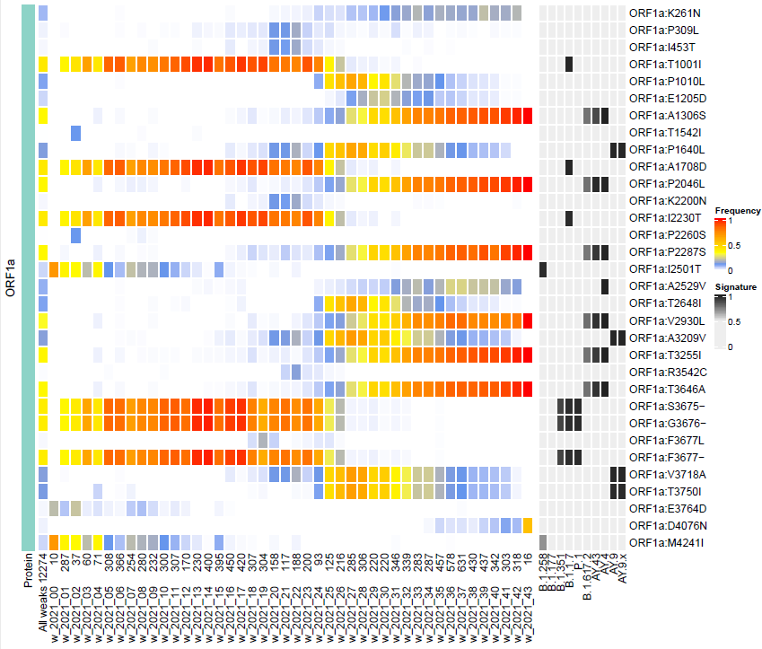

Slide 32
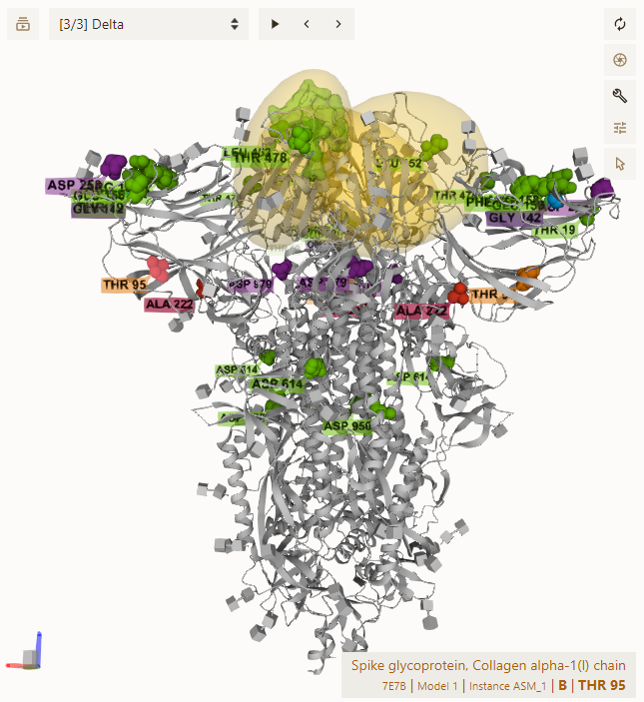
AY.4.X
https://molstar.org/

Slide 33
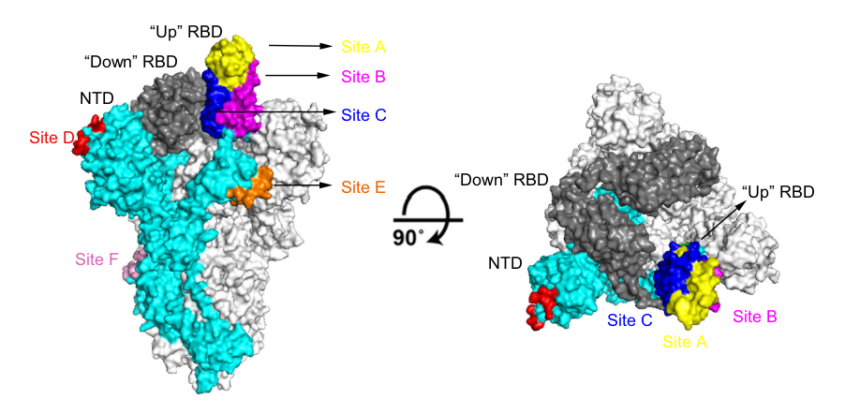
Antibody binding sites on Spike protein

Slide 34
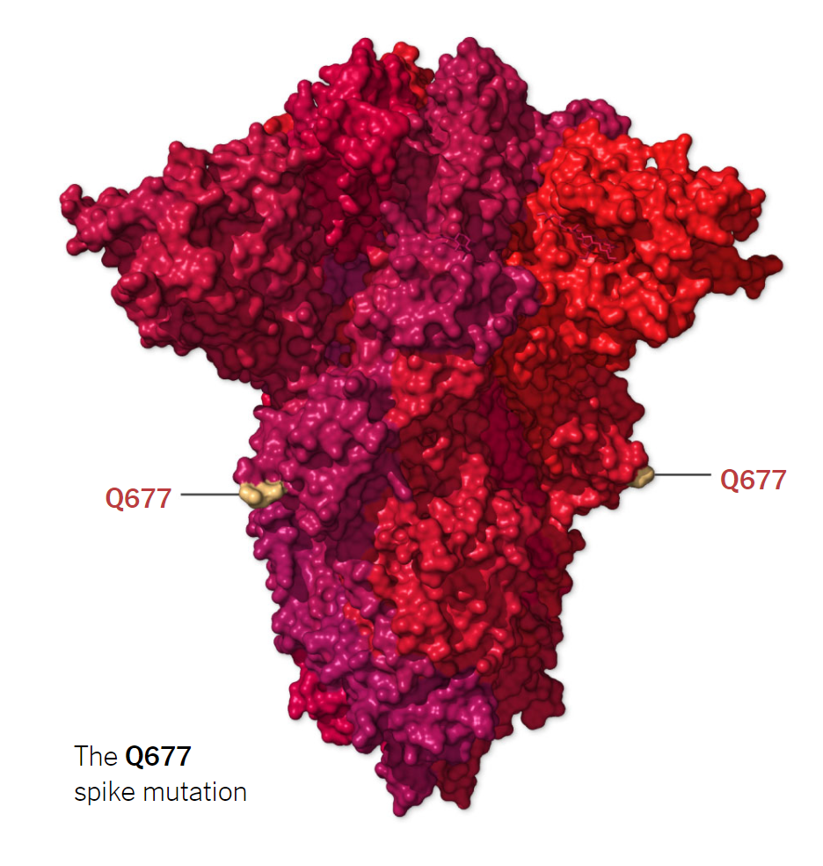
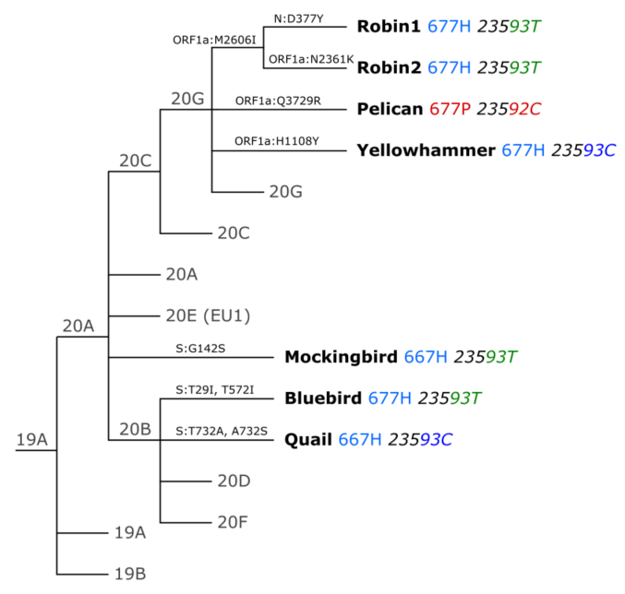
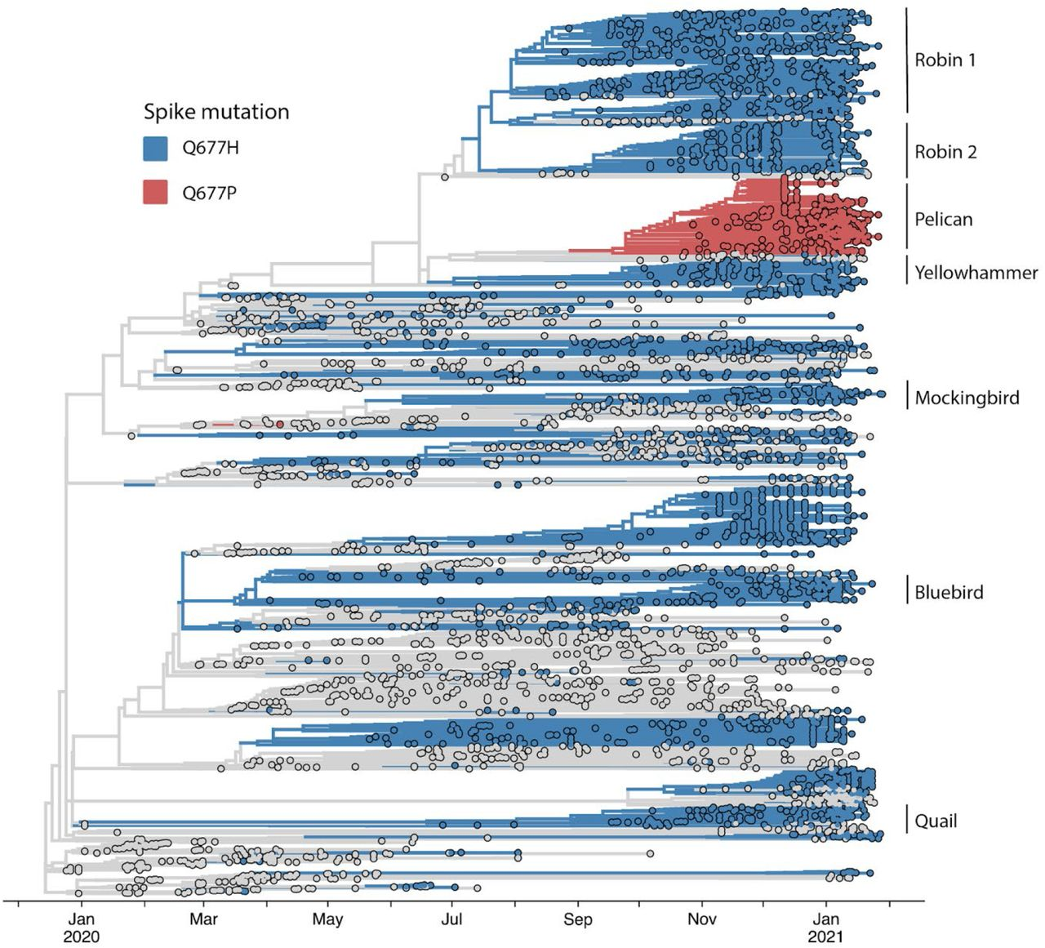
Q677 mutation

Slide 35
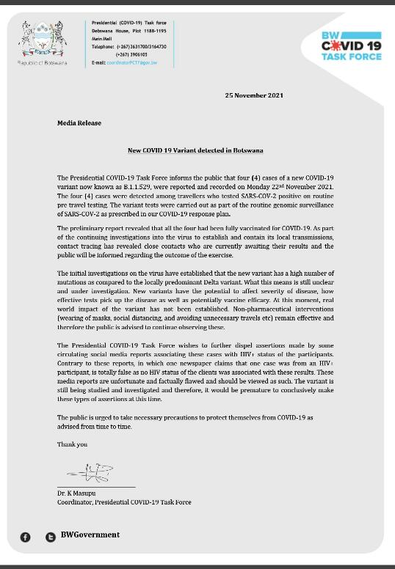
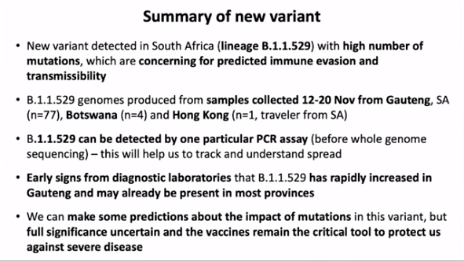
Omicron is coming

Slide 36
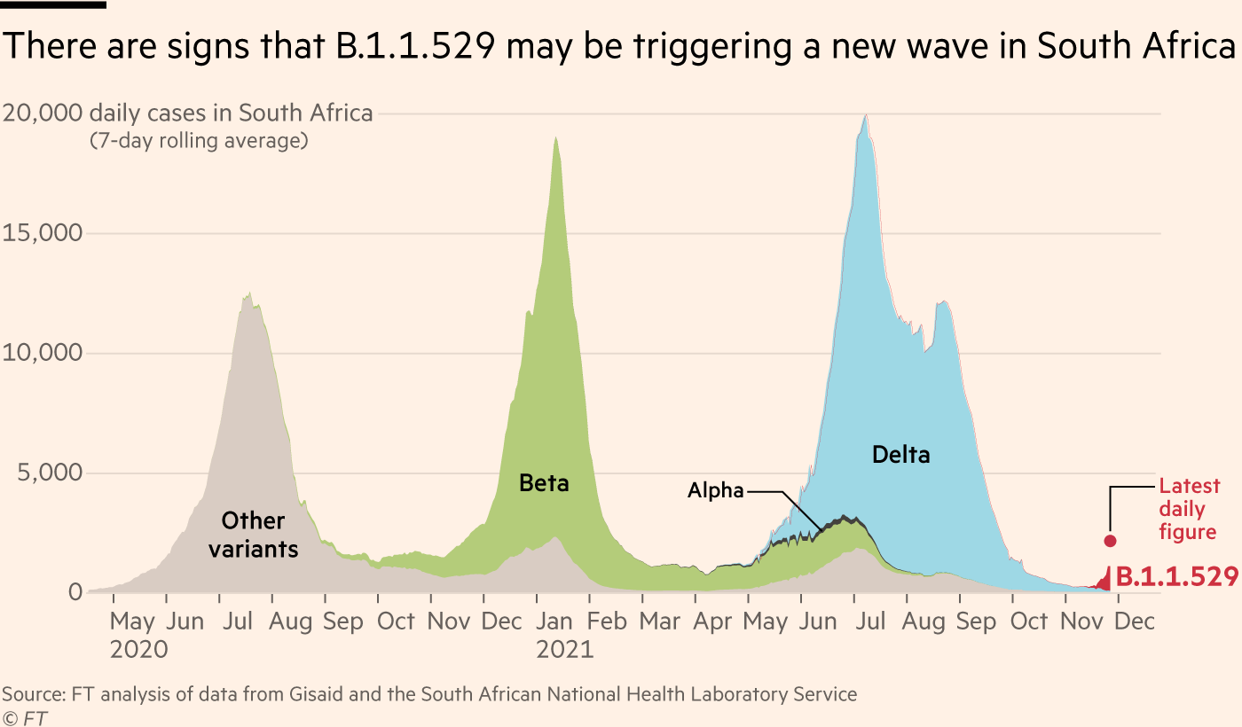

Slide 37
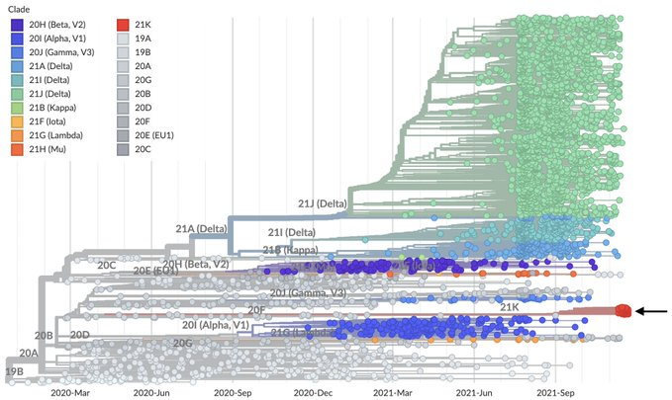

Slide 38
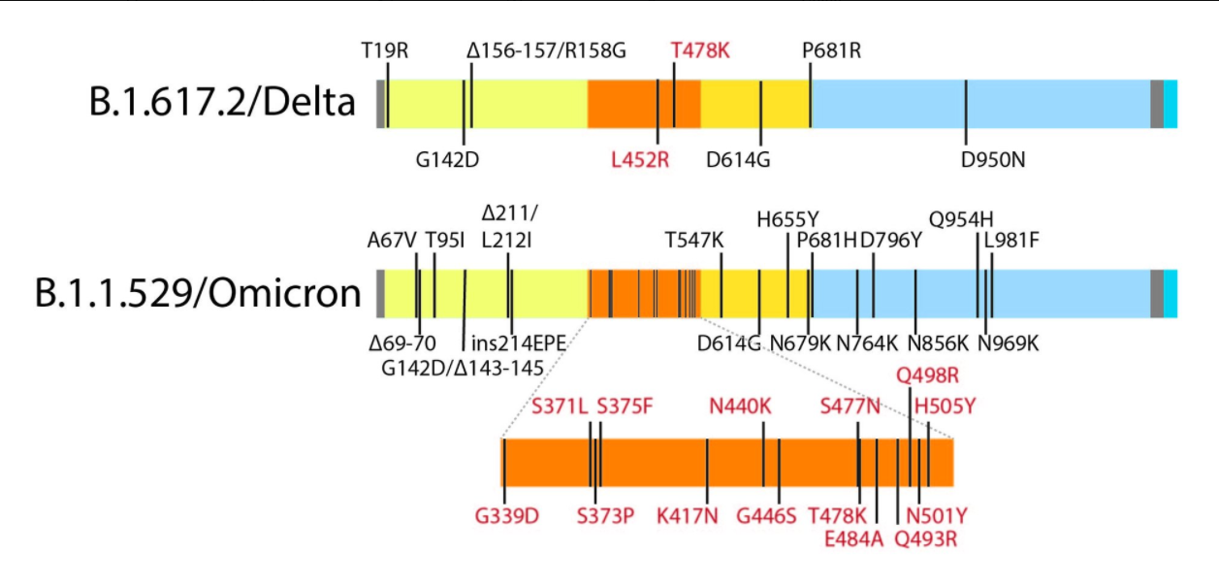

Slide 39
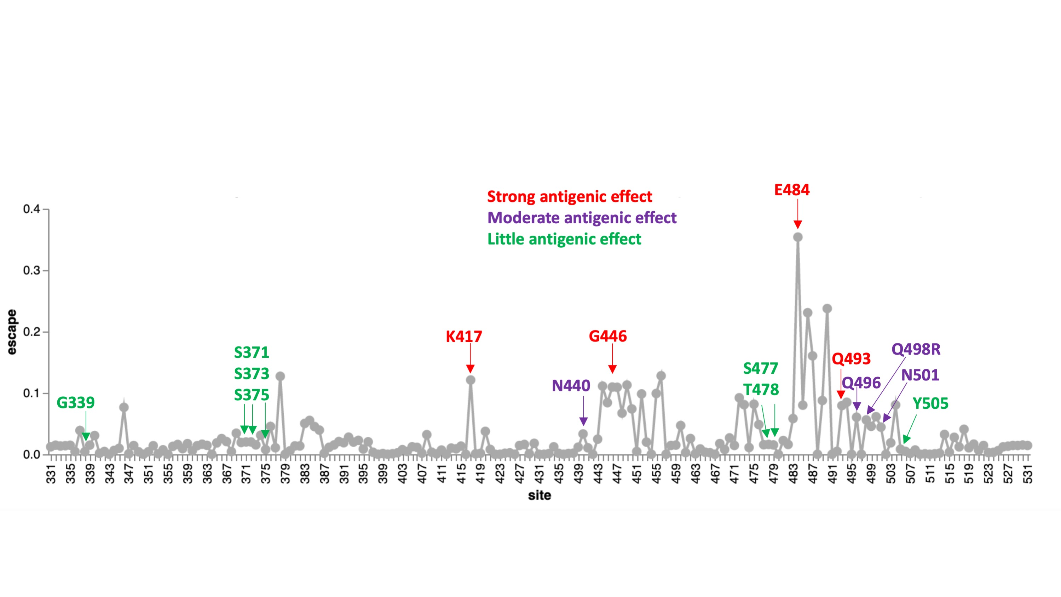

Slide 40


Slide 41


Slide 42

Immunity escape

Slide 43


Slide 44



adaptation
WT
omicron
ACE2
Thanks to Karel Berka

Slide 45

Change of tropism?

Slide 46


Slide 47
Notes to origin of SARS-CoV-2

Slide 48

How about other coronaviruses?
Notes:
By nagualdesign - This file is a derivative work of an image by Firas A. Rabi, Mazhar S. Al Zoubi, Ghena A. Kasasbeh, Dunia M. Salameh, and Amjad D. Al-Nasser.[1], CC BY 4.0, https://commons.wikimedia.org/w/index.php?curid=99490645

Slide 49


Slide 50

Other human coronaviruses

Slide 51


Slide 52

Origin of SARS-CoV-2
1. Tongguan Mine Shaft in Mojiang, Yunnan
2. The Wuhan Institute of Virology
3. The Wuhan Center for Disease Control and Prevention
4. The Huanan Seafood Wholesale Market,

Slide 53


Figure 1
Cell 2021 1844848-4856DOI: (10.1016/j.cell.2021.08.017)
Notes:
Phylogenetic and epidemiological data on the early COVID-19 pandemic in Wuhan
(A) Phylogenetic tree of early SARS-CoV-2 genomes sampled from Wuhan during December 2019–January 2020. The split between lineages A and B is labeled with the coordinates and base of the two differentiating nucleotide mutations. Cases with a known association to the Huanan or other markets are denoted by symbols (reported in World Health Organization, 2021).
(B) Map of districts of Wuhan showing the location of markets, the Wuhan National Biosafety Laboratory at the Zhengdian Scientific Park of the Wuhan Institute of Virology (denoted WIV), where the coronavirus isolation and culture work of Dr. Shi Zhengli is performed, and the earliest known cases.
(C–E) Location of recorded COVID-19 cases in Wuhan from December 8 to December 31, 2019. Cases with a home address outside of Wuhan city are not shown.
(F–H) Map of districts of Wuhan indicating the first record of excess deaths due to pneumonia (shaded green) from January 15, 2020. Case and excess death data were extracted and redrawn from figures provided in World Health Organization (2021).
See also Document S1.

Slide 54

Searching of origin of SARS-CoV-2

Slide 55


Slide 56

Searching of origin of SARS-CoV-2

Slide 57

Figure 2
Cell 2021 1844848-4856DOI: (10.1016/j.cell.2021.08.017)
Notes:
Evolution of the furin cleavage site in the spike protein of betacoronaviruses
(A) Sequence alignment of the region around the furin cleavage site (FCS) in SARS-CoV-2 (NCBI: MN908947) and bat coronavirus RaTG13 (NCBI: MN996532) showing that the former was the result of an out-of-frame nucleotide sequence insertion.
(B) Amino acid sequence alignment of the FCS region in representative members of the different subgenera of betacoronaviruses, highlighting the evolutionary volatility of this site and that the relevant amino acid motif (RRAR) in SARS-CoV-2 is functionally suboptimal. The residues predicted to be O-linked glycans are also marked.
See also Document S1.

Slide 58



Slide 59


Slide 60


Slide 61
That’s it, thanks
COG-CZ
Jan Pačes
Ústav molekulární genetiky AV ČR
Vysoká škola Chemicko-Technologická

Slide 62

MERS

Slide 63

Notes:
nextstrain

Slide 64


Slide 65

Spread of variants in space and time
Evropa
Afrika

Slide 66
Varianta B.1.1.7 (20I/501Y.V1)
Britská linie (prosinec 2020)
cca o 50% nakažlivější než původní wuhanský typ
N501Y – je v místě kontaktu s ACE2, umožňuje pevnější vazbu, je zodpovědná za efektivnější šíření. Nemá vliv na vazbu protilátek
P681H – zřejmě usnadňuje tvorbu nových spike proteinů
H69–V70 a Y144/145 delece, které mění tvar spike proteinu a pravděpodobně umožní únik některým protilátkám

Slide 67
Význam mutace N501Y

Slide 68


Mutace v Spike proteinu varianty B.1.1.7

Slide 69

Varianta B.1.351 (20H/501Y.V2)
Jihoafrická (prosinec 2020)
N501Y - (jako B.1.1.7)
K417N - podobně jako předcházející mutace zesiluje vazbu na ACE2 receptor
E484K – únik některým protilátkám

Slide 70

Varianta P1 (20J/501Y.V3)
Brazilská (konec roku 2020)
  Prvně detekovaná v Japonsku u turistů z Brazílie
podtřída B.1.1.28, podobná B.1.351
N501Y - (jako B.1.1.7)
K417T – na stejném místě jako u B.1.351, zesiluje vazbu na ACE2 receptor
E484K – únik některým protilátkám

Slide 71
Další důležité mutace
D614G – rozšířila se hned v počátcích, dominantní na celém světě. Zřejmě trochu zvyšuje infektivitu, klinicky se dává do souvislosti se ztrátou chuti a čichu
L452R – šíří se v USA, hlavně v Kalifornii (linie B.1.421 a B.1.429)

Slide 72
Q677 mutace

Slide 73

monitoring of mutations
Alpha disapearing
Delta growing
New mutations

Slide 75

Sezónost respiračních virů

Slide 76

Mutace společné více variantám

Slide 77


Slide 78

Spike gene

Slide 79

Mutation speed of SARS-CoV-2

Slide 80


3D structure of spike protein, trimer

Slide 81
The END
Jan Pačes
Ústav molekulární genetiky AV ČR
Vysoká škola Chemicko-Technologická

