Slide 1

Variant calling and annotation

Slide 2
You allready know how to
Download relevant data from SRA archive using SRAtoolkit
  https://trace.ncbi.nlm.nih.gov/Traces/sra/sra.cgi?view=software
Check the data quality using FastQC and other tools
  http://www.bioinformatics.babraham.ac.uk/projects/fastqc/
Correct problems with the data (remove adaptor sequences, trim low quality parts of the reads) using, e.g., Trimmomatic
  http://www.usadellab.org/cms/?page=trimmomatic
Prepare (index) reference genome and align reads to the reference genome using BWA or BowTie
  http://bowtie-bio.sourceforge.net/bowtie2/index.shtml
Visualize the data using IGV
  http://software.broadinstitute.org/software/igv/

Slide 3
Today we will learn to
Call variants
  Find differences between our data and the reference genome
Annotate variants
  Find the clinical relevance of the detected variants
Visualise the variants

Slide 4
Today we will learn to
Call variants
  Find differences between our data and the reference genome
Annotate variants
  Find the clinical relevance of the detected variants
Visualise the variants
Our today‘s goal is no smaller than to identify mutation causing many cancers including more than 60% of melanomas

Slide 5
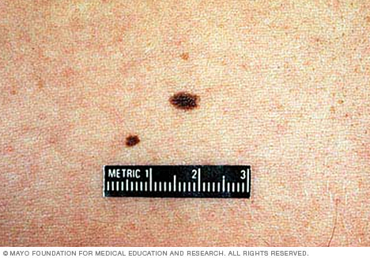
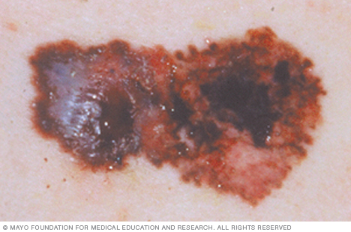
Are there any genetic differences between normal tissue and melanoma?
http://www.mayoclinic.org

Slide 6
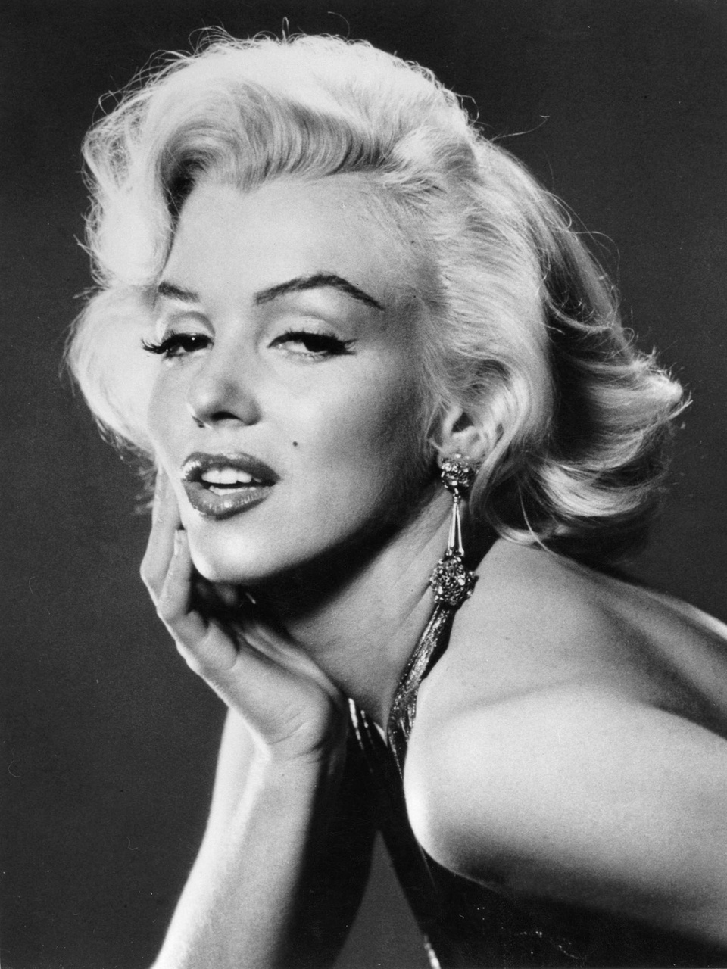
Beauty marks / normal moles
Uniform color
Distinct border separating the mole from your surrounding skin
Oval or round and usually smaller than 6 millimeters in diameter
Most people have between 10 and 45 moles
Moles may change in appearance over time
Moles are benign (even beautiful)
Melanocytes that form the mark are genetically normal
http://www.mayoclinic.org

Slide 7

Melanoma
Asymmetrical shape
Irregular border
Changes in color
Diameter larger than 6 millimeters
Evolving
Melanoma is malignant and deadly
Melanoma cells are genetically abberant and do not respond to stimuli of neighboring cells
http://www.mayoclinic.org

Slide 8
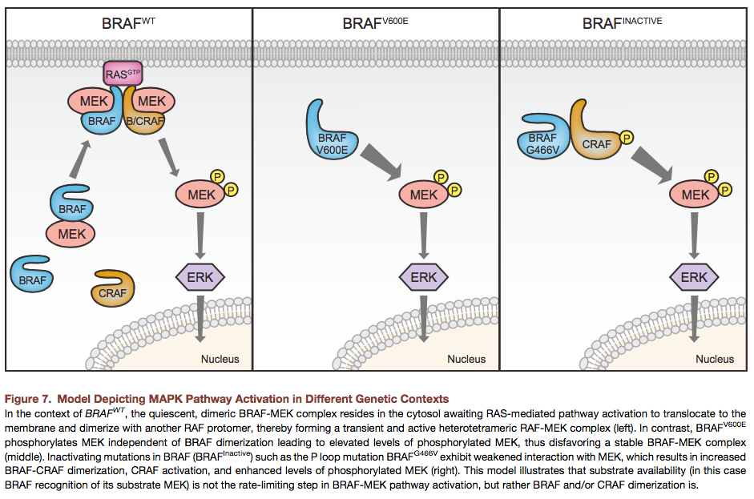
Melanoma
Transcriptomic analyses indicate that melanoma cells have abberant signalling by the Erk-signalling pathway
The pathway controls cell proliferation and survival and its link to cancer spread is obvious
Are there any genetic changes in the constituents of the pathway?
We are looking for somatic mutations, mutations that occur in melanoma cells but not in normal cells of the same individual
Haling et al., Cancer Cell 2014

Slide 9
Human reference genome
Genome Reference Consortium Human Build 38 (GRCh38)
Golden path length 3,096,649,726 bp
Total assembly length 3,554,996,726 bp (includes haplotypes and pseudoautosomal regions)
20,338 coding genes
22,521 non coding genes (5,363 small and 14,720 long)
14,638 pseudogenes
329,179,721 short variants
5,955,877 structural variants
200,310 gene transcripts
http://www.ensembl.org/Homo_sapiens/Info/Annotation

Slide 10
Human reference genome
Genome Reference Consortium Human Build 38 (GRCh38)
Golden path length 3,096,649,726 bp
Total assembly length 3,554,996,726 bp (includes haplotypes and pseudoautosomal regions)
20,338 coding genes
22,521 non coding genes (5,363 small and 14,720 long)
14,638 pseudogenes
329,179,721 short variants
5,955,877 structural variants
200,310 gene transcripts
Enormous space for variation and
somatic mutations
http://www.ensembl.org/Homo_sapiens/Info/Annotation

Slide 11

Genetic variation causes differences in phenotypes, differences between people

Slide 12
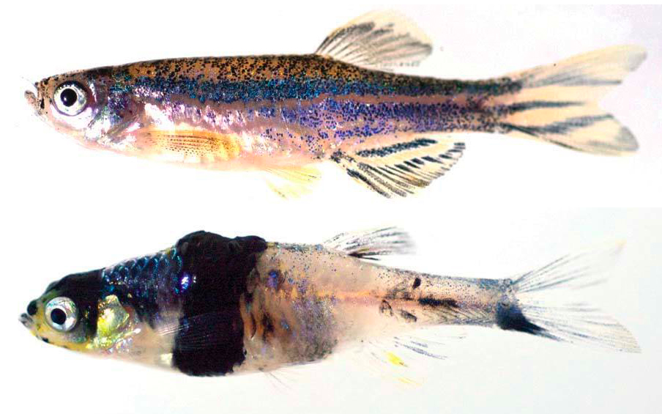
Some genetic variation may cause diseases
including melanoma
Kaufman et al., Science 2016

Slide 13

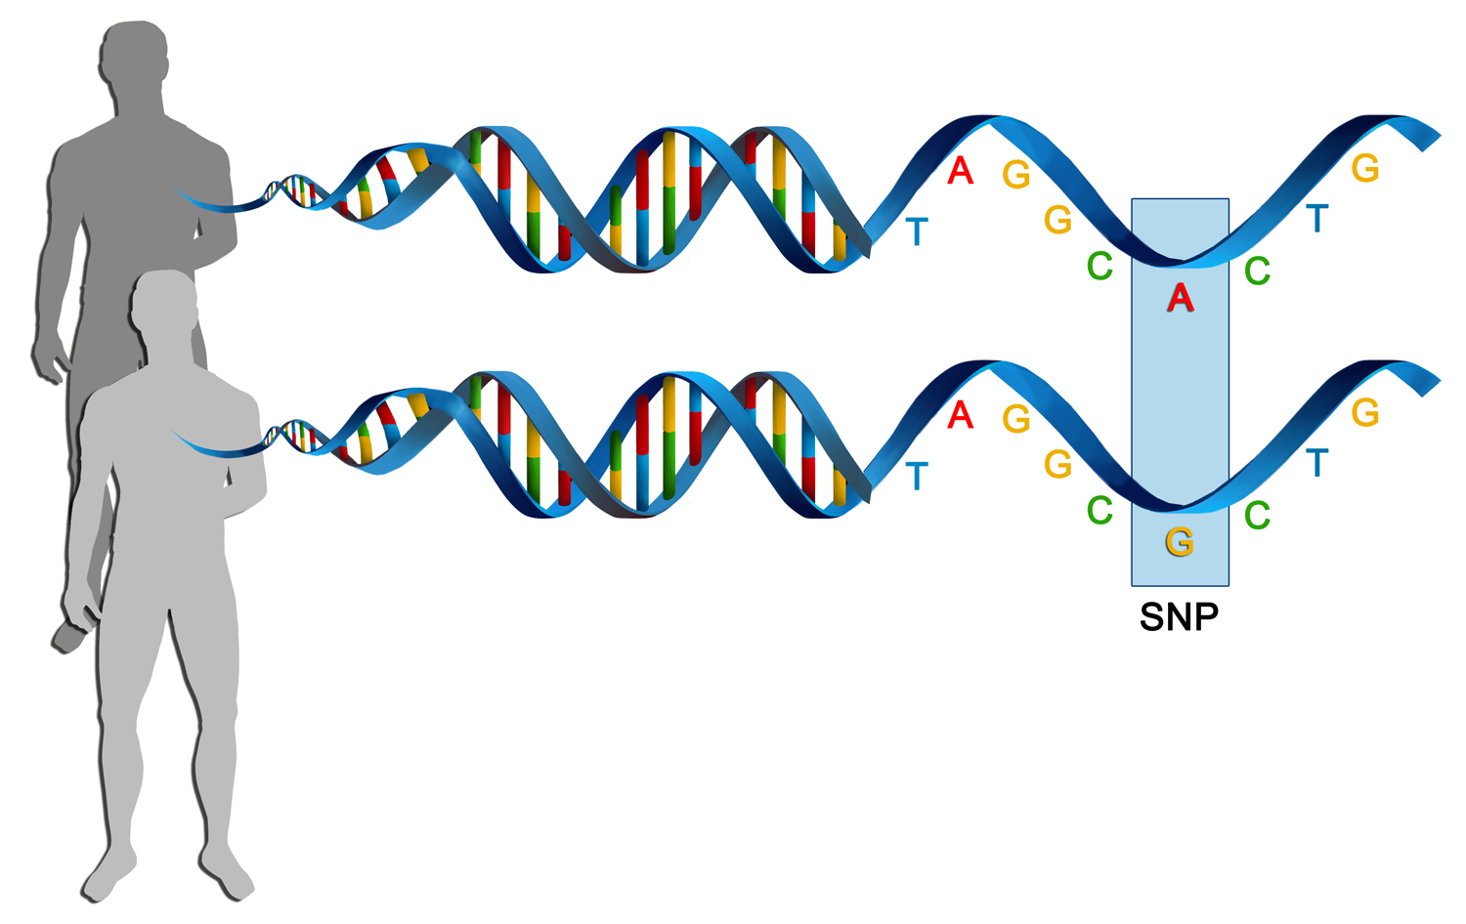
Types of genetic variants / mutations
Germline
Somatic
Genetic changes in individuals
relative to the reference genome
between individuals
between tissues of the same individual
Adapted from https://software.broadinstitute.org/gatk/ and http://atlasofscience.org and

Slide 14
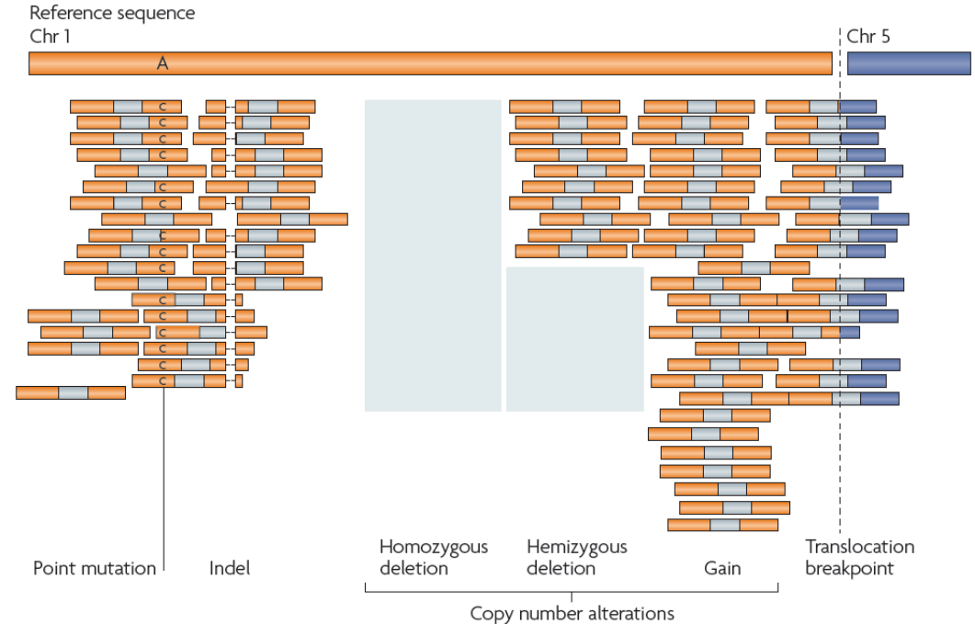
Types of genetic variants / mutations / 2
Single, di-, tri- nucleotide polymorphism / variant (SNP / SNV)
Insertion od deletion (Indel)
Copy number polymorphism or variant (CNP / CNV)
Structural variant (SV)
SNP / SNV
Indel
CNP / CNV
SV
Adapted from https://software.broadinstitute.org/gatk/

Slide 15
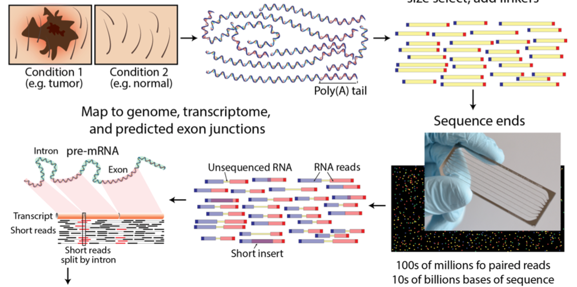

Sequencing approaches to identify short genetic variants and somatic mutations
DNA
Labelled DNA fragments
Normal blood and melanoma samples
Align to reference genome
Sequencing reads
Find differences between blood and melanoma reads
Adapted from Griffith et al., PLoS One 2015

Slide 16
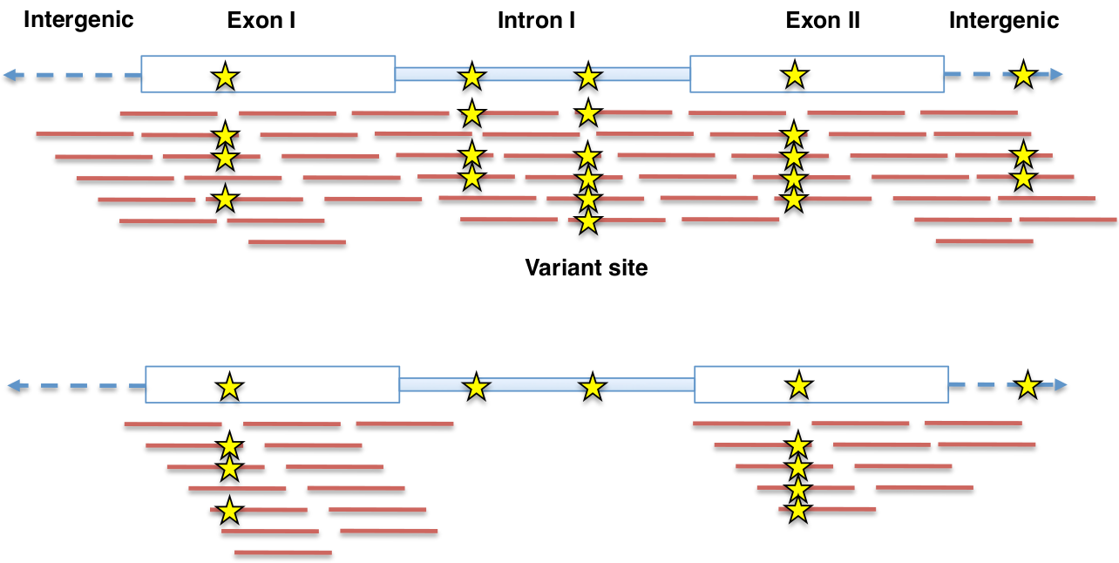
Sequencing approaches to identify short genetic variants and somatic mutations / 2
Whole genome sequencing (WGS)
Whole exome sequencing (WES) or some gene panel; sequence capture
Adapted from https://software.broadinstitute.org/gatk/documentation/presentations.php

Slide 17
A typical dataset
An example dataset from Hugo et al. in their 2017 Cell paper
SRAtoolkit to dowload data from the BioProject
  https://www.ncbi.nlm.nih.gov//bioproject/PRJNA307199
A subset of nine patients
For each patient we have two samples – blood, which is considered genetically normal, and melanoma
The original data is huge
  Approximatelly 100 million reads per sample
  Roughly 8 GB of data per sample
Hugo et al., Cell 2017

Slide 18
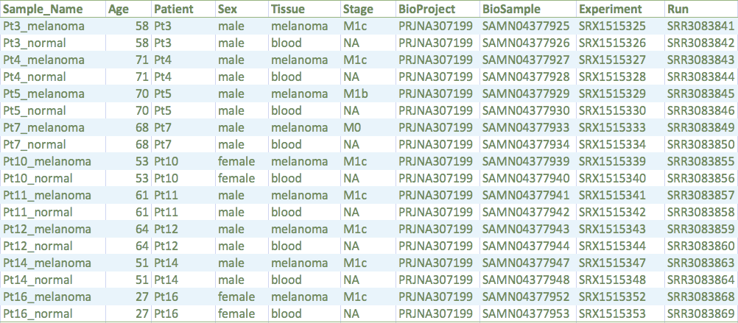
The dataset
Hugo et al., Cell 2017

Slide 19
Software
Picard – manipulation of the input files
  http://broadinstitute.github.io/picard/
  MIT license (essentially free for all uses)
  Alternative software is, e.g., samtools
GATK – gold standard in variant calling
  Genome analysis toolkit, https://software.broadinstitute.org/gatk/
  Free for academy, licensed for commerce, coming version will be open source
  Alternative software FreeBayes or DeepVariant by Google
Mutect2 – detects somatic mutations in tumours
  Part of the Genome analysis toolkit, https://software.broadinstitute.org/gatk/
  Free for academy, licensed for commerce, coming version will be open source
  Alternative software VarScan2

Slide 20
Software / 2
SnpEff – variant annotation
  http://snpeff.sourceforge.net/
  LGPLv3 license (essentially free for all uses)
  Alternative is, e.g., Ensembl VEP, PredictSNP2
IGV - variant visualization
  Integrative genomics viewer, http://software.broadinstitute.org/software/igv/
  MIT license (essentially free for all uses)
  Alternative is Tablet or web based genomic browsers such as ensEMBL or UCSC genome browser
All the software is Java based and thus multiplatform

Slide 21
Analysis workflow
Obtain analysis-ready reads
  Sequencing (starting from the biological material we obtain raw reads in the fastq format)
  Raw read trimming (remove any technical artifacts in the data and low quality reads)
  Align the reads on the reference genome (obtain bam files)
  Mark duplicates & sort (get rid of reads that come from the same DNA fragment)
  Indel realignment (adjust for errors introduced by aligner)
  Base recalibration (adjust for inaccuracies in base-quality estimation and obtain analysis-ready reads)

Slide 22
Analysis workflow / 2
Variant discovery per se - depends on type of variant, which we want to study
  Germline SNPs and Indels
  Somatic SNVs and Indels – this talk
  Somatic CNVs

Slide 23
Analysis workflow / 5
Annotate variants – estimate consequences of the detected variants
  Is the variant in coding or non-coding region of the genome?
  What gene may be affected by the variant?
  Is the variant synonymous/silent or non-synonymous?
  Does it introduce an aberrant stop codon?
  Does it damage splicing site?
  What are the consequences for the coded protein?
Visualize the variants
  The results are stored in a VCF file, which stores positions of the detected variants and alleles in all samples, together with variant annotation

Slide 24
Analysis workflow / 6
Disease gene prioritization – select the variants worth further study
  Driver / passenger mutation in cancer
  Pathogenicity prediction
  Possibility of translation to clinics

Slide 25
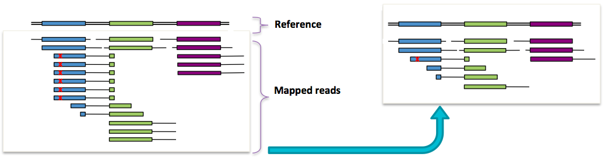
Obtain analysis-ready reads: Duplicate reads
Our goal is to remove non-independent observations
Read duplicates are non-independent measurements of single sequence fragment
Their occurrence violate assumptions made during variant calling
Errors in library preparation (X) are propagated to all replicates
Keep one representative read for all replicates (the one with the best quality)
Mark duplicates
Adapted from https://software.broadinstitute.org/gatk/documentation/presentations.php

Slide 26
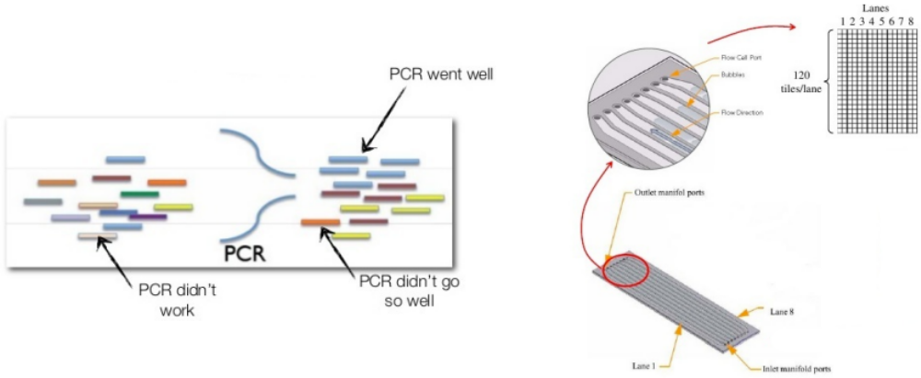
Obtain analysis-ready reads: Duplicate reads
PCR/amplification replicates occur during sequencing library preparation
Optical replicates occur during Illumina sequencing, several clusters are created from the same fragment
PCR/amplification
Optical
Adapted from https://software.broadinstitute.org/gatk/documentation/presentations.php

Slide 27
Obtain analysis-ready reads: Realignment around indels
Our goal is to improve alignments around indels (insertions and deletions) with local realignment
Aligner considers each read independently
It often makes mistakes at read ends and in homopolymer runs
It cannot see indels near ends of reads
The penalty for two mismatches is 2 x -1, the penalty for opened gap is -3
reference C A T G
insertion C AGCT G
deletion C . T G
reference T A C C C A T T T T T T T C T A A A A G C T
Aligner C C A T T T T T T C T A A A A A C T
Correct C C A – T T T T T T C T A A A A A C T
Adapted from https://software.broadinstitute.org/gatk/documentation/presentations.php

Slide 28
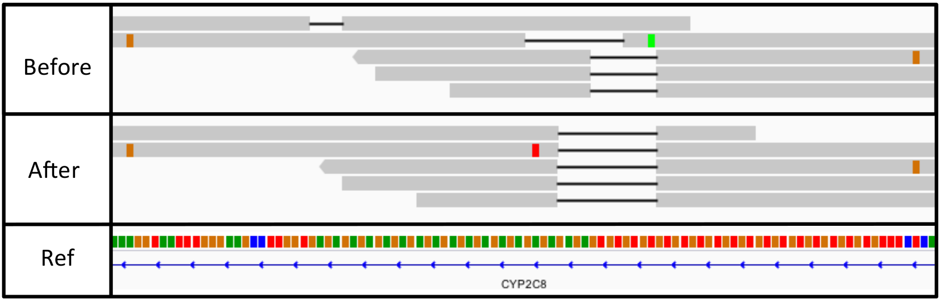
Obtain analysis-ready reads: Realignment around indels
Local realignment uses information across reads to find out correct alignment
Adapted from https://software.broadinstitute.org/gatk/documentation/presentations.php

Slide 29
Obtain analysis-ready reads: Base quality score recalibration
Quality scores issued by sequencers are inaccurate and biased
  But the quality scores are critical for all downstream analysis
  Systematic biases in quality are a major contributor to bad variant calls
Systematic errors correlate with basecall features
  Reported quality score (expected)
  Position within the read (machine cycle)
  Sequence context (sequencing chemistry effects)
Calculate error empirically and find patterns in how error varies with basecall features
  Any difference against the reference is error, unless it is a known variant
Recalibrate the qualities
Adapted from https://software.broadinstitute.org/gatk/documentation/presentations.php

Slide 30
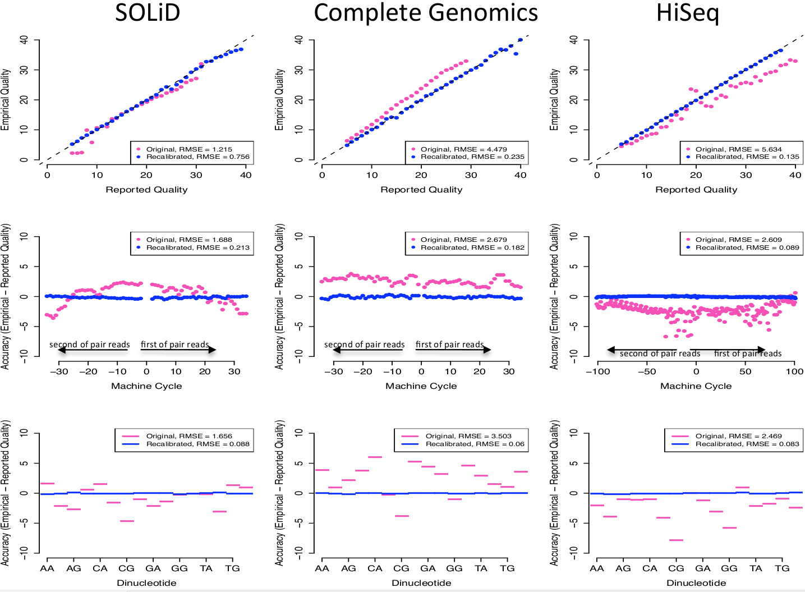
Adapted from https://software.broadinstitute.org/gatk/documentation/presentations.php

Slide 31
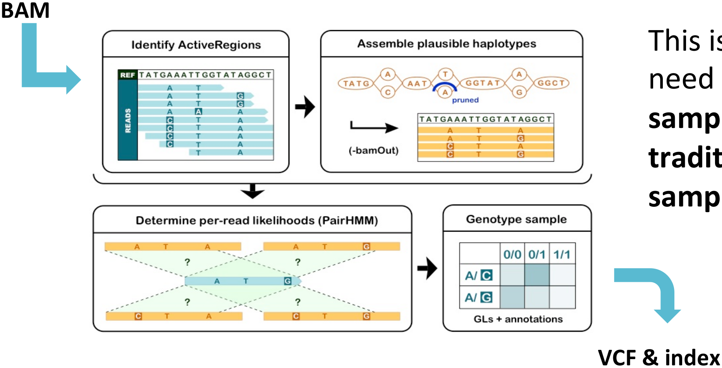
Variant discovery per se: Simple germline variant discovery
Adapted from https://software.broadinstitute.org/gatk/documentation/presentations.php

Slide 32
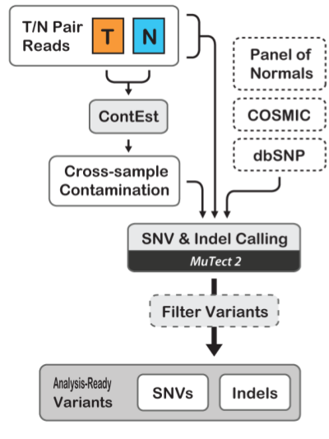
Variant discovery per se: Somatic variant discovery
Discovery of somatic SNVs and Indels
  Compare tumour (melanoma) samples and normal (blood) tissues
  Melanoma samples may contain healthy tissue
  Create panel of normals (PoN) to see natural variants
  Estimate contamination of the samples
  Get genotypes of normal samples (germline SNP and indels)
  Estimate sequencing artifacts, if any
  Call somatic SNVs and indels
  The results are stored in a VCF file, which stores positions of the detected variants and alleles in all samples
Adapted from https://software.broadinstitute.org/gatk/documentation/presentations.php

Slide 33
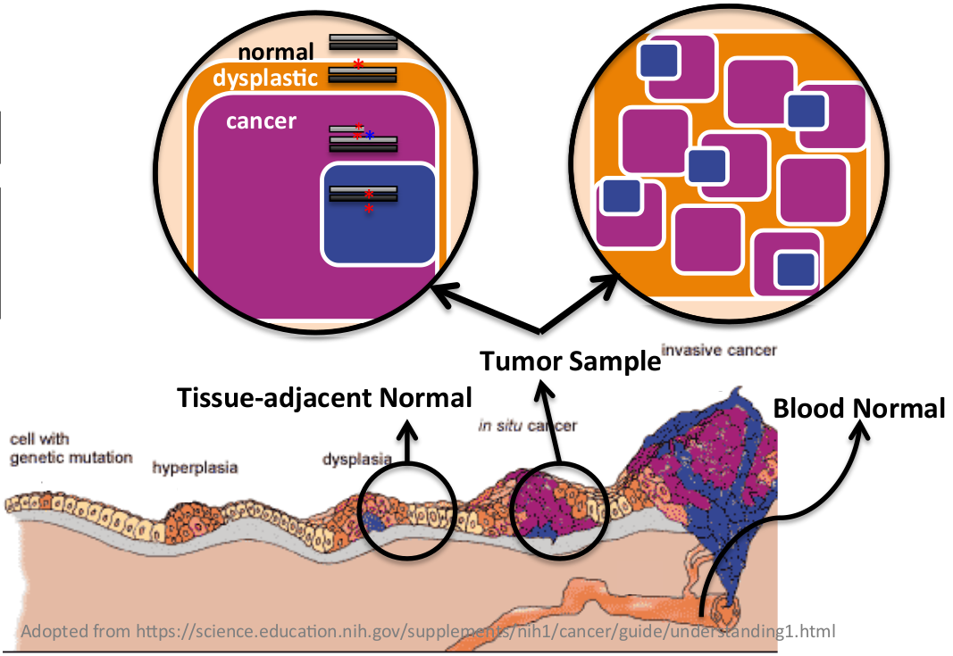
Variant discovery per se: Somatic variant discovery
Tumor heterogeneity is based on polygenomic populations, segregated or intermixed, due to ongoing subclonal evolution
Tumor purity = fraction of tumor cells in the sample
Adapted from https://software.broadinstitute.org/gatk/documentation/presentations.php

Slide 34
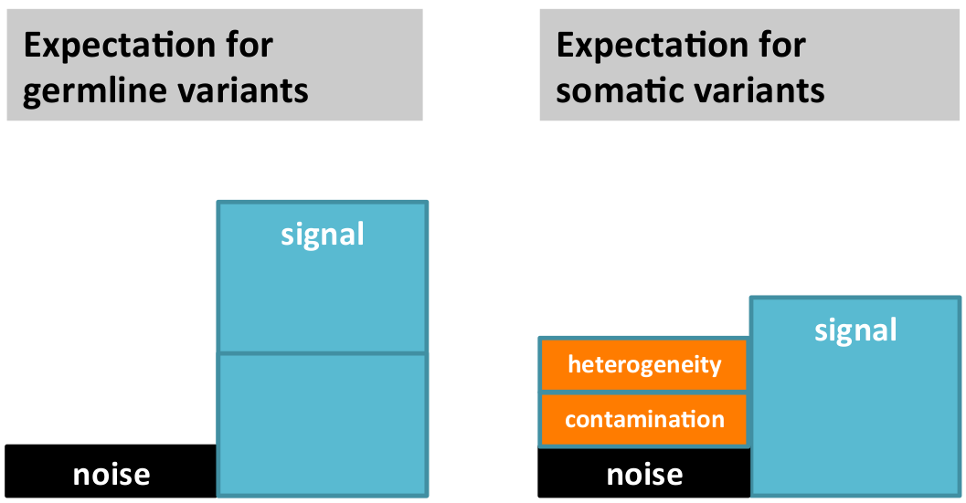
Variant discovery per se: Somatic variant discovery
Tumor heterogeneity is based on polygenomic populations, segregated or intermixed, due to ongoing subclonal evolution
Tumor purity = fraction of tumor cells in the sample
Some assumptions made in germline variant discovery do not apply
Allele frequency is expected to follow ploidy
Allele frequency is not expected to follow ploidy
Adapted from https://software.broadinstitute.org/gatk/documentation/presentations.php

Slide 35
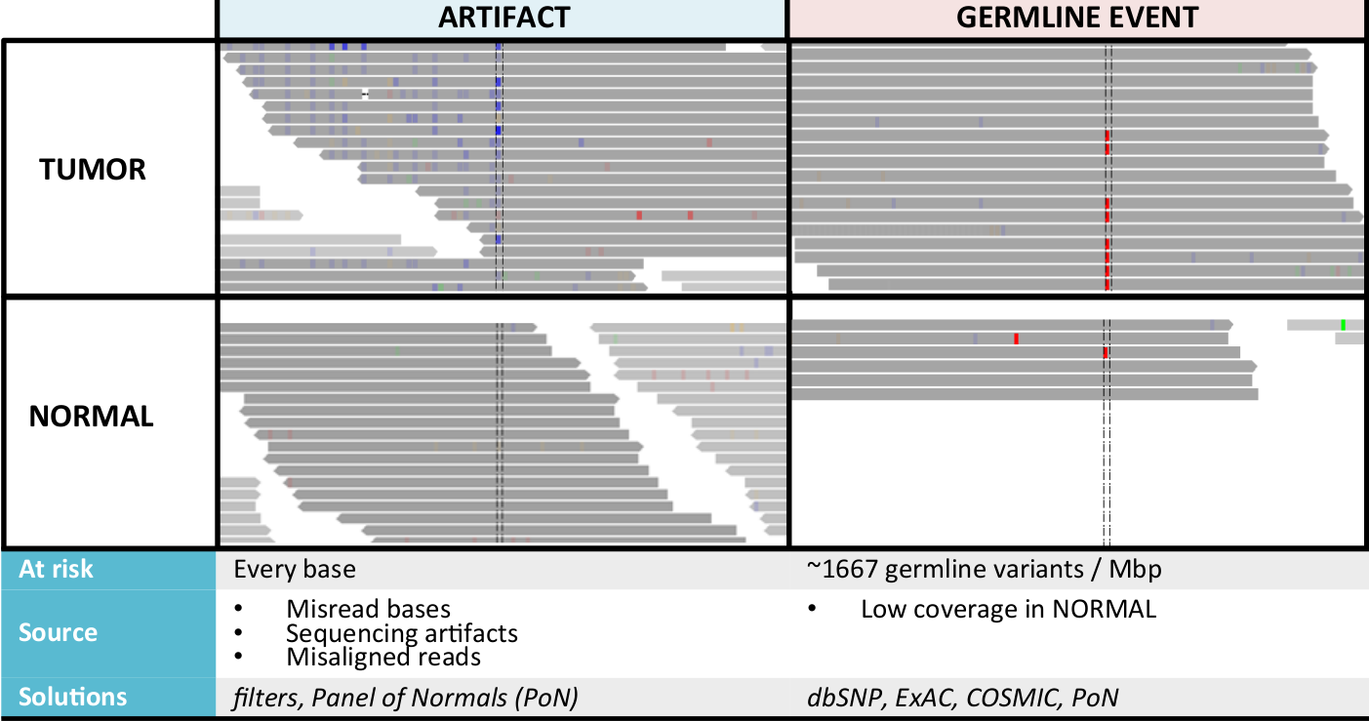
Variant discovery per se: Somatic variant discovery
False positives from artifacts and germline variation
Adapted from https://software.broadinstitute.org/gatk/documentation/presentations.php

Slide 36
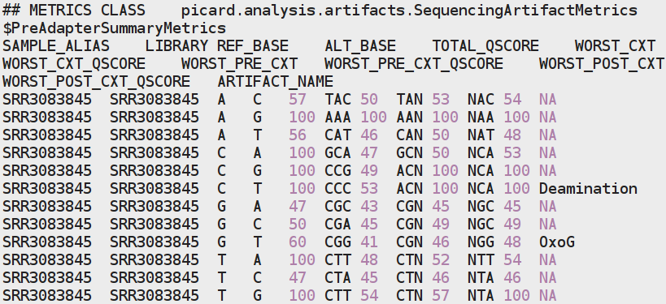
Variant discovery per se: Estimate artifacts
Picard’s CollectSequencingArtifactMetrics provides us with an estimate of the extent of potential artifacts related to sequence context
The metrics can help you decide whether you should consider downstream filtering
Among several output files, examine the ​ pre_adapter_summary_metrics using cat:
​

Slide 37
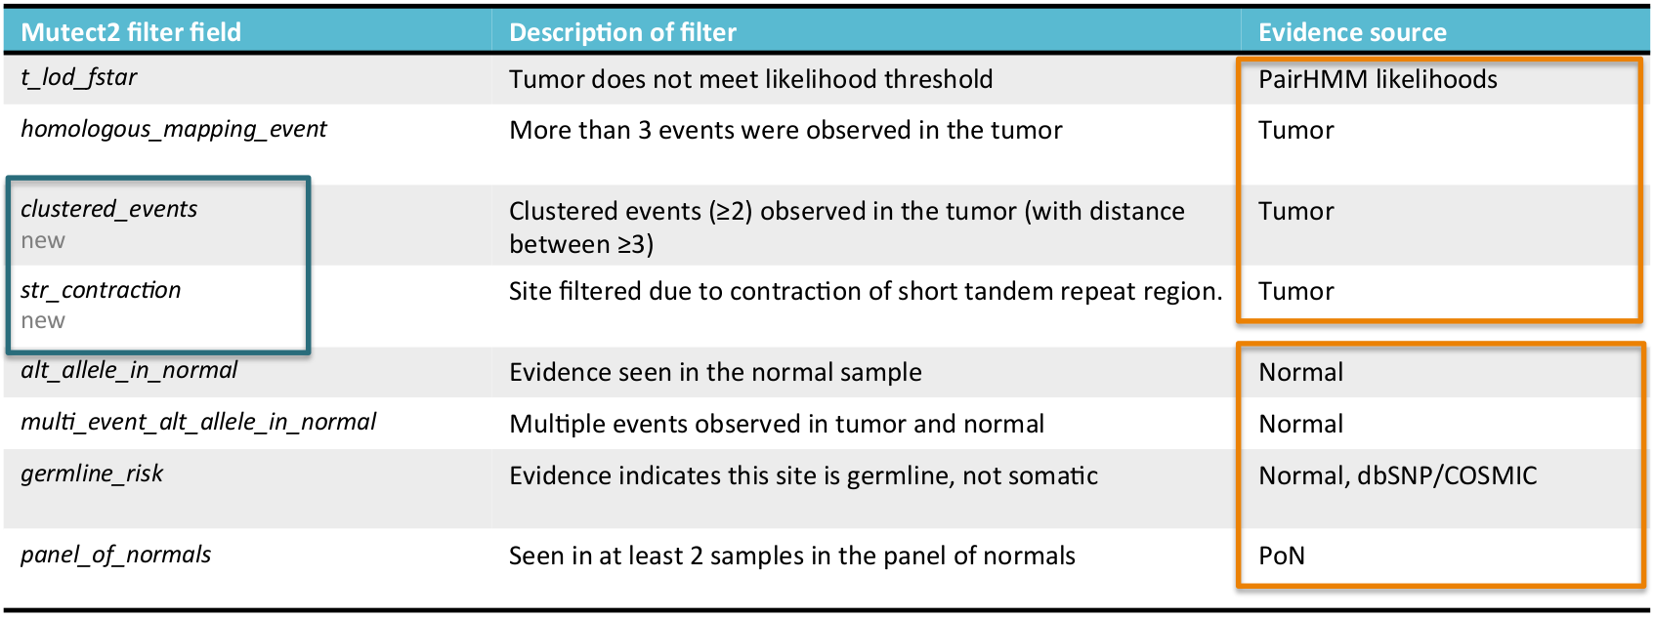
Variant discovery per se: Filter calls
Many filters are available (names differ by software, here GATK)
Adapted from https://software.broadinstitute.org/gatk/documentation/presentations.php

Slide 38
Variant Call Format (VCF) file
Header contains metadata
  Header lines start with #. Special keywords are denoted with ##.
  Recommended keywords include fileformat, fileDate, contig, and reference.
  INFO, FILTER, and FORMAT describe the fields used in the records in the body of the file
Records
  CHROM, POS – contig (chromosome) and position of the variant on the contig
  ID, REF, ALT – identifier of the variant, reference allele, and alternative allele
  QUAL, FILTER – quality score of the variant; filters passed
  INFO – extensible list of key-value pairs describing the variant
  FORMAT – extensible list of fields for sample description
  SAMPLE – sample information according to FORMAT

Slide 39
VCF file – simple example
##fileformat=VCFv4.0
##fileDate=20090805
##source=myImputationProgramV3.1
##reference=1000GenomesPilot-NCBI36
##INFO=<ID=NS,Number=1,Type=Integer,Description="Number of Samples With Data">
##INFO=<ID=DP,Number=1,Type=Integer,Description="Total Depth">
##INFO=<ID=AF,Number=.,Type=Float,Description="Allele Frequency">
##INFO=<ID=AA,Number=1,Type=String,Description="Ancestral Allele">
##INFO=<ID=DB,Number=0,Type=Flag,Description="dbSNP membership, build 129">
##INFO=<ID=H2,Number=0,Type=Flag,Description="HapMap2 membership">
##FILTER=<ID=q10,Description="Quality below 10">
##FILTER=<ID=s50,Description="Less than 50% of samples have data">
##FORMAT=<ID=GT,Number=1,Type=String,Description="Genotype">
##FORMAT=<ID=GQ,Number=1,Type=Integer,Description="Genotype Quality">
##FORMAT=<ID=DP,Number=1,Type=Integer,Description="Read Depth">
##FORMAT=<ID=HQ,Number=2,Type=Integer,Description="Haplotype Quality">
#CHROM POS ID REF ALT QUAL FILTER INFO FORMAT NA00001 NA00002 NA00003
20 14370 rs6054257 G A 29 PASS NS=3;DP=14;AF=0.5;DB;H2 GT:GQ:DP:HQ 0|0:48:1:51,51 1|0:48:8:51,51 1/1:43:5:.,.
20 17330 . T A 3 q10 NS=3;DP=11;AF=0.017 GT:GQ:DP:HQ 0|0:49:3:58,50 0|1:3:5:65,3 0/0:41:3
20 1110696 rs6040355 A G,T 67 PASS NS=2;DP=10;AF=0.333,0.667;AA=T;DB GT:GQ:DP:HQ 1|2:21:6:23,27 2|1:2:0:18,2 2/2:35:4
20 1230237 . T . 47 s50 NS=3;DP=13;AA=T GT:GQ:DP:HQ 0|0:9:7:56,60 0|0:48:4:51,51 0/0:61:2
20 1234567 microsat1 GTCT G,GTACT 50 PASS NS=3;DP=9;AA=G GT:GQ:DP 0/1:35:4 0/2:17:2 1/1:40:3
Adapted from http://www.internationalgenome.org/

Slide 40
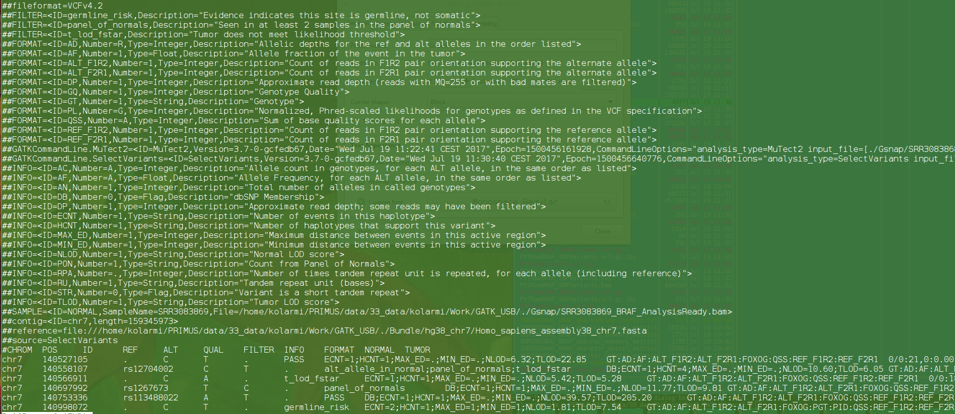
VCF file – actual example
Adapted from https://software.broadinstitute.org/gatk/documentation/presentations.php

Slide 41
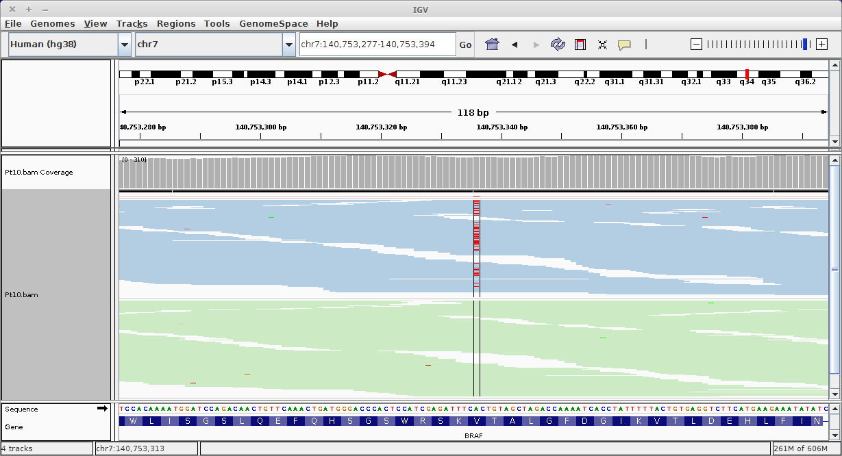
Variant discovery per se: Visualize called variants
​Use IGV to visualize locus chr7:140,753,277-140,753,394

Slide 42
Annotate variants
We successfully prepared analysis-ready bam files
Called variants
We know how to visualize the variants
We still have to
Annotate variants – estimate consequences of the detected variants
  Is the variant in coding or non-coding region of the genome?
  What gene may be affected by the variant?
  Is the variant synonymous/silent or non-synonymous?
  Does it introduce an aberrant stop codon?
  Does it damage splicing site?
  What are the consequences for the coded protein
Adapted from https://software.broadinstitute.org/gatk/documentation/presentations.php

Slide 43
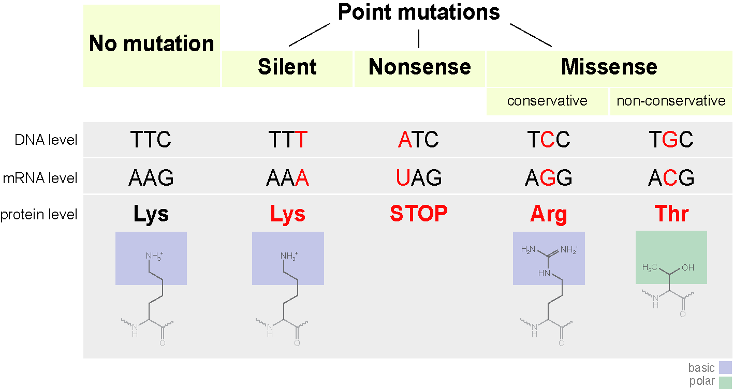
Annotate variants
Mutations
  Coding / non-coding
  Silent / nonsense / missense / frameshift
Adapted from https://upload.wikimedia.org/wikipedia/commons/6/69/Point_mutations-en.png

Slide 44
Annotate variants with SnpEff
SnpEff returns
  Feature type that is affected by the mutation (e.g. transcript, motif, miRNA)
  Feature ID as a db entry for the feature (e.g. transcript ID, motif ID, miRNA, ChIP-seq peak, histone mark)
  Transcript biotype: coding or noncoding
  Position in cDNA, CDS, protein
  Effect estimate (e.g.
    frameshift_variant, stop_gained, start_lost, splice_acceptor_variant,
    missense_variant,, disruptive_inframe_deletion, coding_sequence_variant,
    splice_region_variant, synonymous_variant,
    3_prime_UTR_variant, downstream_gene_variant, TF_binding_site_variant, …)
  Putative impact (high, moderate, low, modifier)

Slide 45
Annotate variants with SnpEff
SnpEff output is a complex vcf file with plenty information
The most interesting part is the line
We see that the patient Pt10 has somatic V600E mutation in BRAF
Position of the variant and its quality
chr7 140753336 rs113488022 A T . PASS
DB;ECNT=1;HCNT=1;MAX_ED=.;MIN_ED=.;NLOD=42.39;TLOD=160.89;
ANN=T|missense_variant|MODERATE|BRAF|ENSG00000157764|transcript|ENST00000288602.10|protein_coding|15/18|c.1799T>A|p.Val600Glu|1860/2480|1799/2301|600/766||,
GT : AD : AF : ALT_F1R2: ALT_F2R1: REF_F1R2: REF_F2R1
0/0: 148,0: 0.00 : 0 : 0 : 54 : 94
0/1: 84,52: 0.392: 20 : 32 : 32 : 52
SnpEff annotation
Genotype of the samples

Slide 46
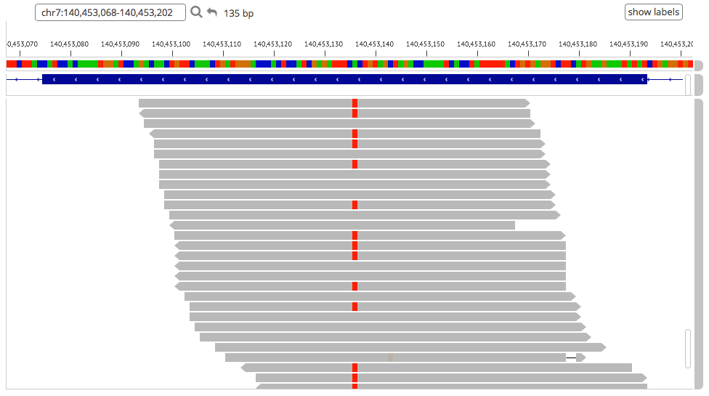
Recurrent BRAF mutation in melanomas
http://exac.broadinstitute.org, Davies et al., Nature 2002

Slide 47
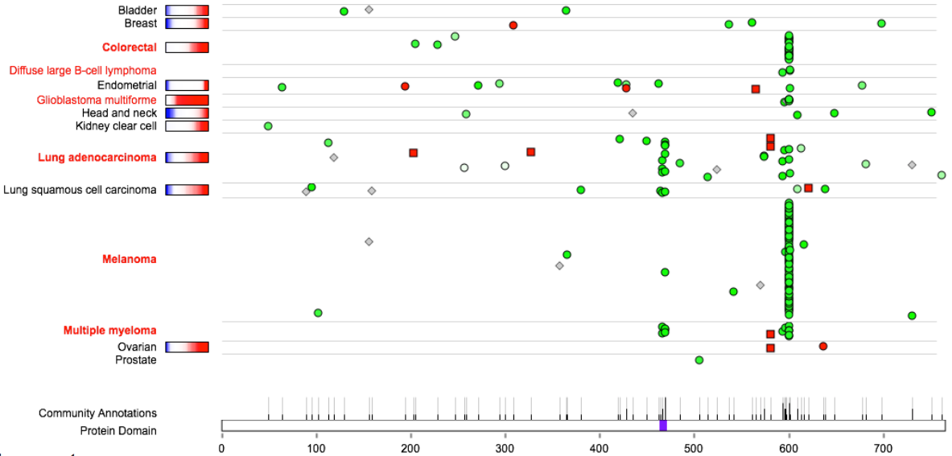
Recurrent BRAF mutation in melanomas
http://www.tumorportal.org/

Slide 48
Recurrent BRAF V600E mutation in melanomas
60% melanomas have a specific mutation in B-Raf protein
Valine at position 600 is replaced by glutamate
This replacement leads to structural changes of the protein kinase, which in turn constitutively activates the Erk-signalling pathway
The melanoma cells are driven to proliferation, migration, and ability to survive out of their natural niche
Haling et al., Cancer Cell 2014

Slide 49
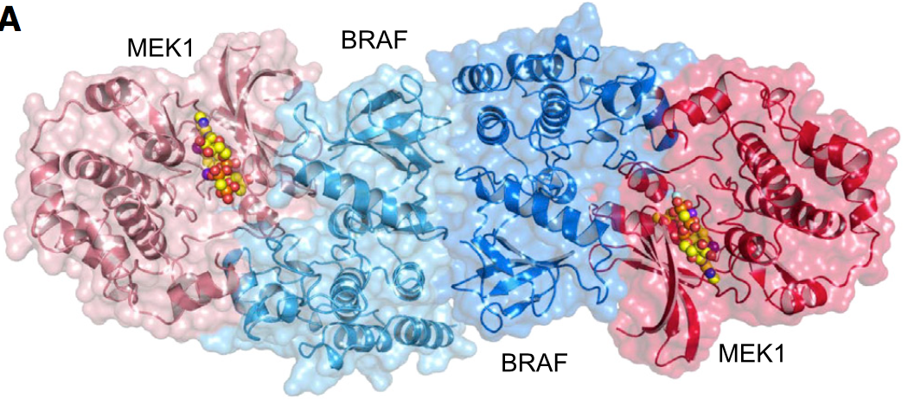
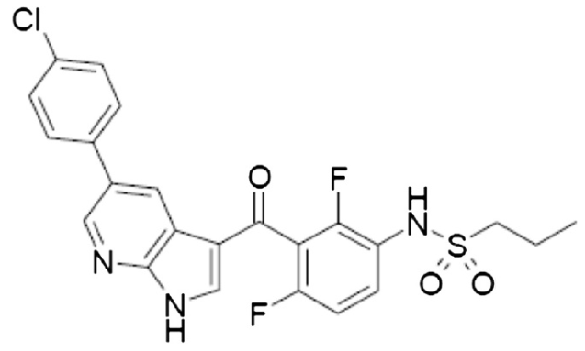
Recurrent BRAF V600E mutation in melanomas
We even know the structural consequences of the mutation and mechanism of the action
A small molecular drug was developed to block the action (vemurafenib) and clinically approved
Treatment by this drug prolongs survival of melanoma patients by six months
Unfortunately, resistance develops
Haling et al., Cancer Cell 2014

Slide 50
Summary
For a small cohort of patients, we
Got sequence data
Preprocessed raw sequencing data
Aligned the fastq reads to reference genome
Prepared bam reads for variant calling
Called, filtered, and visualized variants
Annotated the variants
Patient Pt10 has somatic V600E mutation in BRAF gene
We can direct her to treatment by vemurafenib and hopefully cure her melanoma
...|BRAF|ENSG00000157764|transcript...
...18|c.1799T>A|p.Val600Glu|1860/24...

