Slide 1

Genome-wide association studies

Slide 2
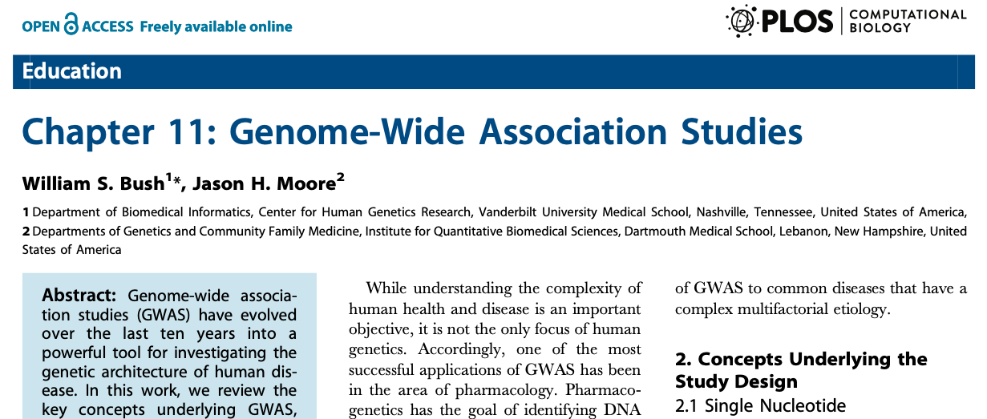
Based on
Bush & Moore, PLoS Comp. Biol. 2012

Slide 3

Recomended reading

Slide 4
Goals of a genetic study of a disease
Determine if there is a genetic component of a disease
Describe mode of disease inheritance
Determine the effect size of the genetic component
Identify the gene causing the disease
Notes:
Need to interact
Bought in summer 2019

Slide 5
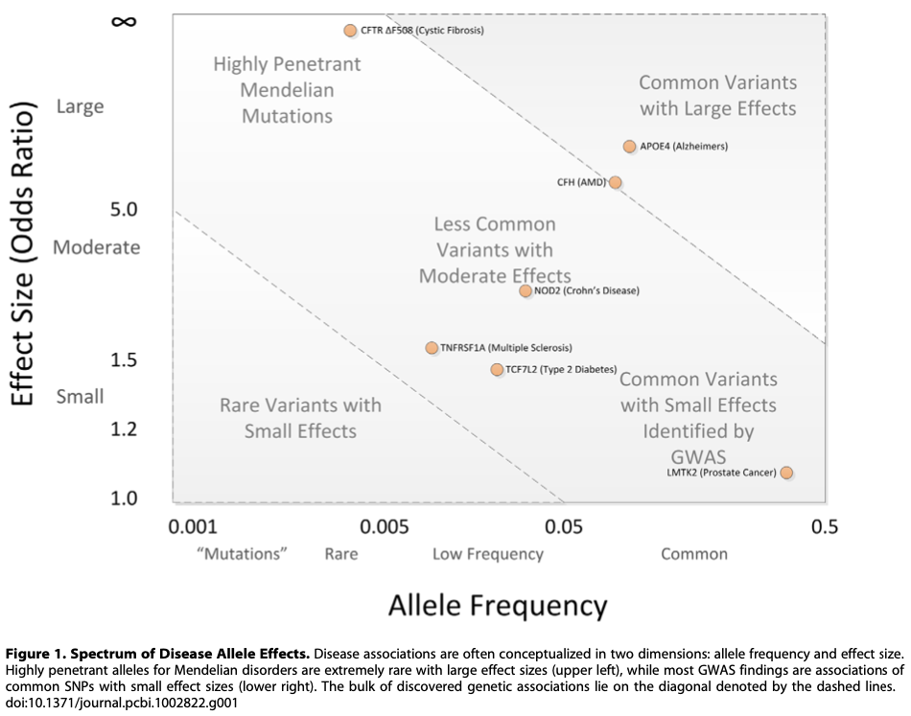
Based on
Evolution?
Purifying selection.
Evolution?
Prohibited!
Evolution?
Neutral?
Evolution?
Nearly neutral.
Minor allele frequency
Bush & Moore, PLoS Comp. Biol. 2012

Slide 6
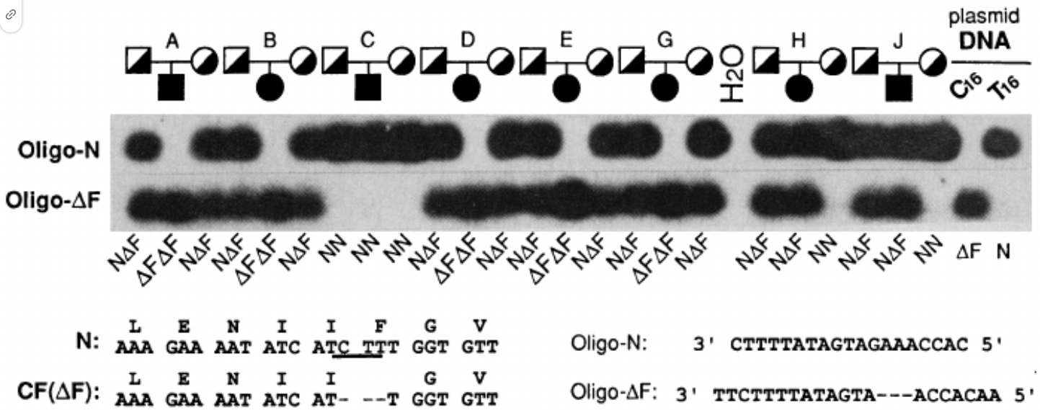
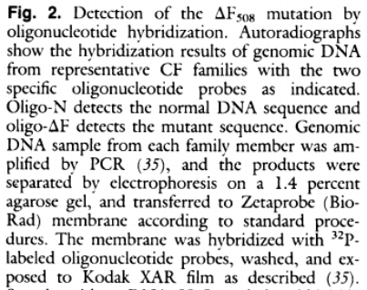
Mendelian diseases (rare variants)
The genetic component may be determined using family study, linkage analysis
Allows estimation of genetic component
Genetic markers
Allows examination of mode of inheritance
Difficult to collect
Power derived from the number of families
E.g. CFTR gene in cystic fibrosis,
Huntington disease, …
Kerem et al., Science 1989
Notes:
Need to interact
Bought in summer 2019

Slide 7
Complex diseases - many common variants
Linkage analysis fails when applied to more common diseases
Common disease / common variant hypothesis
Implies small effect size or penetrance of the variant
Multiple common alleles must influence disease susceptibility
Each SNP explains only a small proportion of the risk
Family-based studies are not suitable for detection of common variants
Notes:
Need to interact
Bought in summer 2019

Slide 8


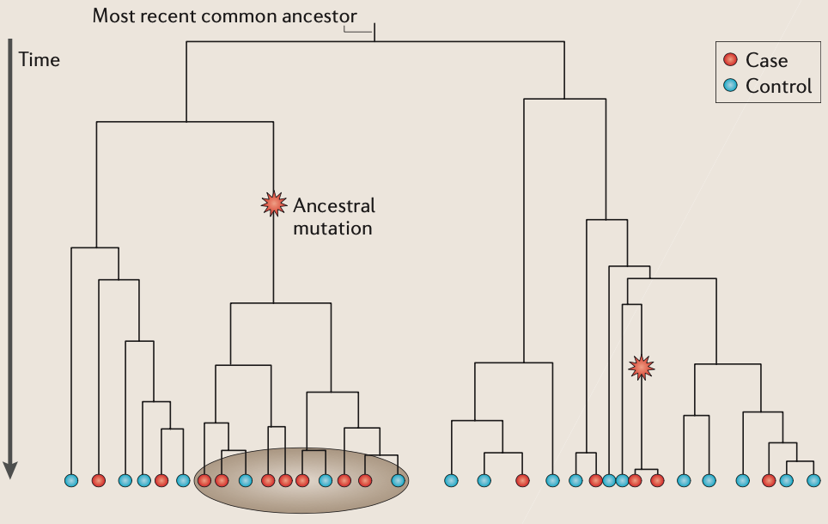
Complex diseases - many common variants
Still, the genetic component may be determined using population study
Large sample sizes
Assumes there is a genetic component
Power derived from odds ratio of controls to cases
Notes:
Need to interact
Bought in summer 2019

Slide 9
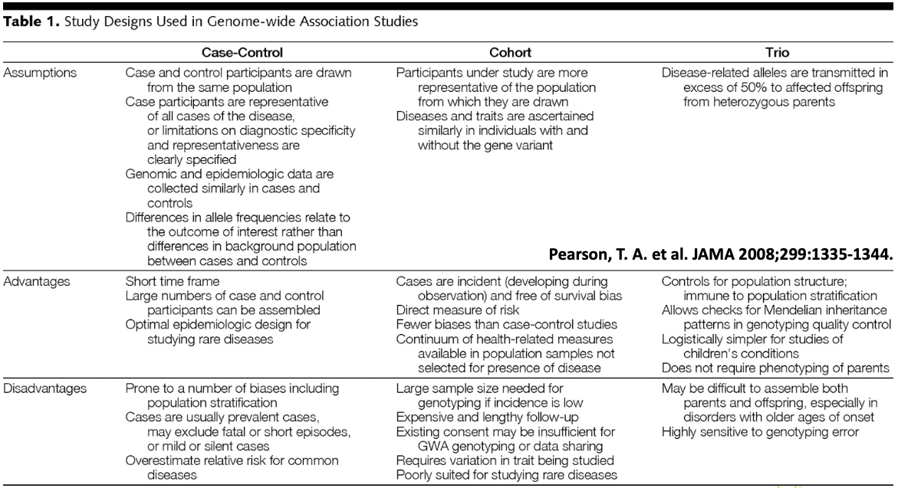
Genome wide association study (GWAS)
Pearson et al. JAMA 2008
Notes:
Need to interact
Bought in summer 2019

Slide 10
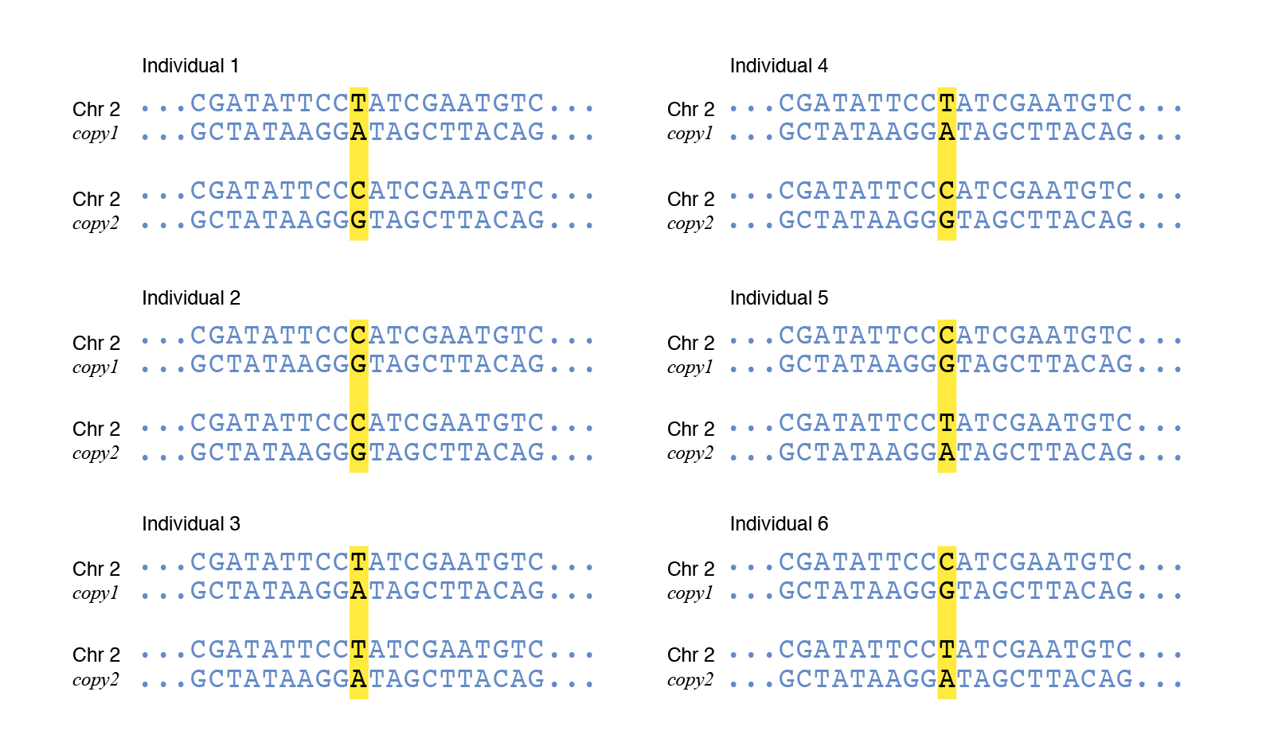
Concepts underlying the GWAS studies
Single nucleotide polymorphism (SNP)
Common genetic variation
Minor allele frequency
C.f. rare detrimental variants = mutations
Notes:
Need to interact
Bought in summer 2019

Slide 11
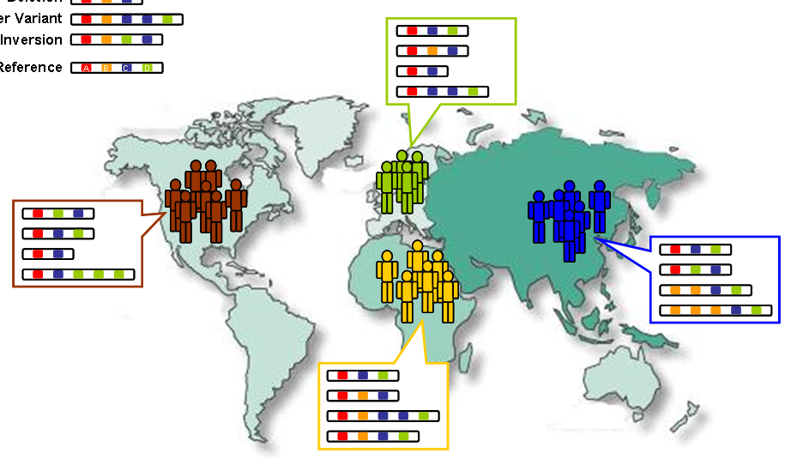
Concepts underlying the GWAS studies
Dense set of genetic markers
HapMap project genotyping different human populations (Human haplotype map project)
Over 1.6 million SNP identified
The International HapMap Project
Notes:
Need to interact
Bought in summer 2019

Slide 12
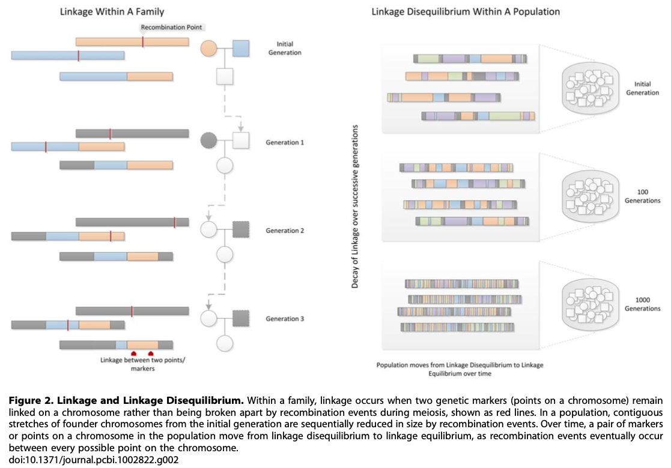
Concepts underlying the GWAS studies
Linkage disequilibrium
Notes:
Need to interact
Bought in summer 2019

Slide 13
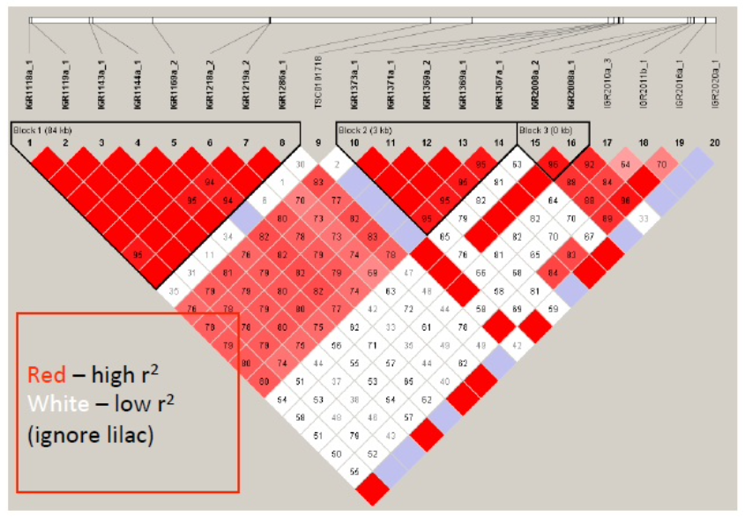
Concepts underlying the GWAS studies
Linkage diseqilibrium organizes the genome into haplotype blocks
(~30 kb)
80 % of common SNP can be captured using a subset of less than 1 million SNP
Notes:
Need to interact
Bought in summer 2019

Slide 14
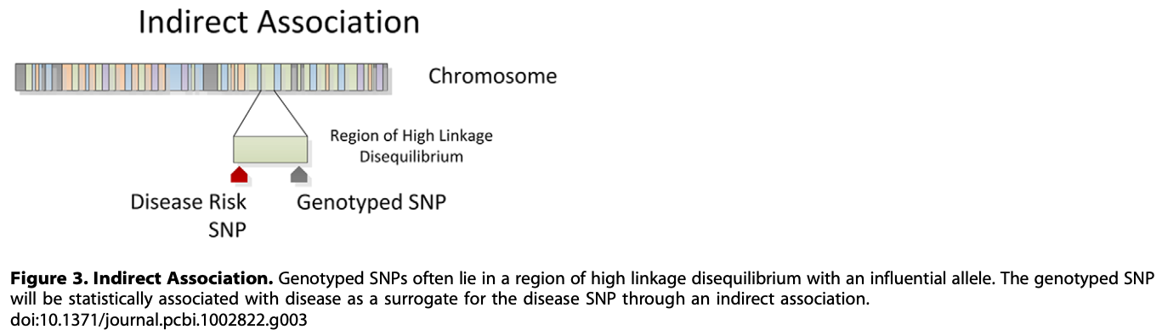
Concepts underlying the GWAS studies
The presence of LD creates two possible positive outcomes from a genetic association study
Direct association: Disease risk SNP is genotyped and statistically associated with the trait.
Indirect association: Disease risk SNP is not directly typed, but instead a tag SNP in high LD with the influential SNP is statistically associated to the trait
Notes:
Need to interact
Bought in summer 2019

Slide 15
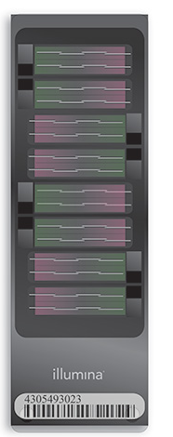
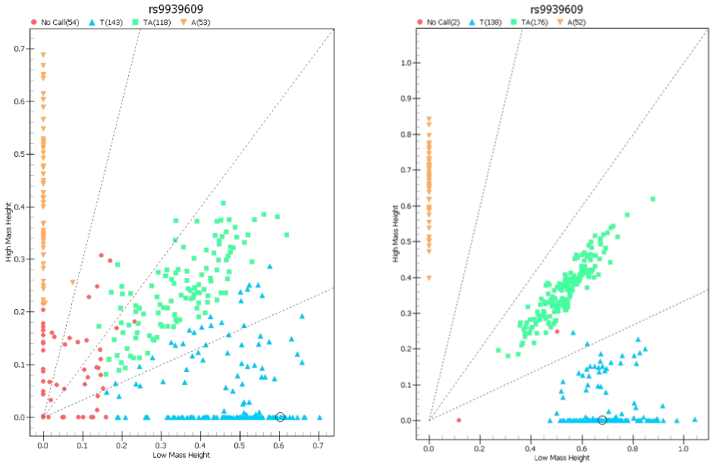
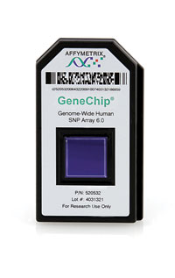
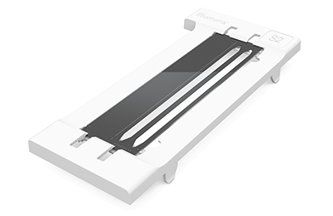
Genotyping technologies
Arrays
NGS
Notes:
Need to interact
Bought in summer 2019

Slide 16
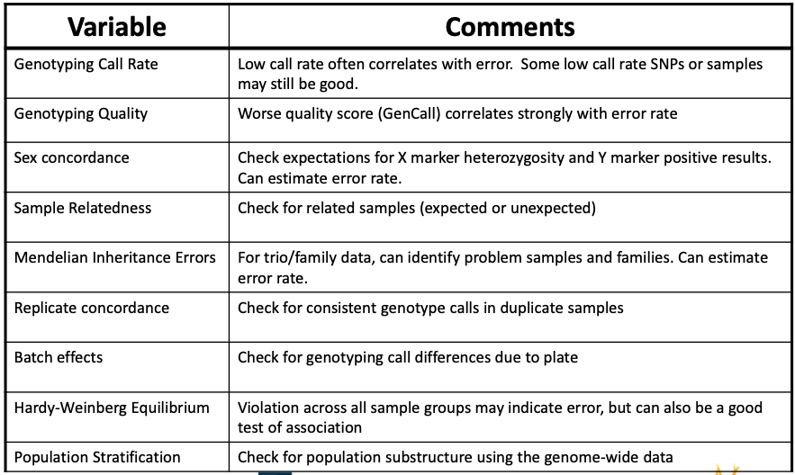
Quality control is extremely important
Notes:
Need to interact
Bought in summer 2019

Slide 17
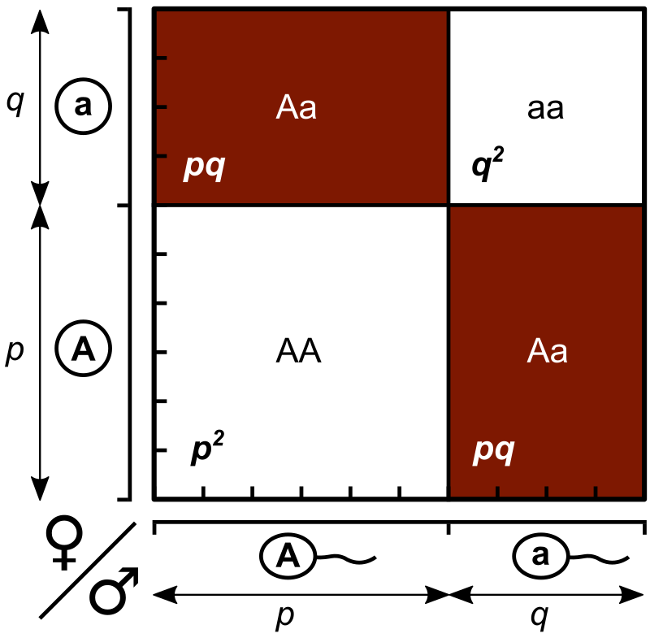
Hardy-Weinberg Equilibrium
Notes:
Need to interact
Bought in summer 2019

Slide 18
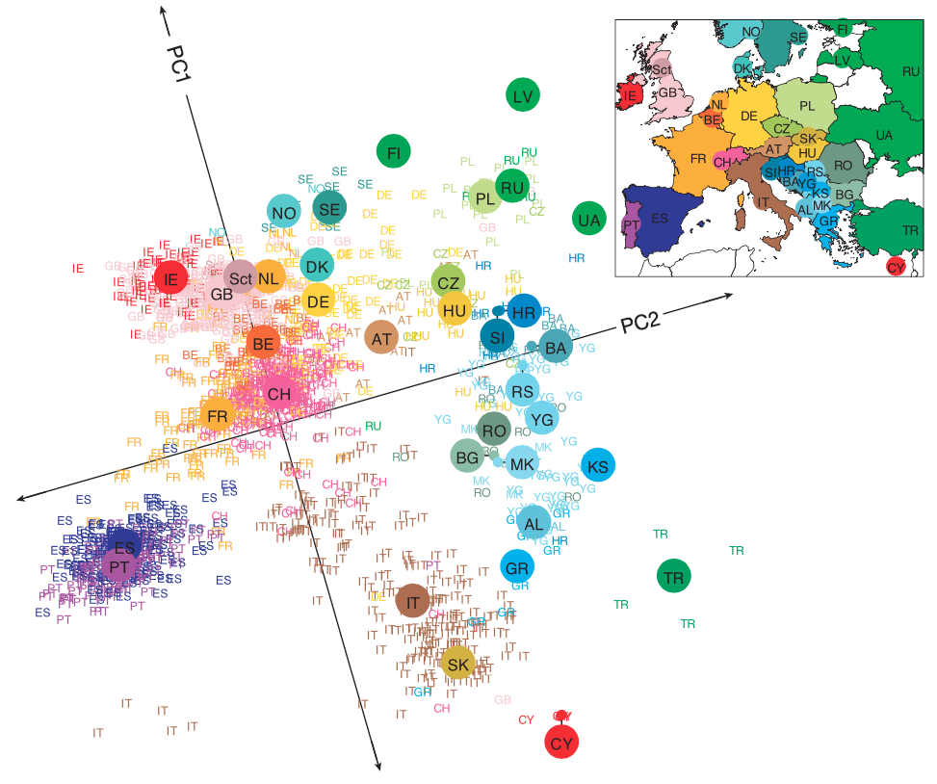
Population stratification
Principal component analysis (PCA)
Can cause confounding
Can be removed
Novembre et al, Nature 2008
Notes:
Need to interact
Bought in summer 2019

Slide 19
Batch effects
Evidence that associations can result due to allele frequency difference due to plate effects
Careful consideration when creating plate maps – Plate cases and controls together
– Randomize by race, gender, age, BMI, others...
After genotyping look for plate effects – MAF differences by plate
– Call rate by plate
– Association tests (one plate versus all others)
Notes:
Need to interact
Bought in summer 2019

Slide 20
Study design
Categorical vs. quantitative traits
Quantitative traits improve power (high-density lipoprotein, cholesterol levels, …)
When no quantitative trait is known for the disease, categorical traits are used (case vs. control)
As many individuals are genotyped, standardized phenotype criteria has to be used
Large sample sizes
Notes:
Need to interact
Bought in summer 2019

Slide 21
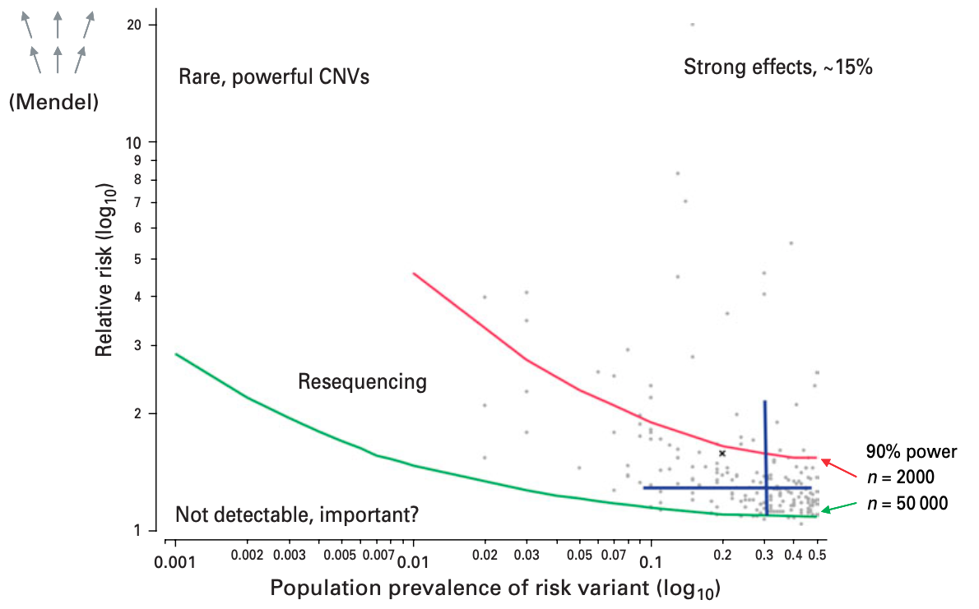
Sample size - thousands
Corvin et al, Psychological Med 2010
Notes:
Need to interact
Bought in summer 2019

Slide 22
Association tests
Univariate analysis SNP by SNP: each SNP is examined independently for association with the phenotype
Quantitative traits: generalized linear models (software GEMMA)
Case/control traits: contingency table methods (χ² test, Fisher’s exact test or Cochran-Armitage test) or logistic regression, which allows for clinical covariates (software PLINK)
The models should account for covariates
Population substructure should be removed (software EIGENSTRAT)
Multi-locus analysis is prohibitively expensive
Notes:
Need to interact
Bought in summer 2019

Slide 23
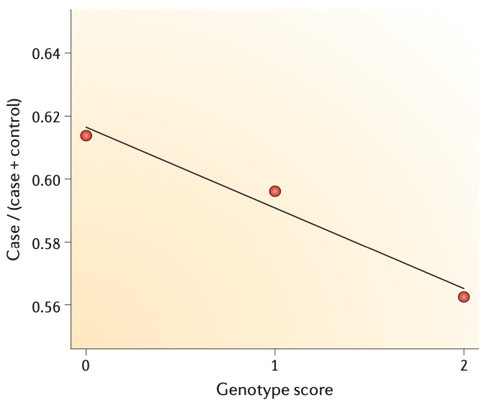
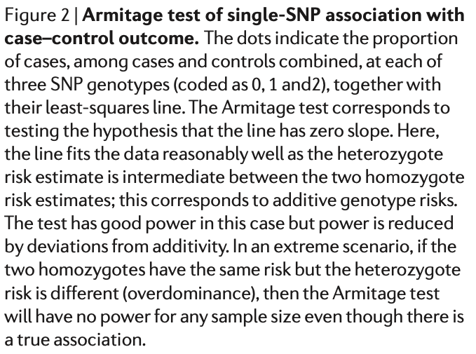
Cochran-Armitage test
Allele aa aA AA
Balding, Nat Rev Genet 2006
Notes:
Need to interact
Bought in summer 2019

Slide 24
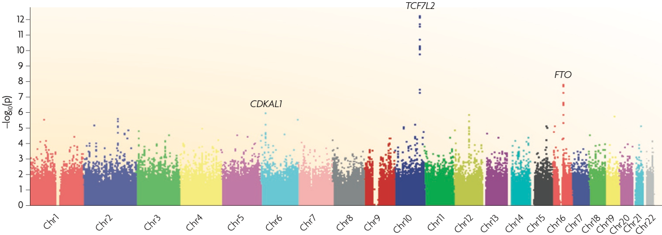
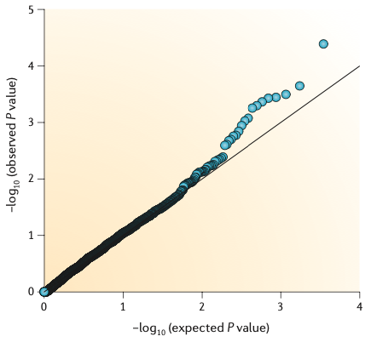
Visualization
Manhattan plot
Q-Q plot
Balding, Nat Rev Genet 2006; McCarthy et al, Nat Rev Genet 2008
Notes:
Need to interact
Bought in summer 2019

Slide 25
Multiple testing issue
Hundreds of thousand SNPs are tested – we have to control Type 1 error
Bonferroni correction
FDR
Permutation testing (reassign phenotypes)
Genome-wide significance – based on distribution of LD in the genome there is an effective number of independent genomic regions. Set threshold in accordance with this number. For Europeans it is p < 7.2 10⁻⁸
Notes:
Need to interact
Bought in summer 2019

Slide 26
Validation
Due to many statistical issues
Each study must be verified on an independent statistical sample of the same population
The study can be generalized to other populations (Europeans, Africans, Asians, …)
Metaanalyses may increase statistical power
Notes:
Need to interact
Bought in summer 2019

Slide 27
Winner’s Curse in GWAS
Consider an item with a fixed value
If there are ten American tourists bidding on the same item, the bids will average around the item’s true value
By definition, the winner will always overpay
When running a GWAS and discovering a SNP association, you will overestimate the strength of the association
Power calculations use an effect size to know how many samples you need to detect this effect
If the effect size is actually smaller than you think, you’ll need more samples to see your effect again
Notes:
Need to interact
Bought in summer 2019

Slide 28
Follow up
Once we found the genomic loci associated with the trait, we have to identify the actual causative variant.
DNA: more detailed regional genotyping, regional resequensing, analysis of the HapMap or 1000 genomes data, CNV
RNA: changes in mRNA abundance and structure, GTEx
Molecular and cellular biology: knock-out and knock-in experiments
Clinical: common variants are supposed to have weak effect, thus clinical validation may be difficult
Notes:
Need to interact
Bought in summer 2019

Slide 29
GWAS examples
Multiple Sclerosis GWAS – Trio design, extensive QC
http://www.ncbi.nlm.nih.gov/pubmed/17660530
Type II Diabetes GWAS
http://www.ncbi.nlm.nih.gov/pubmed/17463246
Notes:
Need to interact
Bought in summer 2019

Slide 30
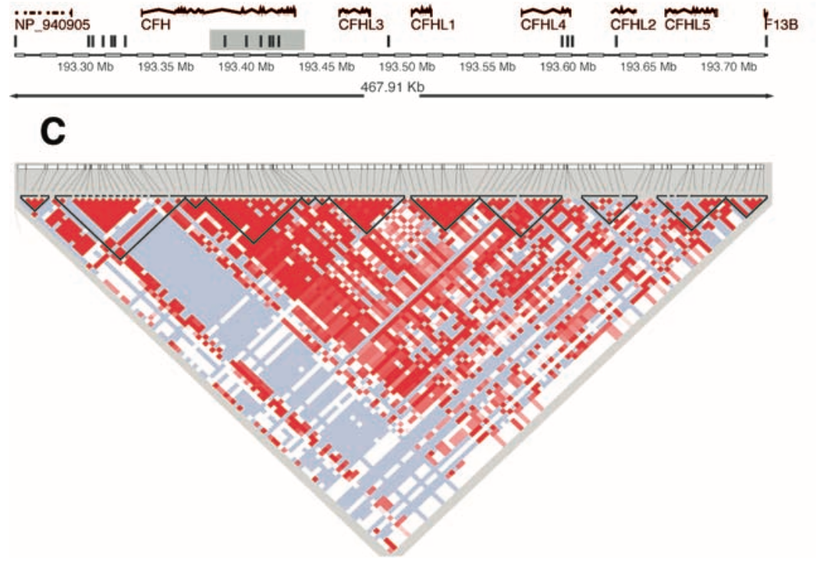
Macular degeneration
Age-related macular degeneration (AMD) is a major cause of blindness in the elderly
A genome-wide screen of tens of cases and controls for polymorphisms associated with AMD.
Complement factor H gene (CFH) is strongly associated with AMD
In individuals homozygous for the risk allele, the likelihood of AMD is increased by a factor of approx. 5.
Resequencing revealed a polymorphism in linkage disequilibrium with the risk allele representing a tyrosine-histidine change at amino acid 402.
This polymorphism is in a region of CFH that binds heparin and C-reactive protein.
Three independent groups, Science 2005
Notes:
Need to interact
Bought in summer 2019

Slide 31
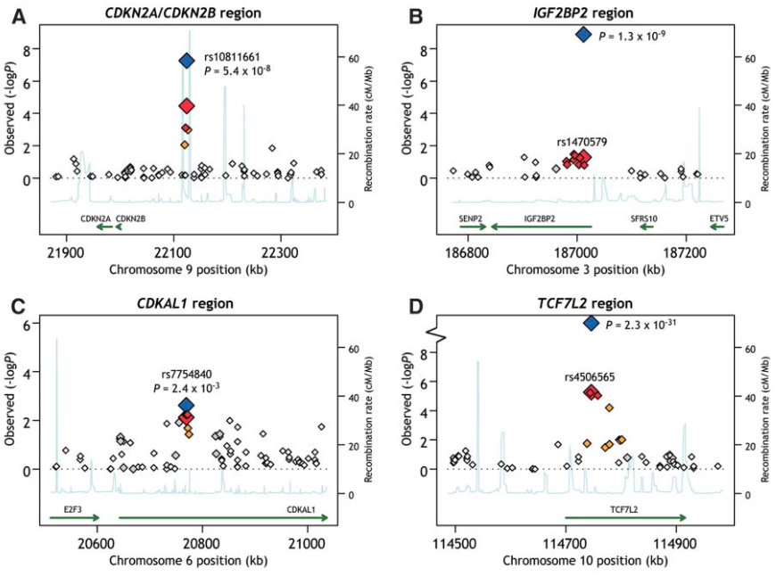
Diabetes
Genome-wide association study of thousands of individuals
Just a part of the study: We analyzed 386,731 common single-nucleotide polymorphisms (SNPs) in 1464 patients with T2D and 1467 matched controls, each characterized for measures of glucose metabolism, lipids, obesity, and blood pressure. With collaborators (FUSION and WTCCC/UKT2D), we identified and confirmed three loci associated with T2D—in a noncoding region near CDKN2A and CDKN2B, in an intron of IGF2BP2, and an intron of CDKAL1 …
Three independent groups, Science 2007
Notes:
Need to interact
Bought in summer 2019

Slide 32
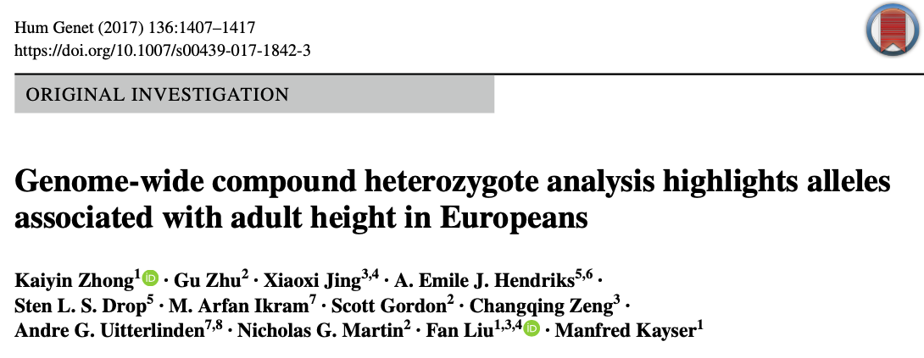
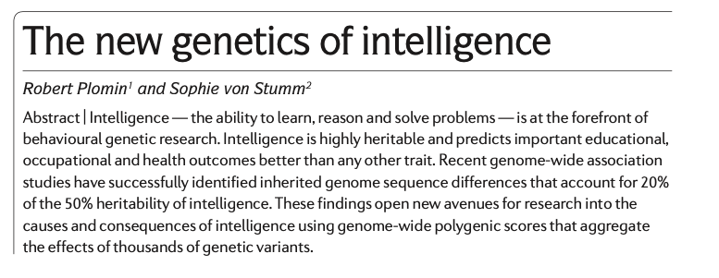
Heigth & intelligence
Notes:
Need to interact
Bought in summer 2019

Slide 33
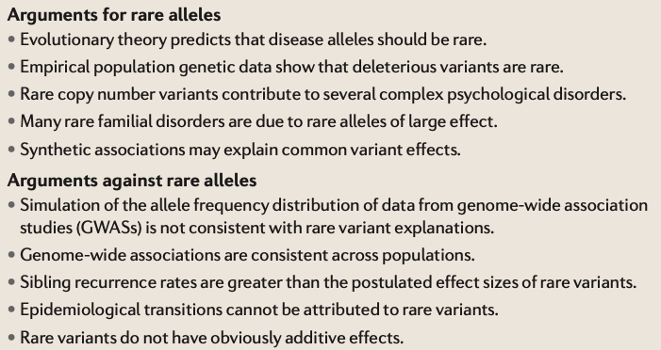
Rare alleles vs. Common alleles
Gibson, Nat Rev Genet 2012
Notes:
Need to interact
Bought in summer 2019

Slide 34
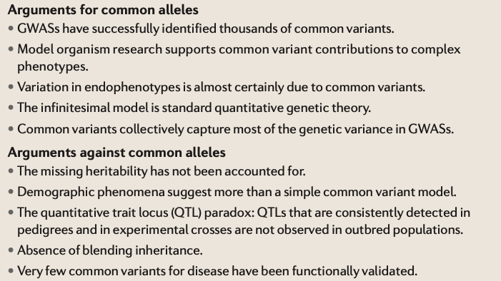
Rare alleles vs. Common alleles
Gibson, Nat Rev Genet 2012
Notes:
Need to interact
Bought in summer 2019

Slide 35
Reporting and deposition
Databases of GWAS studies
The database of Genotypes and Phenotypes dbGaP (https://www.ncbi.nlm.nih.gov/gap/)
The European Genome-phenome Archive EGA (https://ega-archive.org)
Notes:
Need to interact
Bought in summer 2019

Slide 36
Exercises
Homework
True or False: Common diseases, such as type II diabetes and lung cancer, are likely caused by mutations to a single gene. Explain your answer.
Will the genotyping platforms designed for GWAS of European Descent populations be of equal utility in African Descent populations? Why or why not?
When conducting a genetic study, what additional factors should be measured and adjusted for in the statistical analysis?
True or False: SNPs that are associated to disease using GWAS design should be immediately considered for molecular studies. Explain your answer.
Notes:
Need to interact
Bought in summer 2019

