Slide 1
phylogenomics
Jan Pačes jan.paces@img.cas.cz, IMG
Michal Kolář michal.kolar@img.cas.cz, IMG
Karel Janko janko@iapg.cas.cz, IAPG
Edward Ehler ehler@img.cas.cz, IMG

Slide 2
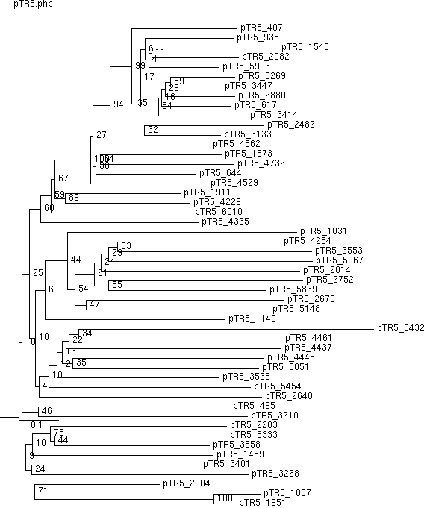
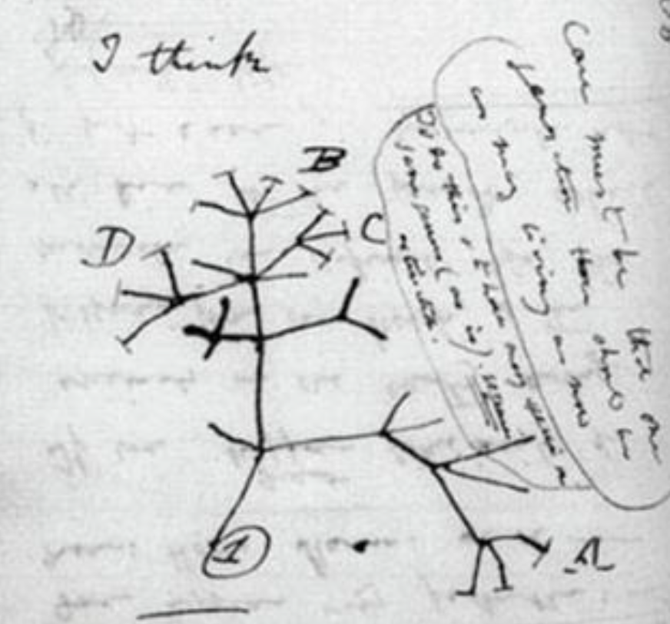
Phylogenetic analysis
Darwin, 1837
Shows evolutionary relations between sequences.

Slide 3
What is phylogenetics good for?
Deduce relatioships among species or genes
Identify genes undergoing negative (or positive) selection
Explore the evolution of traits through history
Estimate the timing of historical events

Slide 4
initial assumptions
There are three basic assumptions in cladistics:
Any group of organisms is related by descent from a common ancestor (fundamental tenet of evolutionary theory).
There is a bifurcating pattem of cladogenesis. (This assumption is controversial.)
Change in characteristics occurs in lineages over time. This is a necessary condition for cladistics to work.

Slide 5
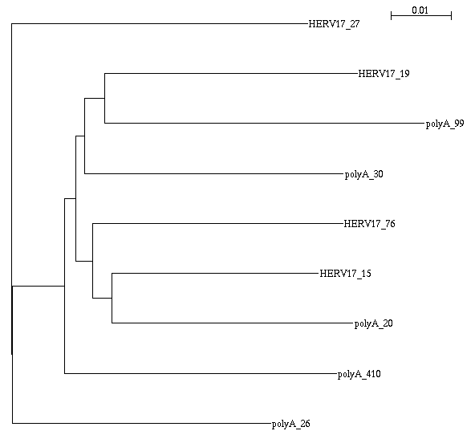
terminology
Nodes
  External, a.k.a tips
  Internal, a.k.a hypothetical ancestors
Branches
Topology of the tree
  bifurcations
  aditive tree
  ultrametric tree
root of the tree
  oldest point
true tree
derived tree

Slide 6
example
( ( ( (
polyA_26:0.042779,
HERV17_27:0.049179
):0.008643,
polyA_410:0.045034
):0.001912,
( (
polyA_20:0.039953,
HERV17_15:0.034230
):0.003074,
HERV17_76:0.041414
):0.002812
):0.001440,
polyA_30:0.042838,
(
polyA_99:0.052972,
HERV17_19:0.041888
):0.003257
)

Slide 7
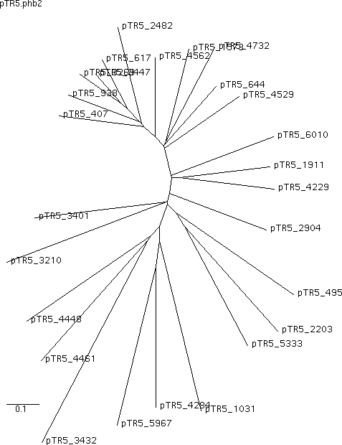
example

Slide 8
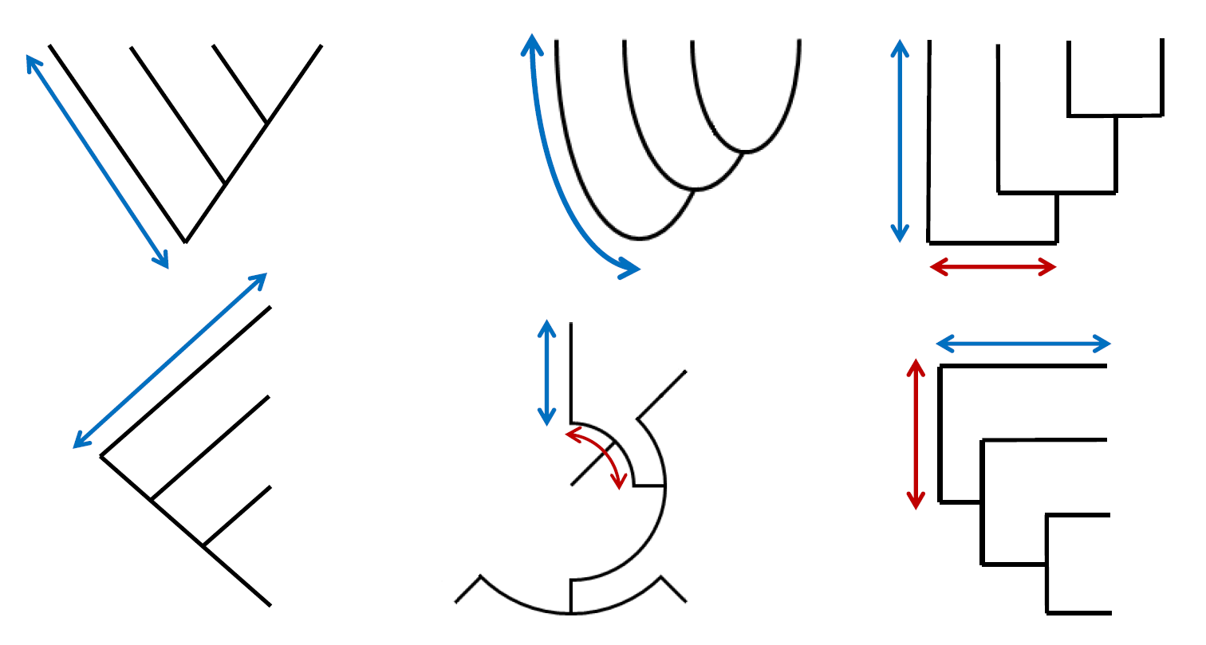
Alternative representation of trees
Blue arrow: genetic distance; Red arrow: meaningless, only for visualization

Slide 9
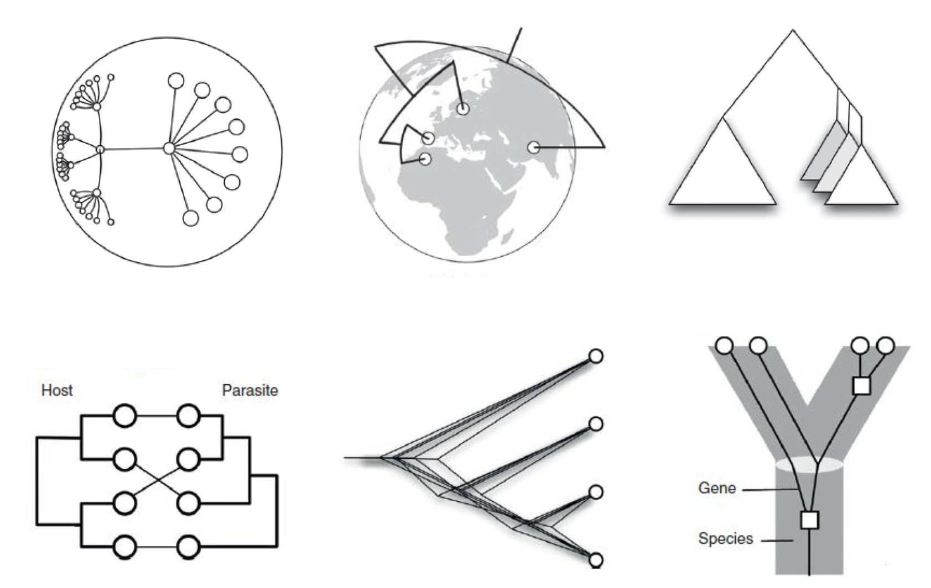
Other tree representations

Slide 10
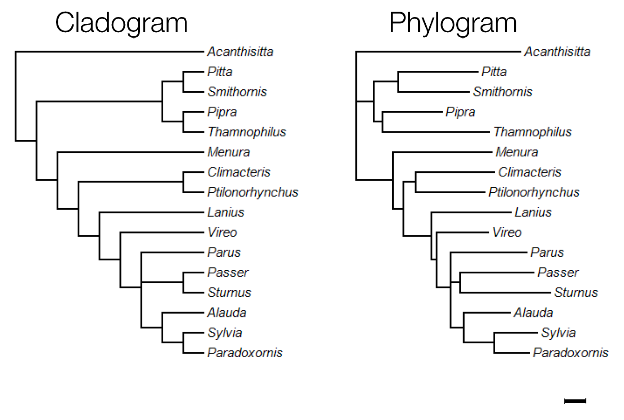
Trees without branch lengths

Slide 11
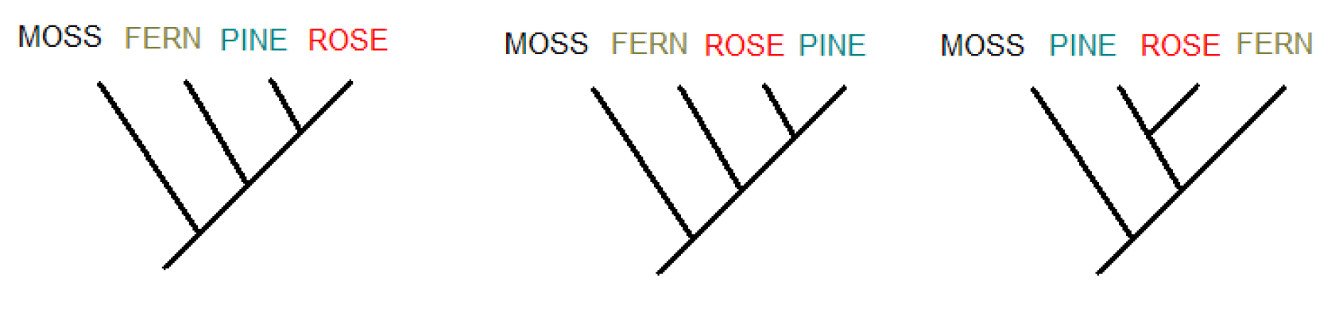
Test: are these topologies the same?

Slide 12
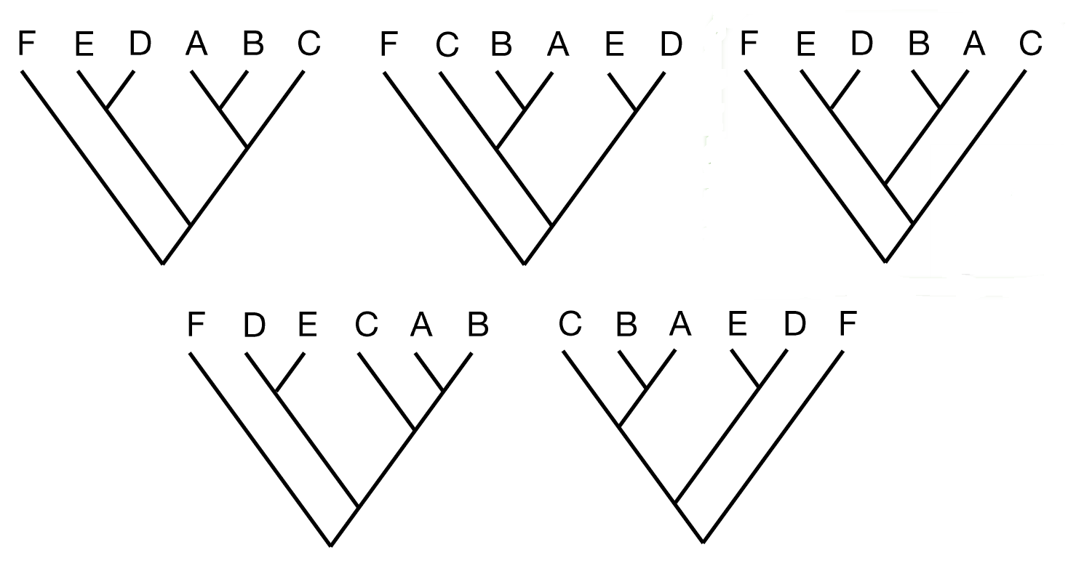
Test: tree with a different topology?

Slide 13
methods
algorithmical methods:
  Fast
  giving one result, but not everytime the best one (local optimum)
optimalization methods:
  slower, but can found global maximum
  gives often range of the best results

Slide 14
Global and local maximum

Slide 15
methods
Requirement for input data:
Alignment only of homologous parts
Skip gaps
(trees, based on other data: restriction analysis or unique insertions or deletions)

Slide 16
algorhitmical (distant) methods
Input: matrix of distances
UGPMA (Unweighted pair group method with arithmetic averages)
WGPMA (Weighted …)
Minimal evolution (e.g. Neighbour-joining)

Slide 17
neighbour-joining
Star decomposition method

Slide 18
substitutional models
DNA:
  Single parametric: Jukes-Cantor
  Two parametric: Kimura
Transition: purin - purin
Transversion: pyrimidin - purin
For proteins:
  Substitution matrix (BLOSUM etc.)

Slide 19
matrix of distances
9
polyA_26
polyA_30 0.1102
polyA_20 0.1144 0.1027
polyA_99 0.1326 0.1100 0.1237
polyA_410 0.1089 0.1009 0.1067 0.1150
HERV17_27 0.1070 0.1263 0.1285 0.1504 0.1198
HERV17_76 0.0960 0.1024 0.0953 0.1221 0.1036 0.1188
HERV17_19 0.1045 0.0994 0.1019 0.1097 0.1059 0.1304 0.0975
HERV17_15 0.0980 0.0975 0.0841 0.1170 0.0977 0.1127 0.0860 0.0927

Slide 20
optimalisation methods
Method: search for optimal tree
Input: multiple alignment
Maximum parsimony
  Minimises number of mutational steps
Maximum likelihood – ML
  Statistical likelihood of alternative trees
  Explicit model of substitution
Bayesian methods
  Like ML with prior knowledge

Slide 21
parsimony
A: TATGTTC
B: TATTTTC
C: TACGTAC
D: GACTTAA
A
C
B
D
A
B
C
D
A
C
D
B

Slide 22
parsimony - step 1
A: TATGTTC
B: TATTTTC
C: TACGTAC
D: GACTTAA
A
C
1
1
1
B
D
A
B
C
D
A
C
D
B

Slide 23
parsimony - step 2
A: TATGTTC
B: TATTTTC
C: TACGTAC
D: GACTTAA
A
C
1 + 1
1 + 2
1 + 2
B
D
A
B
C
D
A
C
D
B

Slide 24
parsimony - step 3
A: TATGTTC
B: TATTTTC
C: TACGTAC
D: GACTTAA
A
C
2 + 2
3 + 1
3 + 2
B
D
A
B
C
D
A
C
D
B

Slide 25
parsimony - step 4
A: TATGTTC
B: TATTTTC
C: TACGTAC
D: GACTTAA
A
C
4 + 1
4 + 2
5 + 2
B
D
A
B
C
D
A
C
D
B

Slide 26
parsimony - step 5
A: TATGTTC
B: TATTTTC
C: TACGTAC
D: GACTTAA
A
C
5 + 1
6 + 1
7 + 1
B
D
A
B
C
D
A
C
D
B

Slide 27
parsimony - result
A: TATGTTC
B: TATTTTC
C: TACGTAC
D: GACTTAA
A
C
6
7
8
B
D
A
B
C
D
A
C
D
B

Slide 28
optimalisation methods
Parsimony does not count length of branches and probabilities of individual changes.
Maximum likelihood choose the trees, where less probable events are on longer branches.

Slide 29
differencies
DISTANCE, PARSIMONY, AND MAXIMUM LIKELIHOOD
Distance matrix methods simply count the number of differences between two sequences. This number is referred to as the evolutionary distance, and its exact size depends on the evolutionary model used.
The principle of maximum parsimony searches for a tree that requires the smallest number of changes to explain the differences observed among the taxa under study.
A maximum-likelihood approach to phylogenetic inference evaluates the probability that the chosen evolutionary model has generated the observed data.

Slide 30
topology testing
Bootstrap: selection without repeat
Jack Knife: selection without repeat, but shorter sequences or lower number.
Bayesian methods
Approximate likelihood ratio test (aLRT)

Slide 31
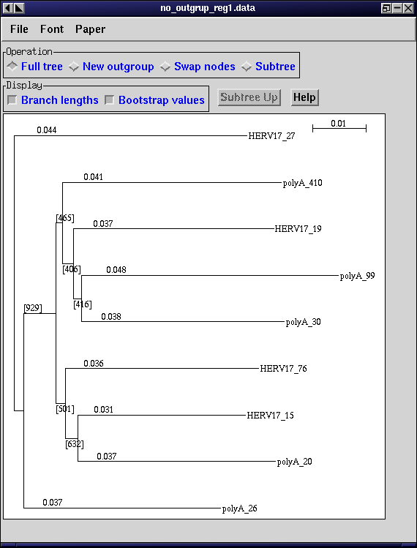
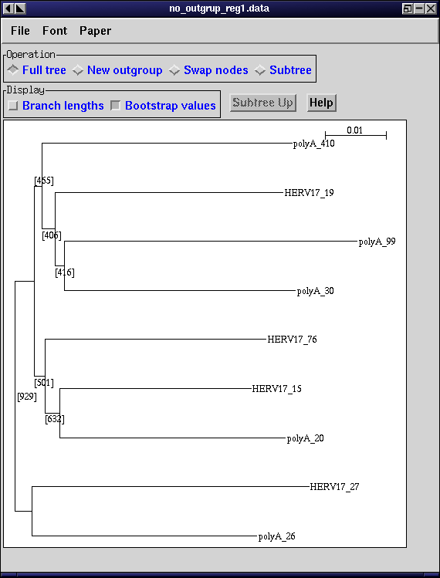
root of the tree

Slide 32
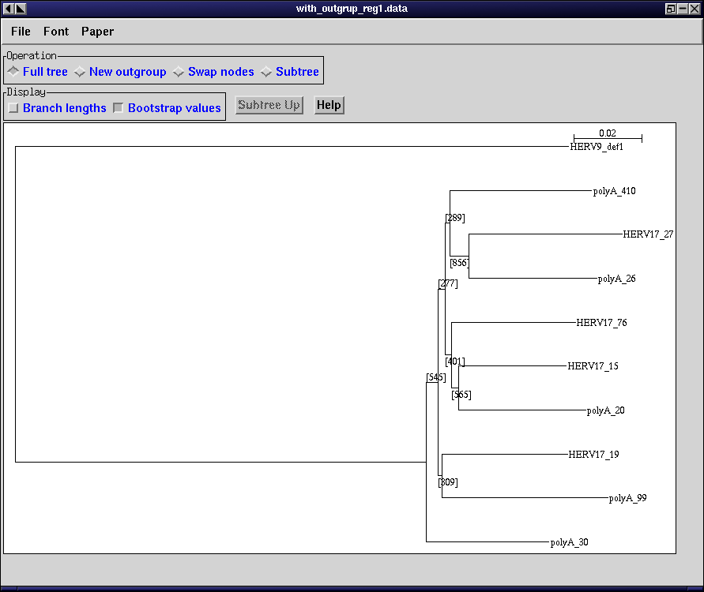
root of the tree
Root indicates direction of the evolution
Most recent common ancestor MRCA
Midpoint rooting
  Assume constant evolutionary rate
Outgroup rooting
  Outgroup is node known to have diverged earliest

Slide 33

Monophyletic group
A.k.a clade
Share a more recent common ancestor within the group than outside the group

Slide 34
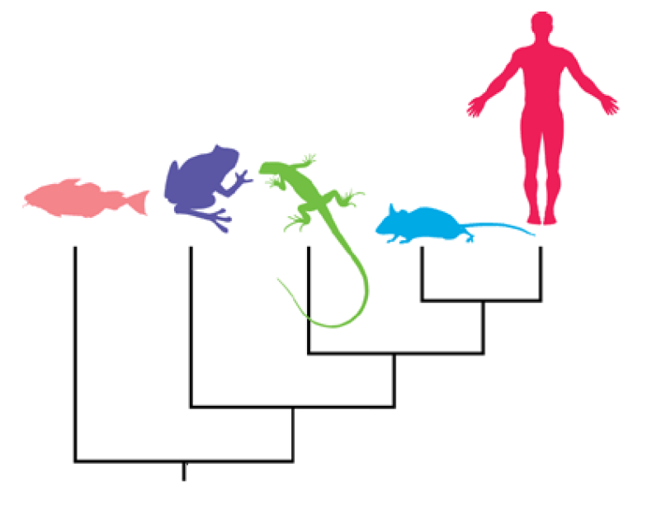
Test: understanding the tree
Which is true?
A) mouse is more closely related to fish than frog is to fish
B) lizard is more closely related to fish than mouse is to fish
C) human and frog are equally related to fish

Slide 35
Additional concepts is phylogenetics
Gene duplication
Recombination
Horizontal gene transfer
Coevolution
Gene conversion
Codon bias
Hypermutable sites

Slide 36
programs
http://geta.life.uiuc.edu/~nikos/LINKS/
biocomputing_servers.html
http://bioweb.pasteur.fr/seqanal/
phylogeny/phylip-uk.html
http://evolution.genetics.washington.edu/
phylip/software.html

